Slide 1
PONTO DE CONTROLE 2: CAPINATOR – ROBÔ CORTADOR DE GRAMA AUTÔNOMO

Slide 2
Objetivos
Objetivo Geral:
1. Projetar um cortador de grama micro controlado utilizando como elemento principal o MSP430G2553 instalado na placa LauchPad da empresa Texas Instruments para a disciplina de Eletrônica Embarcada.
Objetivos Específicos:
Projetar um cortador de grama que seja capaz
de:
● dado uma área limitada fechada, desviar de
obstáculos sem interferência humana;
● cortar gramas de áreas planas e levemente
inclinado;
● desviar dos obstáculos de maneira autônoma;
● assegurar a saúde do operador ao manuseá-lo;
● ser energeticamente viável;
● não evadir do local limitado..

Slide 3
Motivações
Comodidade
Segurança
Ergonomia

Slide 4
Parte I
1
Estatística Descritiva
Prevalência das EOAPD nos grupos de controle e caso

Slide 5
Caso-Controle Prevaência EOAPD
1
Análise da prevalência EOAPD para orelha equerda, direita e ambas do grupo de caso e controle.

Slide 6
Prevalência EOAPD Orelha Direita
PREVALÊNCIA DAS EOAPD
 | GRUPO CASO |  |  |  | GRUPO CONTROLE
 | Normal |  | Alterado |  | Normal |  | Alterado
Lateralidade | N | % | N | % | N | % | N | %
AO | 4 | 44,4 | 1 | 11,1 | 9 | 100 | 0 | 0
OE | 5 | 55,5 | 3 | 33,3 | 9 | 100 | 0 | 0
OD | 7 | 77,7 | 1 | 11,1 | 9 | 100 | 0 | 0
Tabela 1.1 Prevalência das EOAPD
Como pode ser visto, nenhum dos integrantes do grupo controle teve um caso de anormalidade na EOAPD , porém estatisticamente isso não prova essa tendência. Para que essa hipótese seja confirmada ou não será utilizado o teste Qui-quadrado de Person,.

Slide 7
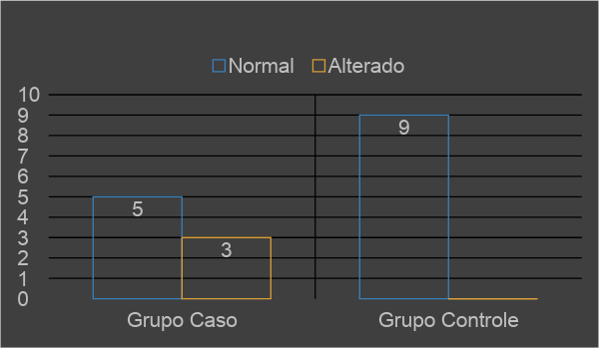
Prevalência EOAPD Orelha Esquerda
PREVALÊNCIA DAS EOAPD
 | GRUPO CASO |  |  |  | GRUPO CONTROLE
 | Normal |  | Alterado |  | Normal |  | Alterado
Lateralidade | N | % | N | % | N | % | N | %
OE | 5 | 55,5 | 3 | 33,3 | 9 | 100 | 0 | 0
Tabela 1.2 Prevalência das EOAPD Orelha Esquerda

Slide 8
Quotations are commonly printed as a means of inspiration and to invoke philosophical thoughts from the reader.

Slide 9
BIG CONCEPT
Bring the attention of your audience over a key concept using icons or illustrations

Slide 10
YOU CAN ALSO SPLIT YOUR CONTENT
White
Is the color of milk and fresh snow, the color produced by the combination of all the colors of the visible spectrum.
Black
Is the color of coal, ebony, and of outer space. It is the darkest color, the result of the absence of or complete absorption of light.

Slide 11
IN TWO OR THREE COLUMNS
Yellow
Is the color of gold, butter and ripe lemons. In the spectrum of visible light, yellow is found between green and orange.
Blue
Is the colour of the clear sky and the deep sea. It is located between violet and green on the optical spectrum.
Red
Is the color of blood, and because of this it has historically been associated with sacrifice, danger and courage.

Slide 12
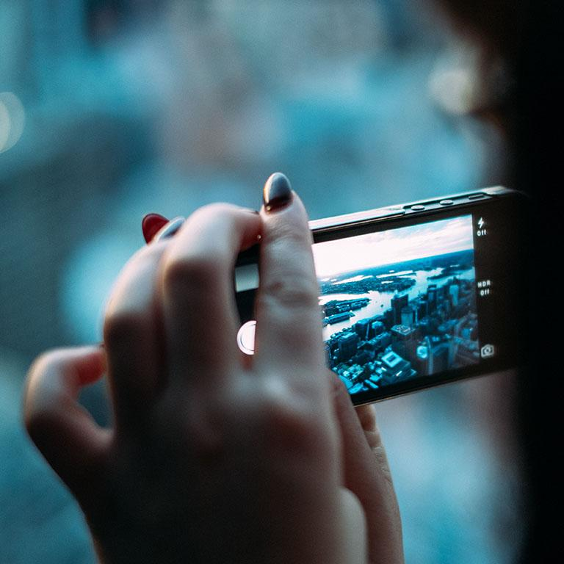
A PICTURE IS WORTH A THOUSAND WORDS
A complex idea can be conveyed with just a single still image, namely making it possible to absorb large amounts of data quickly.

Slide 13
WANT BIG IMPACT?
Use big image.

Slide 14
USE CHARTS TO EXPLAIN YOUR IDEAS
White
Gray
Black

Slide 15
AND TABLES TO COMPARE DATA
 | A | B | C
Yellow | 10 | 20 | 7
Blue | 30 | 15 | 10
Orange | 5 | 24 | 16

Slide 16

MAPS
our office

Slide 17
89,526,124
Whoa! That’s a big number, aren’t you proud?

Slide 18
89,526,124$
185,244 users
100%
That’s a lot of money
And a lot of users
Total success!

Slide 19
OUR PROCESS IS EASY
First
Second
Last

Slide 20
LET’S REVIEW SOME CONCEPTS
Yellow
Is the color of gold, butter and ripe lemons. In the spectrum of visible light, yellow is found between green and orange.
Blue
Is the colour of the clear sky and the deep sea. It is located between violet and green on the optical spectrum.
Red
Is the color of blood, and because of this it has historically been associated with sacrifice, danger and courage.
Yellow
Is the color of gold, butter and ripe lemons. In the spectrum of visible light, yellow is found between green and orange.
Blue
Is the colour of the clear sky and the deep sea. It is located between violet and green on the optical spectrum.
Red
Is the color of blood, and because of this it has historically been associated with sacrifice, danger and courage.

Slide 21
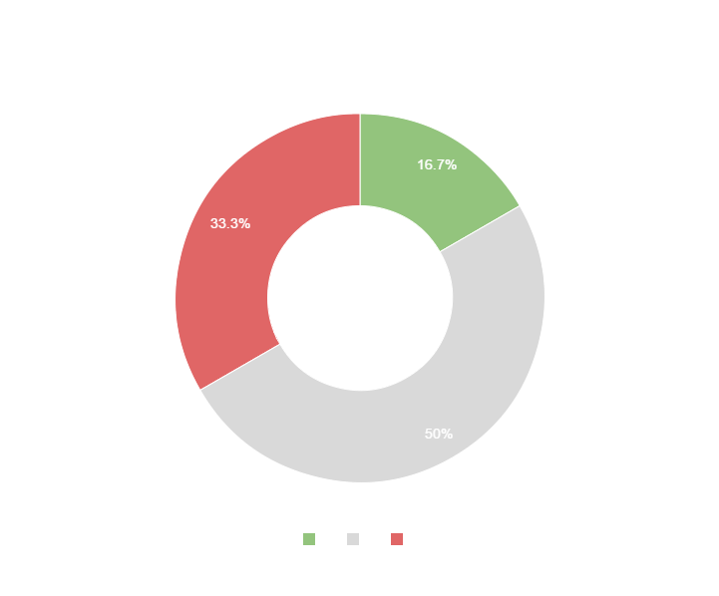
You can copy&paste graphs from Google Sheets

Slide 22
Place your screenshot here
ANDROID PROJECT
Show and explain your web, app or software projects using these gadget templates.

Slide 23
Place your screenshot here
iPHONE PROJECT
Show and explain your web, app or software projects using these gadget templates.

Slide 24
Place your screenshot here
TABLET PROJECT
Show and explain your web, app or software projects using these gadget templates.

Slide 25
Place your screenshot here
DESKTOP PROJECT
Show and explain your web, app or software projects using these gadget templates.

Slide 26
Thanks!
ANY QUESTIONS?
You can find me at
@username
user@mail.me

Slide 27
CREDITS
Special thanks to all the people who made and released these awesome resources for free:
Presentation template by SlidesCarnival
Photographs by Unsplash

Slide 28
PRESENTATION DESIGN
This presentations uses the following typographies and colors:
Titles & body copy: Quicksand
You can download the fonts on this page:
https://www.fontsquirrel.com/fonts/quicksand
Dark gray #2e3037
Aqua #39c0ba
Salmon #f35b69
Blue #6d9eeb
You don’t need to keep this slide in your presentation. It’s only here to serve you as a design guide if you need to create new slides or download the fonts to edit the presentation in PowerPoint®

Slide 29
SlidesCarnival icons are editable shapes.
This means that you can:
Resize them without losing quality.
Change line color, width and style.
Isn’t that nice? :)
Examples:

Slide 30
😉
Now you can use any emoji as an icon!
And of course it resizes without losing quality and you can change the color.
How? Follow Google instructions https://twitter.com/googledocs/status/730087240156643328
✋👆👉👍👤👦👧👨👩👪💃🏃💑❤😂😉😋😒😭👶😸🐟🍒🍔💣📌📖🔨🎃🎈🎨🏈🏰🌏🔌🔑 and many more...

