Slide 1
作 业 AI with Pytorch

Slide 2
作业评分标准
用自己的语言写作，可以有自己的独特表达方式，如图文结合 （完全，部分，非自己）
表达简洁 （非常、较、不、有创意）
内容完整 （完、不完整)
禁止直接抄袭，判定抄袭后，教务处备案，直接判定0分（是，不）

Slide 3
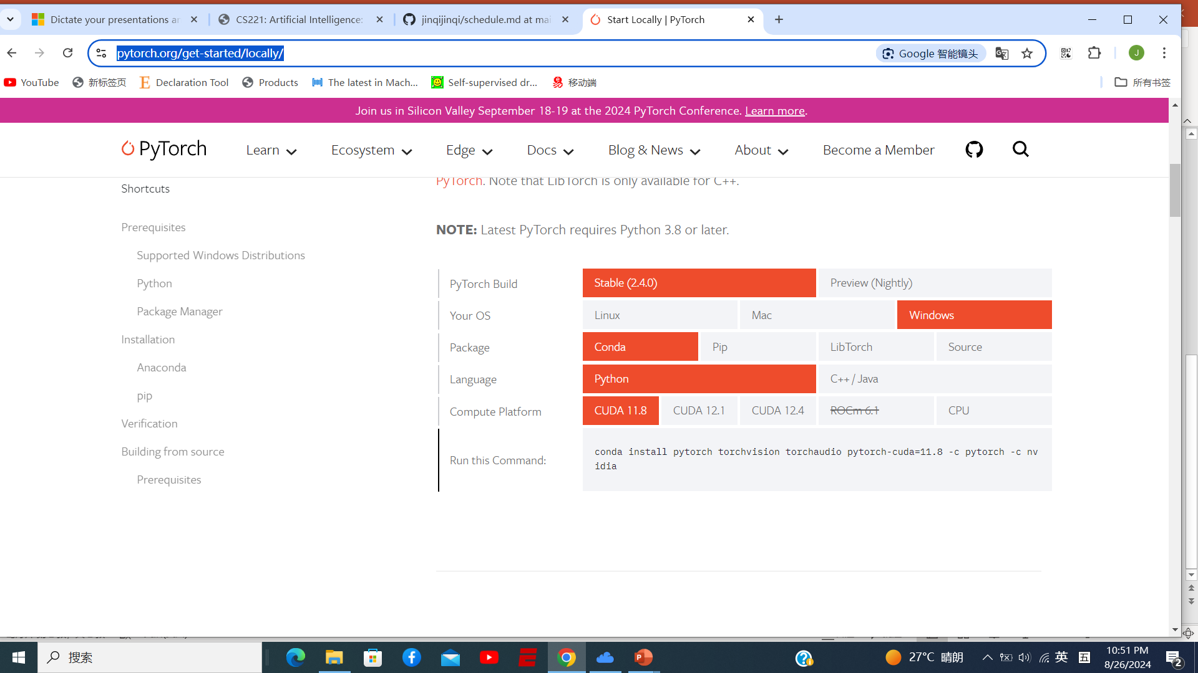
Pytorch Installation
https://pytorch.org/get-started/locally/

Slide 4
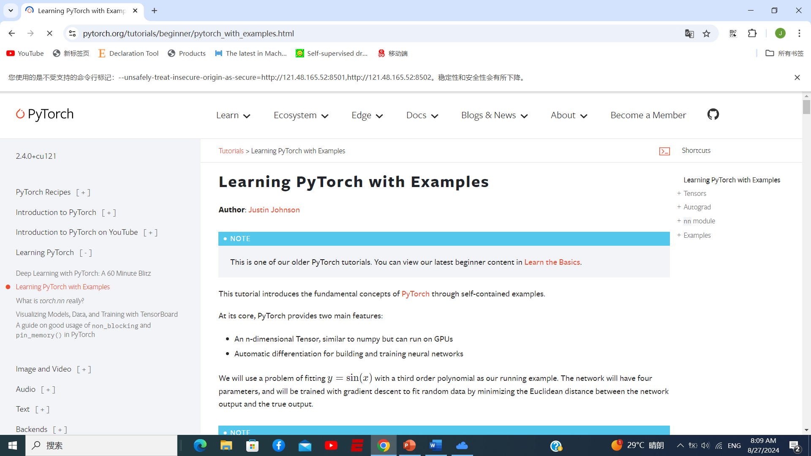
Learning PyTorch with Examples
https://pytorch.org/tutorials/beginner/pytorch_with_examples.html

Slide 5
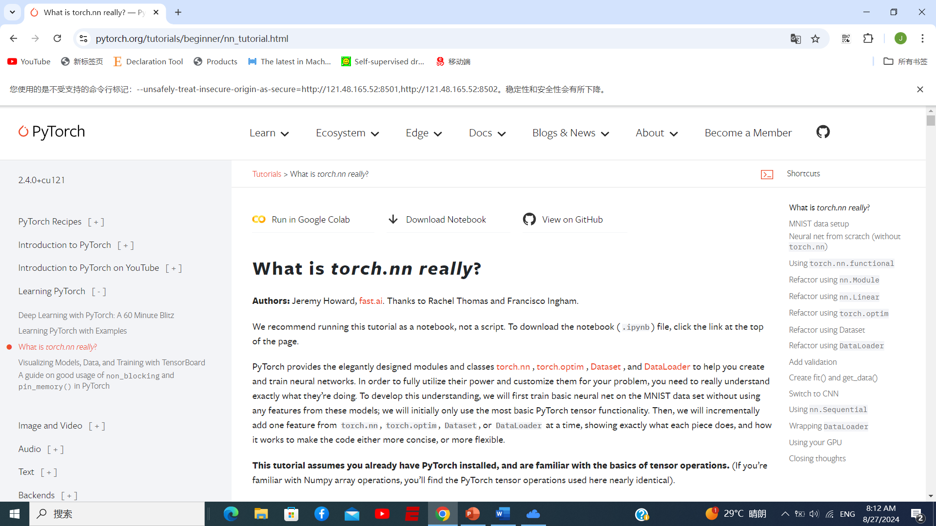
What is torch.nn really?
https://pytorch.org/tutorials/beginner/nn_tutorial.html

Slide 6
Homework 1--Pytorch Installation 简述
..\homework\作业 1-pytorch安装.docx
https://pytorch.org/get-started/locally/

Slide 7
Homework 1--Pytorch Installation 简述
..\homework\作业 1-pytorch安装.docx
https://pytorch.org/get-started/locally/

Slide 8
Homework 2--Learning PyTorch with Examples简述内容
..\homework\作业 2-Learning PyTorch with Examples.docx
https://pytorch.org/tutorials/beginner/pytorch_with_examples.html

Slide 9
Homework 3--What is torch.nn really?简述内容
..\homework\作业 3-torch-nn.docx
https://pytorch.org/tutorials/beginner/nn_tutorial.html

Slide 10
Homework 4—图像识别简述
..\homework\作业 4-图像识别.docx
https://pytorch.org/tutorials/beginner/basics/quickstart_tutorial.html

Slide 11
Homework 5—语音识别简述内容
..\homework\作业 5-语音识别.docx
https://pytorch.org/audio/stable/tutorials/speech_recognition_pipeline_tutorial.html

Slide 12
Homework 6—文本识别简述内容
..\homework\作业 6-文本识别.docx
https://pytorch.org/tutorials/beginner/translation_transformer.html

Slide 13
7. Final Report—Mario play agent简述
..\homework\作业 7-课程最终报告-马里奥玩家.docx
https://pytorch.org/tutorials/intermediate/mario_rl_tutorial.html

