Slide 1
计算方法
3月4日

Slide 2
第2章 插值法
引言
拉格朗日插值
均差与牛顿插值多项式
埃尔米特插值
分段低次插值
三次样条插值

Slide 3
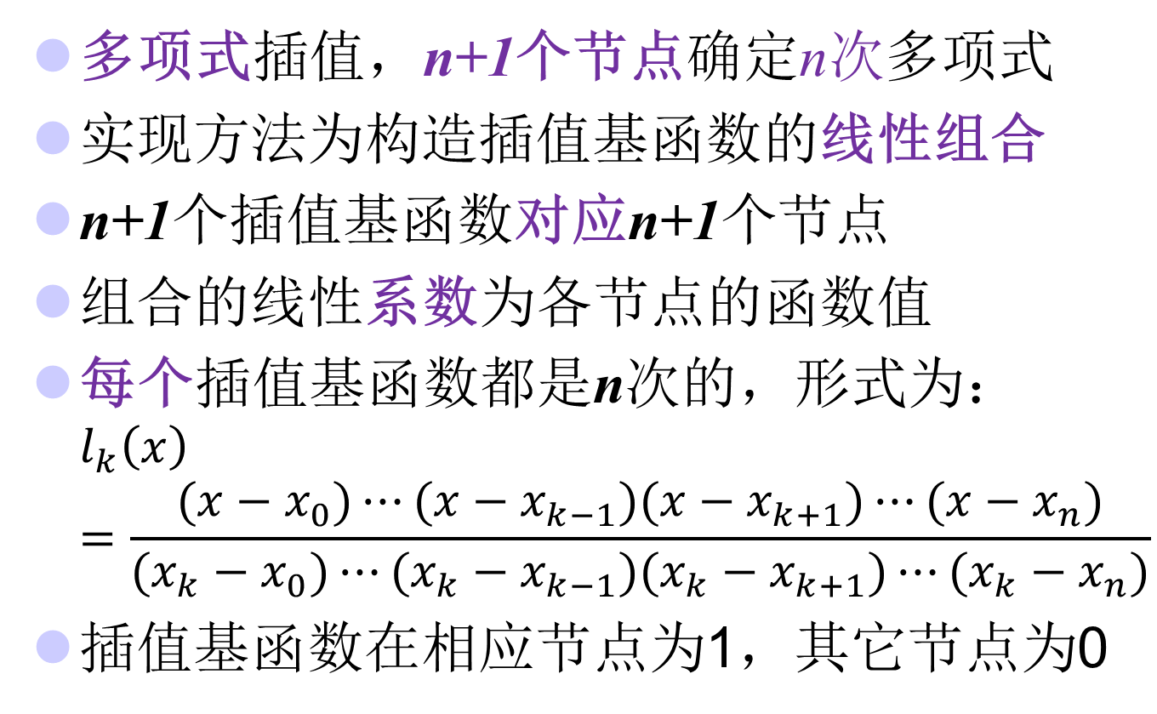
拉格朗日插值法复习
多项式插值，n+1个节点确定n次多项式
实现方法为构造插值基函数的线性组合
n+1个插值基函数对应n+1个节点
组合的线性系数为各节点的函数值
每个插值基函数都是n次的，形式为： $l_{k}\left(x\right)=\frac{(x−x_{0})⋯(x−x_{k−1})(x−x_{k+1})⋯(x−x_{n})}{(x_{k}−x_{0})⋯(x_{k}−x_{k−1})(x_{k}−x_{k+1})⋯(x_{k}−x_{n})}$
插值基函数在相应节点为1，其它节点为0

Slide 4
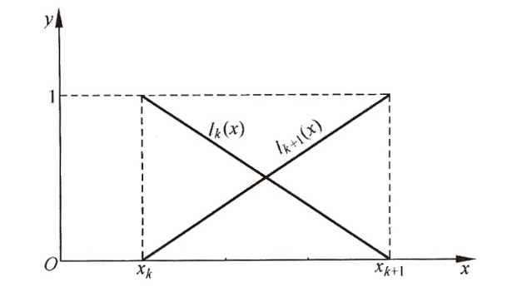
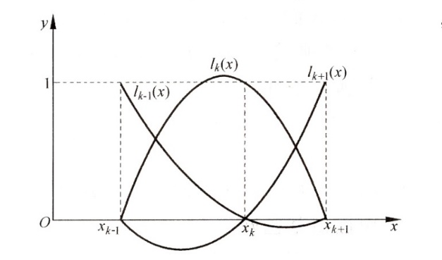
拉格朗日插值法的缺陷
拉格朗日插值法的优点是公式结构紧凑．不足在于当插值节点增减时全部插值基函数都要重新计算，这在实际计算中很不方便．
有没有其它方法，它可以克服该缺点，即增加节点时，在现有公式的基础上求解，从而降低计算量？

Slide 5
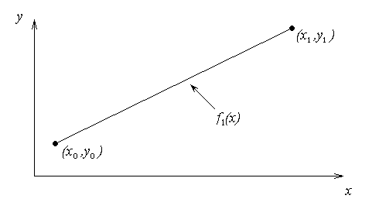



线性插值（一次）
给定(x₀,y₀)和(x₁,y₁)，有且只有一条直线通过这两点
其中
$$P_{1}(x)=a_{0}+a_{1}(x−x_{0})$$
$$a_{0}=f(x_{0})$$
$$a_{1}=\frac{f(x_{1})−f(x_{0})}{x_{1}−x_{0}}$$
P₀(x)=a₀

Slide 6
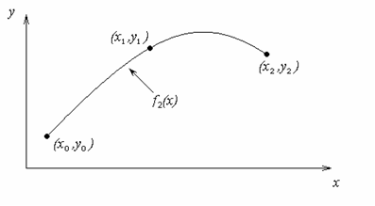
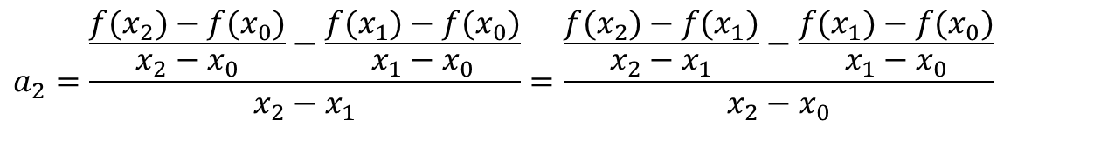
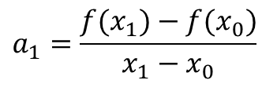

二次插值
$$给定(x_{0},y_{0}),(x_{1},y_{1}),(x_{2},y_{2}),寻找二次多项式通过这些点$$
$$P_{2}(x)=a_{0}+a_{1}(x−x_{0})+a_{2}(x−x_{0})(x−x_{1})$$
$$a_{0}=f(x_{0})$$
$$a_{1}=\frac{f(x_{1})−f(x_{0})}{x_{1}−x_{0}}$$
$$a_{2}=\frac{\frac{f(x_{2})−f(x_{0})}{x_{2}−x_{0}}−\frac{f(x_{1})−f(x_{0})}{x_{1}−x_{0}}}{x_{2}−x_{1}}=\frac{\frac{f(x_{2})−f(x_{1})}{x_{2}−x_{1}}−\frac{f(x_{1})−f(x_{0})}{x_{1}−x_{0}}}{x_{2}−x_{0}}$$

Slide 7
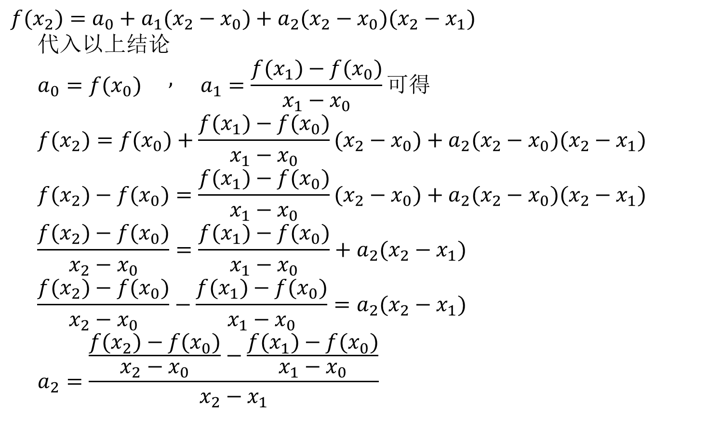
a₂形式一
$$f(x_{2})=a_{0}+a_{1}(x_{2}−x_{0})+a_{2}(x_{2}−x_{0})(x_{2}−x_{1}) \\ 代入以上结论 \\ a_{0}=f(x_{0})\begin{matrix} & , & \end{matrix}a_{1}=\frac{f(x_{1})−f(x_{0})}{x_{1}−x_{0}}可得 \\ f(x_{2})=f(x_{0})+\frac{f(x_{1})−f(x_{0})}{x_{1}−x_{0}}(x_{2}−x_{0})+a_{2}(x_{2}−x_{0})(x_{2}−x_{1}) \\ f(x_{2})−f(x_{0})=\frac{f(x_{1})−f(x_{0})}{x_{1}−x_{0}}(x_{2}−x_{0})+a_{2}(x_{2}−x_{0})(x_{2}−x_{1}) \\ \frac{f(x_{2})−f(x_{0})}{x_{2}−x_{0}}=\frac{f(x_{1})−f(x_{0})}{x_{1}−x_{0}}+a_{2}(x_{2}−x_{1}) \\ \frac{f(x_{2})−f(x_{0})}{x_{2}−x_{0}}−\frac{f(x_{1})−f(x_{0})}{x_{1}−x_{0}}=a_{2}(x_{2}−x_{1}) \\ a_{2}=\frac{\frac{f(x_{2})−f(x_{0})}{x_{2}−x_{0}}−\frac{f(x_{1})−f(x_{0})}{x_{1}−x_{0}}}{x_{2}−x_{1}}$$

Slide 8
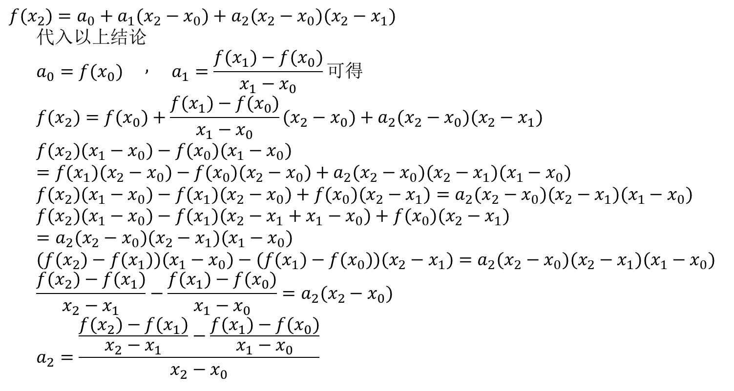
a₂形式二
$$f(x_{2})=a_{0}+a_{1}(x_{2}−x_{0})+a_{2}(x_{2}−x_{0})(x_{2}−x_{1}) \\ 代入以上结论 \\ a_{0}=f(x_{0})\begin{matrix} & , & \end{matrix}a_{1}=\frac{f(x_{1})−f(x_{0})}{x_{1}−x_{0}}可得 \\ f(x_{2})=f(x_{0})+\frac{f(x_{1})−f(x_{0})}{x_{1}−x_{0}}(x_{2}−x_{0})+a_{2}(x_{2}−x_{0})(x_{2}−x_{1}) \\ f(x_{2})(x_{1}−x_{0})−f(x_{0})(x_{1}−x_{0})=f(x_{1})(x_{2}−x_{0})−f(x_{0})(x_{2}−x_{0})+a_{2}(x_{2}−x_{0})(x_{2}−x_{1})(x_{1}−x_{0}) \\ f(x_{2})(x_{1}−x_{0})−f(x_{1})(x_{2}−x_{0})+f(x_{0})(x_{2}−x_{1})=a_{2}(x_{2}−x_{0})(x_{2}−x_{1})(x_{1}−x_{0}) \\ f(x_{2})(x_{1}−x_{0})−f(x_{1})(x_{2}−x_{1}+x_{1}−x_{0})+f(x_{0})(x_{2}−x_{1})=a_{2}(x_{2}−x_{0})(x_{2}−x_{1})(x_{1}−x_{0}) \\ (f(x_{2})−f(x_{1}))(x_{1}−x_{0})−(f(x_{1})−f(x_{0}))(x_{2}−x_{1})=a_{2}(x_{2}−x_{0})(x_{2}−x_{1})(x_{1}−x_{0}) \\ \frac{f(x_{2})−f(x_{1})}{x_{2}−x_{1}}−\frac{f(x_{1})−f(x_{0})}{x_{1}−x_{0}}=a_{2}(x_{2}−x_{0}) \\ a_{2}=\frac{\frac{f(x_{2})−f(x_{1})}{x_{2}−x_{1}}−\frac{f(x_{1})−f(x_{0})}{x_{1}−x_{0}}}{x_{2}−x_{0}}$$

Slide 9
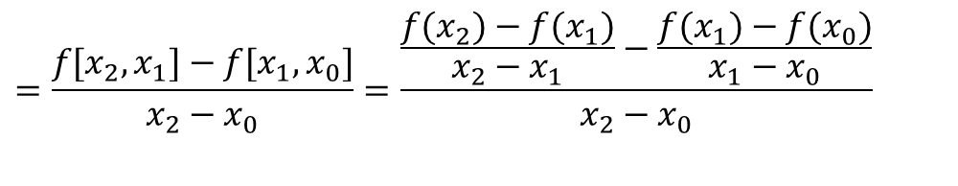
二次插值的一般形式
$$f_{2}(x)=a_{0}+a_{1}(x−x_{0})+a_{2}(x−x_{0})(x−x_{1})$$
其中
a
=
f
[
x
]
=
f
(
x
)
0
0
0
f
(
x
)
−
f
(
x
)
a
=
f
[
x
,
x
]
=
1
0
1
1
0
x
−
x
1
0
f
(
x
)
−
f
(
x
)
f
(
x
)
−
f
(
x
)
2
0
−
1
0
f
[
x
,
x
]
−
f
[
x
,
x
]
x
−
x
x
−
x
a
=
f
[
x
,
x
,
x
]
=
2
0
1
0
=
2
0
1
0
2
2
1
0
x
−
x
x
−
x
2
1
2
1
$$=\frac{f[x_{2},x_{1}]−f[x_{1},x_{0}]}{x_{2}−x_{0}}=\frac{\frac{f(x_{2})−f(x_{1})}{x_{2}−x_{1}}−\frac{f(x_{1})−f(x_{0})}{x_{1}−x_{0}}}{x_{2}−x_{0}}$$
即
$$f_{2}(x)=f[x_{0}]+f[x_{1},x_{0}](x−x_{0})+f[x_{2},x_{1},x_{0}](x−x_{0})(x−x_{1})$$

Slide 10
三次插值（推测）

Slide 11
n次插值的一般形式

Slide 12
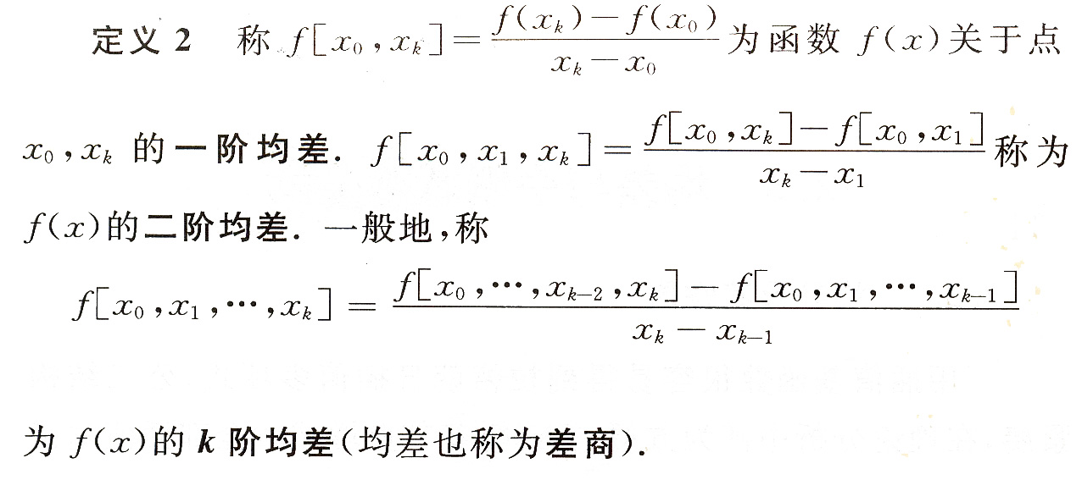

均差的定义

Slide 13
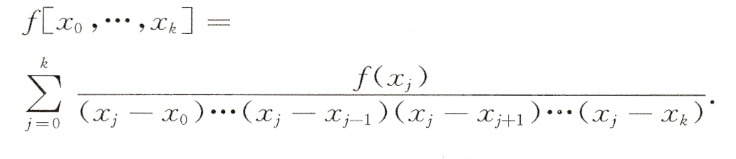
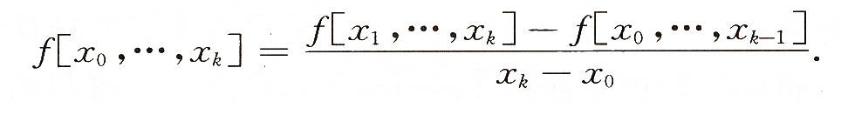

均差的性质
对称性：均差与节点的排列次序无关
基于对称性，可得均差的改进表达式
与n阶导的关系
$$f\left[x_{0},x_{1},⋯,x_{n}\right]=\frac{f^{\left(n\right)}(ξ)}{n!}, ξε[a,b]$$

Slide 14
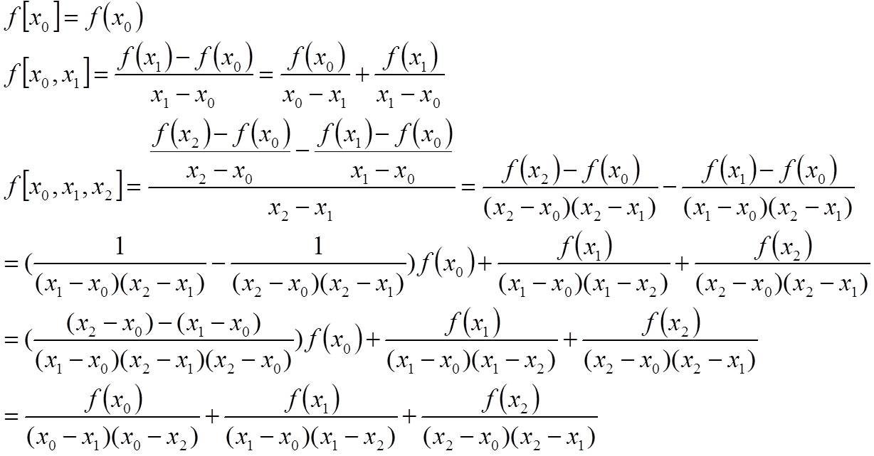
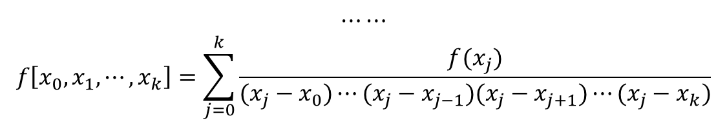
均差的性质1：对称性
$$⋯⋯$$
$$f\left[x_{0},x_{1},⋯,x_{k}\right]=\sum_{j=0}^{k}{\frac{f(x_{j})}{(x_{j}−x_{0})⋯(x_{j}−x_{j−1})(x_{j}−x_{j+1})⋯(x_{j}−x_{k})}}$$

Slide 15
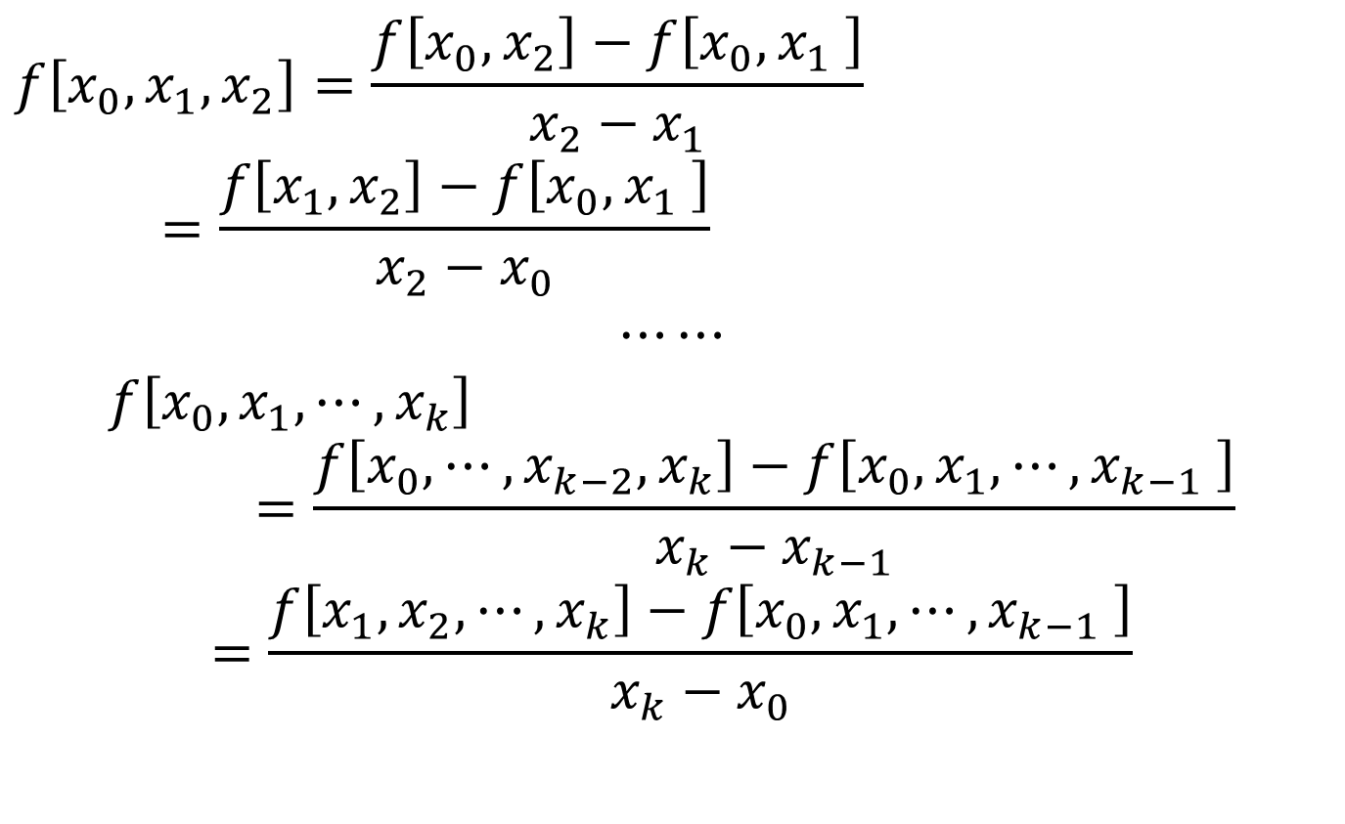
均差的性质2：两种递推形式
$$f\left[x_{0},x_{1},x_{2}\right]=\frac{f\left[x_{0},x_{2}\right]−f\left[x_{0},x_{1} \right]}{x_{2}−x_{1}}=\frac{f\left[x_{1},x_{2}\right]−f\left[x_{0},x_{1} \right]}{x_{2}−x_{0}}$$
$$⋯⋯$$
$$f\left[x_{0},x_{1},⋯,x_{k}\right]=\frac{f\left[x_{0},⋯,x_{k−2},x_{k}\right]−f\left[x_{0},x_{1},⋯,x_{k−1} \right]}{x_{k}−x_{k−1}}$$
$$=\frac{f\left[x_{1},x_{2},⋯,x_{k}\right]−f\left[x_{0},x_{1},⋯,x_{k−1} \right]}{x_{k}−x_{0}}$$

Slide 16
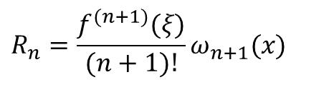

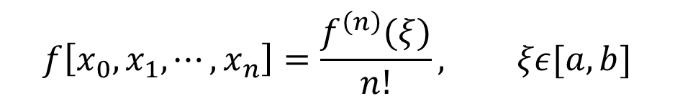
均差的性质3：与导数的关系
$$f\left[x_{0},x_{1},⋯,x_{n}\right]=\frac{f^{\left(n\right)}(ξ)}{n!}, ξε[a,b]$$
拉格朗日插值法的余项为
牛顿插值法的余项为
拉格朗日和牛顿插值获得的插值多项式是唯一的，余项是等价的
$$R_{n}=\frac{f^{(n+1)}(ξ)}{(n+1)!}ω_{n+1}(x)$$
$$R_{n}\left(x\right)=f[x,x_{0},⋯,x_{n}]ω_{n+1}(x)$$

Slide 17
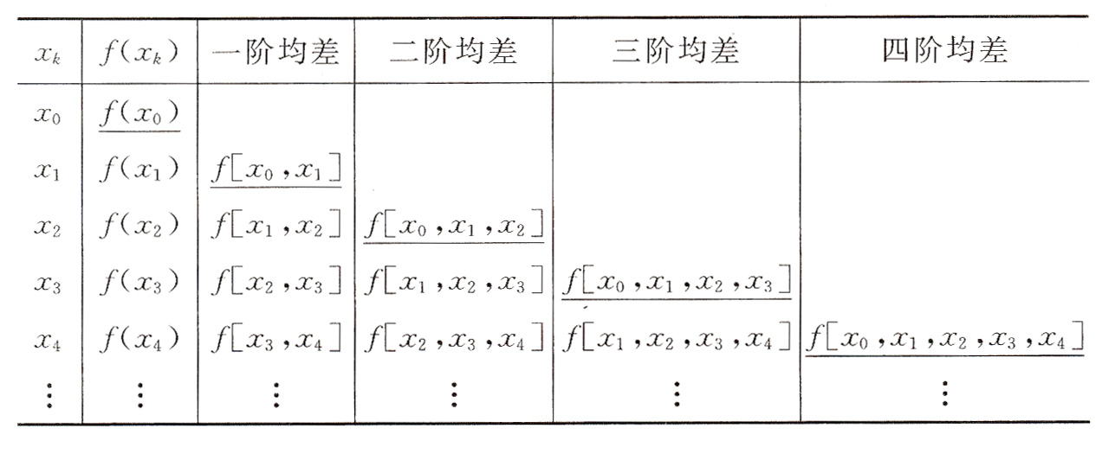
编程实现
为了好算，采用第二种形式☺

Slide 18
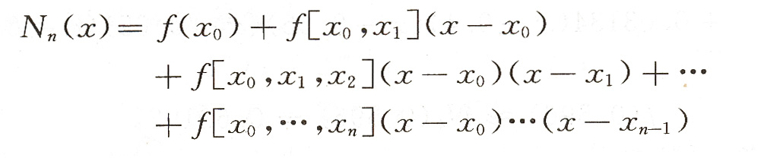
牛顿均差插值多项式
牛顿插值公式
余项（与拉格朗日插值余项等价）

Slide 19
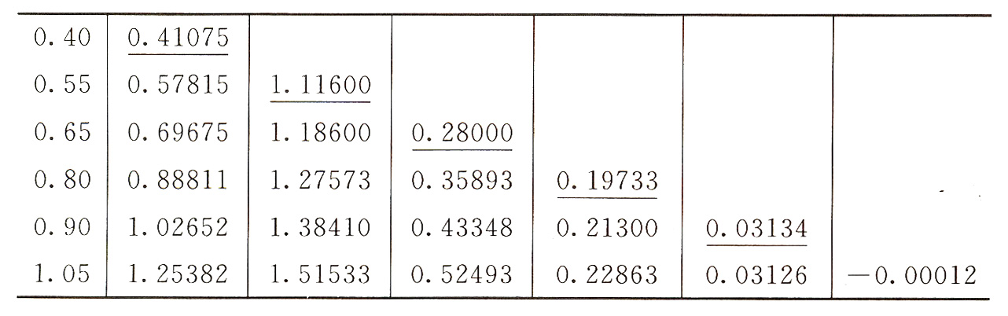
例2 根据给出的f(x)的函数值表，求各次牛顿插值多项式，并由此计算f(0.596)的近似值。
exmaple204

Slide 20
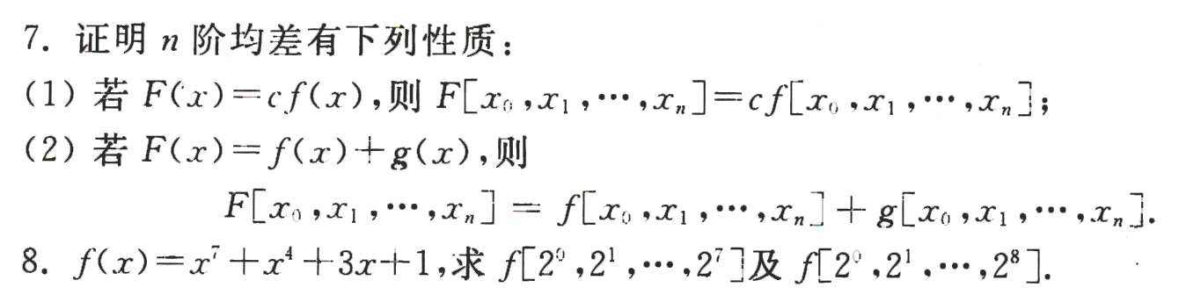
作业
P48
7、8

