Slide 1
Tarjan's Magic
Algorithms based on DFS

Slide 2
CONTENT OF SLIDE
1
Cut Vertex And Bridge
Point Biconnected Components
2
3
Edge Biconnected Components
Strongly Connected Components
4

Slide 3
Cut Vertex And Bridge
dfn[u]: Timestamp of DFS
low[u]: The lowest dfn value of u and its descendant's back edge connected nodes.
f
f
How to find Cut Vertex?
u
u
v
v

Slide 4
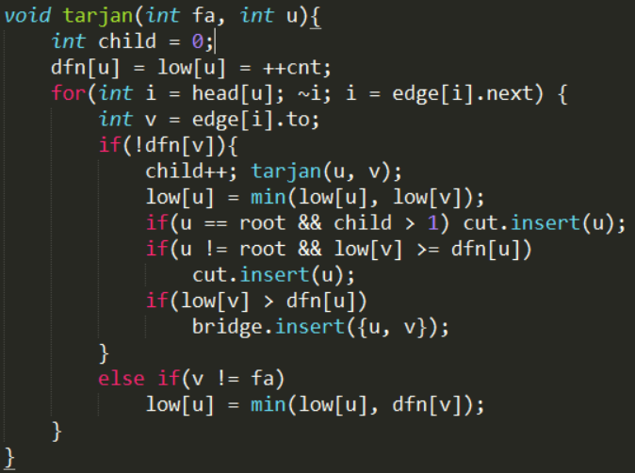
Cut Vertex And Bridge

Slide 5
Point Biconnected Components
A biconnected graph is a connected and "nonseparable" graph, meaning that if any vertex were to be removed, the graph will remain connected. And a biconnected component is a maximal biconnected subgraph.

Slide 6
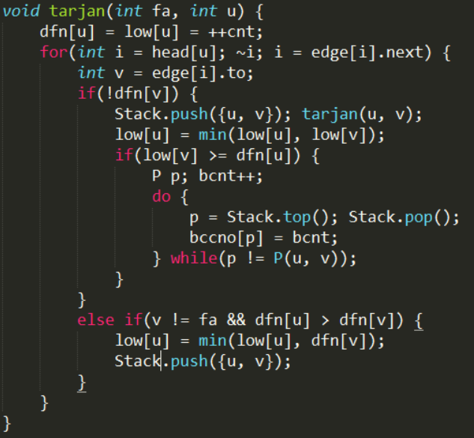
CODE

Slide 7
Edge Biconnected Components
Similar to Point Biconnected Components but if any
edge were to be removed, the compnet will remain
connected. In other words, there is no bridge.

Slide 8
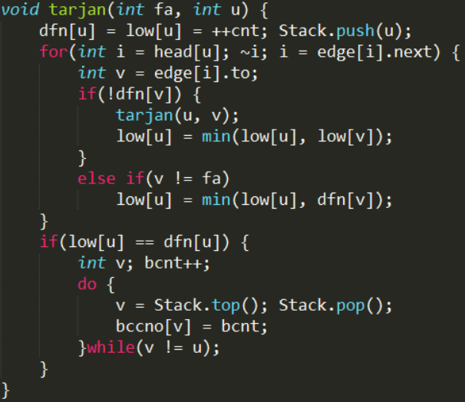
CODE

Slide 9
Strongly Connected Components
A graph is said to be strongly connected if every vertex is reachable from every other vertex. The strongly connected components of an arbitrary directed graph form a partition into subgraphs that are themselves strongly connected.

Slide 10
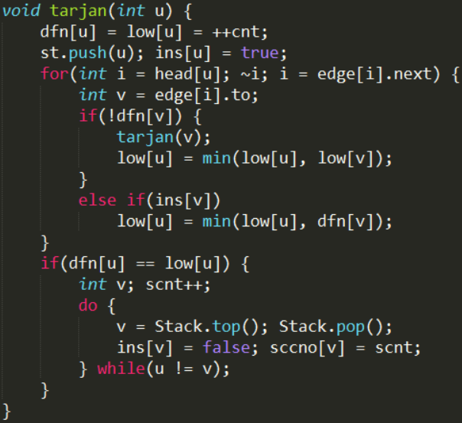
CODE

Slide 11
HihoCoder 1185
描述
暑假到了!!小Hi和小Ho为了体验生活，来到了住在大草原的约翰家。今天一大早，约翰因为有事要出去，就拜托小Hi和小Ho忙帮放牧。
约翰家一共有N个草场，每个草场有容量为W[i]的牧草，N个草场之间有M条单向的路径。
小Hi和小Ho需要将牛羊群赶到草场上，当他们吃完一个草场牧草后，继续前往其他草场。当没有可以到达的草场或是能够到达的草场都已经被吃光了之后，小hi和小Ho就把牛羊群赶回家。
一开始小Hi和小Ho在1号草场，在回家之前，牛羊群最多能吃掉多少牧草？

Slide 12
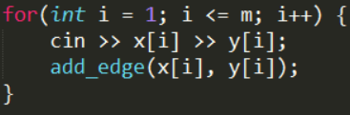
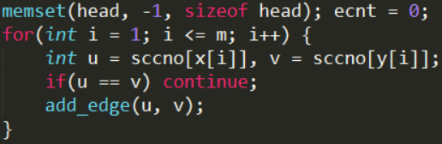
Magic of Shrink Point

Slide 13
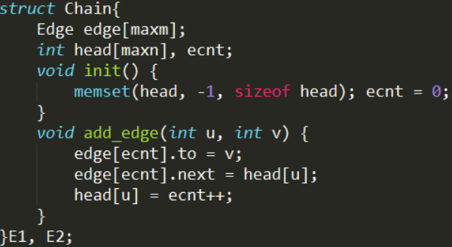
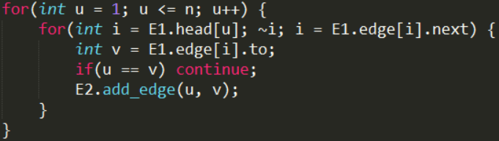
Magic of Shrink Point

Slide 14
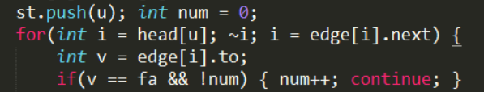
HDU 4612
描述
在一个无向图中添加一条边，使得新图中桥的条数最少，求最少桥数。
multiple edges!!

Slide 15
POJ 3177
描述
有一个无向连通图，你需要一些的边使得新图边双连通，求最少应该添加多少条边？

Slide 16
UVALive 5135
描述
煤矿工地可以看成是由隧道连接挖煤点组成的无向图。为安全起见，希望在工地发生事故时所有挖煤点的工人都能有一条出路逃到救援出口处。于是矿主决定在某些挖煤点设立救援出口，使得无论哪一个挖煤点坍塌之后，其他挖煤点的工人都有一条道路通向救援出口。请写一个程序，用来计算至少需要设置几个救援出口，以及不同最少救援出口的设置方案总数。

Slide 17



