Slide 1
Can we trust Autonomous Vehicles? Are they truly safe?
Step-Up Project ROUTE Data Science Career Challenge
Qasim Rahman, Cardiff University
2nd-Year Computer Science Undergraduate Student
Please note: All data is synthetic data and should not be taken as the complete truth for industry decision-making.

Slide 2
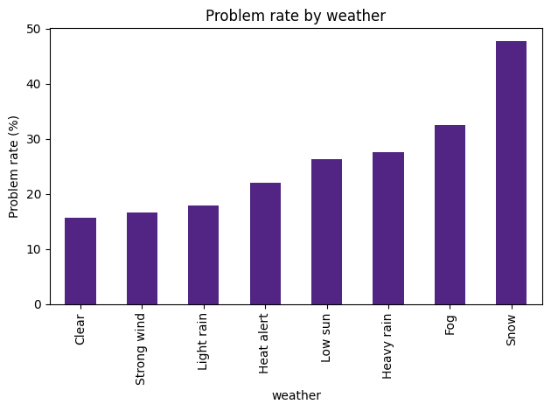
Data Patterns
The rate at which problems are raised differs significantly between clear conditions (15.47%) and snowy conditions (44.7%).
Chi-squared P-Value: 1.8037e-15
Given that we assume that weather and problem rate are completely independent, via the chi-squared test, we have enough evidence to suggest that there is an association between the 2 variables.
Cramer’s V: 0.1837 (statistically the strongest factor seen)
Despite this statistically being a low strength of association, contextually it is the highest strength among all other factors analysed, with all things considered.
Therefore, weather is the most dominant environmental factor to do with AV performance.
It is also important to note that, while weather remains the primary force, traffic level is the secondary driver, with Cramer’s V = 0.1009 The problem rate sits at 24.9% in high traffic and drops to 14.3% in low traffic. This could be due to erratic drivers in heavy, start-stop traffic with unexpected braking and other obstacles in that environment. Low traffic removes those variables. The Chi-Squared
p-value (2.9382e-06) proves that fact, despite being only half as impactful on the problem rate as snowy weather.

Slide 3
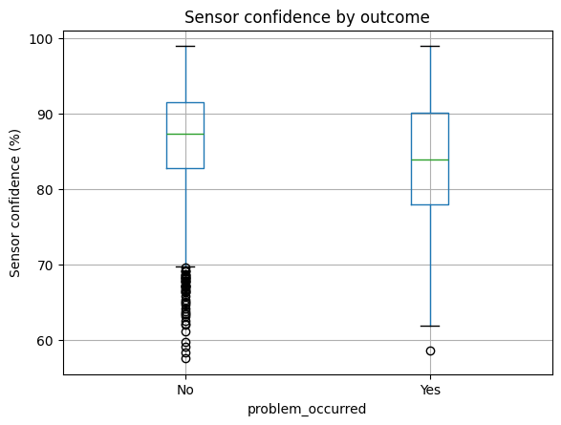
Key Factors
The AI’s Logic: Vulnerabilities and Safety Buffers
Severe Vulnerabilities:
1. Snow-Covered Roads
Severe visual object-detection loss which heavily influences
failure. (Logistic regression coefficient = +1.32)
However, the biggest vulnerability is:
2. Escalating Sensor Alerts
This is the primary failure indicator
When the system generates multiple sensor alerts, the problem
rate skyrockets. (Logistic regression coefficient = +5.64)
Successful journey -> High Median (sensor confidence = 87.5%)
Problematic journey -> Lower Median (sensor confidence 84%)
Safety Buffers:
Low Traffic (Logistic regression coefficient = -0.95)
Motorways (Logistic regression coefficient = -0.56)
The model considers these safe, mathematically pulling the prediction towards a safe journey

Slide 4
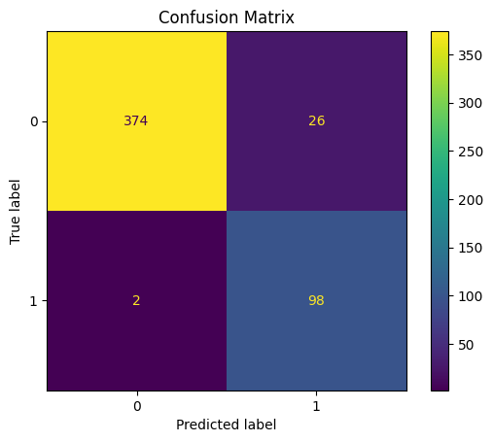
Predictions and Evaluations
Used an 80/20 train-test split to evaluate a Logistic Regression Model fairly, avoiding target leakage by restricting data to pre-journey factors (e.g. environmental, road types).
2 false negatives, 374 true negatives
26 false positives, 98 true positives
We had a 98% Recall rate (extreme AV safety). Only missed the identification of 2 problems.
Conversely, 79% precision rate (26 false alarms, which could annoy passengers)
Leads to a total F1-Score of 87.5%
All of this shows an overall accuracy of 94.4%.

Slide 5
AI Improvements and Ethics
How could AI improve?
As it stands, snowy conditions are a definite weakness when considering the weather. It would be worth training
object detection and sensor confidence in these conditions specifically.
Ethical Focus 1 – Safety & Oversight
Ensure human operators are there and ready to take action under any circumstances, especially
Standard operating procedures (SOPs) should be taken more seriously in snowy conditions.
As the model generated 26 false alarms (lower precision), a human operator must actively expect to override.
This requires a flawless and seamless and uncompromisable override system the second the “sensor_alert_count” spikes.
By keeping human operator overrides available, more data can be captured and analysed while technical improvements are slowly incorporated.
Ethical Focus 2 – Accountability and Privacy
What would happen in the case of an accident? Who would be responsible for the 2 false-negatives? Would it be the software designer? Depending on the implementation, it could either be the service provider in the case of (self-driving AVs), or the liability would fall on the person for failing to intervene.
When gathering more data to train on, how would passenger privacy be ensured? It is important to consider either an opt-out system
Alternatively, asking passengers for consent initially for their involvement in data training.
When collecting more data for training the AI, it is important to anonymise those involved to keep their privacy protected and maintained.

Slide 6
Trust Decision
Final Verdict: Conditional Trust
Supportive of the Autonomous Vehicle, during clear weather and motorway transport.
Mandatory AV override with a human operator during snowy conditions.
Main Model: Prioritises safety over smoothness. Good Chance of false alarms.
Data Limitations: Data proves that sensors are weak in snow.
However, there are no specific logs to deduce the root of those failures.
Further Evidence: Before granting full trust, gather hardware
diagnostics to pinpoint precisely what is triggering sensor alerts
as well as response-time data when an operator overrides
the AV safely.

