Slide 1



Dashboard
View in Power BI
Last data refresh:
12/3/2024 8:15:27 PM UTC
Downloaded at:
12/3/2024 8:18:49 PM UTC

Slide 2
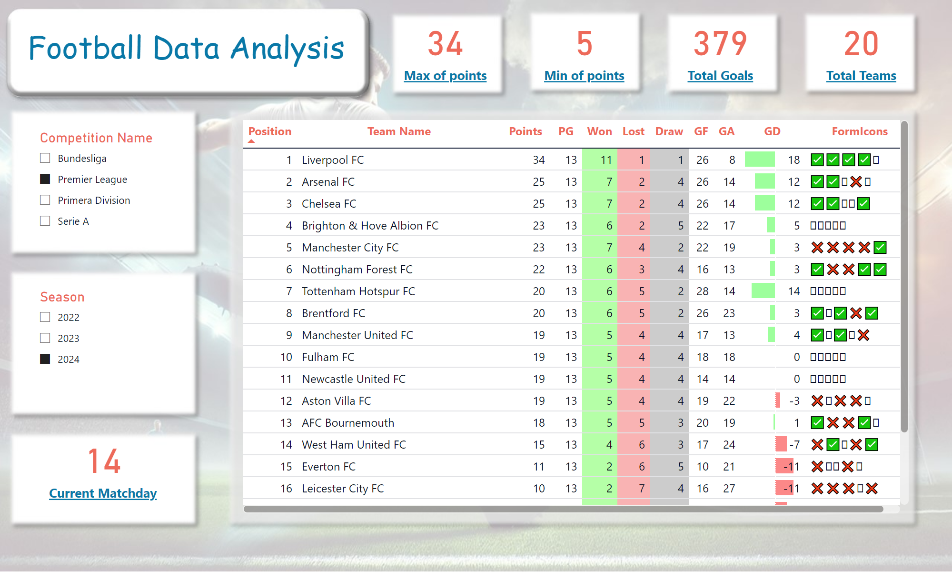
Standing
Notes:
tableEx
No alt text provided
slicer
No alt text provided
slicer
No alt text provided
card
No alt text provided
textbox
No alt text provided
card
No alt text provided
card
No alt text provided
card
No alt text provided
card
No alt text provided

Slide 3
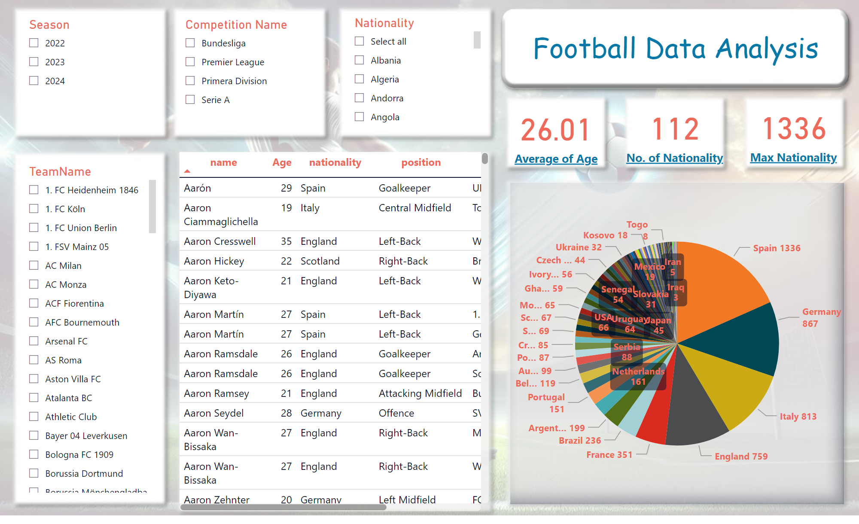
Squad
Notes:
card
No alt text provided
textbox
No alt text provided
card
No alt text provided
tableEx
No alt text provided
slicer
No alt text provided
slicer
No alt text provided
card
No alt text provided
slicer
No alt text provided
pieChart
No alt text provided
slicer
No alt text provided

Slide 4
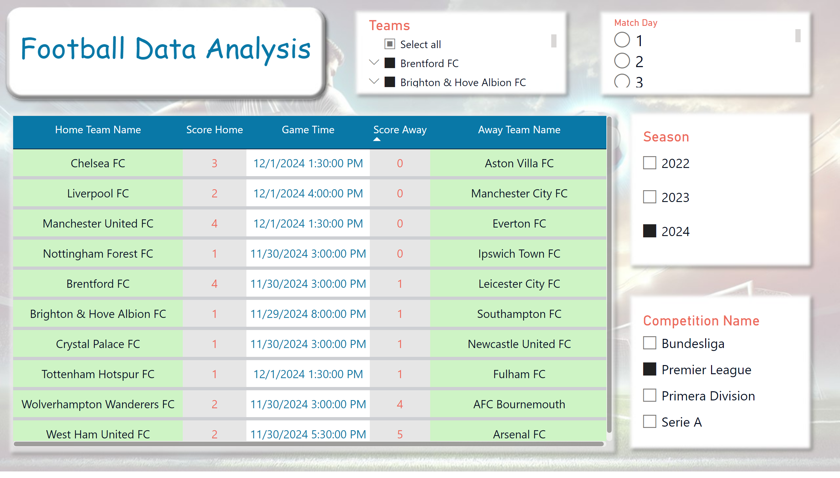
Matches
Notes:
tableEx
No alt text provided
slicer
No alt text provided
slicer
No alt text provided
slicer
No alt text provided
slicer
No alt text provided
textbox
No alt text provided

Slide 5
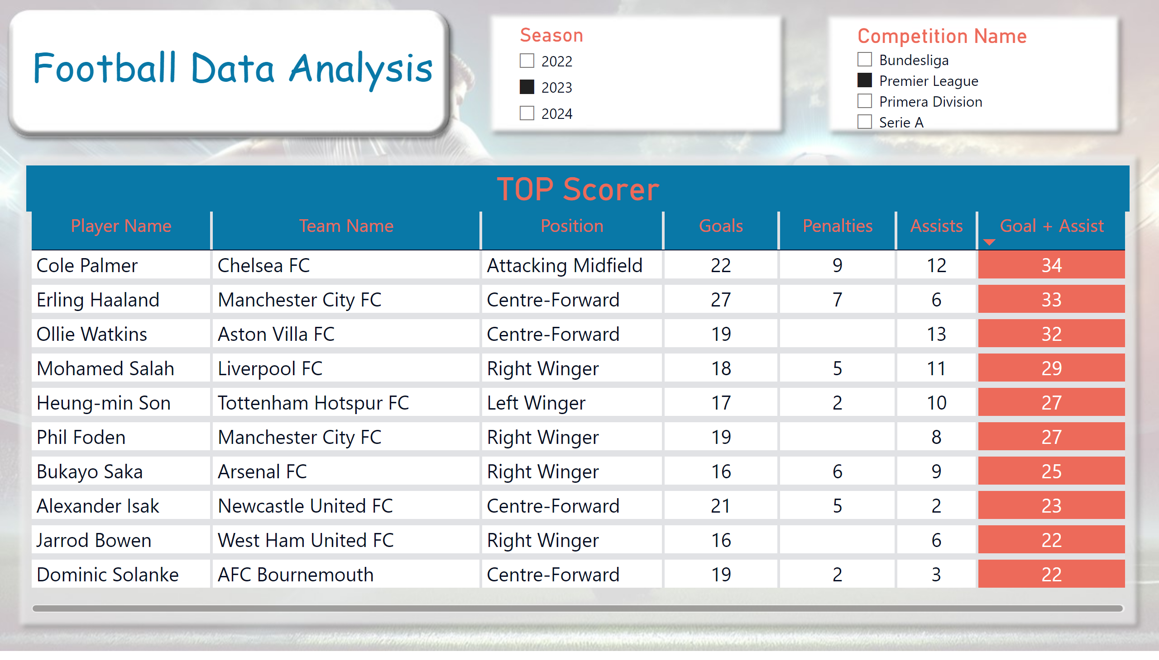
Scorer
Notes:
TOP Scorer
No alt text provided
slicer
No alt text provided
slicer
No alt text provided
textbox
No alt text provided

