Slide 1


Bapuji Institute of Engineering and Technology, Davanagere-577004
Department of CSE(Data Science)
Major Project (BCD685)
Synopsis Presentation on
“Vision-Language Model Fusion of MRI Features and Radiology Reports for Explainable Alzheimer’s Disease Classification”
Team Associates
Name of the student
USN
KEERTHANA K H MISBAH NOORAIN
SMRUTHI D K
VARSHA B O
4BD23CD020
4BD23CD026
4BD23CD042
4BD23CD051
Guide
Prof. Gowramma B H
Assistant Professor
Computer Science & Engineering(Data Science)
Major-Project Coordinator
Dr. Prashanth G R
Associate Professor
Computer Science & Engineering(Data Science)
program Coordinator
Dr. Pradeep N
Professor and Head
Computer Science & Engineering(Data Science)

Slide 2
ABSTRACT
Alzheimer’s disease is a progressive neurodegenerative disorder that affects memory and cognitive functions, making early diagnosis essential yet challenging due to complex brain patterns and varying clinical symptoms. This project proposes an intelligent Alzheimer’s disease classification system using a multimodal vision-language approach. It integrates MRI images and radiology reports using deep learning models, where image and text features are extracted and combined through a Vision-Language Model to improve prediction accuracy. The system will also provide confidence-based results and visual explanations using Explainable Artificial Intelligence techniques.

Slide 3
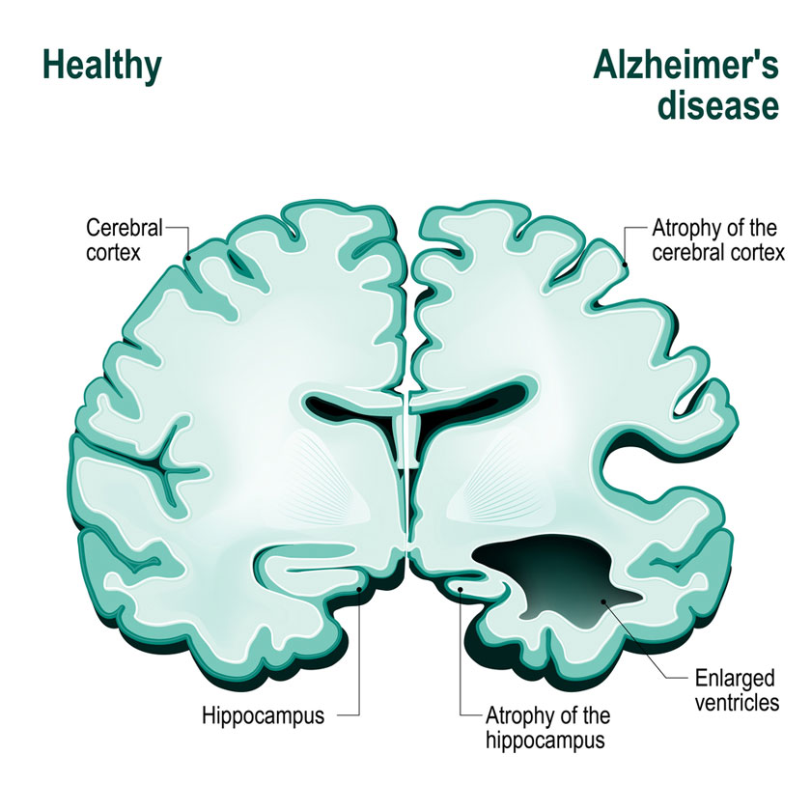
  INTRODUCTION
Alzheimer’s Disease :
Alzheimer’s disease is a progressive neurological disorder affecting memory and cognition.
It is caused by brain cell degeneration leading to brain shrinkage (atrophy).
MRI scans will help in identifying structural changes in the brain.

Slide 4
Stages of Alzheimer’s Disease :
Normal : No significant cognitive impairment, brain functions will be normal.
Mild Cognitive Impairment (MCI) : Early stage with slight memory loss and cognitive changes.
Alzheimer’s Disease : Severe stage with significant memory loss and impaired daily functioning.

Slide 5
Technologies and Proposed Approach :
CNN / Vision Transformer : Will be used to extract features from MRI brain images.
BERT / Transformer Models : Will process and encode radiology reports into meaningful representations.
Vision–Language Model (CLIP / medCLIP) : Will integrate image and text features for multimodal understanding.

Slide 6
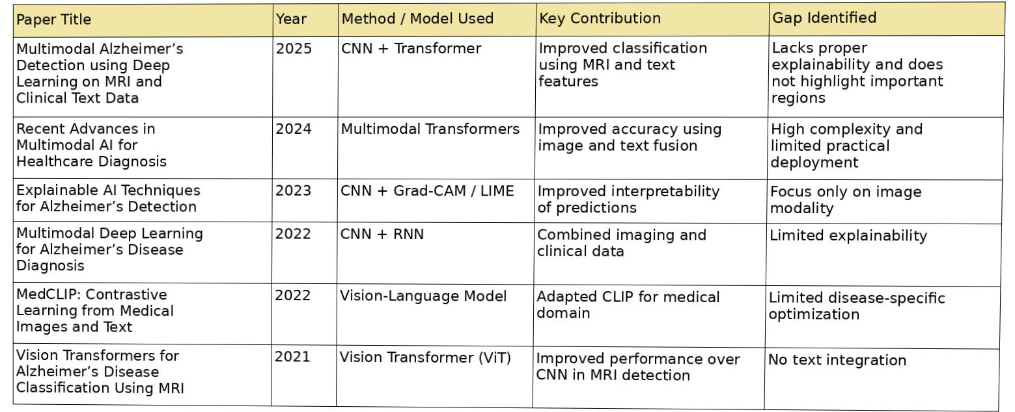
LITERATURE SURVEY

Slide 7
PROBLEM STATEMENT
Early detection of Alzheimer’s disease is difficult due to complex brain patterns and varied symptoms. Existing systems rely mainly on MRI images and ignore clinical text data, reducing accuracy. Additionally, lack of explainability makes predictions hard to trust, creating a need for a multimodal and interpretable AI-based solution.
Topic
PROPOSED SYSTEM
The proposed system will use MRI images and clinical text data for Alzheimer’s detection. A Vision-Language Model will integrate both data types to improve accuracy, while Explainable AI techniques will provide transparent and reliable predictions to support medical decision-making.

Slide 8
OBJECTIVES
To collect MRI brain image datasets and relevant clinical textual data for Alzheimer’s analysis
To preprocess the collected data, including image normalization and text cleaning, to prepare it for model training
3. To develop a multimodal model using Vision-Language techniques by extracting and integrating features from both image and text data
4. To incorporate Explainable AI (XAI) methods to interpret model predictions and improve reliability

Slide 9
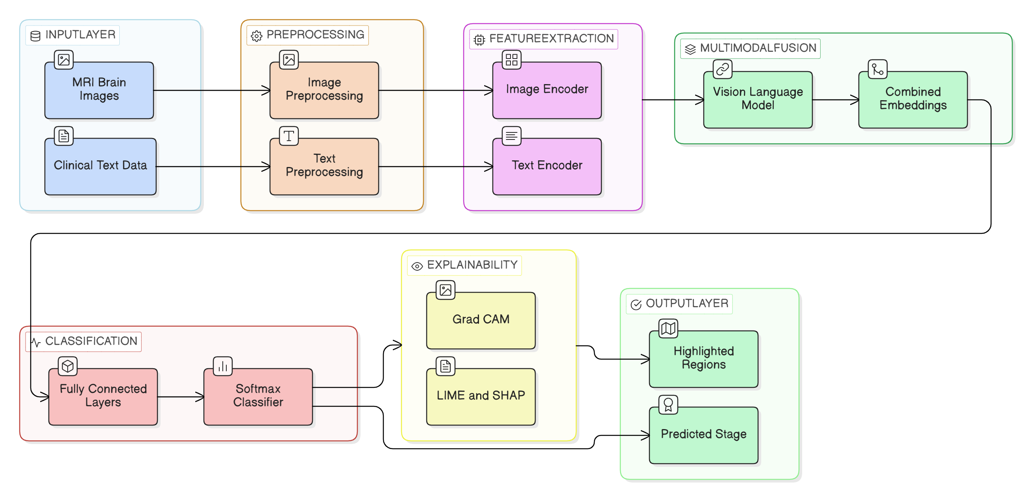
METHODOLOGY DIAGRAM

Slide 10
REQUIREMENTS
Python(3.x)
PyTorch / TensorFlow
Vision-Language Models (CLIP / MedCLIP)
BERT / ClinicalBERT (for text processing)
Vision Transformer (ViT) / CNN (for image feature extraction)
HuggingFace Transformers
OpenCV (for image preprocessing)
NumPy, Pandas, Scikit-learn
VS Code

Slide 11
EXPECTED OUTCOMES
• Will achieve multimodal Alzheimer’s classification using MRI scans and radiology reports
• Will improve diagnostic accuracy through image and text fusion
• Will generate confidence-based predictions with disease stage classification
• Will provide visual explanations using explainable AI (highlighting brain regions)
• Will feature an interactive interface for input and result visualization

Slide 12
REFERENCES
Z. Wang et al., “MedCLIP: Contrastive Learning from Unpaired Medical Images and Text,” in Proc. EMNLP, 2022.
Available: https://arxiv.org/abs/2210.10163
A. Dosovitskiy et al., “An Image is Worth 16x16 Words: Transformers for Image Recognition at Scale,” in Proc. ICLR, 2021.
Available: https://arxiv.org/abs/2010.11929
H. Touvron et al., “Training Data-efficient Image Transformers & Distillation through Attention,” in Proc. ICML, 2021.
Available: https://arxiv.org/abs/2012.12877
W. Zhang et al., “Deep Learning Based Multi-modal Classification for Alzheimer’s Disease Diagnosis,” NeuroImage, vol. 183, pp. 522–531, 2019.
Available: https://doi.org/10.1016/j.neuroimage.2018.08.035

Slide 13
THANK YOU!

