Slide 1

SEERAT-E-AISHA(R.A)

Slide 2
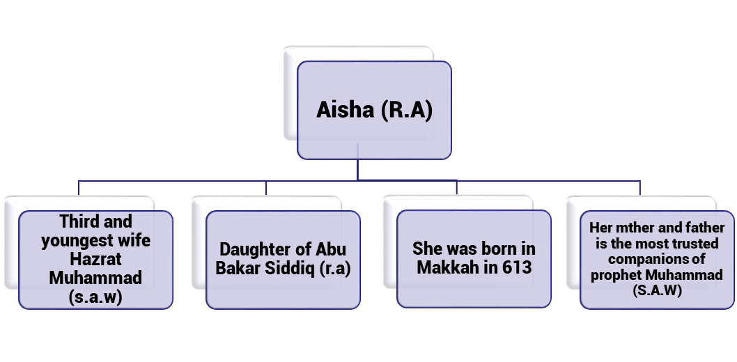
FOUR IMPORTANT THINGS ABOUT AISHA (R.A)

Slide 3
AISHA BINT –E-ABU BKAR SIDDIQ(R.A)
Aisha (r.a) was born in Makkah in 613. She was the daughter of the closest man to the prophet Muhammad (s.a.w). Her mother Umme Roman Zainab (r.a) and father Abu Bakar Siddiq (r.a) is the most trusted companions of Hazrat Muhammad (s.a.w). She showed the world how women could be more knowledgeable than a man. She was politician and warrior 14 centuries ago. She had a brilliant mind She was involved a religious matters and political events as well.

Slide 4
CLOSEST TO PROPHET MUHAMMAD (S.A.W)
Aisha (r.a) was his third and youngest wife and lived with him until his passing. She was known as a strong lady. She was described in the history books as someone gifted with incredible intelligence and immense beauty. She lived 10years of her live with prophet Muhammad (s.a.w) within that period she had learned islam directly. A great deal of knowledge that we have today, about how Muhammad (s.a.w) lived his life and his behavior towards his household and others. Aisha (r.a) not ony knew the sunnh but she also memorise the Quran by heart and understood it and live it. There are many narrations detailing the love between. Aisha( r.a) and the Prophet (s.a.w) serves as an example of how Muslim marriages should be. The Prophet (s.a.w) was the most gentle, especially towards his wives and children. .

Slide 5
RESPECTED MUSLIM SCHOLAR
Aisha (r.a) adopted a great position. She became an ideal for all womens anywhere in anytime. She has many qualities and one of the most prominent ones. She was young when she married the Prophet (s.a.w). and was able to absorb knowledge and information.This ability made her the educator and transmitter of sacred knowledge. Aisha (R.A.) became involved in the politics of early Islam. During the time of islam when women were not expected or wanted to contribute outside the household. Ayesha (R.A) delivered public speeches became directly involved was in wars and battles and helped men and women to understand the practice. Ayesha (R.A) was known an as intelligent women who debated law with male companions.

Slide 6
THE RIGHTS OF WOMEN
Prophet Muhammad s.a.w had set examples, through his wives, for all women to learn from. Prophet (s.a.w) an amazing indication that men and women can learn from one another, protect and help each other. In Islam, no gender is superior to the other. Since the 7th century, more than 1400 years ago, Prophet Muhammad s.a.w had revolutionised Their rights were given to them by the Prophet s.a.w. During this 7th century women’s rights. Islam gave them the rights. Aisha (r.a) was a great example of being a woman of high stature in knowledge and contribution without the need to compromise honour, dignity and piety.

