Slide 1
Mind
Ease
Yara Alhammouri - 768008964
Misbah Begum - 418008089
Ali Jouni - 769009393

Slide 2
Executive Summary
MindEase is a web-based application designed to help students manage stress and anxiety through self-awareness and guided self-care resources. The platform enables users to assess their stress levels using an interactive emoji-based survey and provides personalized resources such as relaxation videos, stress-relief games, and practical mental health tips. By offering a calm, accessible, and supportive environment, MindEase promotes mental health awareness and encourages healthy coping strategies. The system also provides emergency contact information for students who may require professional support.

Slide 3
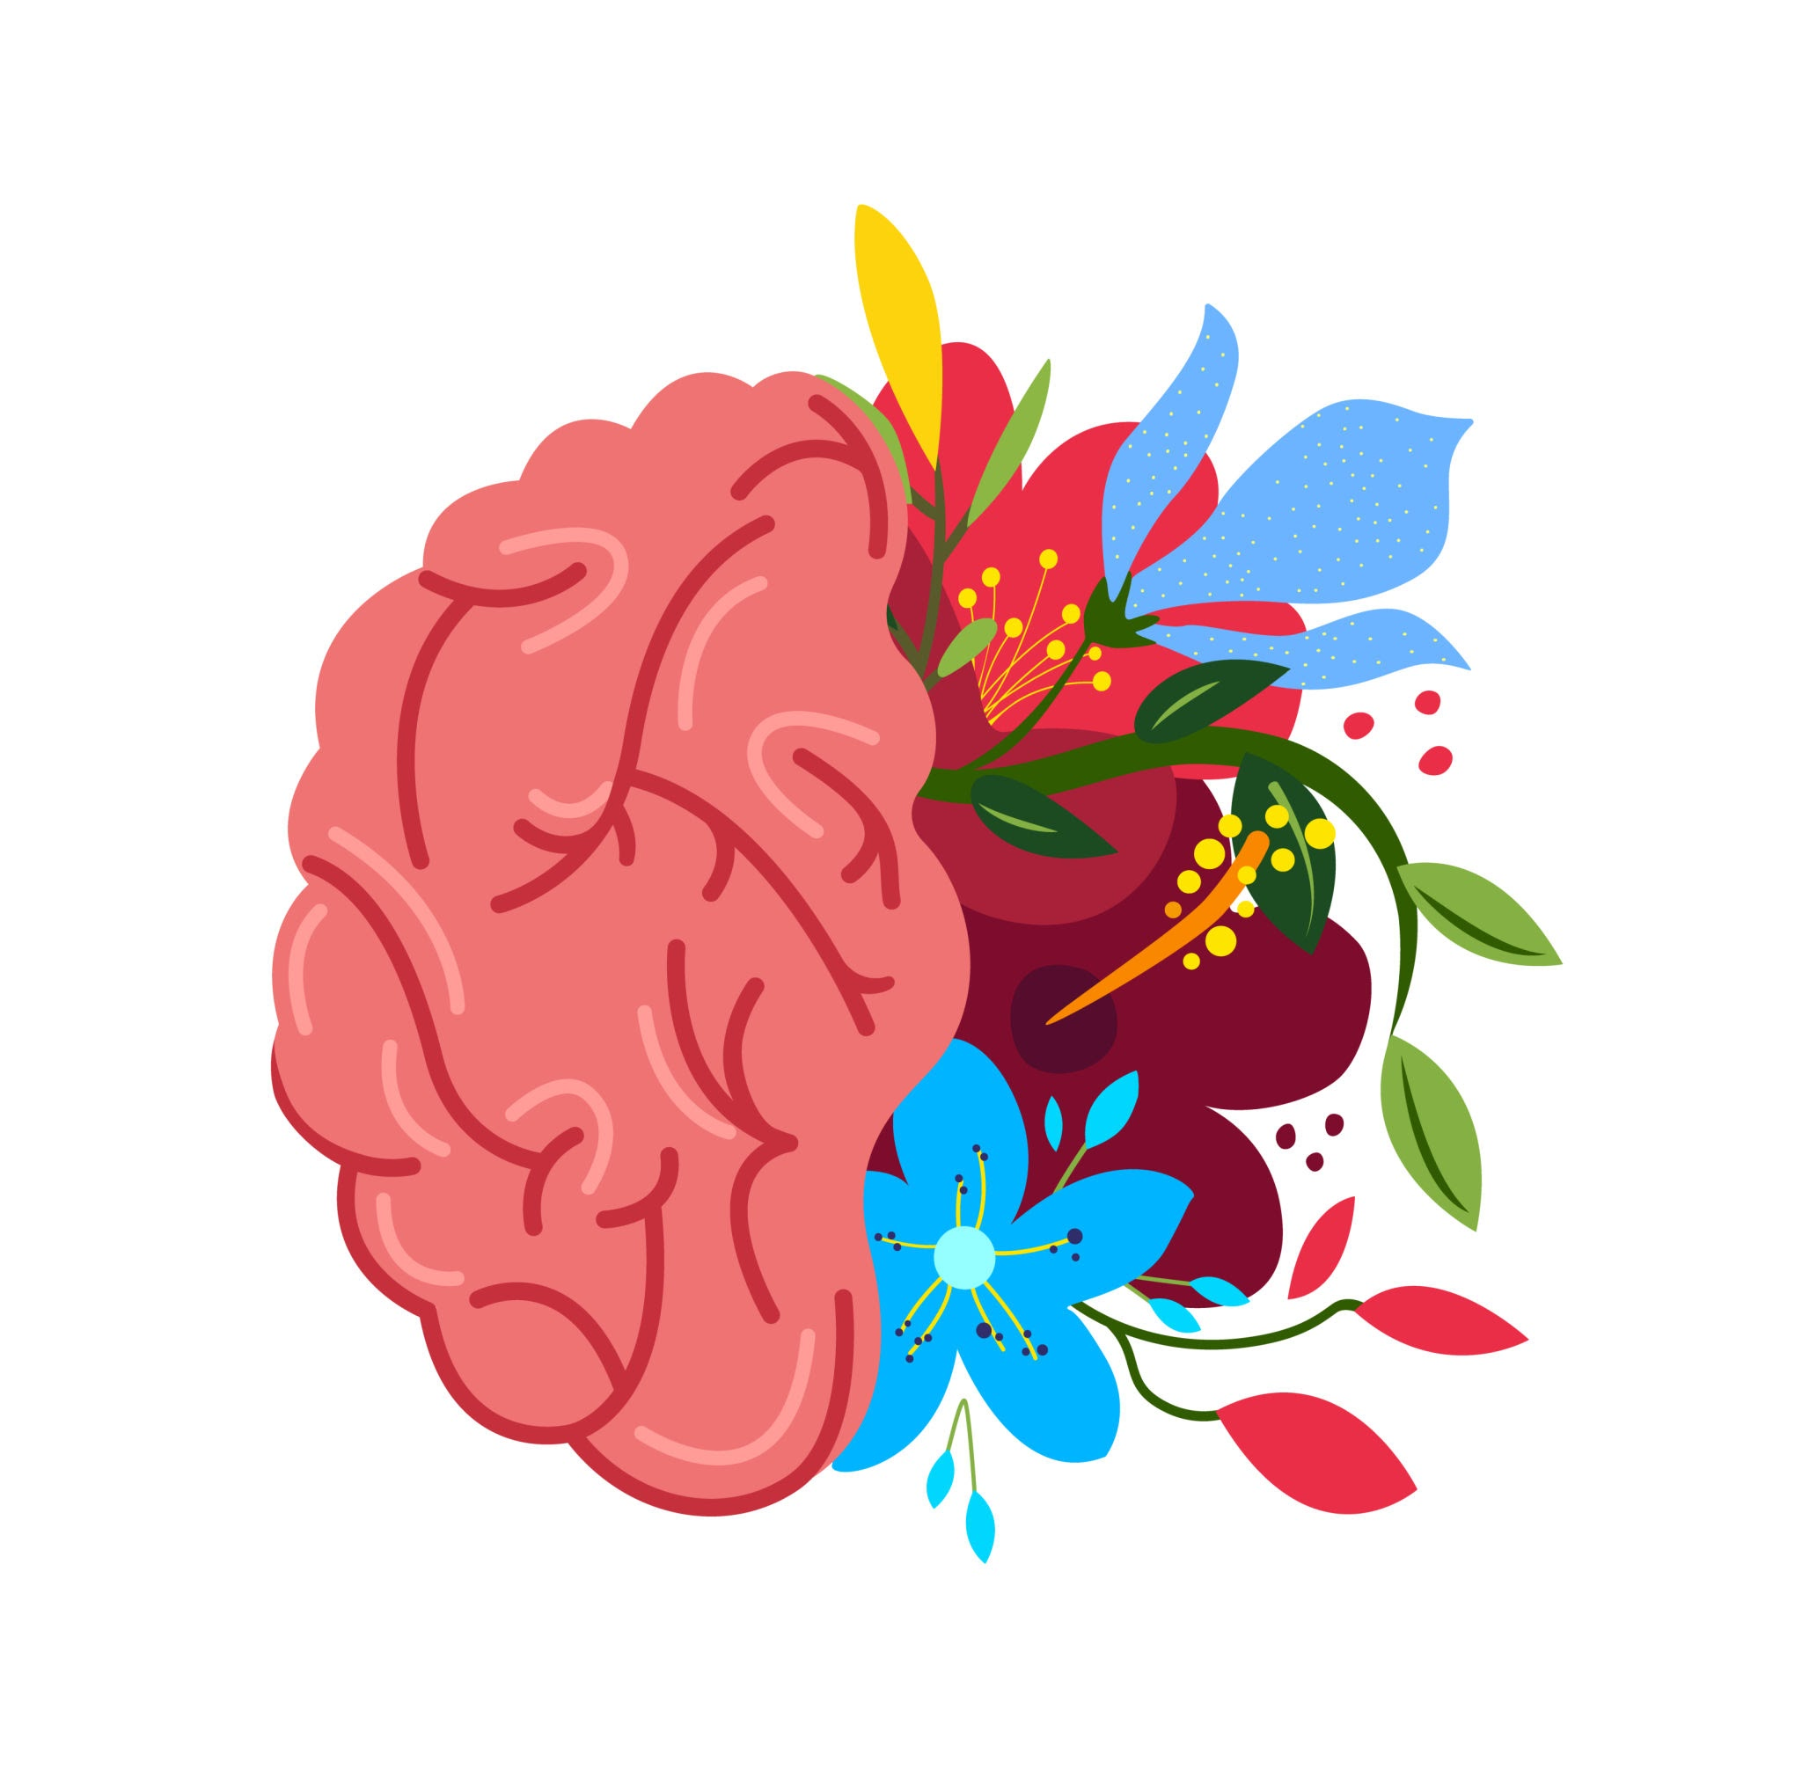
Project Scope
The scope of MindEase includes the development of a secure web platform that allows students to evaluate and manage stress levels. Core functionalities include user registration and login, an interactive 1–5 emoji-based stress survey, personalized content delivery based on survey results, and the display of emergency mental health contact information. The application is designed as a support and awareness tool rather than a diagnostic or treatment system.

Slide 4
Project Timeline
Phase I
Phase II
Phase III
Planning, requirement analysis, and UI/UX design (3 weeks)
Frontend and backend development with database integration (3 weeks)
Testing, refinement, demo preparation, and final submission (1–2 weeks)

Slide 5
Technical Requirements
Front-End
Back-End
Java with Spring Boot framework
MVC architecture using controllers, services, repositories, and views
Mustache templates for dynamic page rendering
Spring Security for authentication and authorization
HTML5 for page structure
CSS3 and Bootstrap/Tailwind for styling and responsive design
JavaScript for interactive surveys, navigation, and dynamic content
Database & Integration
MySQL for storing user data, survey responses, and resources
APIs for integrating videos or meditation content

Slide 6
Key Features
Personalized Resources
Interactive stress survey
Responsive UI/UX
Emoji-based 1–5 scale survey
Determines stress level (Low, Moderate, High)
Redirects users to relevant resources
Stress-relief videos, tips, and simple games
Content tailored to the user’s stress level
Emergency contact details displayed when required
Minimalistic, nature-inspired design
Consistent navigation from Landing → Survey → Resources
Responsive across different devices

Slide 7
User Interaction Scenario
A student visits the MindEase landing page and securely registers or logs into the system. The student completes a short emoji-based survey to indicate their current stress level. Once submitted, the system evaluates the response and redirects the student to a personalized resource page. Relevant tips, videos, and stress-relief activities are displayed based on the assessed stress level. If needed, emergency contact information for professional mental health support is also provided.

Slide 8
UI/UX Design
MindEase uses a clean, minimalistic, nature-inspired design to promote calmness and relaxation. Soft beige or cream backgrounds with muted green and earthy tones create a soothing visual experience. Navigation is consistent across the Landing, Survey, and Resource pages for smooth user flow. Content is presented using card-based layouts for clarity and ease of interaction. Emoji-based survey inputs and subtle animations enhance engagement while maintaining simplicity. The interface is fully responsive and optimized for both touch and mouse input.

Slide 9
Limitations / Challenges
Scalability:
Survey Accuracy:
Content-Variety:
Security:
Secure handling of user credentials and survey data is critical.
System performance may be affected if a large no. of students access the platform simultaneously
Limited resources may restrict personalization options for each stress level.
Results depend on self-reported data and may not fully reflect a user’s actual mental state.

Slide 10
THANK
YOU

