Slide 1
Supply Chain
Decision Brief
Careem Quik — UAE dark-store network
2025-01-01 to 2026-06-30 · 546 days · AED
Prepared for the Supply Chain Director
ILLUSTRATIVE — SYNTHETIC DATA
Notes:
Synthetic data throughout. The purpose is to demonstrate the analytical method, not to report on a real business.

Slide 2
1
The decision
What is being asked, before any of the analysis
6
AED 727k
AED 103k
AED 983k
actions recommended
net annual value
one-off investment
identified leakage
Approve now
R1 and R5a. Both are scheduling changes — no headcount, no capital.
Mandate to negotiate
R2 and R3. Both need supplier agreement before they can move.
Note
One recommendation is analysed and rejected. The obvious fix for the worst-performing store costs more than it saves.
Illustrative — synthetic data
Notes:
Lead with the ask. The rest of the deck justifies it.

Slide 3
2
Where the network stands
Every headline metric against its declared target
Fill rate
Waste rate
Supplier OTIF
Delivery p50 (min)
90.5%
3.6%
90.9%
20.2
target 97.0%
target 2.0%
target 95.0%
target 20.0
Order cancel rate
Fleet utilisation
Inventory turns (annual)
3.2%
86.7%
60.3
target 2.5%
target 85.0%
target 45.0
Illustrative — synthetic data

Slide 4
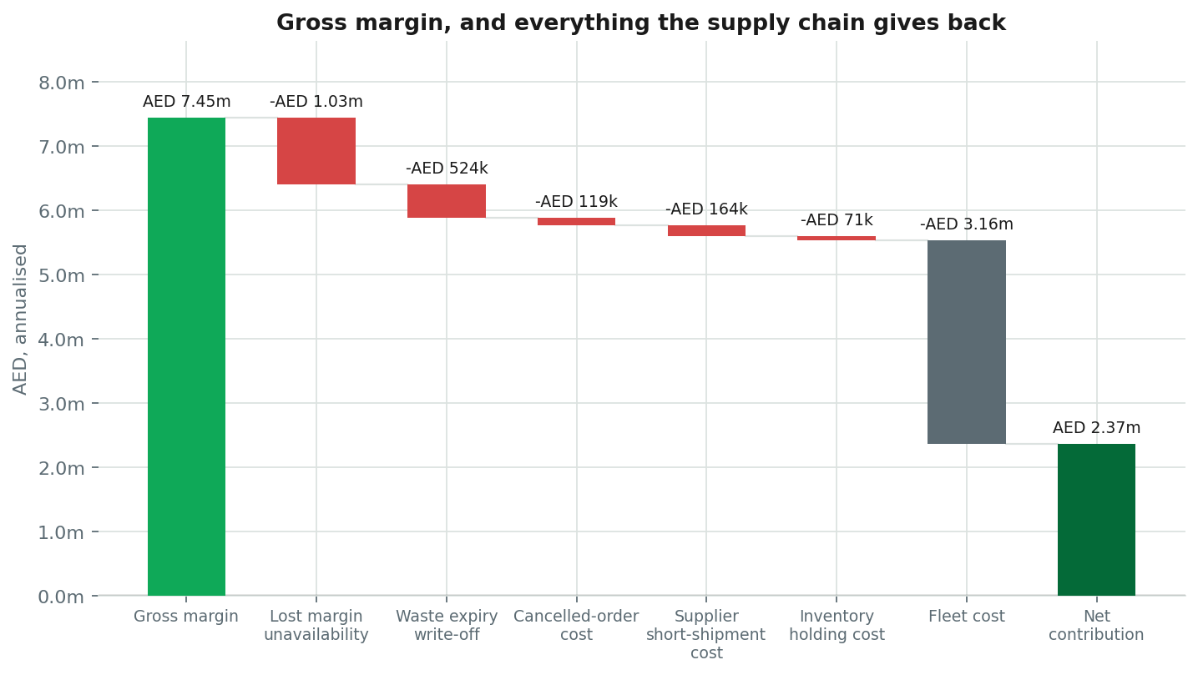
3
Where the margin goes
AED 7.45m of gross margin, and what the supply chain gives back
Illustrative — synthetic data

Slide 5
4
What is going wrong
Ranked by materiality weighted by confidence. Root causes, not symptoms
1
Availability swings 16pp across the week — Thursday 96.4% down to Monday 80.2% — because orders are reviewed Monday and Wednesday but demand peaks Friday and Saturday
AED 478k/yr
97% conf.
2
266 store-SKU lines have a case pack holding more days of stock than the product's own shelf life — 65% of network write-off, AED 204k a year that no store can prevent by ordering better
AED 204k/yr
87% conf.
3
Network fill rate is 90.5% against a 97% target — closing the gap is worth AED 0.71m a year
AED 708k/yr
97% conf.
4
Gulf Fresh Produce is the network's least reliable supplier — OTIF 76% against a 95% target, costing about AED 191k a year
AED 191k/yr
98% conf.
5
The slowest 82 of 215 SKUs earn 5.0% of revenue but occupy 26% of shelf slots and account for 35% of write-off
AED 154k/yr
93% conf.
Illustrative — synthetic data

Slide 6
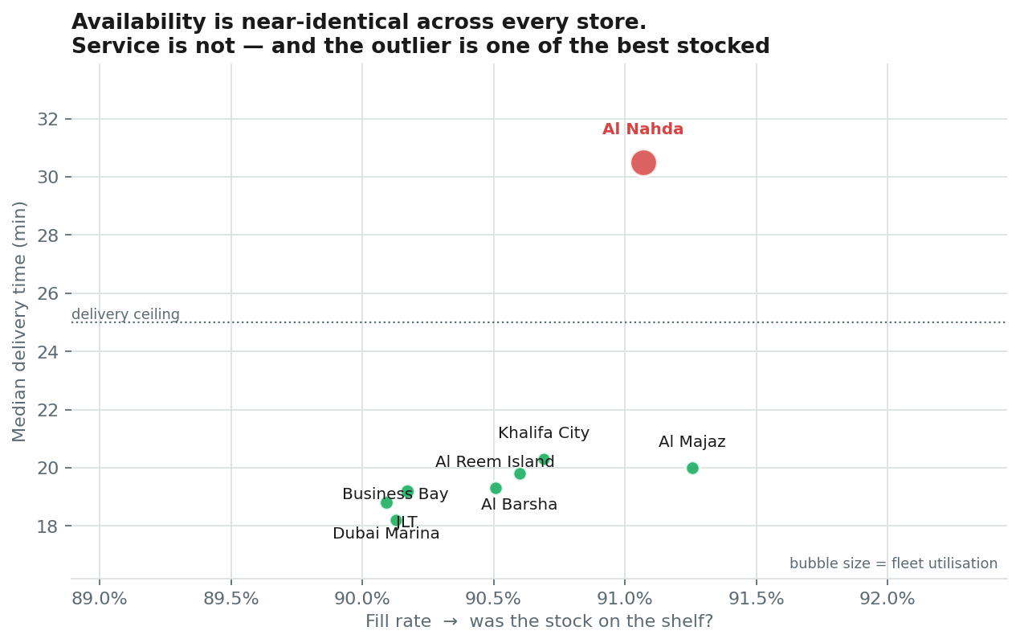
5
One store looks like an inventory problem
It is not. This is the distinction the analysis exists to make
The symptom
Delivery p50: 30.50 min
Delivery p90: 46.40 min
Cancellation rate: 8.5%
What rules inventory out
Fill rate: 91.1% — network median 90.6% — the stock was on the shelf, so this is not a stock problem
Waste rate: 2.6% — network median 3.1% — inventory is not being mismanaged here either
The cause
Al Nahda delivers in 30 min against a network median of 20 and cancels 8.5% of orders — the constraint is fleet capacity, not stock
Illustrative — synthetic data
Notes:
A tool reasoning from symptoms to inventory would get this wrong and spend a quarter fixing something that was never broken.

Slide 7
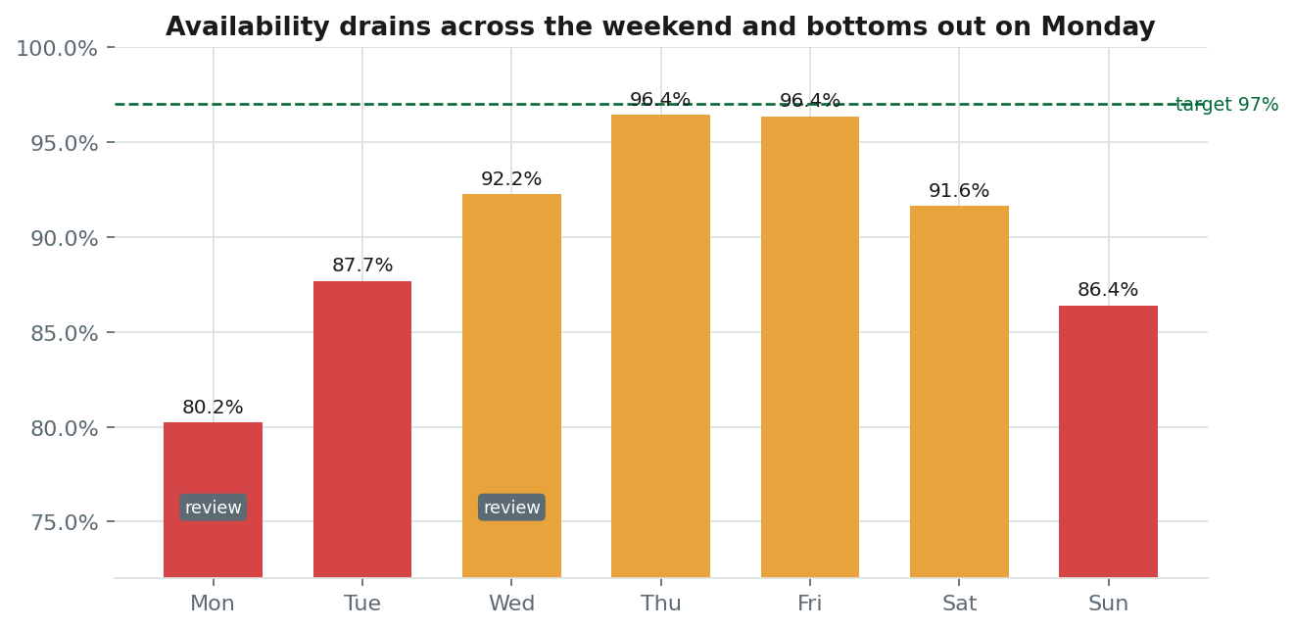
6
The largest single leak is a calendar
Orders are reviewed on the two quietest days of the week
Illustrative — synthetic data

Slide 8
7
What to do
6 actions, AED 727k a year net of the cost of acting
# | Action | Owner | When | Effort | Net/yr | Payback
R1 | Re-time replenishment review and forecast forward, not backward | Demand Planning Lead | immediate | medium | AED 311k | 1.0 mo
R2 | Re-specify case packs on short-shelf-life lines | Procurement Lead | near term | high | AED 111k | immediate
R4 | Rationalise the slow-moving tail and reallocate the slots | Category Manager | near term | medium | AED 107k | 2.5 mo
R3 | Put Gulf Fresh Produce on a formal performance plan and dual-source | Procurement Lead | near term | medium | AED 83k | immediate
R5a | Re-time captain shifts at Al Nahda to the demand peak | Fleet Operations Manager | immediate | low | AED 73k | 2.5 mo
R6 | Build a Ramadan operating playbook | Supply Chain Director | structural | medium | AED 42k | 11.5 mo
AED 761k
AED 34k
AED 103k
AED 727k
gross benefit
ongoing cost
one-off investment
net annual value
Illustrative — synthetic data

Slide 9
8
And one thing not to do
The obvious fix does not pay, and saying so is part of the job
Add 2.5 captain shifts/day at Al Nahda
Instead
Re-time captain shifts at Al Nahda to the demand peak
Benefit
AED 83k
Do this first because it is cheap and reversible, and because it tests whether the constraint is genuinely total capacity or merely its distribution across the day.
Cost
AED 111k
Net
-AED 28k
AED 73k a year, at low effort
Illustrative — synthetic data
Notes:
Knowing that the obvious fix does not work is worth as much as knowing which one does.

Slide 10
What we would measure
Each action has a leading indicator that moves before the money does. If it has not moved by the review point, stop the action rather than extend it.
R1
Weekly fill-rate spread (best day minus worst day) below 5pp within two months; Monday fill rate above 92%
weekly
R2
Waste rate on affected lines below 4% within one quarter; no fill-rate deterioration on the same lines
monthly
R4
Slot productivity (revenue per slot) up 10% within two quarters with no fall in basket size or order frequency
monthly
R3
OTIF above 90% within one quarter; lead-time CV below 0.35
weekly
R5a
Delivery p50 at Al Nahda below 25 min and cancellation rate below 4.0% within six weeks
weekly
R6
Fill rate inside the peak window within 2pp of the annual average, versus the current shortfall
annual, with a post-event review
Illustrative — synthetic data. No Careem data was used.

