Slide 1
Supply Chain
Decision Brief
Careem Rides — UAE marketplace
2025-07-01 to 2026-06-30 · 365 days · AED
Prepared for the City Operations Director
ILLUSTRATIVE — SYNTHETIC DATA
Notes:
Synthetic data throughout. The purpose is to demonstrate the analytical method, not to report on a real business.

Slide 2
1
The decision
What is being asked, before any of the analysis
2
AED 49k
AED 30k
AED 214k
actions recommended
net annual value
one-off investment
identified leakage
Approve now
R1 and R5a. Both are scheduling changes — no headcount, no capital.
Mandate to negotiate
R2 and R3. Both need supplier agreement before they can move.
Note
One recommendation is analysed and rejected. The obvious fix for the worst-performing store costs more than it saves.
Illustrative — synthetic data
Notes:
Lead with the ask. The rest of the deck justifies it.

Slide 3
2
Where the network stands
Every headline metric against its declared target
Fulfilment rate
Rider cancel rate
ETA p50 (min)
ETA promise gap (min)
89.3%
4.5%
7.6
0.9
target 95.0%
target 3.0%
target 7.0
target 1.0
Captain 30-day churn
Captain activation
Average surge
18.0%
45.0%
1.1
target 10.0%
target 55.0%
target 1.1
Illustrative — synthetic data

Slide 4
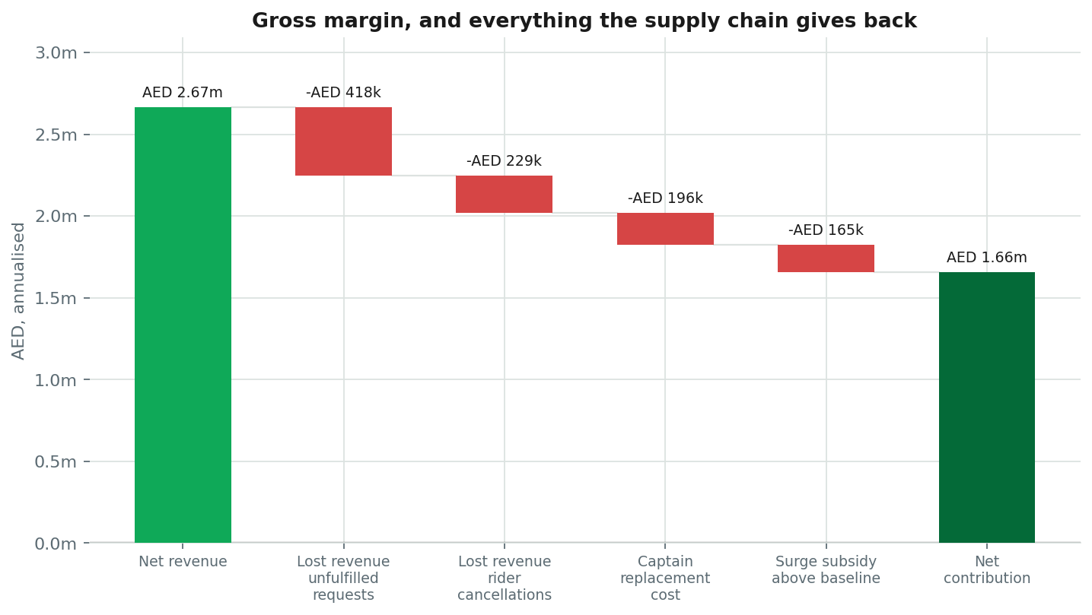
3
Where the margin goes
AED 2.67m of gross margin, and what the supply chain gives back
Illustrative — synthetic data

Slide 5
4
What is going wrong
Ranked by materiality weighted by confidence. Root causes, not symptoms
1
The network fulfils 89.3% of requests against a 95% target — the shortfall is worth AED 0.22m a year
AED 223k/yr
98% conf.
2
Captains who do not clear 20 trips in their first week churn at 26% against 8% for those who do — 3.3× the rate, and 55% of joiners fall in that group
AED 110k/yr
98% conf.
3
Dubai Airport loses 50% of demand between 06:00–09:00 while surge sits at 1.76× — supply is not responding to price
AED 59k/yr
94% conf.
4
Business Bay, Yas Island promise arrival 4.3 min sooner than they deliver, and cancel 11% of trips against 4% elsewhere — the estimate causes the cancellation, not the wait
AED 45k/yr
95% conf.
Illustrative — synthetic data

Slide 6
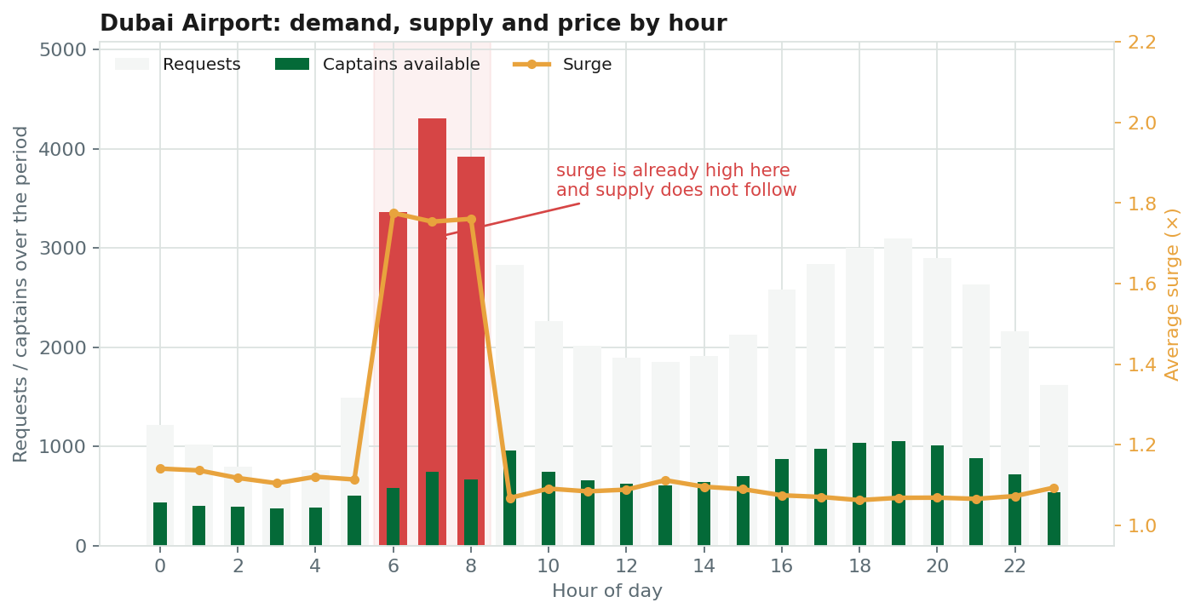
5
One zone looks like a pricing problem
It is not. Surge is already high and supply is not responding
The symptom
Unfulfilled rate in window: 49.8%
Surge in window: 1.76 ×
Captains per request: 17.2%
What rules pricing out
Correlation of captain supply with surge: -0.45 — negative — supply falls as surge rises here, so raising it further is counterproductive
The cause
Dubai Airport loses 50% of demand between 06:00–09:00 while surge sits at 1.76× — supply is not responding to price
Illustrative — synthetic data
Notes:
A tool reasoning from symptoms to pricing would get this wrong and spend a quarter fixing something that was never broken.

Slide 7
6
The largest single leak is a calendar
Orders are reviewed on the two quietest days of the week
Illustrative — synthetic data

Slide 8
7
What to do
2 actions, AED 49k a year net of the cost of acting
# | Action | Owner | When | Effort | Net/yr | Payback
R3 | Recalibrate the ETA model in the zones that over-promise | Rider Experience Lead | near term | low | AED 36k | 9.9 mo
R1 | Guarantee captain supply into Dubai Airport during 06:00–09:00 | Supply Growth Lead | immediate | medium | AED 13k | immediate
AED 68k
AED 19k
AED 30k
AED 49k
gross benefit
ongoing cost
one-off investment
net annual value
Illustrative — synthetic data

Slide 9
What we would measure
Each action has a leading indicator that moves before the money does. If it has not moved by the review point, stop the action rather than extend it.
R3
Cancellation rate in the affected zones within 1pp of the network baseline, with request volume unchanged
weekly
R1
Unfulfilled rate in Dubai Airport during 06:00–09:00 below 10% within six weeks, with no fulfilment deterioration in adjacent zones
weekly
Illustrative — synthetic data. No Careem data was used.

