Slide 1
CSE 220 · Signals and Linear Systems Sessional
FourierLab
Audio Lab
STFT · Time-Frequency
Exploring Signals in the Frequency Domain
Image Lab
2D DFT · k-Space MRI
Maskat Rahman 2305066
Md. Misbah Uddin Rafi 2305069
Supervisor: Md. Ashrafur Rahman Khan · Lecturer, CSE, BUET
Music Lab
Source Sep. · DSP Mixing
BUET · Department of CSE
1 / 6

Slide 2
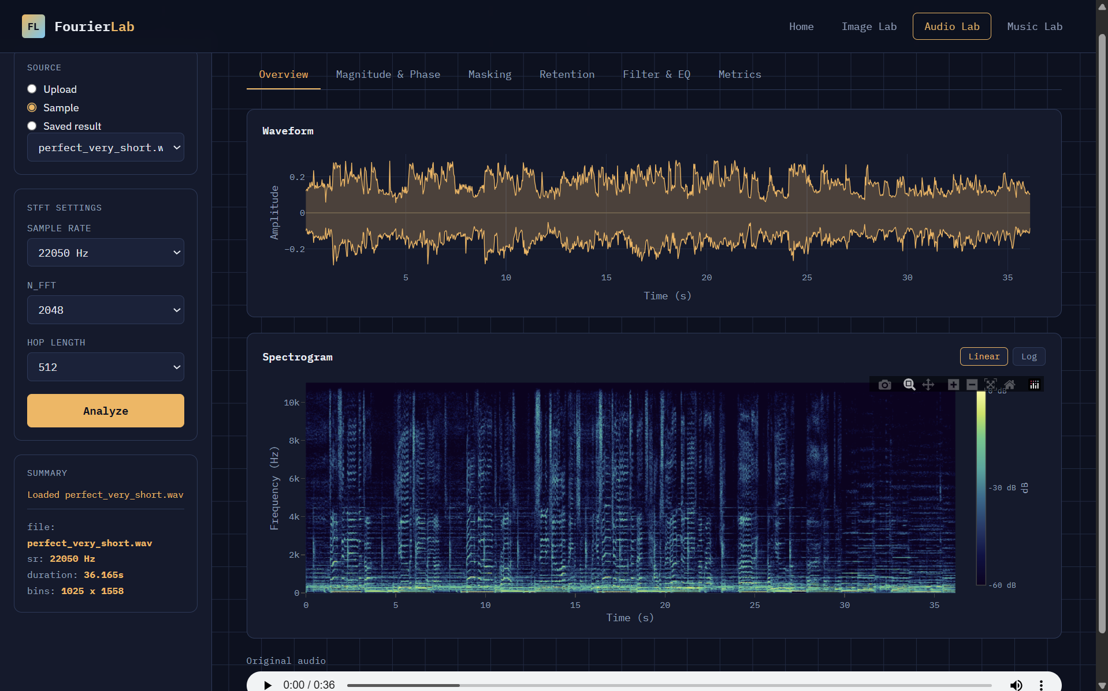
AUDIO LAB
Waveform & Spectral Analysis
Core Transform
The Short-Time Fourier Transform slides a window w(n) over the signal, computing a DFT per frame — yielding magnitude and phase at every (time, frequency) bin.
X(m,k) = Σ x(n+mH)·w(n)·e(-j2πkn/N)
m = frame · H = hop length · N = FFT size
Magnitude vs. Phase
Reconstruct using magnitude-only (zero phase) and phase-only (unit magnitude). Magnitude carries the perceptual content — phase alone sounds like noise.
[ Screenshot: Waveform + Spectrogram / Mag-Phase Tab ]
X(m,k) = |X(m,k)| · e^(j·∠X(m,k))
STFT
Windowing
ISTFT
Spectrogram
2 / 6

Slide 3
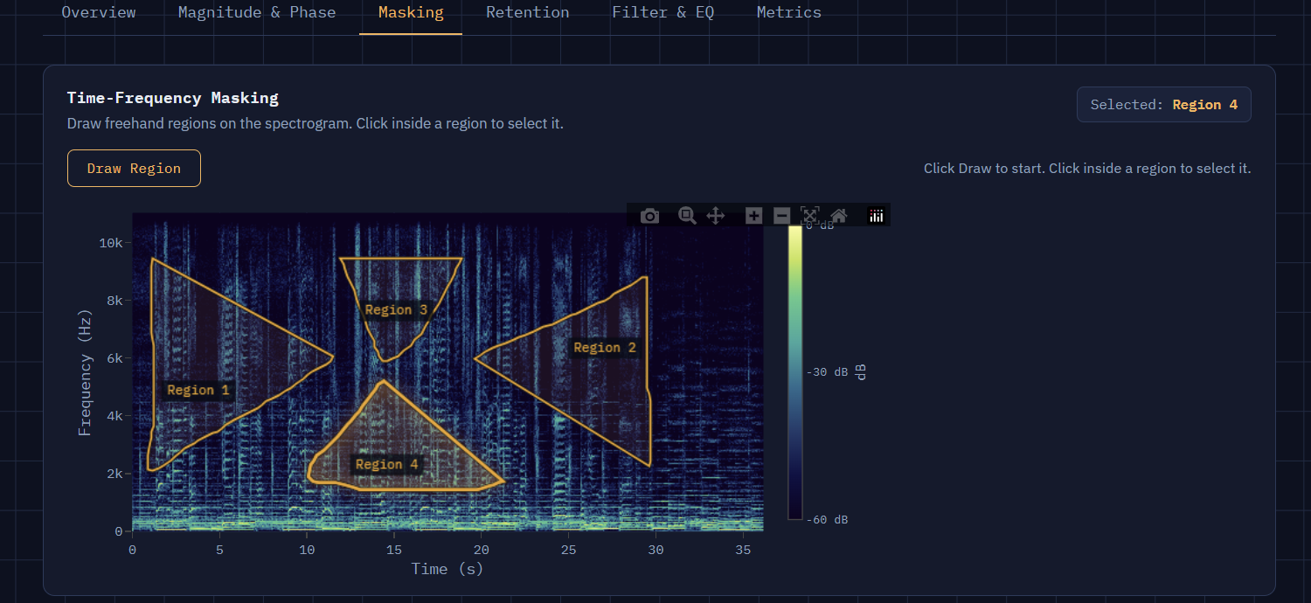
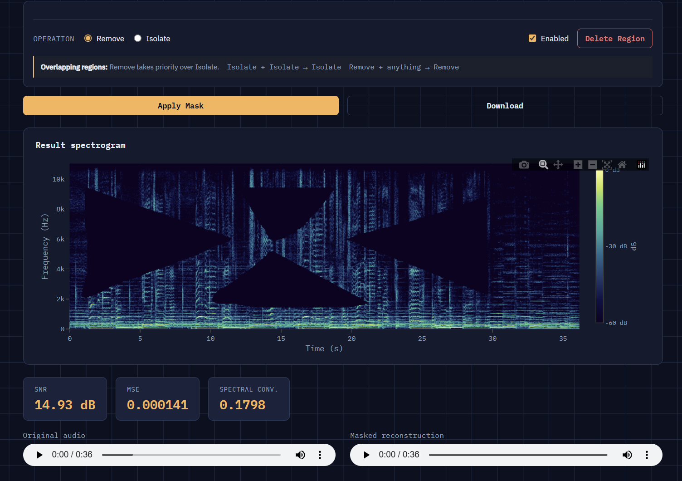
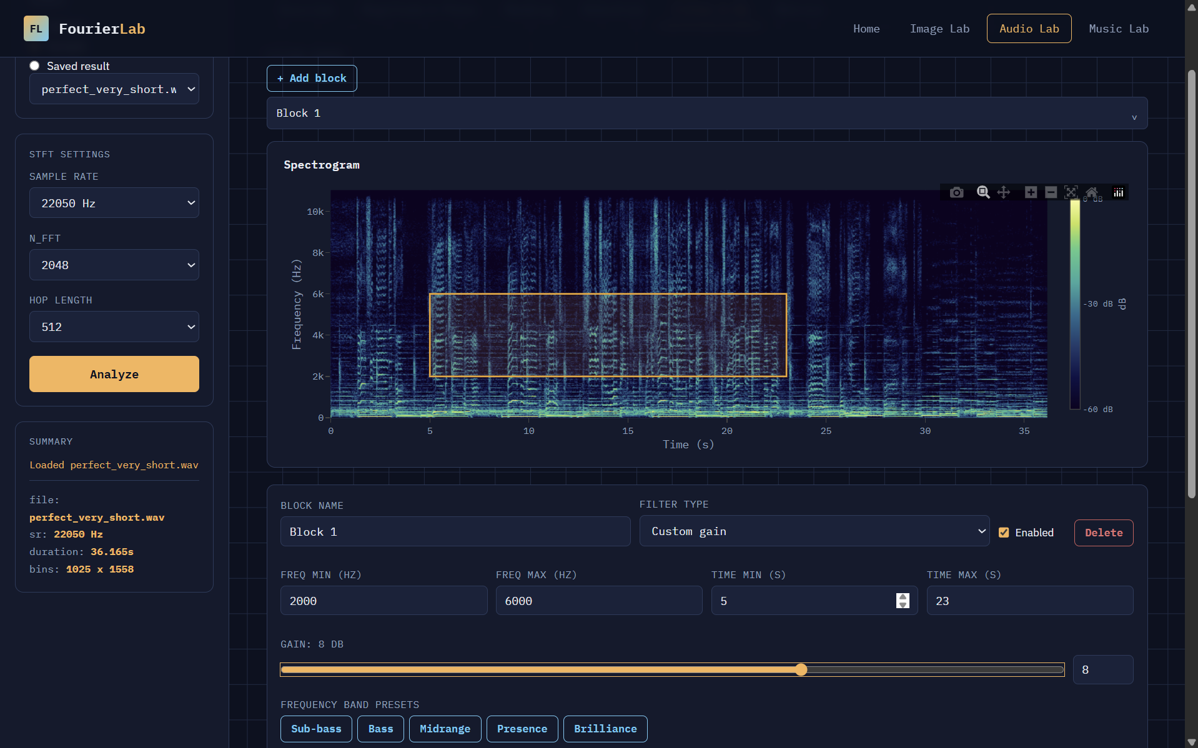
AUDIO LAB
Masking · Retention · Filter & EQ
Lasso Masking
Progressive Retention
Filter & EQ Chain
Draw freeform polygons directly on the spectrogram to Remove or Isolate time-frequency regions.
Keep only the top-N magnitude bins or lowest frequencies. Sweep retention fraction 2–100% and plot SNR vs. fraction retained.
Stack Lowpass · Highpass · Bandpass · Notch · Custom Gain blocks, each with a freq range and optional time range.
mask(m,k) = 0 if (t,f) ∈ region
D_ret = top-k(|X|) or low-freq(X)
Y(m,k) = X(m,k) · G(k) · 1[t ∈ range]
SNR · MSE · Spectral Convergence
Strategies: Low Frequency · Top Magnitude
Cosine-tapered edges to prevent Gibbs ringing
Point-in-polygon ray-casting per (time, freq) bin
Concept: energy compaction — most signal energy lives in a small subset of coefficients
Real-time EQ curve preview (gain dB vs frequency)
3 / 6

Slide 4
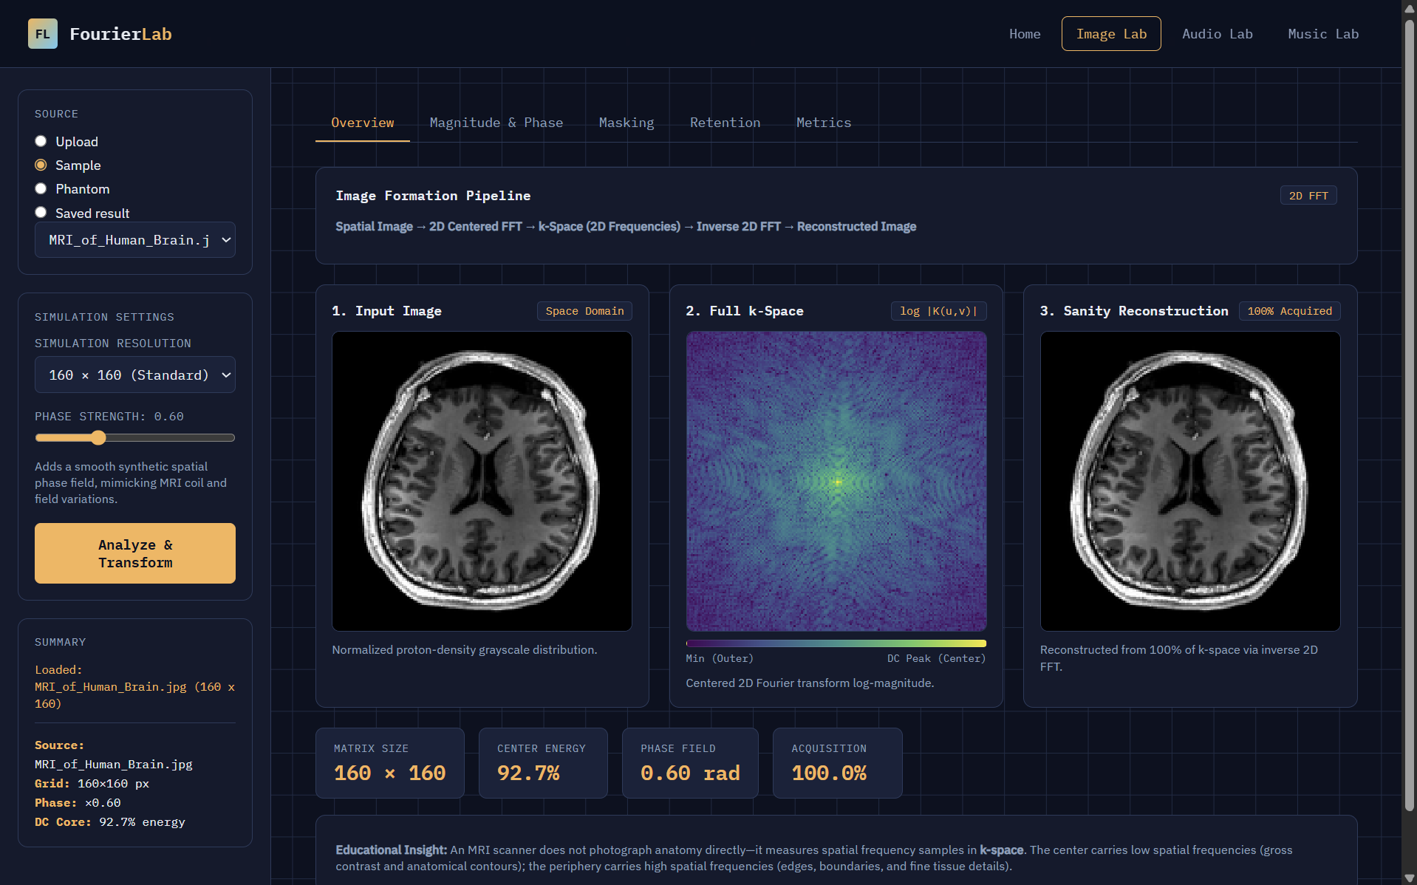
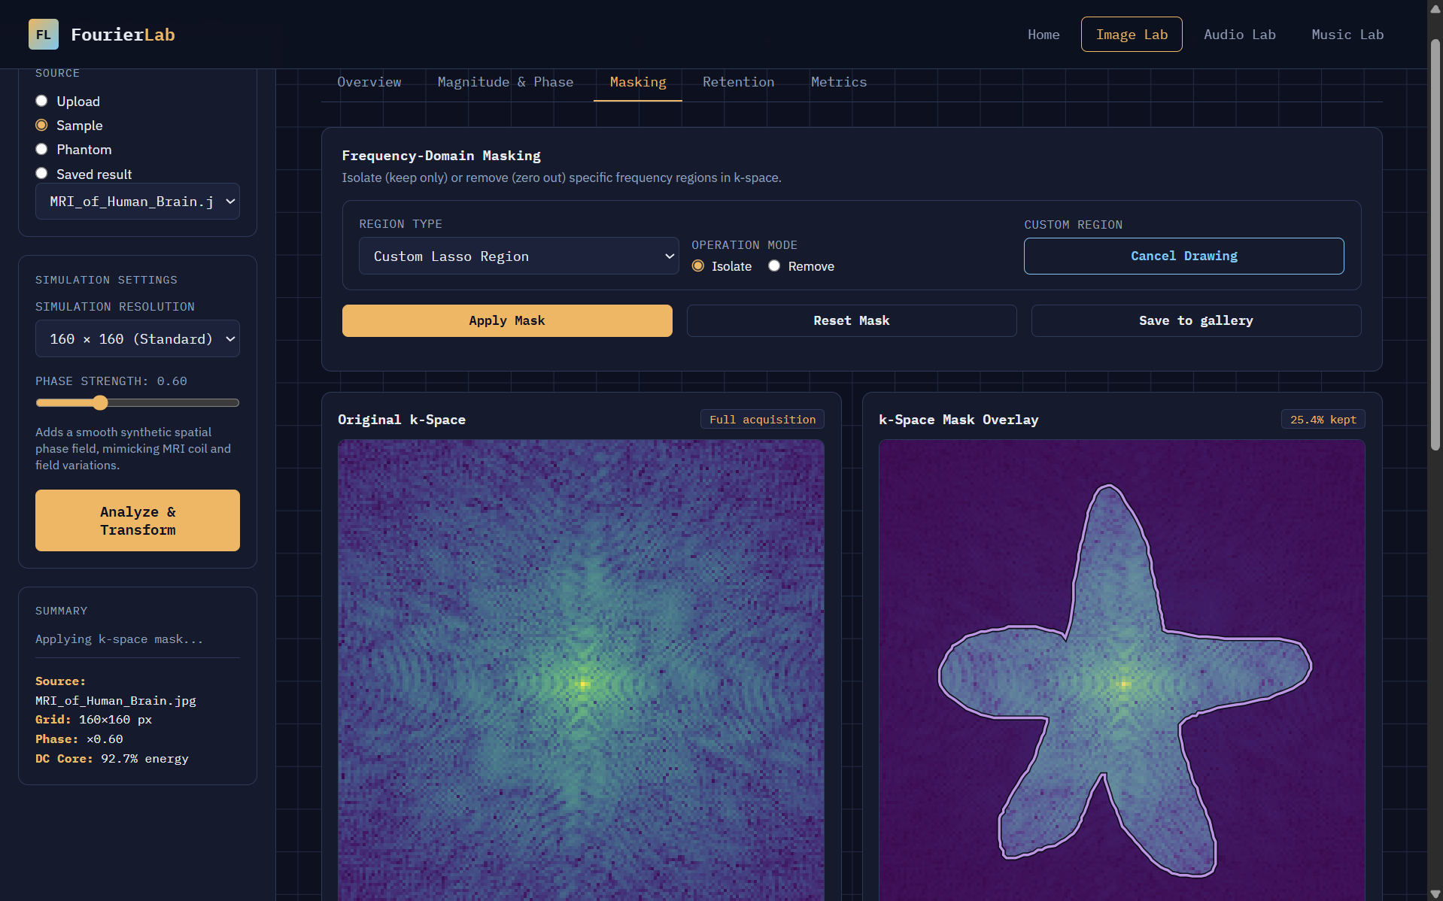
IMAGE LAB
MRI k-Space Reconstruction
2D DFT → k-Space
MRI acquires raw data in the frequency domain (k-space). Low spatial frequencies near center encode contrast; high frequencies at periphery encode edges.
K(u,v) = ΣΣ f(x,y)·e^(-j2π(ux/M + vy/N))
Hero Feature — Lasso Masking on k-Space
Draw a freeform polygon directly on the k-space image. Ray-casting in normalized coordinates (kx, ky) ∈ [−0.5, 0.5]². Isolate or remove the region, then reconstruct via IFFT2.
Progressive Retention
Retain center-radius fraction or top-magnitude k-space bins. Sweep → PSNR & SSIM vs. retention %.
MSE
PSNR
SSIM
Error Heatmap
4 / 6

Slide 5
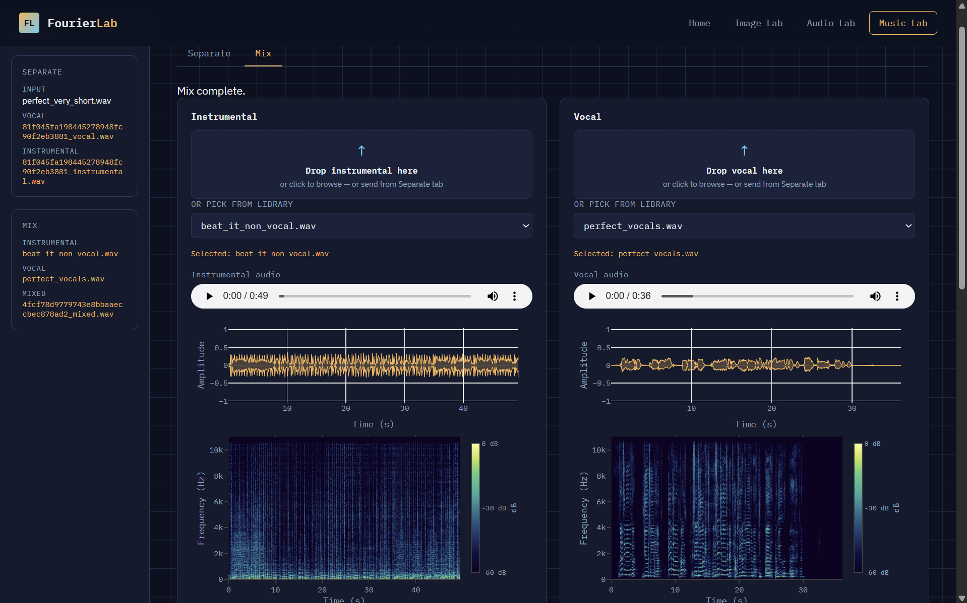
MUSIC LAB
Source Separation & Audio Mixing
Vocal / Instrumental Separation
DSP Mixing
Uses Demucs — Meta's hybrid transformer model (waveform + spectrogram domain). Separates audio into vocal and instrumental stems in two-stem mode.
Neural network trained on paired data — goal matches freq-domain masking, but learned rather than hand-crafted.
Auto-align tracks via cross-correlation, apply independent gain per stem, then mix by superposition:
y(t) = g_inst·x_inst(t) + g_voc·x_voc(t−τ)
τ = argmax( x_inst ⋆ x_voc ) · g = 10^(GdB/20)
ML Model
[ Screenshot: Music Lab — Separate Tab (original + vocal + instrumental) / Mix Tab ]
5 / 6

Slide 6
Signals & Linear Systems Concepts Applied
FEATURE
MODULE
CONCEPT
Waveform & STFT Spectrogram
Audio Lab
Short-Time Fourier Transform, Windowing
Magnitude vs. Phase
Audio Lab
Polar form of complex spectrum
Lasso Masking
Audio Lab
Time-frequency masking, ISTFT reconstruction
Progressive Retention
Audio Lab
Energy compaction, signal approximation
Filter & EQ Chain
Audio Lab
Freq-selective filtering, Convolution theorem
2D DFT & k-Space Analysis
Image Lab
2D Discrete Fourier Transform, spatial frequency
Lasso Masking on k-Space
Image Lab
2D freq masking, Inverse 2D DFT
MRI Retention Sweep
Image Lab
Circular low-pass filtering in k-space
Demucs Separation
Music Lab
ML-based source separation (beyond DSP)
Audio Mixing
Music Lab
Superposition, cross-correlation, gain
"Transform · Mask · Reconstruct · Measure — one framework, every domain."
6 / 6

