Slide 1

Information Security
Intro and working
Misbah Kiran
BITF24M042

Slide 2
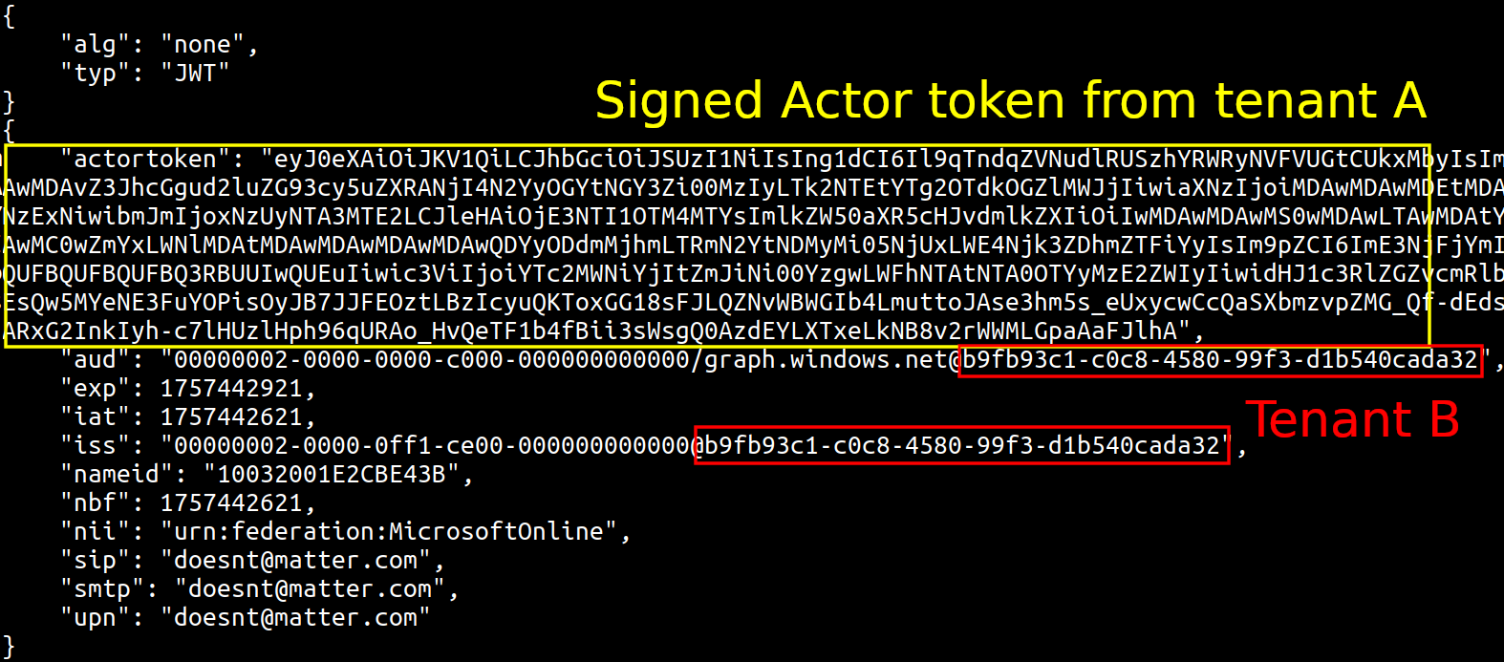
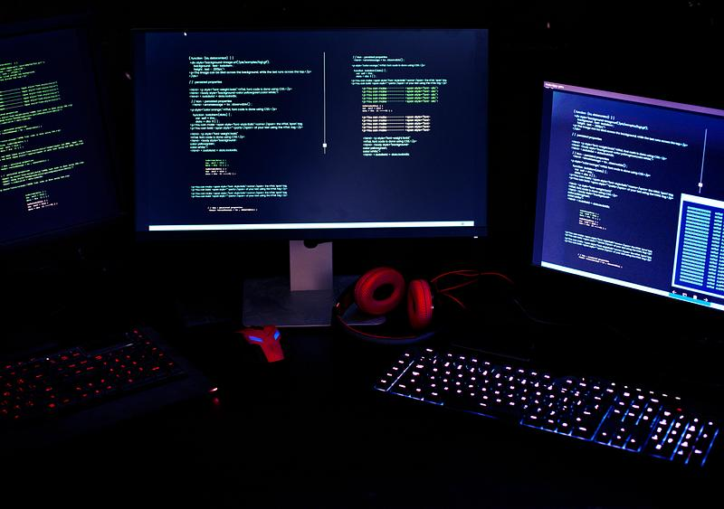
Multi-Layer Canary Token Based Intrusion Detection System:_________

Slide 3
Introduction
Rapid increase in cyber threats makes information security essential
Traditional systems focus on external attacks, ignore internal misuse
Sensitive files can be accessed without detection ⚠️
This project uses canary tokens (decoy files) as traps
Any access, modification, or deletion triggers an instant alert 🚨
System also records activity with timestamp logging
Demonstrates a simple deception-based intrusion detection system

Slide 4

:
Working of the System
System starts by creating canary (decoy) files such as passwords and config files
User is given options to access, modify, or delete files
When a canary file is used, it is treated as suspicious activity ⚠️
System immediately shows a security alert on screen 🚨
A sound notification is triggered to grab attention
The event is recorded in a log file with file name, action, and timestamp
Admin can securely view logs using a password
This helps in identifying unauthorized or malicious behavior

Slide 5

Flowchart: Working of System
Start
↓
Create Canary Files (Decoy Files)
↓
Display Menu to User
↓
User Selects Action
(Access / Modify / Delete)
↓
Check File Name
↓
Is it a Canary File?
↓ ↓
YES NO
↓ ↓
Generate Alert Normal Action
(Sound + Screen) ↓
↓ No Alert
Save Log (Time, Action, File)
↓
Admin Can View Logs
↓
End / Repeat
Low | Experts employed by companies to test and improve their cybersecurity.
Low
Low
Medium
Medium
Medium | Novices who use pre-created scripts and programs for hacking.

Slide 6
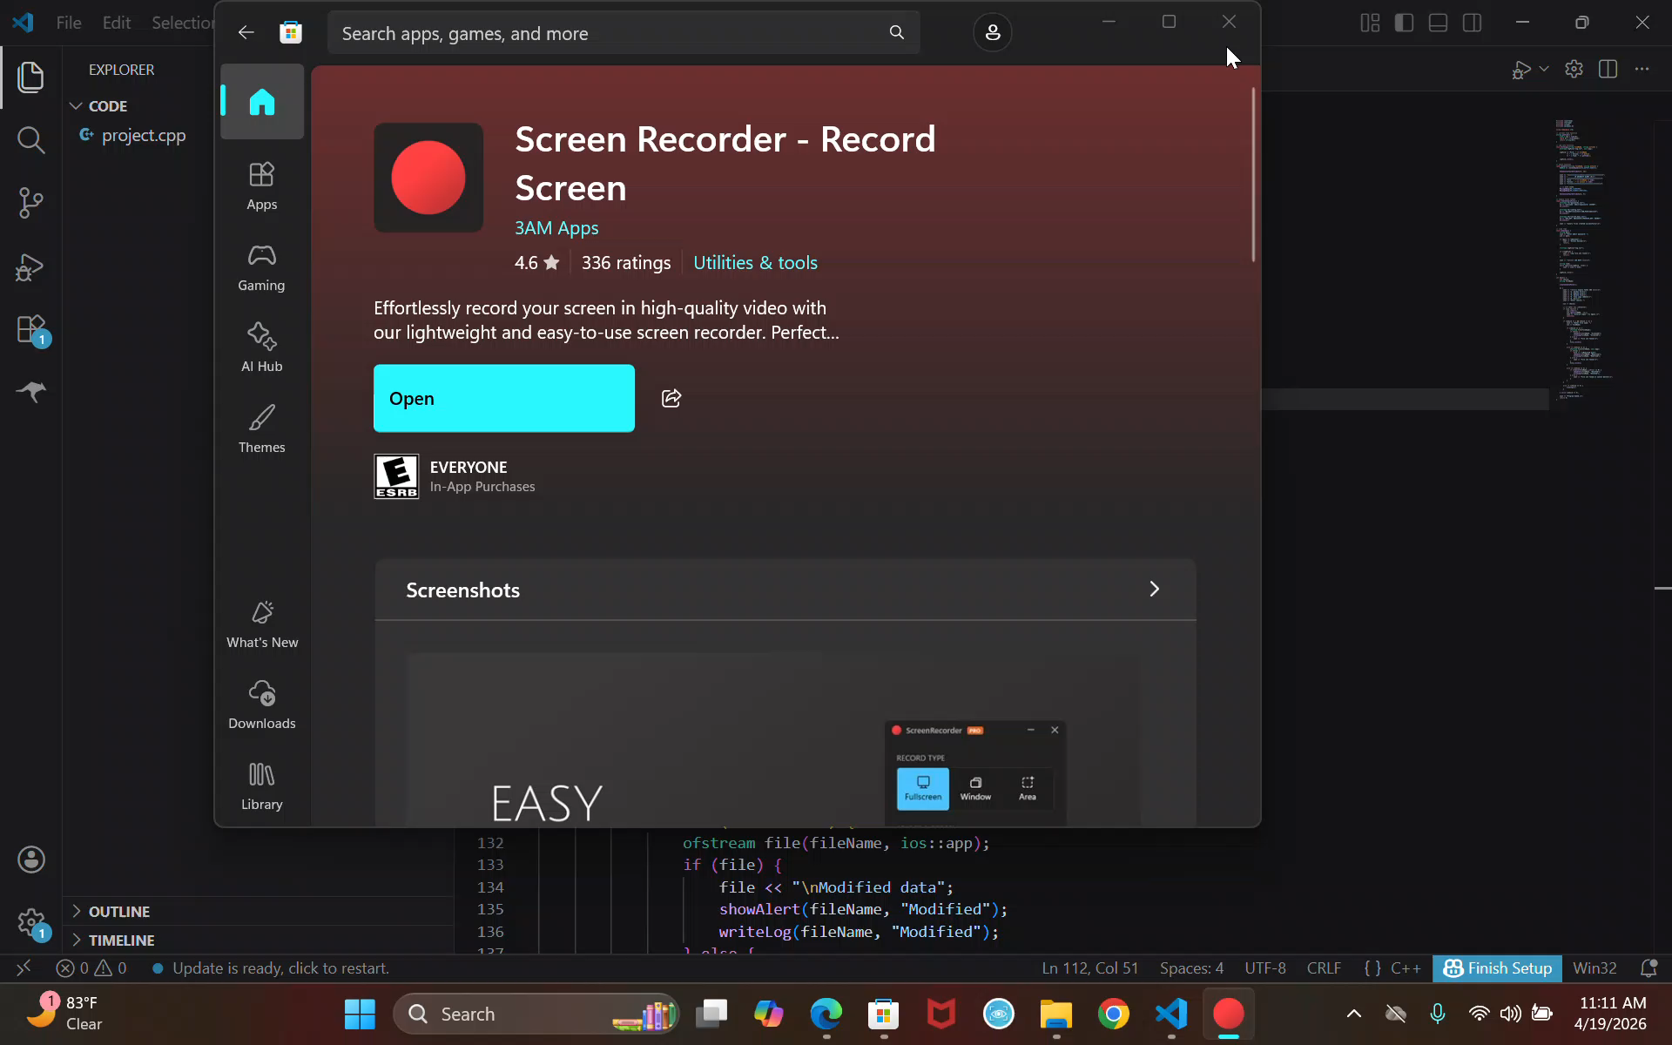
RUNNING DEMO OF PROJECT

Slide 7
THANK YOU FOR YOUR ATTENTION

