Slide 1
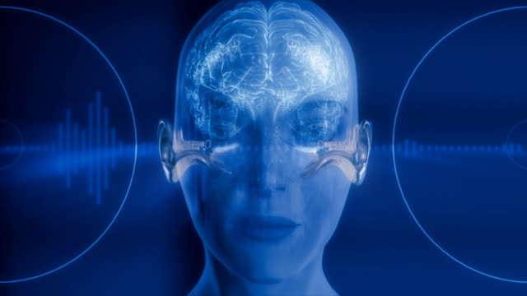
Audio classification of Urbansound8k dataset using machine learning and deep learning
Presented by MSCS21 Misbah Aziz and Bilal Ahmed

Slide 2
Introduction: I. Background and Motivation: In each part of human existence, sound assumes a significant part. From individual security to basic observation, sound is a vital component to foster the mechanized frameworks for these fields, Sound recognizable proof is considered as serious deal in sound analysis and sound classification field[1]. Grouping audio or sound has been a significant field of examination for a long time now and there have been many attempted and tried techniques with various models and features which have demonstrated to be helpful and exact. Classification of audio can go from fields like media, bioacoustics checking, and gatecrasher identification in untamed life regions to audio observation, and ecological sounds [2]. In the utilization of Artiﬁcial insight and progressed sound advancements in creature sound classiﬁcation , certain difficulties are as yet confronted, for example, the disturbances of foundation commotion [3].

Slide 3
II. Audio classification using urbansound8k dataset We have taken urbansound8k dataset which contains 8732 named passages which contains 10 unique labelled classes the voice of siren, children playing, street music, dog bark, car horn, air conditioner, drilling, jackhammer, gunshot and engine idling. In this project we have utilized machine learning models and deep learning algorithms. or example, DNN for the ID of various sounds from various voices datasets with the assistance of Different classifier to which class it has a place as indicated by classes.

Slide 4
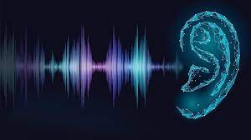
Problem statement: Sounds contain rich information and assist with peopling sense the environments around them. Individuals can recognize complex sounds and ﬁlter out the meaningful information. Along these lines, noise is dropped and the useful information is refined. Today, sensors can undoubtedly gather tons of useful audio data; in any case, processing them to get meaningful information remains burdensome. Many analysts desire to design a human-like machine to reduce this kind of issues

Slide 5
Aims and objectives: The fundamental objective of our project is to: 1. Extracting audio features from urbansound8k dataset. 2. Classifying the category of sound based on class with numeric identifier.

Slide 6
Methodology: dataset:Urbansound8k dataset available on following link: https://urbansounddataset.weebly.com/download-urbansound8k.html. Software: We have used python 3 with Jupiter notebook to implement the audio classification code. Features : We have used Librosa library to extract the MFCC features which used two types of signals one is mono and other one is stereo.

Slide 7
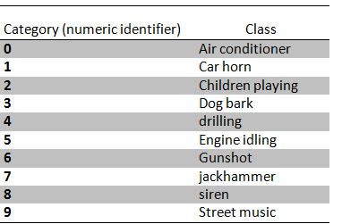
Pre-processing: Given is the overview of classes with specified numeric identifier:

Slide 8
RESULTS: Model training and accuracy: Given is the Accuracy table of models we have used in our project:
Model | Testing Accuracy
ANN | 75.8%
Decision Tree | 70.2%
Random Forest | 64.68%
SVM | 61%

Slide 9
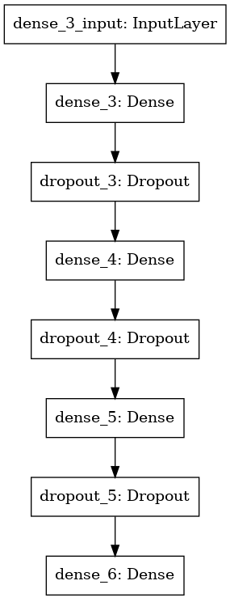
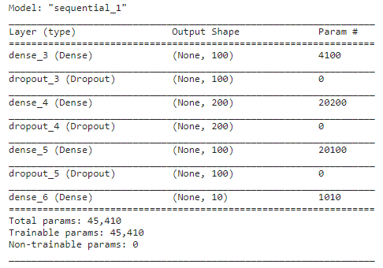
ANN Model:
ANN model diagram
ANN model summary

Slide 10
Classes and its samples distribution Dog bark 1000 Children playing 1000 Air conditioner 1000 Street music 1000 Engine idling 1000 Jackhammer 1000 Drilling 1000 Siren 929 Car horn 429 Gunshot 374

Slide 11
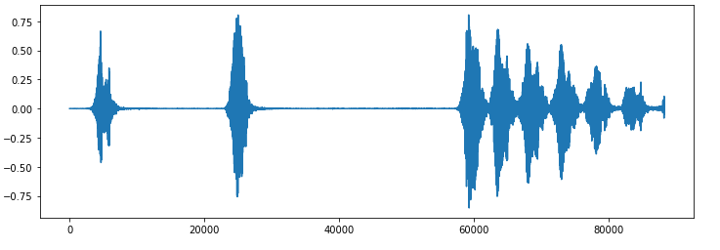
Sample of audio signal generated using Librosa:

Slide 12
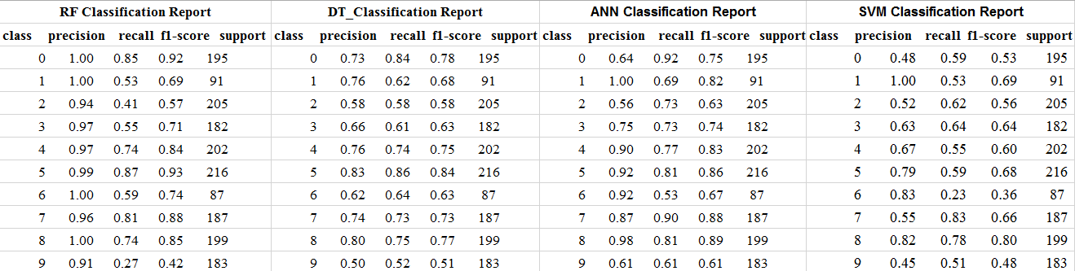
Classification Reports of implemented models.

Slide 13
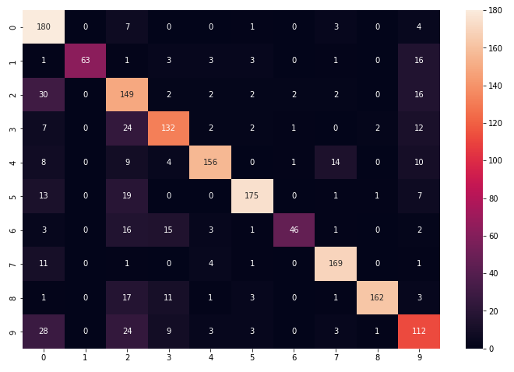
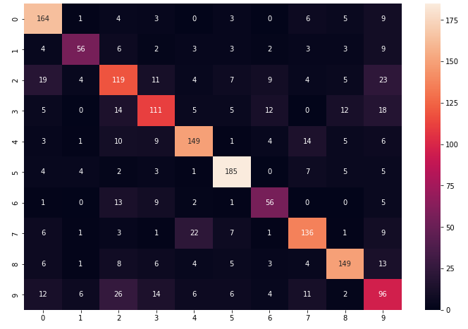
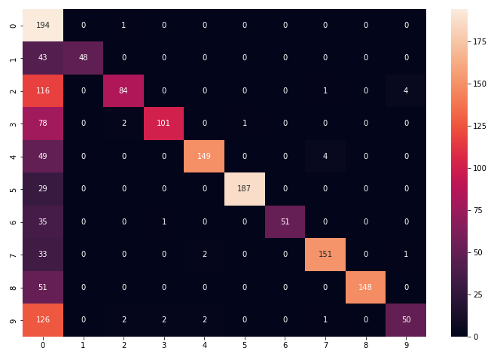
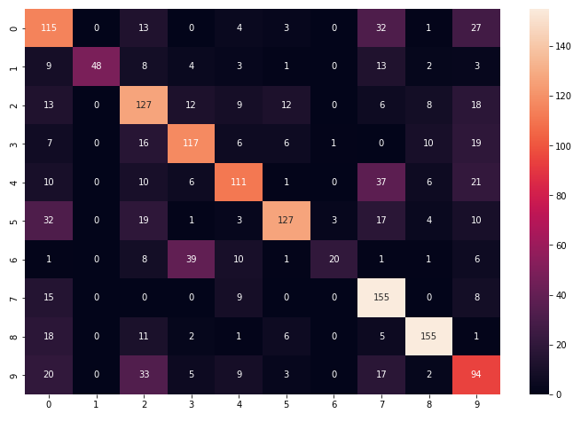
Confusion Matrices of implemented models
Figure 1: ANN confusion Matrix
Figure 2: Decision Tree confusion Matrix
Figure 3: RF confusion Matrix
Figure 4: SVM confusion Matrix

Slide 14
Summary and conclusion: We have introduced a way to deal with sound grouping, which comprises of various highlights We have utilized four different ML models which are ANN, DT, RF and SVM. ANN outperformed all the other machine learning models and decision tree outperformed other models in particularly ML models. Every one of the models have been prepared and tried with unique UrbanSound8K and its increased dataset voice signs of 10 distinct classes were perused by utilizing the python library called Librosa which utilizes two sorts of signs one is mono and other is sound system. Moreover, we might want to continue with this in our future work where we have intended to utilize novel solo learning procedures that can be embraced to prepare, test the models, and really look at their exactness.

Slide 15
References: 1.Li J, Wang Y, Zhu H, Zhang Y. What’s That Sounds? Machine Learning for Urban Sound Classification. 2. Das JK, Ghosh A, Pal AK, Dutta S, Chakrabarty A. Urban sound classification using convolutional neural network and long short term memory based on multiple features. In2020 Fourth International Conference On Intelligent Computing in Data Sciences (ICDS) 2020 Oct 21 (pp. 1-9). IEEE. 3. Jung DH, Kim NY, Moon SH, Jhin C, Kim HJ, Yang JS, Kim HS, Lee TS, Lee JY, Park SH. Deep learning-based cattle vocal classification model and real-time livestock monitoring system with noise filtering. Animals. 2021 Feb;11(2):357. 4. Ruff ZJ, Lesmeister DB, Appel CL, Sullivan CM. Workflow and convolutional neural network for automated identification of animal sounds. Ecological Indicators. 2021 May 1;124:107419.

Slide 16
5.Nanni L, Costa YM, Aguiar RL, Mangolin RB, Brahnam S, Silla CN. Ensemble of convolutional neural networks to improve animal audio classification. EURASIP Journal on Audio, Speech, and Music Processing. 2020 Dec;2020(1):1-4. 6. Khamparia A, Gupta D, Nguyen NG, Khanna A, Pandey B, Tiwari P. Sound classification using convolutional neural network and tensor deep stacking network. IEEE Access. 2019 Jan 8;7:7717-27. 7. A Deep Neural Network for Audio Classification with a Classifier Attention Mechanism.

Slide 17


