Slide 1
Advance Design And Theory of Algorithm
Lecture 6
Dr Aqib Perwaiz

Slide 2


P,
NP
&
NP
Complete
&
Problems
Vertex
Cover
Problem
1

Slide 3
P,
NP
&
NPC
Problems
►Natural to think that ,can all problems be
solved in some specified time, or ever..???
►Algorithmic and computational problems
can
be
categorized
into three categories.
►Polynomial Time, P
►Non
Polynomial, NP
Polynomial Complete, NPC
►Non
2

Slide 4
P
Problems
►All problems are in
size N are solvable some constant k.
►The worst case for
class P, that, on input of
in the time O(N^{k}) ,for
such problems
is O(N^{k})
►
Many
Problems like
►Binary
Search
►Sorting
►MST
Algorithms
are
solvable in polynomial
time.
3

Slide 5
NP
Problems
► NP problems are called “hard problems”.
►Such problems can not be
solved ,
regardless of, how much time they are
provided, until they are given a certificate
that they
are verifiable.
►Certificate is issued while limiting the
domain
of that problem and proving that,
this
instance is solvable in Polynomial Time.
4

Slide 6
NP
Problems
► Verification algorithms for each specific
algorithms exist.
domain of
► One simple example
 Find sum of all even
of NP problem is
numbers.
computer is used, and how
►
Regardless
of which
much
But if
time
is provided, the sum can not be
found.
one time,
►
we
limit ,that provide the sum of first
trillion
even numbers, it is solvable in some
may
be in polynomial.
5

Slide 7
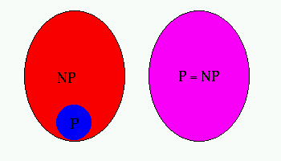
One
Million
$
Question
► Is P=NP, i.e, can all NP problems be solved
polynomial time?
in
► If you think it
is solvable, log on to :
www.claymath.org/prizeproblems/pvsnp.htm
6

Slide 8
NPC Problems
►All such problems that can’t be solved regardless of any computer and time are called NP-Complete problems.
► Example
1: Find the sum of all even
numbers without a verifiable certificate.
► Example
2: Find longest path from A to D
in
a graph, where each node can be visited
more
than once.
7

Slide 9
NPC
Problems
1
B
1
1
1
A
E
C
1
1
D
8

Slide 10
NPC Problems
►NPC problems are also called open
problems.
►This means that neither the researchers
have come to some conclusion, nor they
have given
up saying
“no solution exist for
this problem”
► So NPC
problems are
open research areas.
9

Slide 11
P,
NP
&
NPC Problems
► How to determine that a problem is in NPC

Determine if it is in P
►Solvable in some O(N^{k}) time
If not , see if it is in NP

►A
certificate can be issued, and that can be verified
for
some domain of the problem.

If
not so, the problem is an NP-Complete
problem.
10

Slide 12
NP-Completeness
G e ner a lly , w e th in k of pr ob le m s th at a r e s o lv ab le
by po ly nom ia l- tim e a lgo r ithm s ar e tr ac ta b le, an d
p r ob le m s th at r e q u ir e
in tr ac ta b le.
s u pe r p o ly n o m ia l tim e
a r e
Polynomial
Intractables
?
NP-Complete
Problem
11

Slide 13
Vertex
Cover
(VC)
Problem
A vertex cover of an undirected graph is a subset of its vertices such that for every edge (u, v) of the graph, either ‘u’ or ‘v’ is in vertex cover. Although the name is Vertex Cover, the set covers all edges of the given graph.
Given an undirected graph, the vertex cover problem is to find minimum size vertex cover.
12

Slide 14
Vertex
Cover
(VC)
Problem
► VCP is to find
the vertices in edges.
►The size of VC
a cover of minimum size for
a graph that cover all the
is determined by the number
covered by the algorithm.
of the
vertices
► The VC
but the
Problem was taken as hard problem,
researchers have shown an
algorithm
to find a vertex cover.
12

Slide 15
Vertex
Cover Problem
► The algorithm returns a vertex cover whose
size is guaranteed to be no more than
the size of an optimal vertex cover.
twice
►Size
of
the vertex cover is determined
by
the
number of vertices in it.
13

Slide 16
Vertex
Cover
Problem
Algorithm
14

Slide 17
Vertex
Cover
Problem
b
c
d
a
e
f
g
15

Slide 18
Vertex
Cover
Problem
► Execution
C
E’
ø
(a,b),(b,c),(c,e),(c,d),(e,f),(d,e),(d,g),(d,f)
(b,c)
(d,e),(e,f),(d,g),(d,f)
(e,f)
(d,g)
(d,g)
Ø
16

Slide 19

Vertex
Cover
Problem
b
c
d
a
e
f
g
17

Slide 20
Vertex
Cover
Problem
Edge
(b,c)
is
chosen
b
c
d
a
e
f
g
18

Slide 21
Vertex
Cover
Problem
Edge
(e,f)
is
chosen
b
c
d
a
e
f
g
19

Slide 22
Vertex
Cover
Problem
Edge
(d,g)
is
chosen
b
c
d
a
e
f
g
20

Slide 23
Vertex
Cover
Problem
Vertex cover by the algorithm {vertices : b, c, d, e, f, g } so VC=6
b c ^{d}
a e f
g
21

Slide 24
Vertex
Cover
Problem
Optimal vertex cover {vertices : b, d, e }
b c ^{d}
a e f
g
22

Slide 25
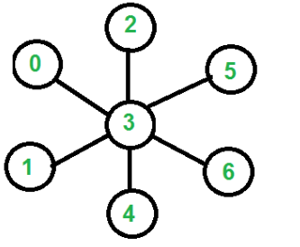
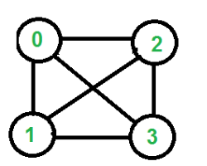
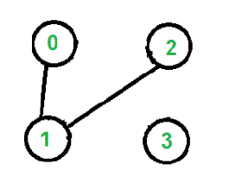
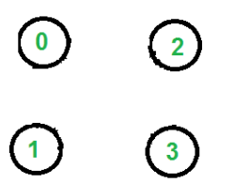
Vertex
Cover
Problem
?
22

Slide 26
Vertex
Cover
Problem
b
c
d
a
g
f
e
h
i
j
23

Slide 27
Vertex
Cover
Problem
► Execution of Algorithm
C
E’
ø
(a,b), (a,g),(a,h),(b,c),(b,g),(g,h), (g,i),(g,f), (c,d),(c,f), (d,e), (d,f),(f,i),(f,e),(f,j), (e,j), (c.g),(h,i),(i,j)
(e,f)
(a,b),(a,g),(a,h),(b,c),(b,g),(g,h),(g,i),(c,d), (c,g), (h,i),(i,j)
(a,g)
(b,c),(c,d),(h,i),(i,j)
(h,i)
(b,c),(c,d)
(b,c)
ø
24

Slide 28
Vertex
Cover
Problem
Step
1.
Selection
edge
(e,f)
b
c
d
a
g
f
e
h
i
j
25

Slide 29
Vertex
Cover
Problem
Step
2.
Selection
edge
(a,g)
b
c
d
a
g
f
e
h
i
j
26

Slide 30
Vertex
Cover
Problem
Step
3.
Selection
edge
(h,i)
b
c
d
a
g
f
e
h
i
j
27

Slide 31
Vertex
Cover
Problem
Step
4.
Selection
edge
(b,c)
b
c
d
a
g
f
e
h
i
j
28

Slide 32
Vertex
Cover
Problem
Selected
Vertices
(Vertex
Cover
Size=8)
b
c
d
a
g
f
e
h
i
j
29

Slide 33
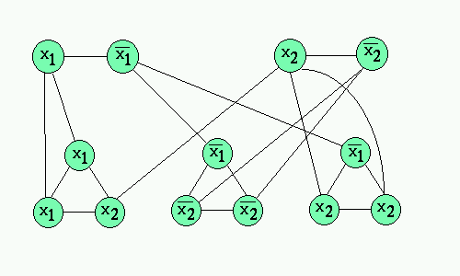
Vertex
Cover
Problem
30

Slide 34
Vertex
Cover
Problem
► The
running
time
of
the
algorithm
is
O(V
+
E)
31

Slide 35
Subset-Sum
Problem
► An instance of the sunset sum problem is a pair (S,t),



where S = {x1,x2,x3, …….xn} of positive integers
and t (target) is a positive integer.
This decision problem asks whether there exists a subset of S that
adds up exactly or approxmately close to the target value t (result
less than target).
► The optimization problem associated with this decision
problem arises in practical applications.
►
An algorithm can be presented for this problem and then can be seen that how it can be modified so that it becomes a fully polynomial-time scheme
►
►
Subset sum problem is NP-complete.
Algorithms of subset-sum problems try to provide exact or approximately close result to required target so that its relative error is small. It is around about 0.5.
32

Slide 36
Subset-Sum
Problem
► S = {1,4,16,64,256,1040,1041,1093,1284,1344}
► t = 3754
► S’ = {1,16,64,256,1040,1093,1284}
► In
subset-sum
problem, there exists a subset such that
t =
∑
S´ ∈S
S '
33

Slide 37
Algorithm
► Martello and Toth defined the concept of greedy approximate algorithm for this problem.
► The time complexity is O(N*logN) but the worst-case performance ratio is 1/2.
► Here is the algorithm for this type:
Implementation:



Global structures: A[1..N], X[1…N] arrays
of
positive
integers
Parameters:
N, T positive integers.
output array X,
If
X[J] = 0
X[J] = 1
A[J] is selected
otherwise
else
For J=1…N
34

Slide 38
Algorithm

Slide 39
Example
1
A :
Index
1
2
3
4
5
6
7
Values
1
4
6
7
9
10
12
X:
Index
1
2
3
4
5
6
7
Values
0
0
0
0
0
0
0
T = 21
Sort A in descending order.
A :
Index
1
2
3
4
5
6
7
Values
12
10
9
7
6
4
1
Loop terms (J)
A[J]
Condition
Result
J = 1
A[1] = 12
12 > 21
T = 21 – 12 = 9
J = 2
A[2] = 10
10 > 9
X[2] = 1
J = 3
A[3] = 9
9 > 9
T = 9 – 9 = 0
J = 4
A[3] = 7
7 > 0
X[4] = 1
J = 5
A[3] = 6
6 > 0
X[5] = 1
J = 6
A[3] = 4
4 > 0
X[6] = 1
J = 7
A[3] = 1
1 > 0
X[7] = 1
So, A’ = {12,9}
12+9 =T= 21
(here in this solution E = 0)
36

Slide 40
Example
Example solved by Greedy Algorithm:
2
►
► A :
Index
Values
► X:
Index
Values
1
1
2
4
3
6
4
7
5
9
6
10
7
12
1
0
2
0
3
0
4
0
5
0
6
0
7
0
► T = 34
Sort A
►
Index
Values
descending order.
1
12
2
10
3
9
4
7
5
6
6
4
7
1
37

Slide 41
Example
Condition
12 > 34
10 > 22
9 > 12
7 > 3
6 > 3
4 > 3
1 > 3
2
►
►
►
►
►
►
►
►
Loop terms (J)
J = 1
J = 2
J = 3
J = 4
J = 5
J = 6
J = 7
A[J]
A[1] = 12
A[2] = 10
A[3] = 9
A[3] = 7
A[3] = 6
A[3] = 4
A[3] = 1
Result
T = 34 – 12 = 22
T = 22 – 10 = 12
T = 12 – 9 = 3
X[4] = 1
X[5] = 1
X[6] = 1
T = 3 – 1 = 2
►
So, A’ = {12,10,9,1} with the help of X array.
►
12+10+9+1
not equal to T
(In this solution E = 2)
38

Slide 42
Word length optimization
Word length is the number of bits, digits, characters, or bytes in one word .
DSP algorithms can either be simulated in floating-point or fixed-point environments.
When compared to implementation on floating-point hardware, implementation on fixed-point hardware offers lower economic cost, lower power consumption, and faster speed, but with a tradeoff in signal quality.
An algorithm has been developed for the bit width optimization
The proposed algorithm has been implemented on CORDIC

Slide 43
Word length Optimization Algorithm
8 step process
Floating to fixed
Accuracy
Handler
Format
conversion
Modeling
of hardware
for selected WL
Selection of
Appropriate
WL
Iteration of
WL
Design space
determination
Design space
exploration
Analysis
%age increase
in accuracy

Slide 44
Hardware
Price
Power*
Floating-Point Program
Floating-
Point
Processor
$
Code
Conversion
L
H
Digital Signal
Processing
Algorithms
Fixed-
Point
Processor
Fixed Point
(Uniform Wordlength)
$
Wordlength
Optimization
L
H
Fixed-
Point
ASIC
Fixed Point
(Optimized Wordlength)
$
L
H
ASIC: Application Specific Integrated Circuit
* Power consumption

Slide 45
Transformations to Fixed Point
Advantages
Lower hardware complexity
Lower power consumption
Faster speed in processing
Disadvantages
Introduces distortion due to quantization error
Search for optimum word lengths by trial & error is time-consuming
Floating-Point Program
Code
Conversion
Transformation
Wordlength
Optimization
Fixed Point
(Optimized Wordlength)

Slide 46
Fixed-Point Data Format
Wordlength (WL)
Wordlength
S
X
X
X
X
X
3.141479492₍₁₀₎ = 011.00100100001110₍₂₎ [WL=17; IWL=3; FWL=14]
Integer
wordlength
Fractional
wordlength
(Binary point)

Slide 47
Optimum Wordlength
Longer wordlength
May improve application performance
Increases hardware cost
Shorter wordlength
May increase quantization errors and overflows
Reduces hardware cost
Optimum wordlength
Maximize application performance or minimize quantization error
Minimize hardware cost
Optimum
wordlength
Distortion d(w)
[1/performance]
Cost c(w)
Wordlength (w)
Notes:
Optimum wordlength can be select from the graph. Large wordlength reduces error. However, it increase costs.
On the other hand, short wordlength decreases costs but it increase error.

Slide 48
CORDIC EXAMPLE
CORDIC
Generates sine and cosine

Slide 49
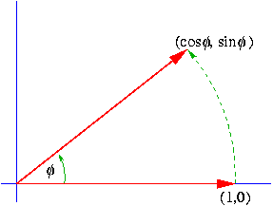
CORDIC...
Uses the rotation transform
(Givens rotation)
To rotate the vector
[
]
[
]
x1
y1
by an angle, φ, to produce
x2
y2
x₂ = x1 cos φ - y1 sin φ
y₂ = x1 sinφ + y1 cos φ

Slide 50
CORDIC...

Slide 51
CORDIC...

Slide 52
Portion of MATLAB code
j = 0;
for Qtm=5:1:32;
j = j + 1;
m=0;
for Qm=7:1:32;m = m+1; tempError = 0; tempError1=0;
for thetad = 0:.03:pi/4;
x(1) = 0.607253; %k
x(1) = (fix(x(1)*2^Qm))/2^Qm; y(1) = 0; y(1) = (fix(y(1)*2^Qm))/2^Qm;
theta(1) = (fix(pi/pi*2^Qtm))/2^Qtm;
for i = 1:7
if(theta(i) > 0) sign= 1;else sign = -1;end
x(i+1) = x(i) - [sign* 2^(-(i-1)) * y(i)];
y(i+1) = [sign* 2^(-(i-1))* x(i)] + y(i);
x(i+1) = (fix(x(i+1)*2^Qm))/2^Qm;
y(i+1)= (fix(y(i+1)*2^Qm))/2^Qm;
theta(i+ 1) = theta(i) - [sign * atan(2 ^-(i-1))];
theta(i+1) = (fix(theta(i+1)*2^Qtm))/2^Qtm; end
tempError = ((abs(cos(thetad)-x(i+1))).^2);
tempError1= ((abs(sin(thetad)-y(i+1))).^2);
hold end
errorMatrix(m,j) = (tempError);
errorMatrix2(m,j)=( tempError1);
end
j
[valu, index]=min(errorMatrix(:,j))
plot(errorMatrix(:,j),'green')
hold on
plot(errorMatrix2(:,j), 'red')
%hold off
pause
end

Slide 53
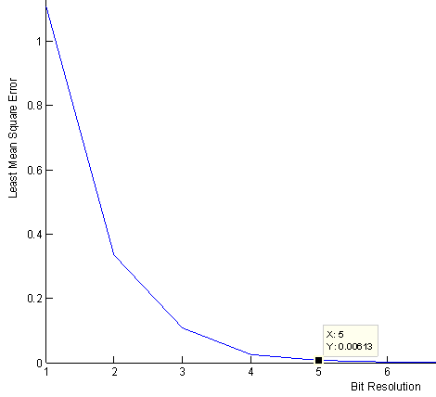
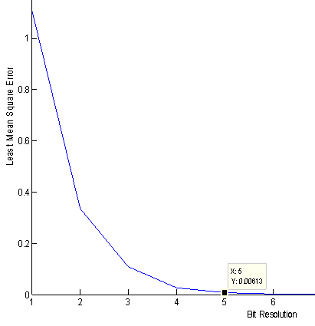
CORDIC ANALYSIS
Min {bit width (X, Y) > (bit width (Φ) minus 2)} = Min least mean square error
Bit resolution Vs LMS where bit width of X,Y < bit width of Φ
Bit resolution Vs LMS error where bit width of X,Y = bit width of Φ

Slide 54
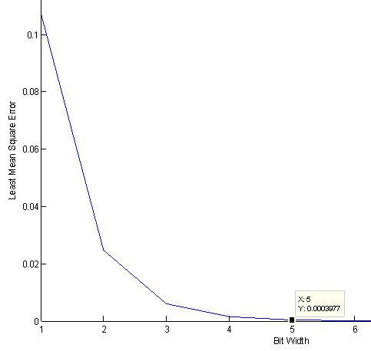
CORDIC ANALYSIS
Min {bit width (X, Y) > (bit width (Φ) minus 2)} = Min least mean square error
Bit resolution Vs LMS error where bit width of X,Y > bit width of Φ

Slide 55
X axis: Bit resolution of X, Y, Φ
X axis: Bit resolution of X, Y, Φ
Analysis on no. of slices, registers and IO’s with bit resolution of X, Y (varying) and Φ (fixed)
Analysis on no. of slices, registers and IO’s with bit resolution X, Y (fixed) and Φ (varying)

Slide 56
CORDIC Analysis
Optimum
wordlength
The total numbers of trials to find the optimum were 27x27=729

Slide 57
THANKYOU

