Slide 1


Introducing
TherAIpist
AI-Powered Mental Health Support Chatbot
Revolutionizing mental wellness for students and professionals. Addressing the growing need for accessible, affordable, and private mental health support.
TherAIpist: Your always-available AI companion for mental well-being.
Statistics: 75% of college students struggle with mental health. 48% of employees report high stress levels impacting their work.

Slide 2

The Problem: Mental Health Crisis
Limited Access
Stigma
Long Waits
Mental health resources like therapists and counselors.
The stigma associated with seeking help is a significant barrier.
Long wait times and high costs of therapy further exacerbate the issue.
UC Berkeley reported a 30% increase in students seeking mental health services. Average wait times exceeded 3 weeks.
Only 41% of adults with a mental health condition received services last year.

Slide 3
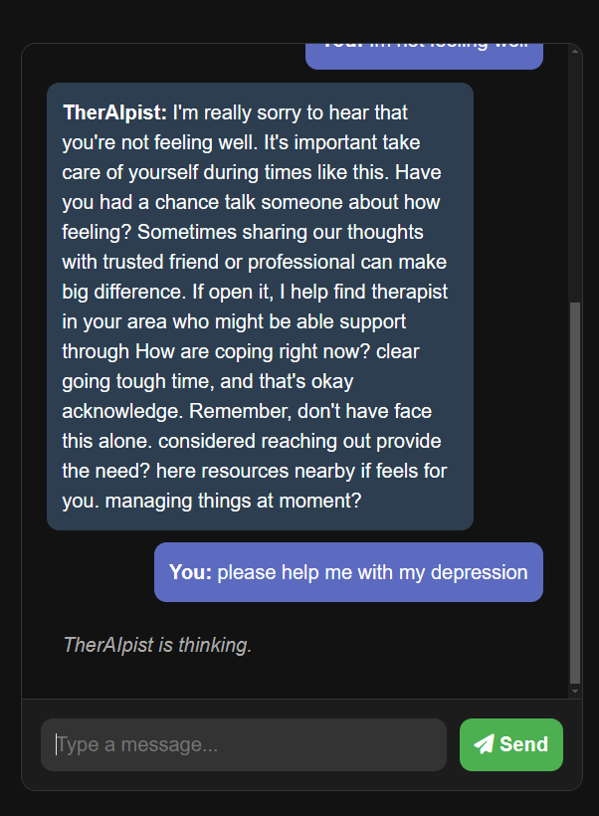



TherAIpist: How It Works
Initial Assessment
Asks targeted questions about stress, mood, and behaviors.
AI Analysis
AI analyzes responses to estimate likelihood of mental health conditions.
Confidential Space
Provides a safe and confidential space for users to discuss concerns.
Uses NLP for empathetic and understanding conversations.

Slide 4
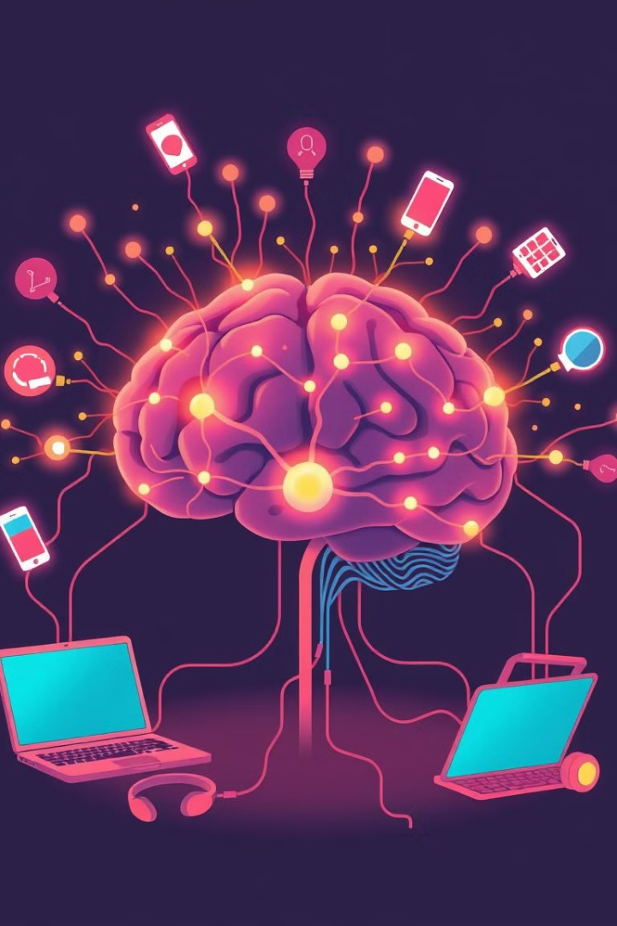
Key Features and Benefits
1
24/7 Availability
Accessible anytime, anywhere via smartphone, tablet, or computer.
2
Privacy
Secure platform ensures user confidentiality and data protection (HIPAA compliant).
3
Personalized
Tailored conversations and resources based on individual needs.
4
Affordable
Cost-effective alternative to traditional therapy.
Integration with crisis hotlines directs users in distress to immediate help.

Slide 5
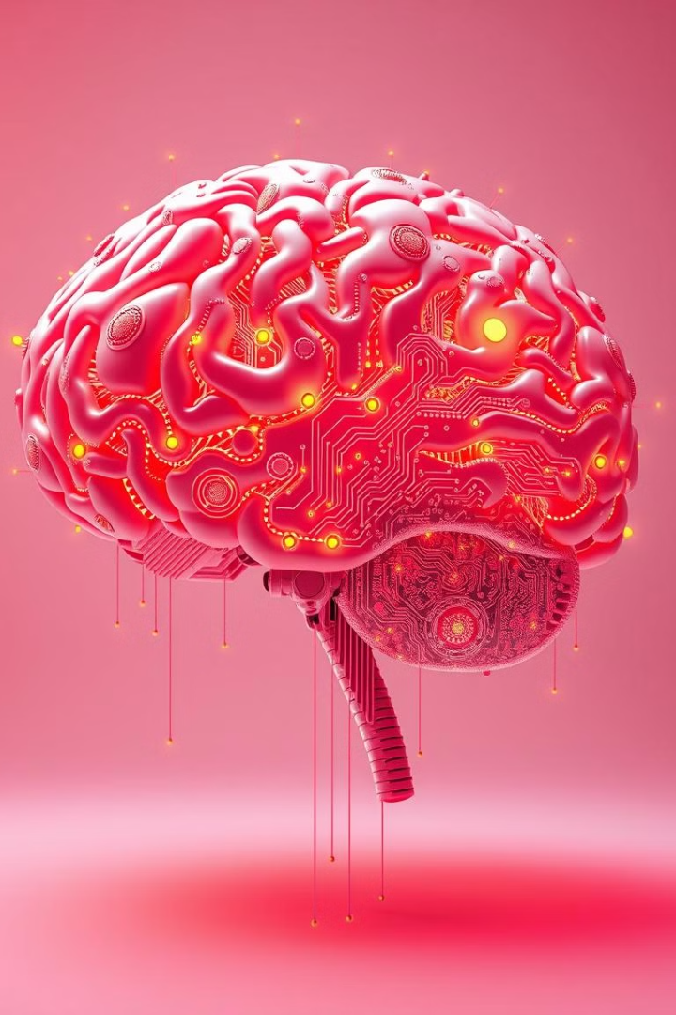



Technology and AI Behind
State-of-the-art natural language processing (NLP) models.
Machine learning algorithms trained on mental health conversations.
Secure data encryption and storage to protect user privacy.
GPT-3 architecture fine-tuned for mental health applications, 99.9% uptime.

Slide 6




SWOT Analysis: Mental Health AI
Weaknesses
Strengths
Lack of human empathy, potential for inaccurate assessments, reliance on technology.
24/7 availability, personalized support, cost-effective.
1
2
Opportunities
Threats
Growing mental health awareness, increasing demand for accessible solutions, integration with existing healthcare systems.
Data privacy concerns, regulatory hurdles, competition from established mental health providers.
4
3

Slide 7



Business Model
2
Enterprise
1
Subscriptions
Premium
3
Subscription-based model for individuals and organizations.
Partnerships with universities and corporations.
Premium features: Advanced support, personalized coaching.
Revenue projections: $5M in year 1, $20M in year 3.

Slide 8
The Future of TherAIpist
1
AI-health
2
Languages
3
Specialized Modules
Roadmap: Integration with AI-health platforms, expanding language support.
Developing specialized modules for specific mental health conditions.
Vision: Become the leading AI-powered mental health companion.
Join us in revolutionizing mental healthcare!

Slide 9




How TherAIpist Works
Initial Assessment
Users complete a questionnaire to assess their mental state and needs.
AI Interaction
AI engages in empathetic and personalized conversations, providing support.
Resource Provision
AI recommends relevant resources, coping strategies, and support networks.
Progress Tracking
Users monitor their progress and receive ongoing support and feedback.

Slide 10

Thank You
We appreciate your time and consideration of TherAIpist.
Let's revolutionize mental healthcare together.

