Slide 1
NLP Project by Nicholas Bacon and Michael Nafe

Slide 2
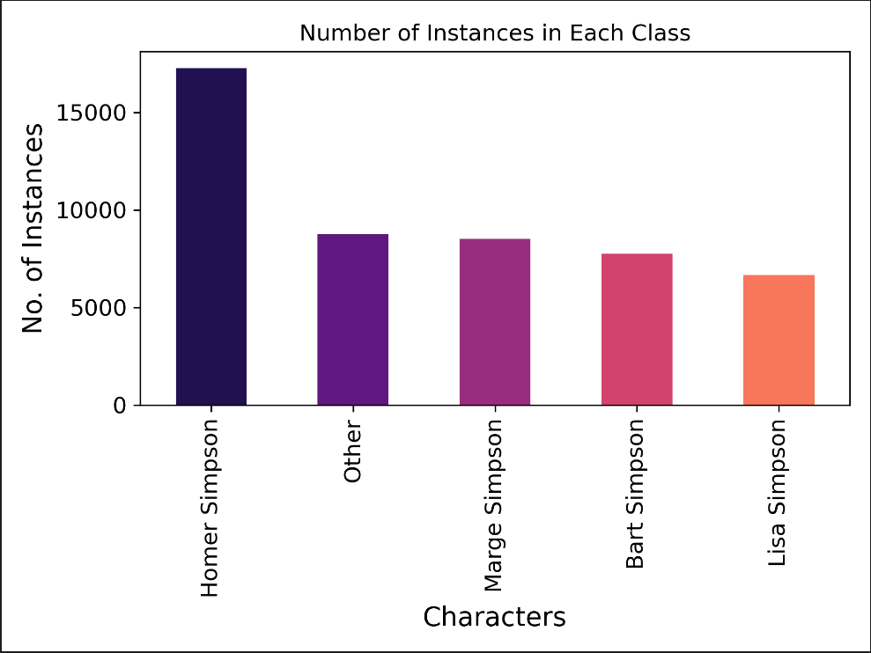
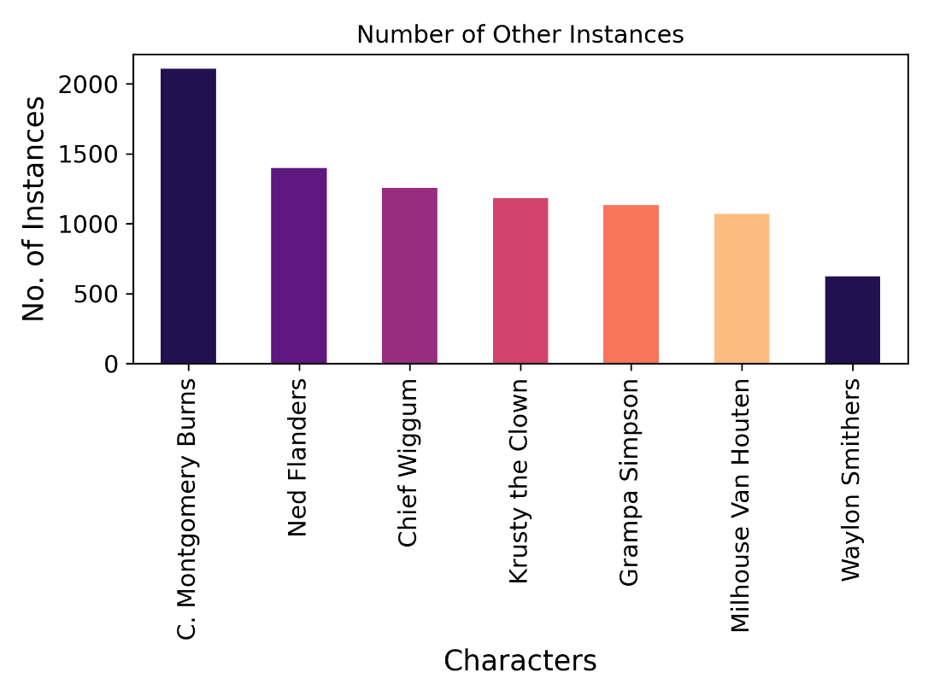
Goal:
Given Simpsons quotes, predict who said it.

Slide 3
Preprocessing
Some of the text instances were
  botched, such as just being “#NAME”, so we removed those.
  one word, such as just “I”, which intuitively does not convey anything unique, so tried working with the data set with and without the one word instances. Not sure if it had any impact.
All ML problems benefit from more data, especially NLP, so we
  used a Google translate library to translate the text instances for class_i to other languages, then back to english, and counted that as a new instance for the class_i.
    Doing this on the entire data set takes significant time.
      We chose to translate a random sample at each language iteration of 1% of each class into all all of the approximate 133 languages provided my the Google translate lib, then back to english. Even this took about 9 hours, but it more than doubled our data set.
    Some of the translations produced very similar instances, others not so much.
      For example: “Crap crap crap crap crap crap” → “Revenge!”

Slide 4
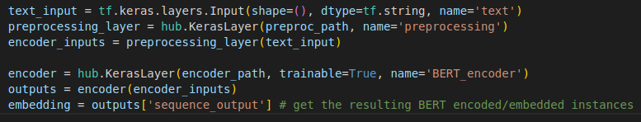
Language Models
ELMo
  Figured out how to embed text with it.
  Moved on from it before figuring out how to use its output as an input to some discriminative NN/layers.
  Not trainable in TF2, so if we used it, we could not fine tune it.
    One of the main reasons we moved on from it.
BERT
  Is trainable, so we could fine tune it.
    Made a trainable keras layer with the BERT encoder.
  Requires the text be in a certain format before valid for encoding.
    BERT Preprocessor
      Takes text input and puts it in the form the BERT encoder expects.
      Made a keras layer with the preprocessor.
  Final language embedding component of our NN consisted of 3 layers, the 3rd being an input layer.
    Outputs from this embedding component could be used as inputs to a discriminative NN.

Slide 5
Training
Tried different training-validation splits:
  .8 training, .2 validation
  .88 training, .12 validation
    The more training data split (.88/.12) did not help much, though that model is one that gave us one of our highest scores.
Used an adam optimizer that allowed us to do “warm up steps” on the model during training.
  Supposed to help with the language model component not forgetting all the language it learned before us giving it the target language.
  Uses an initial learning rate for some number of warm up steps before going into adam mode.
  Tried number of warm up steps equal to a fraction of the number of instances we have.
    .1
    .3
      The .3 attempt had a noticeable late epoch validation loss drop back down after going up for a few epochs (late compared to our other models)
Callbacks
  Save model weights at every epoch.
  If the validation loss goes up for some number of epochs in a row, stop training.
    Helps us not waste time training an over fitting model.

Slide 6
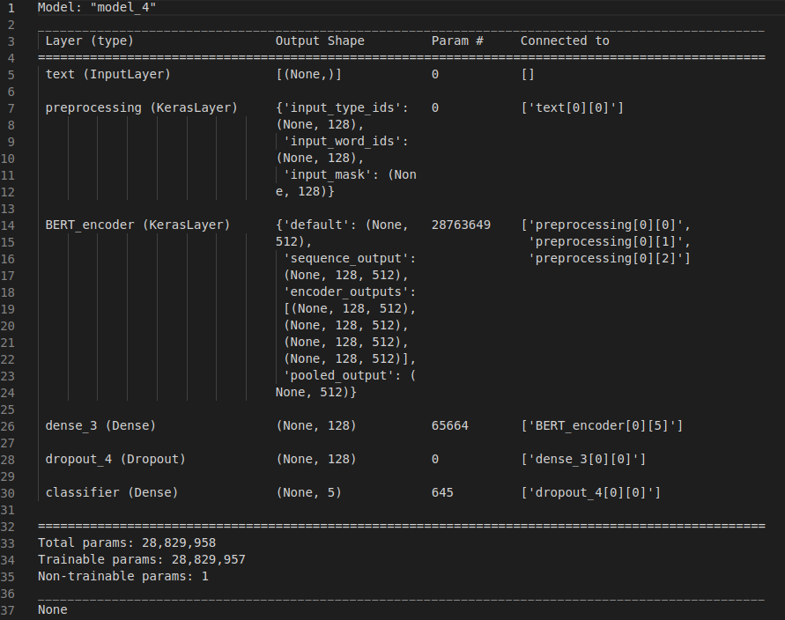
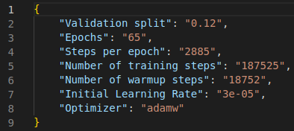
Model 1

Slide 7
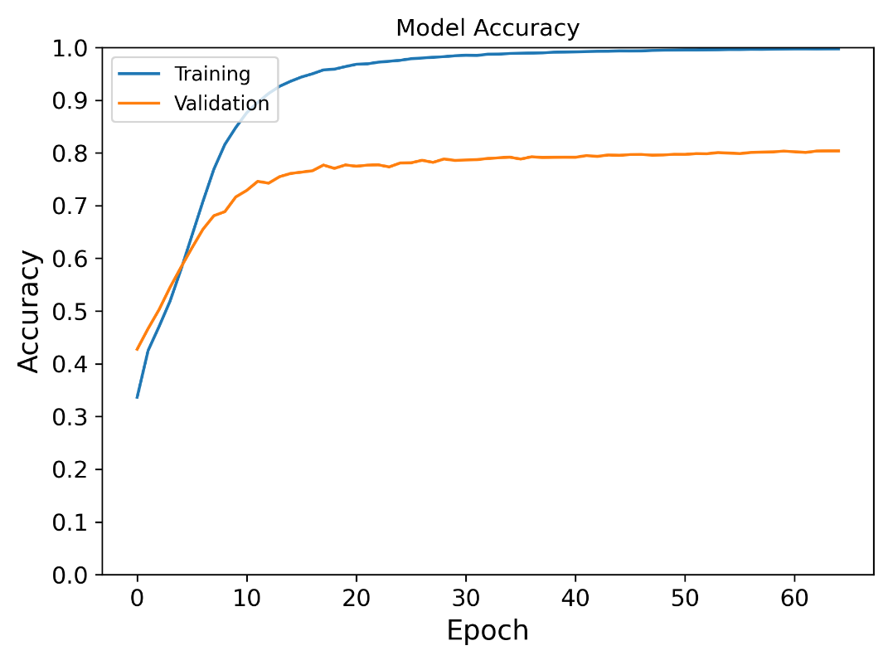
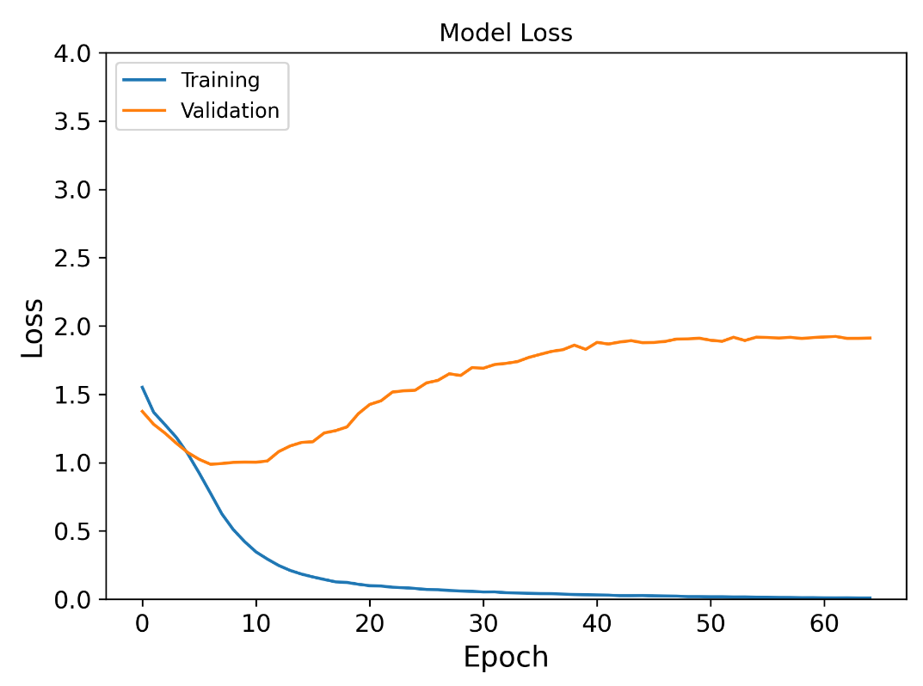
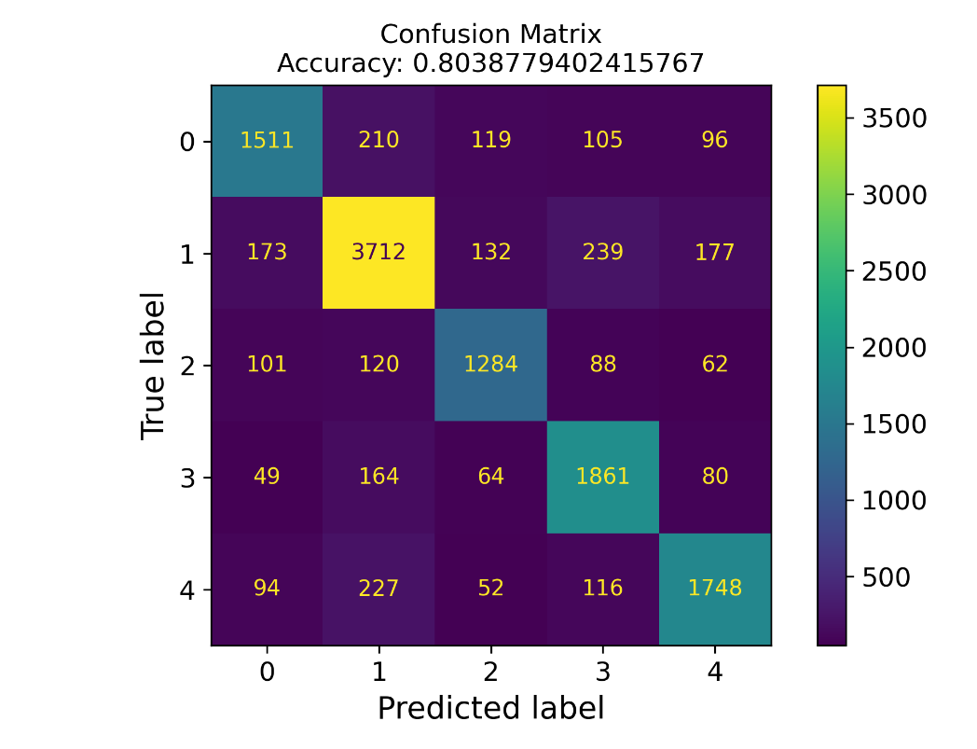
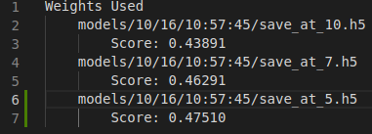
Model 1 Results
Note
  We trained this one before adding in the callback that exits early for rising validation loss

Slide 8
Model 2

