Slide 1
CRUSHIT
Gamified Pedal Can Crusher · Urban Recycling Reimagined
▼
IMechE CADathon 2026 · SDG 11: Sustainable Cities & Communities

Slide 2
THE PROBLEM
Aluminium cans: valuable, recyclable and constantly dumped in the wrong bin
~2.5×
75%
95%
more cans
fit when they are crushed
of aluminium ever made
is still in active use today
energy saved recycling
aluminium compared to smelting it raw
Root cause: Recycling bins are inconvenient, passive, and boring. People skip them especially at events like football matches where waste peaks. CrushIt makes the right choice the fun choice.

Slide 3
OUR SOLUTION
CrushIt: A pedal-powered, gamified aluminium can crusher bin
⚽ STADIUM CRUSHIT
⚡
Zero electricity
Messi 🆚 Ronaldo
Entirely foot-pedal driven. No battery, no grid connection needed.
Who gets more cans? Pick a side!
♻️
Compact crushing
Reduces can volume by approx. 60%. 2.5× more cans per collection cycle.
🔴
Side A
505
cans
🔵
Side B
470
cans
🎮
Gamified engagement
Dual-sided crusher: pick Team A or B to answer trivia/vote. Count tracked live. Fun for all ages.
🔒
Safety-first design
Manual lid closure before pedal activates. Finger entrapment possibility eliminated.
💧
Liquid waste capture
Crush your can. Cast your vote.
Grid lower platform drains residual liquid to sealed tray. Thus, clean crushes and no mess.

Slide 4
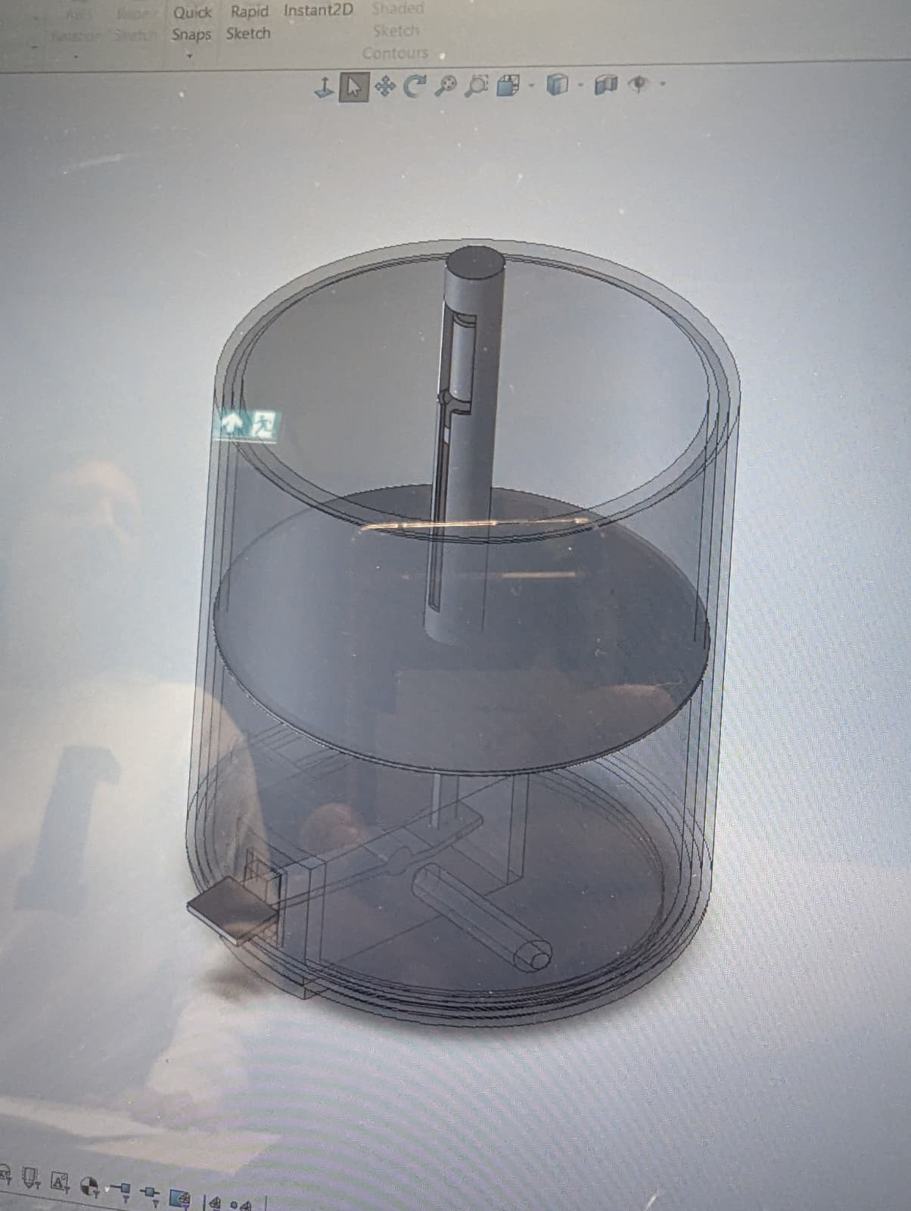
CAD & ENGINEERING DESIGN
1
Foot Pedal Actuation
Pedal drives a 2-hinge toggle linkage, converting foot force to vertical platform travel.
2
Upper Fixed Platform
Spike on punctures can top on contact to releases pressure & drain residual liquid before full crush, mitigating explosion caused by carbonation.
3
Lower Moving Platform
Grid-pattern base travels upward to crush the can. Open grid allows liquid to drain into sealed collection tray below.
4
Slanted Floor + Exit Slot
Floor slightly inclined toward a side slot at base. After crushing, the can slides on to the collection tray.
5
Safety Lid + Pedal Lock
User manually closes lid before use. Mechanical interlock prevents pedal from actuating until lid is fully shut.

Slide 5
MATERIALS & COST VIABILITY
Component | Material | Justification | Est. Unit Cost
Crushing platforms | 304 Stainless Steel | Corrosion-resistant, food-safe, high compressive strength | £15 – 25
Housing enclosure | HDPE (injection moulded) | Weatherproof, lightweight, recyclable; low cost for long life cycle. | £8 – 20
Hinge linkage | Galvanised mild steel | High fatigue life for high-cycle repetitive loading | £5 – 10
Liquid tray | Polypropylene (PP) | Chemical-resistant, food-grade, easy to injection mould | £3 – 6
Puncture spike | Hardened stainless steel | Puncture resistance, hygiene compliance, corrosion-free | £2 – 4
Manufacturing at Scale
SDG 11 Alignment
HDPE injection moulding – enclosure ~£0.80–2.00/unit at volume
Sheet metal stamping – platforms: precise & repeatable
Estimated total unit cost: £55–100 at scale
✓ Cuts bin contamination and landfill waste
✓ 2.5× bin capacity → fewer collection vehicles
✓ Passive design — zero ongoing energy use
✓ All materials recyclable at end-of-life

Slide 6
FUTURE DEVELOPMENT & IMPACT
👁️
Finger-Safety IR Sensor
📊
Live Digital Display
IR sensor detects hands inside crush zone. Auto-locks pedal until clear of hands. More Convient.
LED panel shows crush count, bin fill %, and live game scores. Low power draw. Drives competition and repeat engagement.
🛒
Vending Machine Pairing
📡
Fill-Level Monitoring
Pair CrushIt units adjacent to beverage vending machines. Deposit tokens dispensed per crush for discounts.
Smart sensors report bin fill to council waste teams. Eliminates unnecessary collections, optimising routes.
CrushIt — making recycling something people actually want to do.

