Slide 1
"Hugging Face Transformers vs. OpenAI GPT-4 API: A Comparative Analysis"
Exploring Two Powerhouses in Natural Language Processing
By: Amisha Singleton
Spring 2025 ITAI 2376

Slide 2
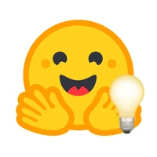
Hugging Face Transformers
Open-source library with a vast collection of pre-trained models.
Built on PyTorch, highly customizable and adaptable.
Large and active community.
Ideal for research, experimentation, and custom model development.

Slide 3
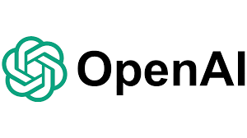
OpenAI GPT-4 API
Access to a powerful, cutting-edge language model.
Limited access, requires API access.
Potentially higher performance for complex tasks.
Suitable for production environments requiring advanced capabilities.

Slide 4
Comparative Analysis
 | Hugging Face Transformers | OpenAI GPT
Usability | High | Moderate
Performance | High | Potentially Superior
Customization | High | Limited
Cost | Free | Requires API Access
Community | Large & Active | Limited

Slide 5
Conclusion
Choose Hugging Face Transformers for research, experimentation, and customization.
Consider OpenAI GPT-4 API for production environments requiring advanced capabilities.
Carefully evaluate your specific needs and choose the framework that best suits your project.

Slide 6
Report #1: Hugging Face Transformers vs. OpenAI GPT-4 API
This report compares Hugging Face Transformers and the OpenAI GPT-4 API, two prominent tools in the field of Natural Language Processing (NLP).
Hugging Face Transformers, an open-source library, provides a vast collection of pre-trained models for various NLP tasks, built on top of PyTorch. Its key strength lies in its flexibility and customization, allowing researchers and developers to fine-tune models for specific needs. The open-source nature fosters a vibrant community and rapid development.
OpenAI GPT-4 API, on the other hand, offers access to a powerful, albeit closed-source, language model. While access is limited, it potentially provides cutting-edge performance and capabilities not readily available through open-source alternatives.
Hugging Face Transformers generally offers greater accessibility and ease of use due to its open nature and extensive documentation. However, OpenAI GPT-4 API might excel in performance for certain complex tasks.

Slide 7
TensorFlow vs. PyTorch: A Comparative Analysis of Deep Learning Frameworks
Choosing the Right Tool for Your Deep Learning Project

Slide 8
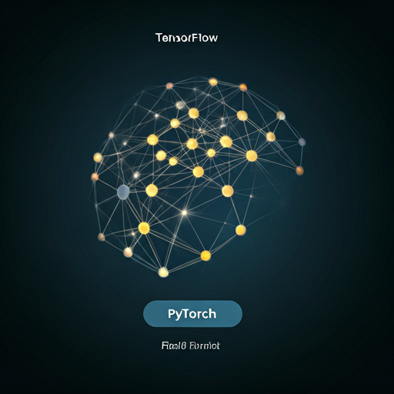
The Importance of Deep Learning Frameworks
Deep learning frameworks provide the building blocks and tools necessary to design, train, and deploy complex neural networks, simplifying the development process. Among these, TensorFlow and PyTorch stand out as the most popular choices.

Slide 9
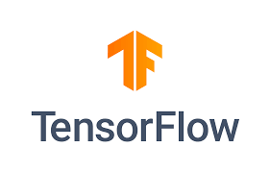
TensorFlow: Production-Ready Powerhouse
Mature and Versatile: "A well-established framework with a rich ecosystem."
Production Focus: "Strong support for deploying models in real-world applications."
Scalability: "Designed to handle large datasets and complex models efficiently."
Static Graphs: "Optimized for performance, especially in large-scale training."
Wide Range of APIs: "Supports multiple programming languages and platforms."

Slide 10
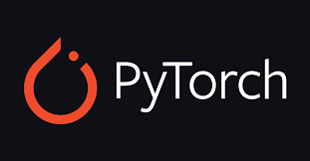
PyTorch: The Research and Development Champion
Intuitive and Pythonic: "Easy to learn and use, especially for those familiar with Python."
Dynamic Graphs: "Flexible and allows for easier debugging and experimentation."
Research-Oriented: "Favored by researchers for its ease of prototyping and rapid iteration."
Strong Community Support: "Active community contributing to its development and providing assistance."
Growing Production Capabilities: "Increasingly used in production settings."

Slide 11
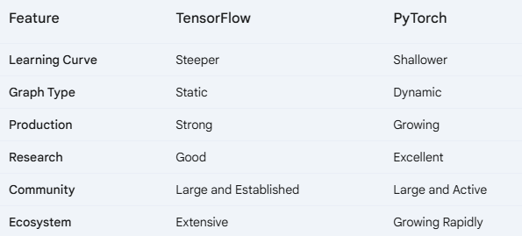
TensorFlow vs. PyTorch: A Head-to-Head Comparison

Slide 12
Making the Right Choice
Project Goals: "Consider your specific project requirements."
Team Expertise: "Choose a framework your team is comfortable with."
Deployment Needs: "Think about where you will deploy your model."
Scalability Requirements: "Evaluate your scaling needs."

Slide 13
Conclusion
TensorFlow offers robust production capabilities and scalability, while PyTorch excels in research and rapid prototyping. The best choice depends on the specific project requirements and team expertise. Selecting the appropriate framework is crucial for the success of your deep learning projects.

Slide 14
Report #2: TensorFlow vs. PyTorch
This report compares TensorFlow and PyTorch, two leading deep learning frameworks.
TensorFlow, developed by Google, is a mature and versatile framework with strong support for production environments. Its static computational graphs enable efficient execution on various platforms, including mobile and embedded devices. TensorFlow boasts a large and active community, along with a comprehensive ecosystem of tools and libraries.
PyTorch, developed by Facebook AI Research, is known for its dynamic computational graphs and user-friendly Pythonic interface, making it popular for research and rapid prototyping. Its focus on dynamic computation provides greater flexibility for experimentation and debugging.
TensorFlow excels in production readiness and scalability, while PyTorch is favored for its ease of use and research-oriented features.

