Slide 1
GLOBAL SALES & RETAIL PERFORMANCE ANALYTICS SYSTEM
An End-to-End Data Engineering & Analytics Project
Ganji Misha Manmai
VNR VJIET

Slide 2
INTRODUCTION
Retail sales data consists of the information generated when products are sold to customers by a retail organization. This data includes details related to sales transactions, products, customers, stores, and regions. Retail businesses generate large volumes of such data on a daily basis through both online and offline sales channels.
Retail sales analytics is the process of organizing and analyzing this data to understand business performance. By analyzing sales data, businesses can identify sales trends, understand customer purchasing behavior, evaluate product performance, and compare performance across different regions and stores.
Retail sales analytics helps organizations transform raw sales data into meaningful insights, which support better planning, performance monitoring, and informed business decision-making.

Slide 3
PROBLEM STATEMENT
A global retail organization generates large volumes of sales, customer, product, and store data across multiple regions and sales channels. This data is often stored in separate files and systems, making it difficult to consolidate, clean, and analyze efficiently.
Due to the lack of an automated and centralized analytics system, the organization faces challenges such as inconsistent data quality, delayed reporting, and limited visibility into sales performance, profitability, and customer behavior. As a result, decision-making becomes time-consuming and less reliable.
There is a need for an end-to-end data analytics solution that can systematically ingest raw retail data, perform cleaning and transformation, generate meaningful business insights, and present them through interactive dashboards to support data-driven decision-making.

Slide 4
Build an end-to-end analytics pipeline
PROJECT OBJECTIVES
Automate data ingestion and transformation
Improve data quality and consistency
Generate meaningful business KPIs
Create interactive Power BI dashboards
Demonstrate real-world ETL and orchestration

Slide 5
DATA SCOPE
Order-Level Sales Transactions
The project processes detailed order-level data including order ID, order date, quantity sold, unit price, discounts, and revenue, enabling accurate sales trend and performance analysis.
Product & Category Details
Product master data such as product ID, product name, category, sub-category, and cost information is used to analyze product performance, profitability, and category-level trends.
Regional & Store-Level Sales Data
Store and region information is integrated with sales and returns data to evaluate regional performance, store-level revenue, return rates, and net sales contribution.
Customer Purchase Behavior
Customer data including customer ID, segment, purchase frequency, and total spend is analyzed to understand customer buying patterns, segmentation, and overall customer value.

Slide 6
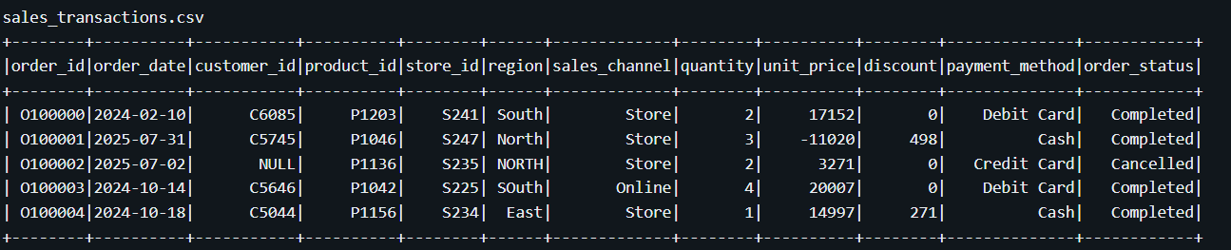
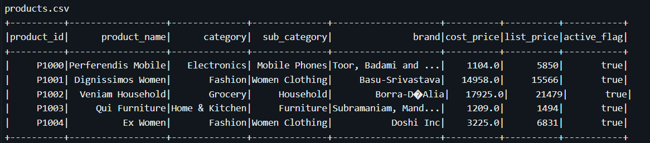
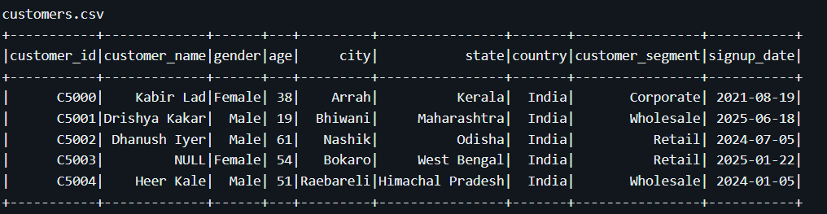
DATASETS USED
10150 rows
Order-level transactional data
Contains order ID, date, product, quantity, pricing, discounts, and revenue-related fields
306 rows
Product master data
Includes product name, category, sub-category, cost price, and selling price
2040 rows
Customer master data
Includes customer ID, segment, and demographic attributes

Slide 7
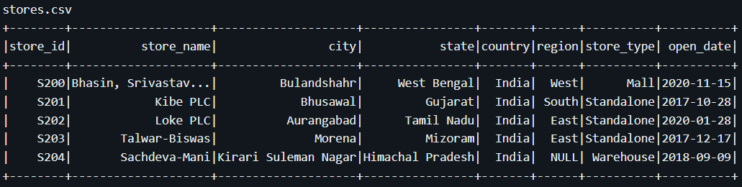
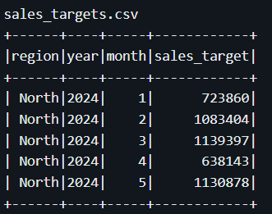
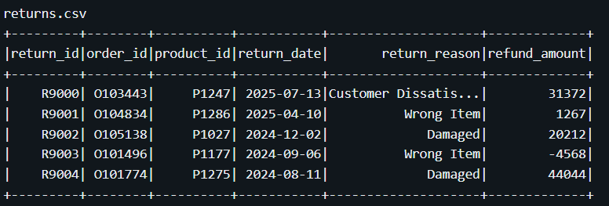
50 rows
Store and regional reference data
Maps stores to regions and locations
48 rows
Sales targets defined by region and time period
Used for target vs actual performance analysis
800 rows
Returned order records
Includes return reason and refund amount

Slide 8
TECH STACK AND WHY?
Tool | Why used in this project
Python | Used to implement ETL logic and data transformations
Pandas | Used for initial data handling and preprocessing
Azure Databricks | Used for scalable Spark-based data processing
PySpark | Used to perform distributed data transformations
Spark SQL | Used for SQL-based analytics and table creation
Delta Tables | Used to provide reliable storage with ACID transactions
Apache Airflow | Used to orchestrate and automate the ETL pipeline
Power BI | Used to visualize business KPIs and analytics
GitHub | Used for version control and project collaboration

Slide 9
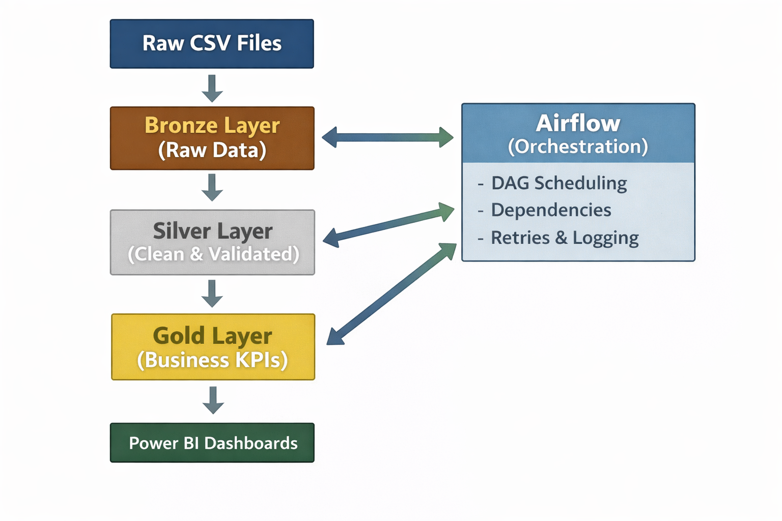
ARCHITECTURE OVERVIEW

Slide 10

MEDALLION ARCHITECTURE
Medallion Architecture is a data design pattern used in modern data engineering to organize data into multiple layers based on data quality and processing stage.
Bronze Layer stores raw data ingested from source systems without modification
Silver Layer contains cleaned, validated, and standardized data
Gold Layer holds aggregated, business-ready datasets used for analytics and reporting
This architecture improves data quality, scalability, maintainability, and enables clear separation between raw data processing and business analytics.

Slide 11
DATABRICKS
Why Databricks Was Used
Retail datasets contain large volumes of transactional data
Databricks provides scalable processing using Apache Spark
Supports the Medallion Architecture (Bronze, Silver, Gold)
Enables reliable data storage using Delta Lake
Suitable for real-world data engineering use cases
How Databricks Was Used
Raw CSV files were ingested into the Bronze layer as Delta tables
Data cleaning, validation, and revenue calculation were performed in the Silver layer
Business-level aggregations and KPIs were created in the Gold layer
PySpark and Spark SQL were used for transformations and analytics
Gold tables were stored in the Databricks workspace for reporting

Slide 12
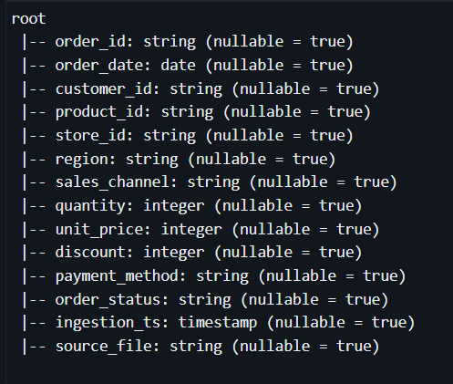
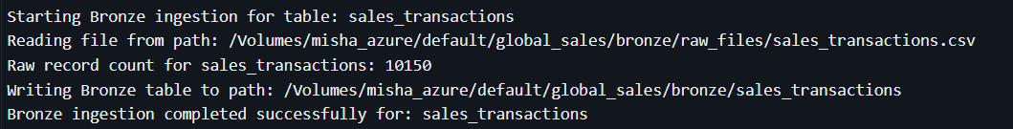
BRONZE LAYER
Bronze Layer
Reads raw CSV files
Stores data as Delta tables
No transformations
Adds ingestion metadata
Goal:
Preserve original data for traceability.

Slide 13
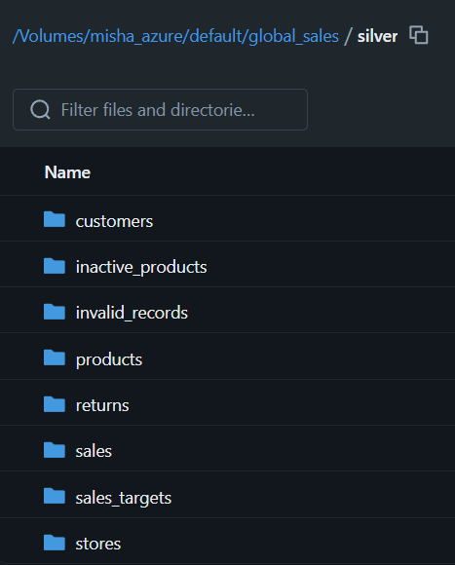
SILVER LAYER
Data Cleaning & Preprocessing
Remove duplicate records
Handle missing values
Validate foreign keys
Filter invalid records
Standardize formats
Create derived metrics like Profit, Revenue
Invalid data is stored separately, not deleted.

Slide 14
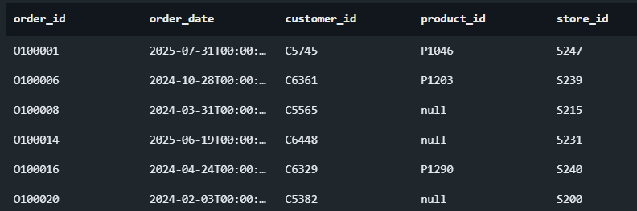
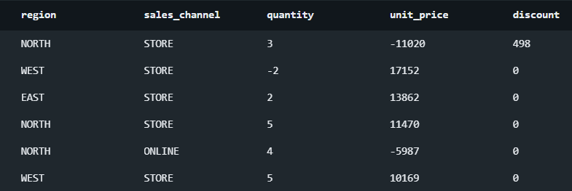
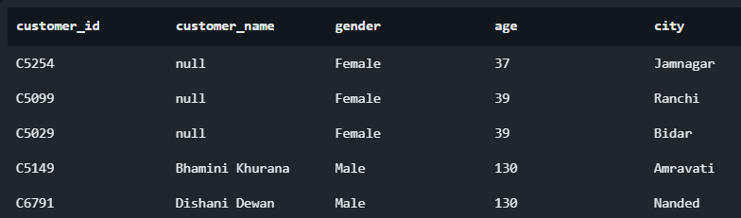
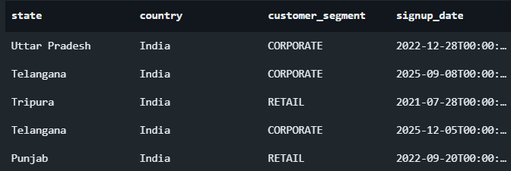
INVALID RECORDS
sales_transactions
customers

Slide 15
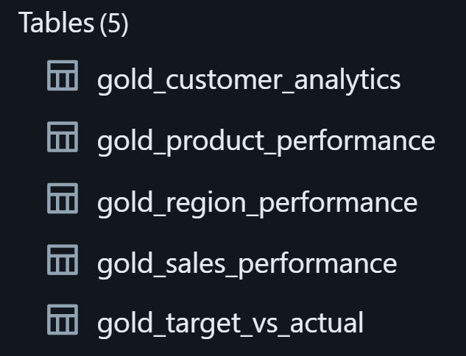
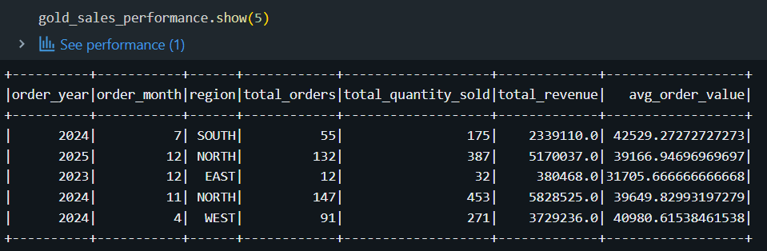
GOLD LAYER
Analytics & KPIs
Gold Layer
Business-ready datasets
Aggregations and KPIs
Joins across domains
Gold Tables Created
Sales Performance
Product Performance
Regional Performance
Customer Analytics
Target vs Actual Analysis

Slide 16
APACHE AIRFLOW
Why Apache Airflow Was Used
ETL pipelines require controlled execution order
Manual execution is error-prone and not scalable
Airflow provides workflow orchestration and automation
Supports retries, monitoring, and logging
How Apache Airflow Was Used
An Airflow DAG was created to orchestrate the ETL pipeline
Tasks were defined for Bronze, Silver, and Gold layers
Task dependencies enforced the order: Bronze → Silver → Gold
Retry logic handled temporary failures
Execution logs were monitored through the Airflow UI

Slide 17
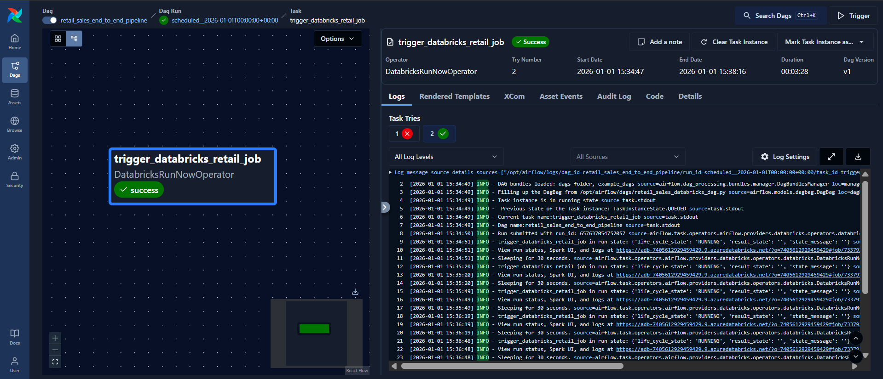
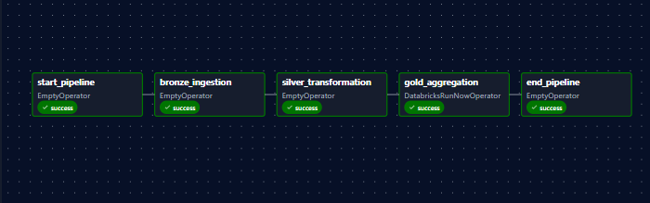
APACHE AIRFLOW
Airflow Implementation
Orchestrates Bronze → Silver → Gold
Enforces task dependencies
Retry logic for failures
Execution logging

Slide 18
POWER BI OVERVIEW
Why Power BI Was Used
Business stakeholders require visual insights, not raw data
Power BI supports interactive and user-friendly dashboards
Integrates well with structured analytics datasets
Widely used in industry for business reporting
How Power BI Was Used
Power BI was connected to Gold-layer tables from Databricks
Three dashboards were created:
Executive Sales Overview
Regional & Store Performance
Product & Customer Analytics
KPIs such as revenue, profit, and target achievement were visualized
Filters, slicers, and charts enabled interactive data exploration

Slide 19
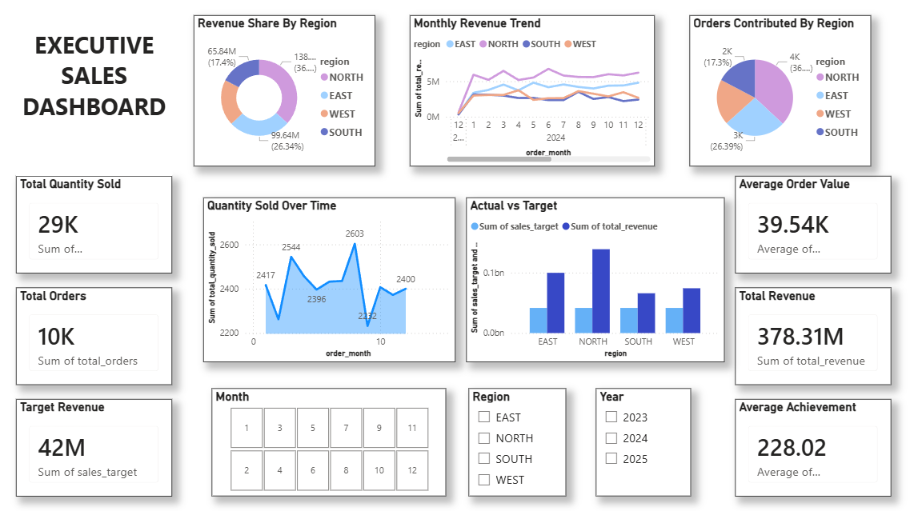
POWER BI DASHBOARDS
EXECUTIVE SALES OVERVIEW

Slide 20
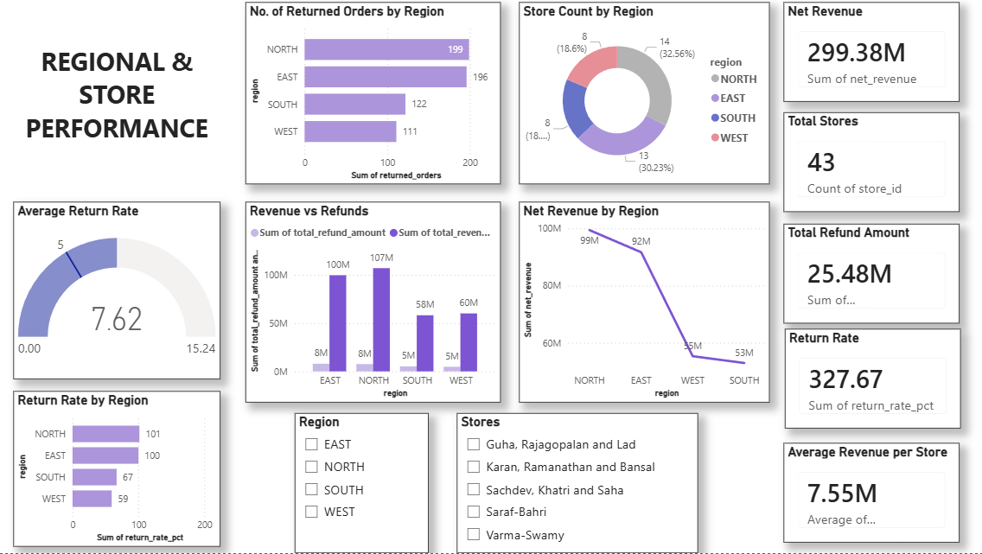
REGIONAL AND STORE PERFORMANCE

Slide 21
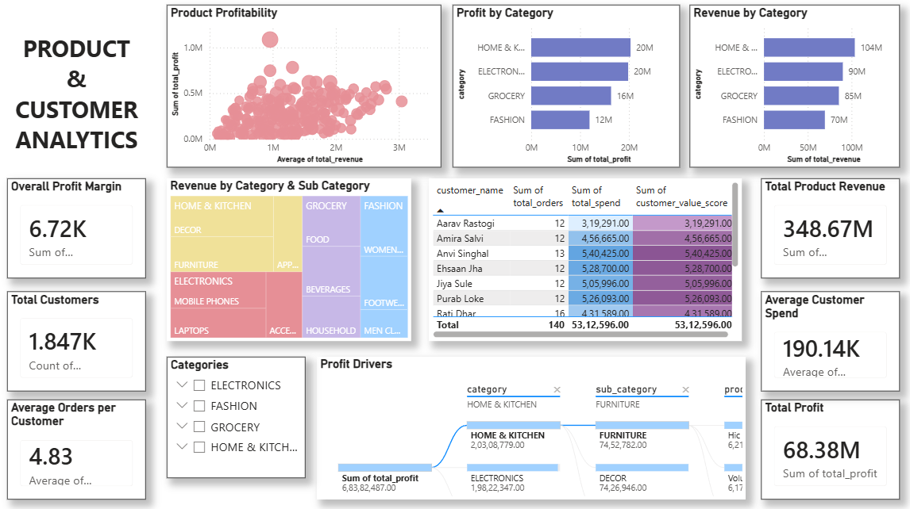
PRODUCTS AND CUSTOMER ANALYTICS

Slide 22
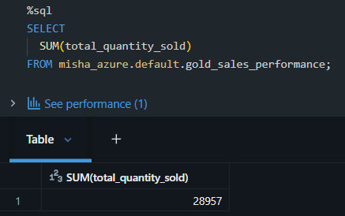
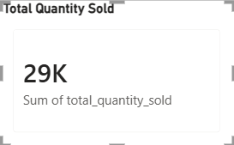
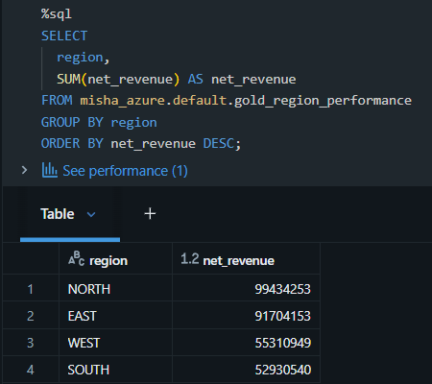
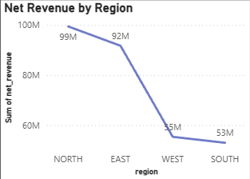
KPI VALIDATION
1.
2.

Slide 23
RESULTS
Results Achieved
Clean, validated datasets
Improved data quality and insights
Business-ready analytics
Interactive dashboards
Fully automated ETL pipeline
Successfully built an end-to-end analytics system

Slide 24
THANK YOU!

