Slide 1

Using INLA-SPDE for Spatial Models in R
Misha Tseitliani
25 November 2025

Slide 2
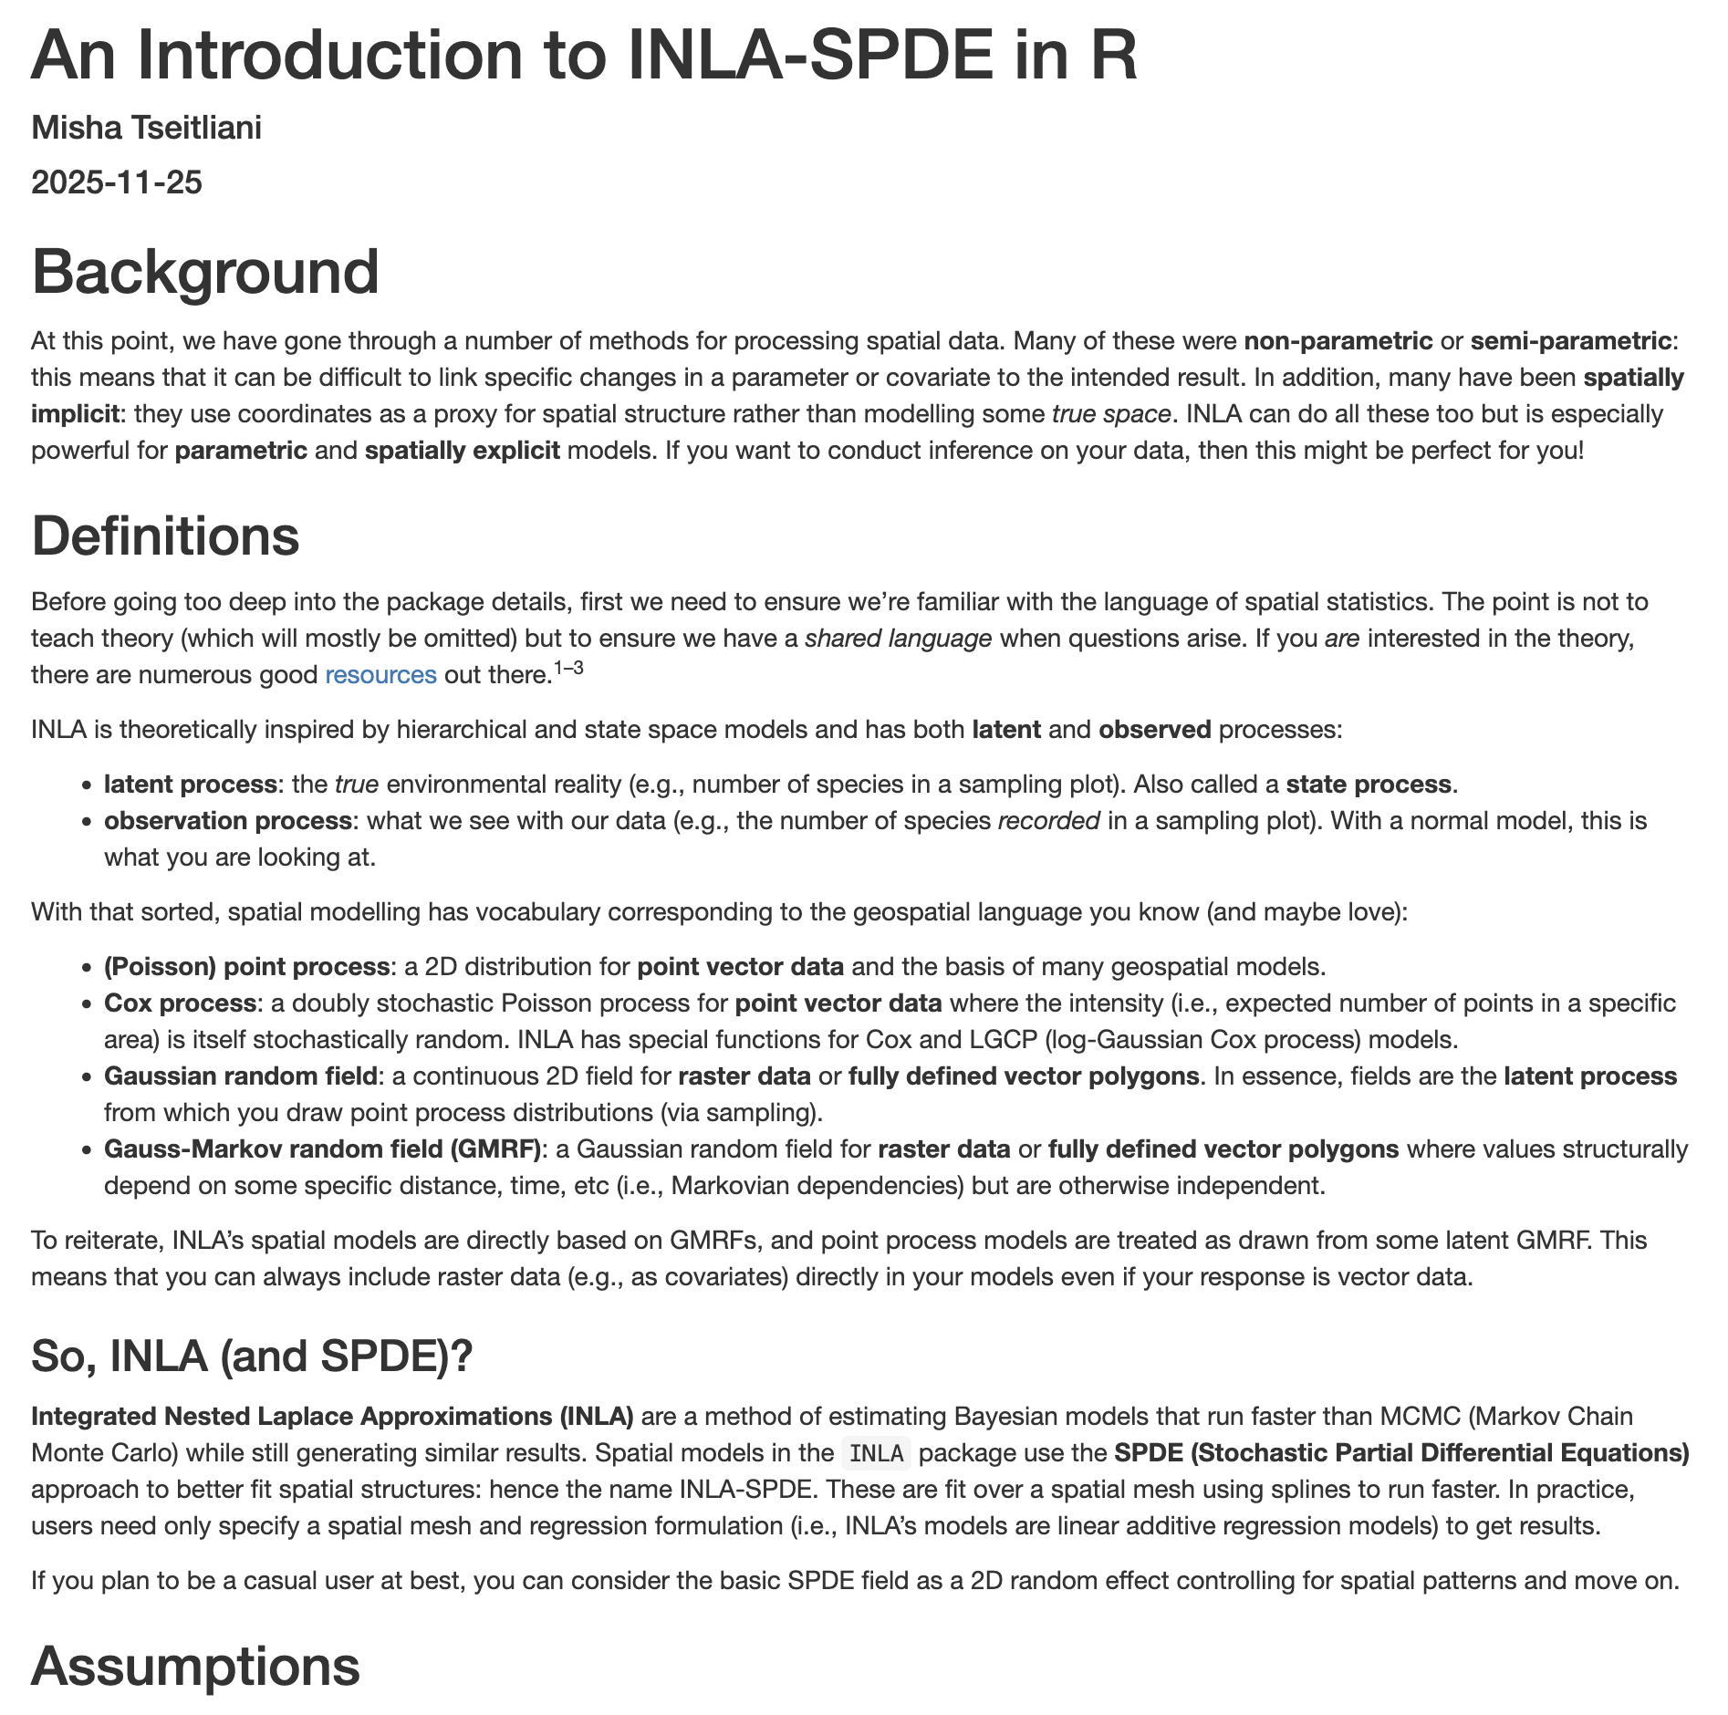
Overview
  Supplement to notes that are available on GitHub (and Moodle) →
  HTML notes are much more comprehensive
  This presentation covers (not in that order)
    Method overview
    Common pitfalls
    Some example syntax
  Look at notes if time allows

Slide 3
What is it?
  Integrated Nested Lagrange Approximation (INLA) – 2009
    Faster alternative to Bayesian estimation than MCMC
  Stochastic Partial Differential Equations (SPDE) – 2011
    Computational method for spatial models over a defined area
  Implemented with three packages in R
    INLA (2009) – original interface
    inlabru (2019) – updated cleaner syntax & defaults
    fmesher (2023) – split off from INLA; area triangulation
  Used most in ecology, health studies (e.g., epidemiology), and environmental studies (e.g., spatial econometrics)

Slide 4
What is it for?
  Main use case is spatial modelling
    Random fields – a continuous latent process in 1+ dimensions that correspond to raster or vector polygon data
    Point process models – point vector processes that can be either marked or unmarked and are realised from some underlying latent random field
  Good temporal (and spatio-temporal) functionality too
  Meant for fast fitting to enable more iterative model development: when in doubt, fit a model.
    Simple syntax for compact models and small datasets
    Complex syntax (incl. parallelisation/HPC) for bigger models & data

Slide 5
Possibilities
  All models are Bayesian. They can include:
    GLM (generalised linear models)
    GLMMs (generalised linear mixed models)
    GEV (generalised extreme value)
    ARMA (autoregressive moving average)
    LGCP (log Gaussian Cox process)
    SVC (Spatially varying covariates)
    Random field models
    Barrier models
    Joint multiple likelihoods (i.e., for SEMs)
    Bayesian melding model (i.e., data fusion)

Slide 6
Assumptions
  There are no real consistent assumptions across all model types
  In spatial models,
    Stationarity – a weaker assumption that the underlying distribution in the latent field is consistent and properly specified across the entire sample area
    Isotropy – a strong assumption (with some exceptions) that our spatial structures are rotation-invariant
  Any INLA model with multiple terms in a single likelihood is a generalised linear additive model
    Recall your GLM(M) assumptions (e.g., mean-variance relationships)
  Every model has its own assumptions (e.g., temporal stationarity)

Slide 7
Spatial Modelling A-Z
  Clean data, make spatial, and rescale
  Build the mesh using fmesher
  Construct special model components (i.e., SPDE)
  Specify the model formula(e)
  Run the fit using INLA/inlabru
  Inspect model object; interpret results
  Conduct posterior checks

Slide 8
Data Structure
  INLA cannot accommodate NAs in the underlying mesh or response variables
  Preference for tidy dataframes and sf/terra spatial objects
  Single likelihoods: data is usually in wide format for random field models but can be long format for point process models
  NAs in covariates are OK, and some special effects (e.g., raster covariates) take their own, separate datasets
  Be careful of collinearity for inference in linear models
  Set aside a validation/test set or simulated data to do score computation for prediction

Slide 9
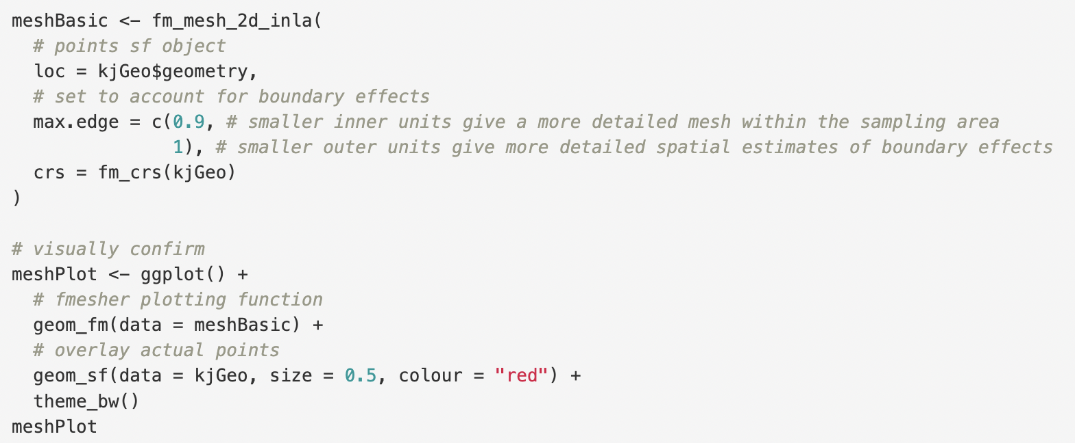

2D Mesh & SPDE

Slide 10
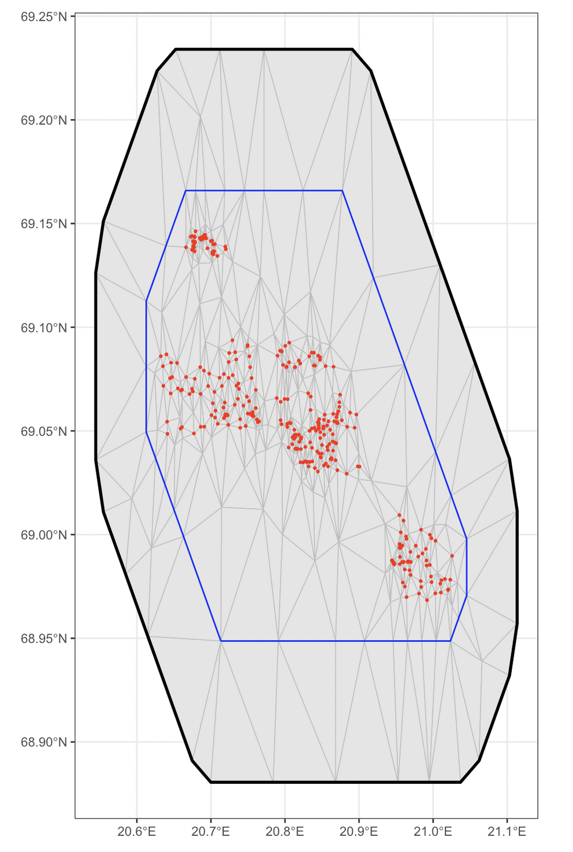
2D Mesh & SPDE

Slide 11
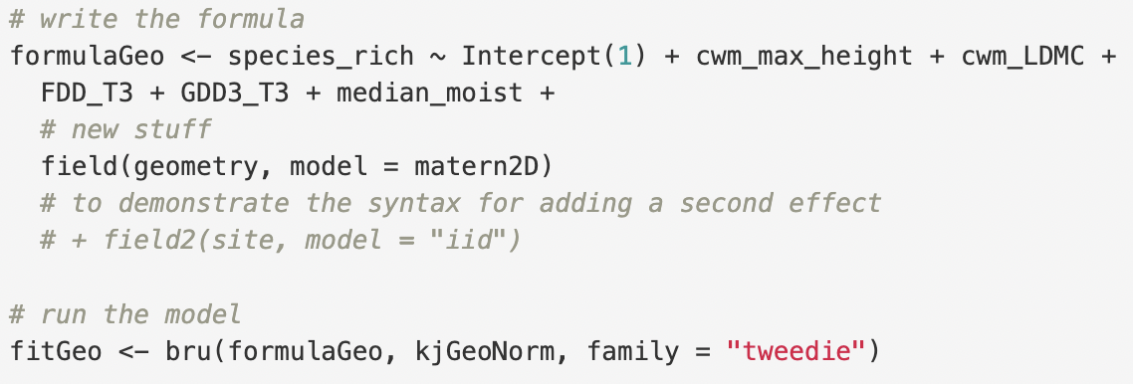
Model Formula & Run

Slide 12
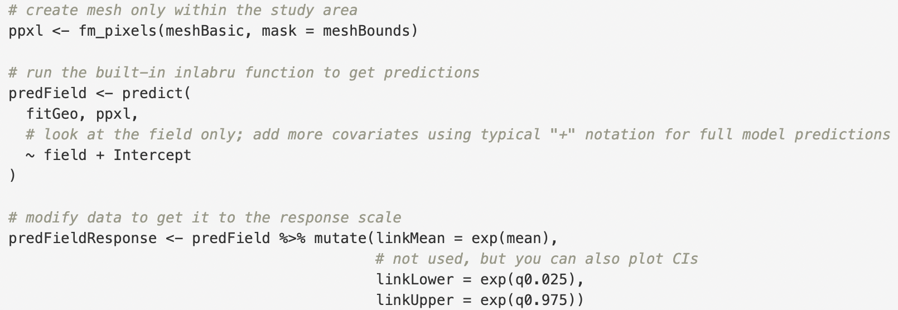
Model Inspection & Checks
  Heavily dependent on model type and analysis aims
  Use summary(), residuals, information criteria (i.e., WAIC, DIC) Make sure to interpret accounting for the model link function and Bayesian methodology
  Check hyperparameters and priors
  Generating predictions is harder but best practice

Slide 13


