Slide 1

PLAN
Motivation: Activity centre (actually maximum range estimates based on poor approximations), density, & abundance estimation
Methods I: Figure 1, Explanation about what is different survey (distance and time)
Method II
Spacial capture recapture
Lambda, Density g0s (add k and g to model equations), i = individuals, j = traps, k = occasions ( This does not exist in their survey; 1 occasion per ssession, g= session
Results I: Figure 2 & Table 3
Results II: Figure 3
Discussion/Limitations 1
No change in detection probabilities
No covariates
Separability: p0 and sigma are poorly separated and react poorly to using the same covariates
Density surfaces and closure issues may warrant more robust theoretical models
Discussion/Limitations 2
Good call-out of papers underestimating home range and overestimating localised densities
Animal behaviour may be an issue with small numbers of individuals: castor oil, trap-happiness, trap-shyness, and only 1 occasion

Slide 2

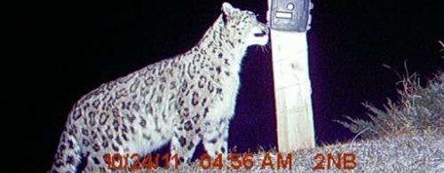

Spatially-Explicit Capture-Recapture in Karakoram
Max Riffi-Aslett, Misha Tseitlin

Slide 3
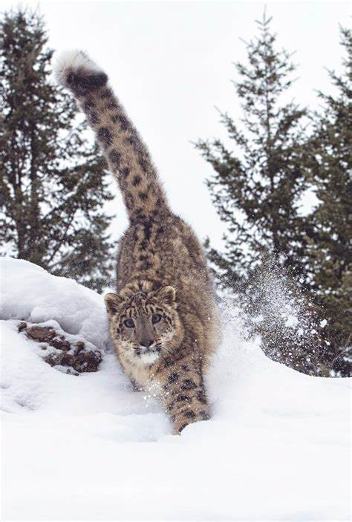
Motivations
Design Recommendations: The current understanding of effective SCR study designs for difficult terrains and elusive wildlife is limited
Rethinking 'Activity Centre' Estimates in SCR: In many cases, what is estimated as an 'activity centre' may not accurately reflect the true core area of an animal's activities. Instead, it could be more indicative of the maximum range of the animal.

Slide 4
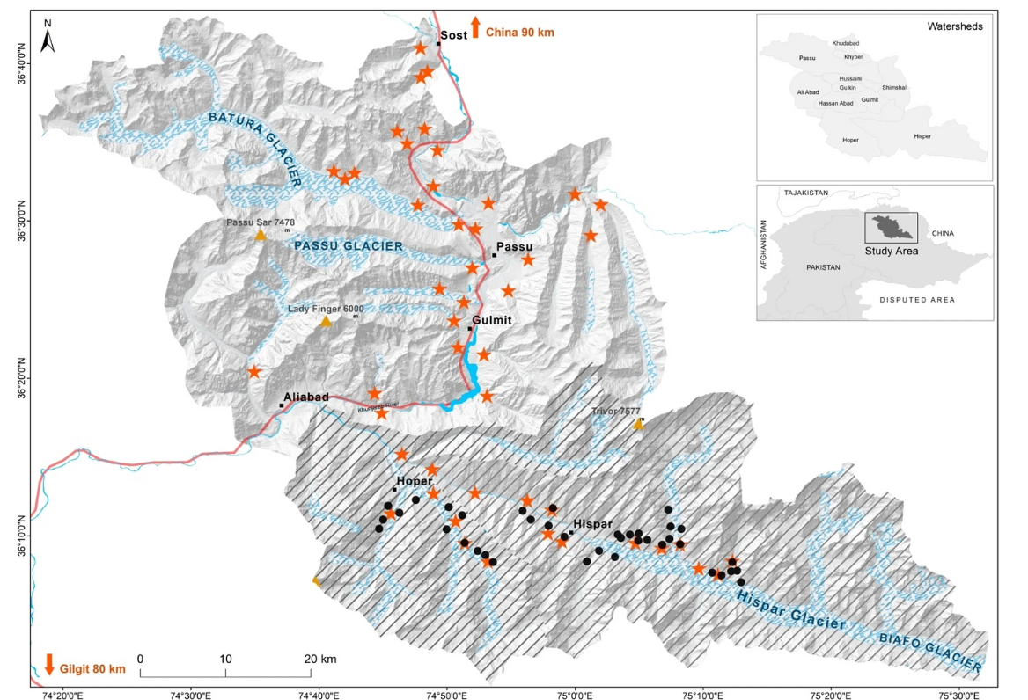
Figure 1: Map of the survey area with camera locations taken from [^1].

Slide 5
Thank you!

Slide 6
Questions?

