Slide 1

PLAN
Motivation: Activity centre (actually maximum range estimates based on poor approximations), density, & abundance estimation
Methods I: Figure 1, Explanation about what is different survey (distance and time)
Method II
Spacial capture recapture
Lambda, Density g0s (add k and g to model equations), i = individuals, j = traps, k = occasions ( This does not exist in their survey; 1 occasion per ssession, g= session
Results I: Figure 2 & Table 3
Results II: Figure 3
Discussion/Limitations 1
No change in detection probabilities
No covariates
Separability: p0 and sigma are poorly separated and react poorly to using the same covariates
Density surfaces and closure issues may warrant more robust theoretical models
Discussion/Limitations 2
Good call-out of papers underestimating home range and overestimating localised densities
Animal behaviour may be an issue with small numbers of individuals: castor oil, trap-happiness, trap-shyness, and only 1 occasion

Slide 2

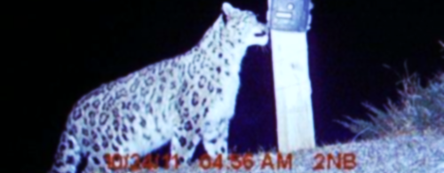

Spatially-Explicit Capture-Recapture in Karakoram
Max Riffi-Aslett, Misha Tseitlin
MT5751 - Project III
Monday, April 1st 2024

Slide 3
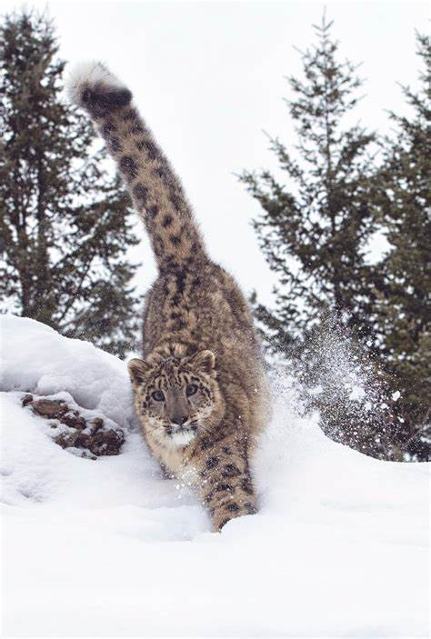
Motivations
Design Recommendations: The current understanding of effective SCR study designs for difficult terrains and elusive wildlife is limited
Rethinking 'Activity Centre' Estimates in SCR: In many cases, what is estimated as an 'activity centre' may not accurately reflect the true core area of an animal's activities. Instead, it could be more indicative of the maximum range of the animal.

Slide 4
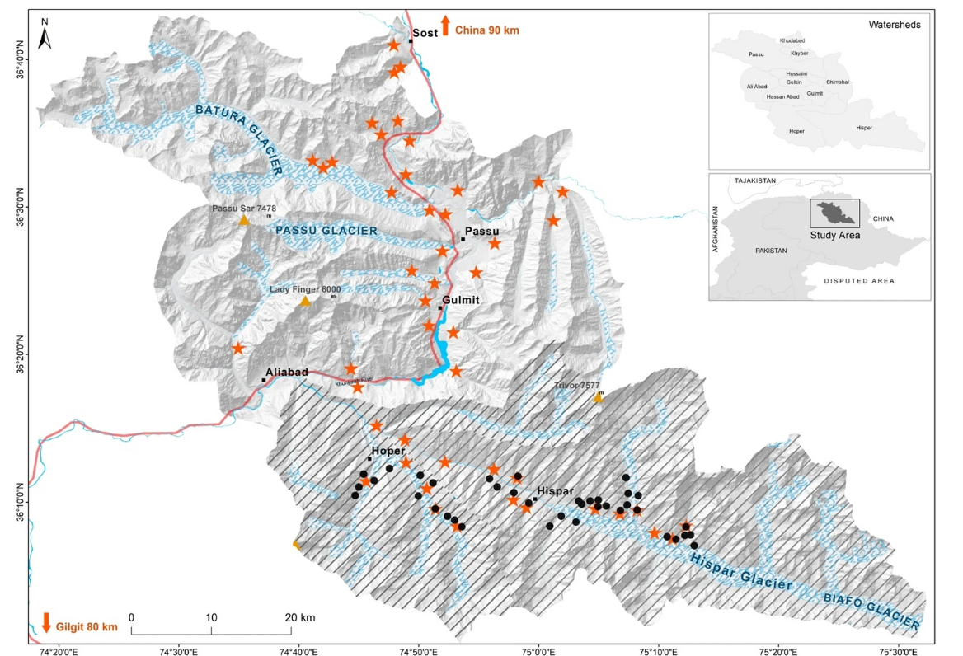
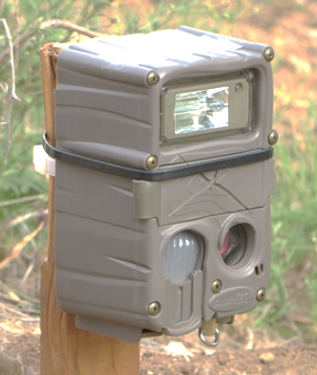
Methods I
^{Survey 1 (Compact Design):}
^{: locations of compact cameras}
^{Timeline: March to May (2016)}
^{Number: 38 cameras}
^{Spacing: 1km2}
^{Area: 253 km2}
Density: 15 cameras per 100 km2
Outcome: 27 independent capture events, 4 unique individuals
^{Survey 2 (Diffuse Design):}
: locations of diffused cameras
^{Timeline: April to June (2018)}
^{Number: 44 camera traps}
^{Spacing: 5km2}
^{Area: 2030 km2}
^{Density: 2 cameras per 100 km2}
Outcome: 21 independent capture events, and 9 unique individuals
Figure 1: Map of the study area indicating the positions of cameras using circles for compact designs and stars for diffused designs. ^{[1].}

Slide 5
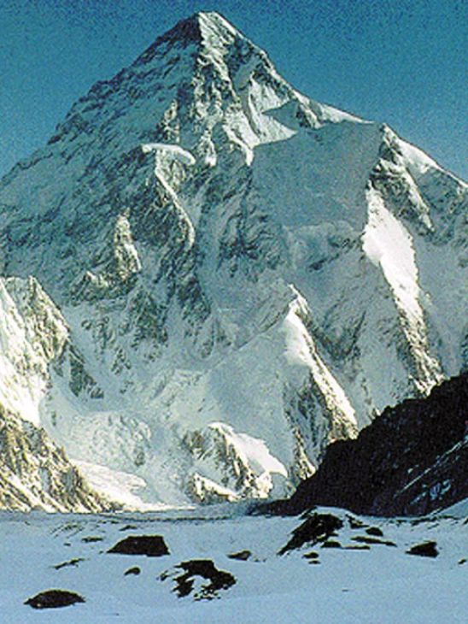
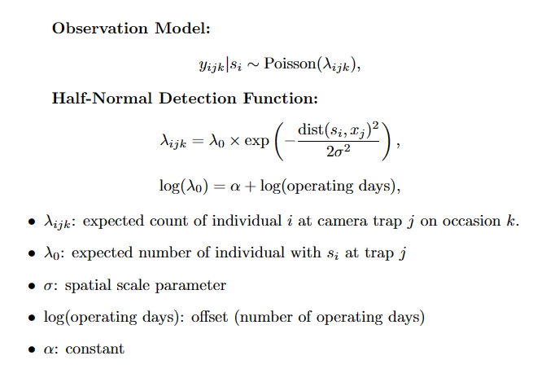
Methods II
Karakoram mountain range in northern Pakistan ^{[2]}.
K2 (RangeMount Godwin Austen), in the Karakoram, int the Pakistani-administered portion of the Kashmir region^{[2]}
Source: (Nawaz, 2021) ^{[1]}

Slide 6
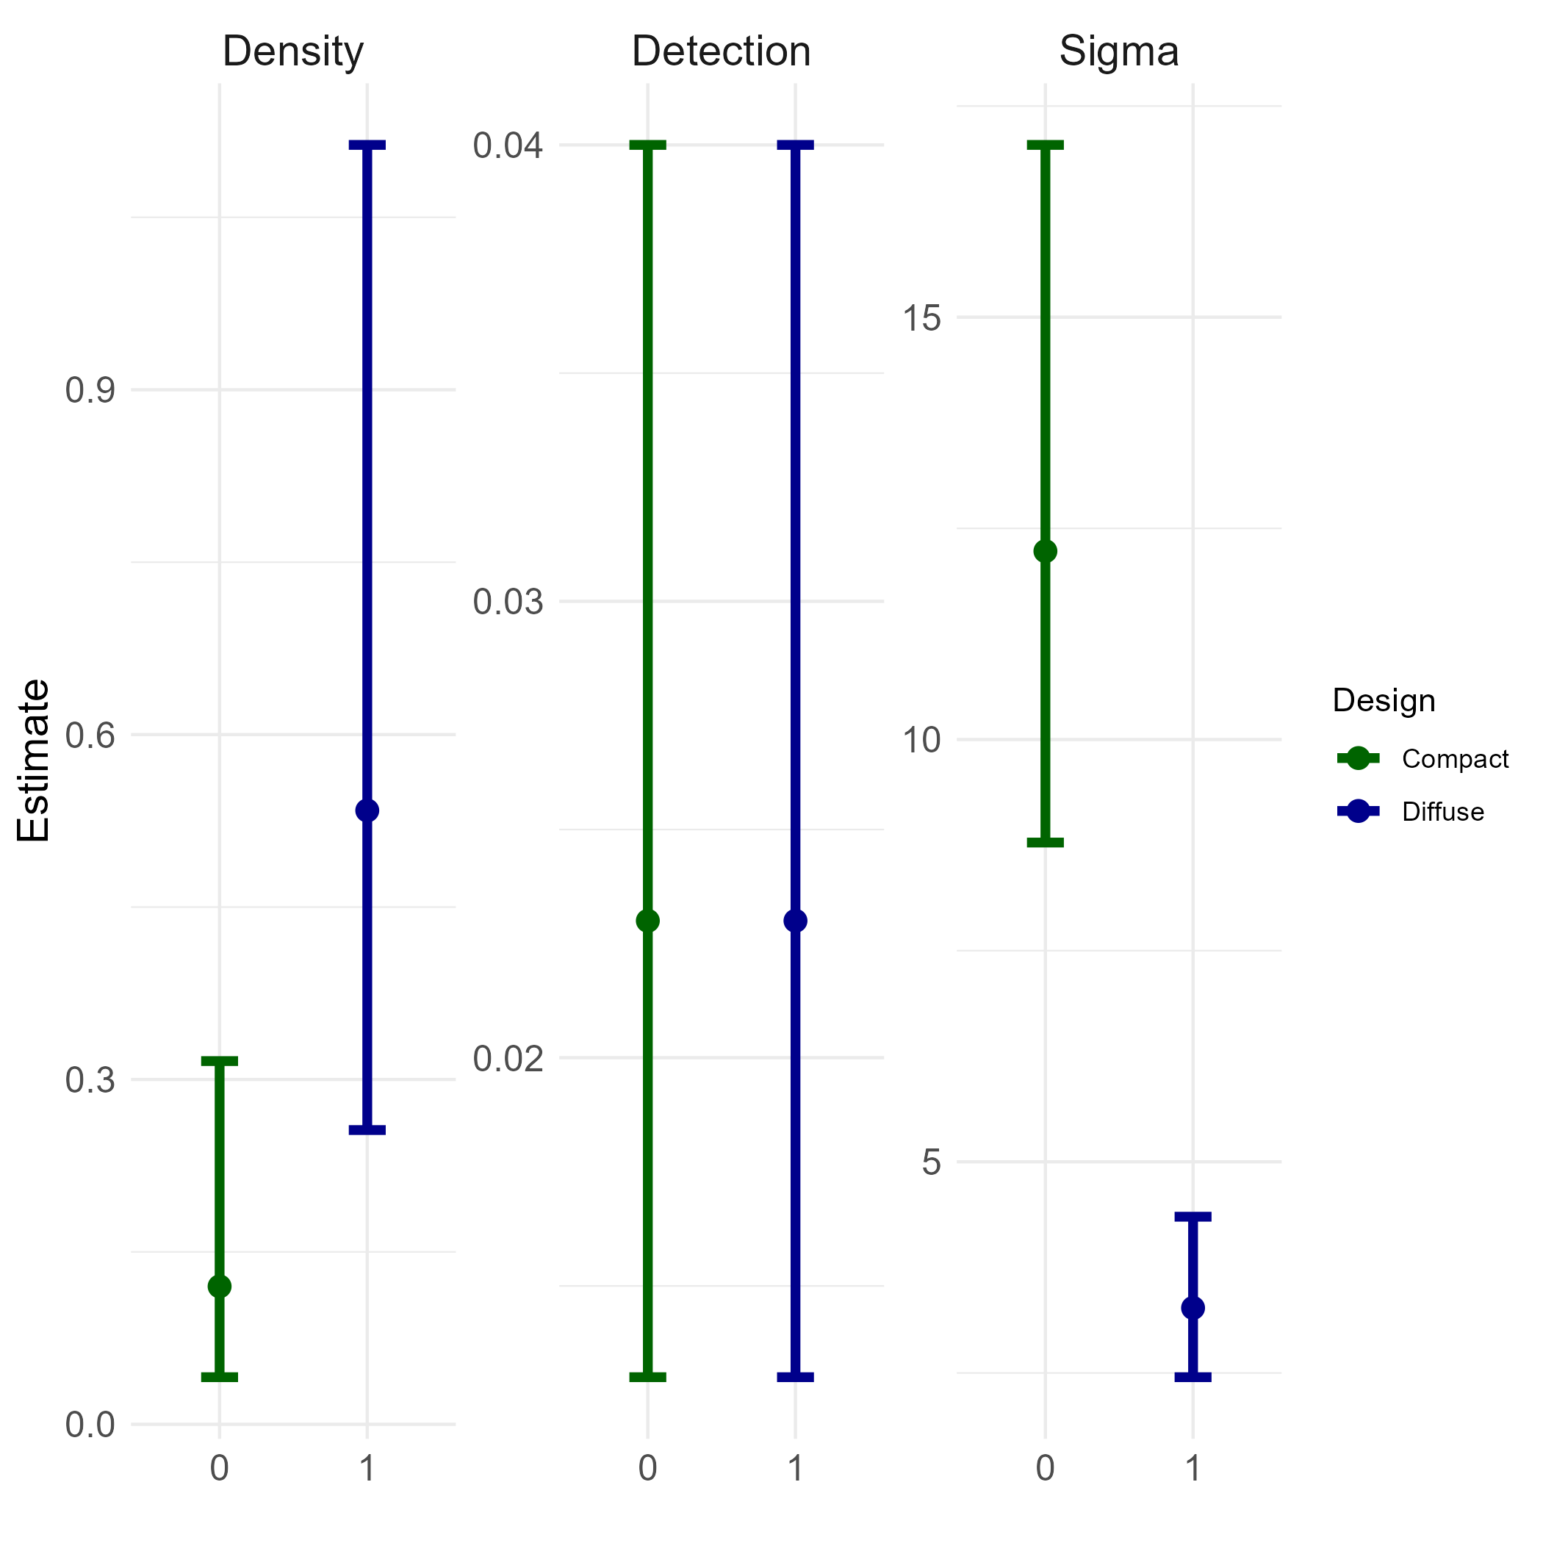
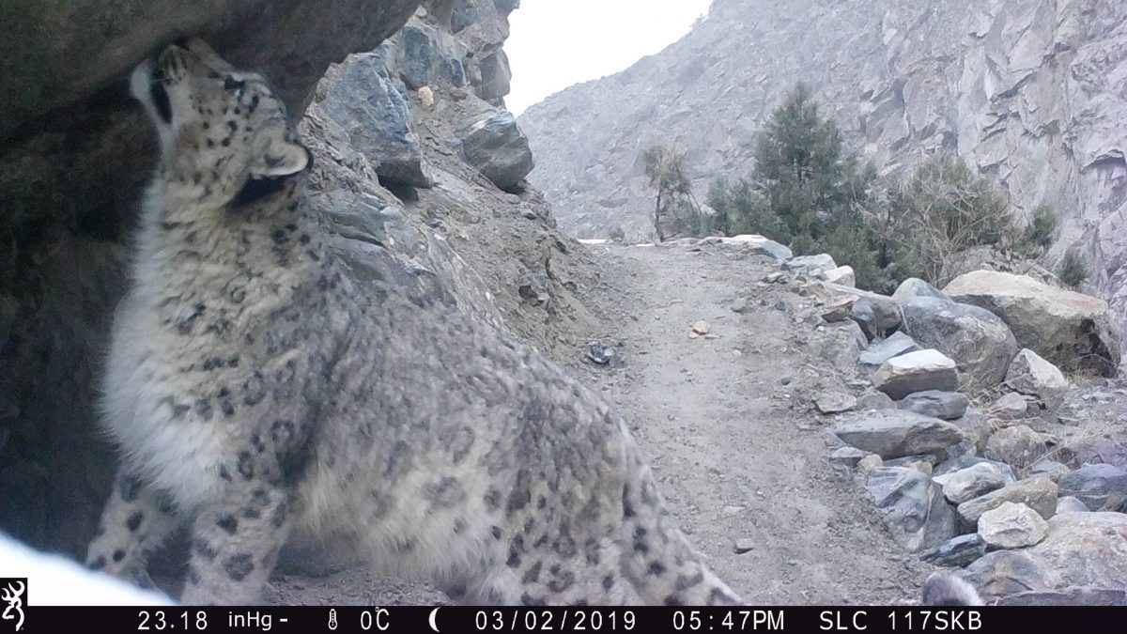
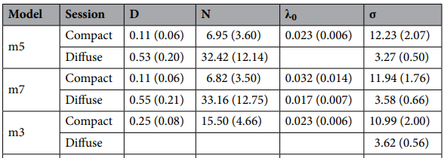
Results I:
Home range size
Compact : 2764.23 km²
Diffuse: 201.22 km²
A Snow Leopard Captured on Camera Trap in Pakistan, Snow Leopard Conservancy. (2020, March 11) ^{[3]}
Figure 2: Effect of design on SCR parameter estimates. Bars indicate 95% Confidence Intervals. ^{[1].}
Table 1: Parameter estimates of SCR. D density/100 km2 , Ν population, 0 detection probability, σ spatial scale parameter. ^{[1].}

Slide 7
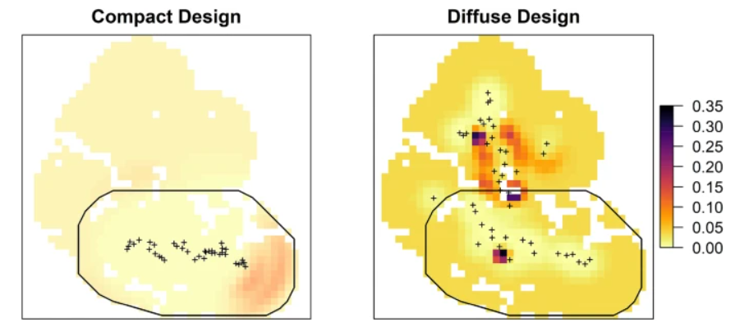
Results II:
This slide seems a bit weak????
Figure 3: Spatial pattern of snow leopard density (animals/100 km²) plus sign represents trap locations. Black polygon marks area of compact design ^{[1]}

Slide 8
No change in detection probabilities
No covariates
Separability: p0 and sigma are poorly separated and react poorly to using the same covariates
Density surfaces and closure issues may warrant more robust theoretical models
Discussion/Limitations 1

Slide 9
Good call-out of papers underestimating home range and overestimating localised densities
Animal behaviour may be an issue with small numbers of individuals: castor oil, trap-happiness, trap-shyness, and only 1 occasion
Discussion/Limitations 1

Slide 10
References
[1] : Nawaz, M. A., Khan, B. U., Mahmood, A., Younas, M., Din, J. u., & Sutherland, C. (2021). An empirical demonstration of the effect of study design on density estimations. Scientific Reports, 11(13104). https://doi.org/10.1038/s41598-021-92668-9
[2] K2 (Mount Godwin Austen), in the Karakoram Range, viewed from the Gilgit-Baltistan district of the Pakistani-administered portion of the Kashmir region. https://www.britannica.com/place/Karakoram-Range
[3] Snow Leopard Conservancy. (2020, March 11). Using camera trap technology to monitor snow leopards [Blog post]. Retrieved from https://snowleopardconservancy.org/2020/03/11/using-camera-trap-technology-to-monitor-snow-leopards/

