Slide 1
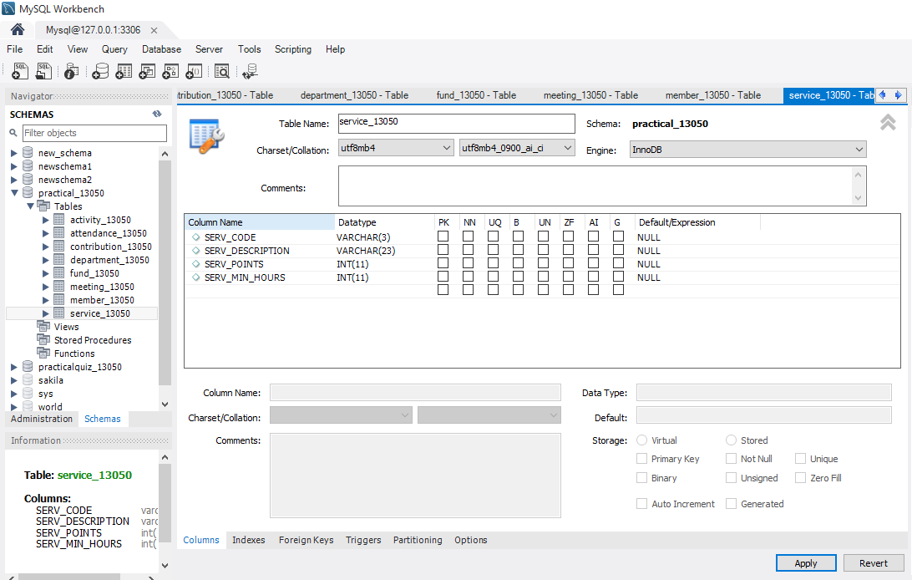
Dumping data in mysql

Slide 2
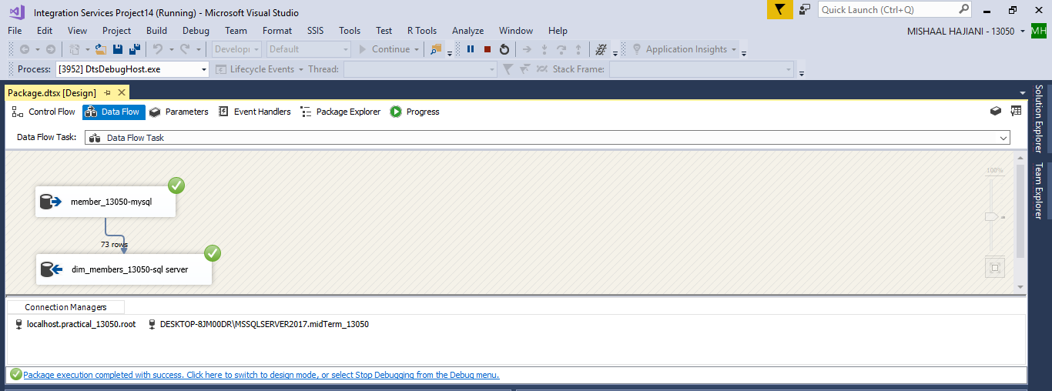

Slide 3
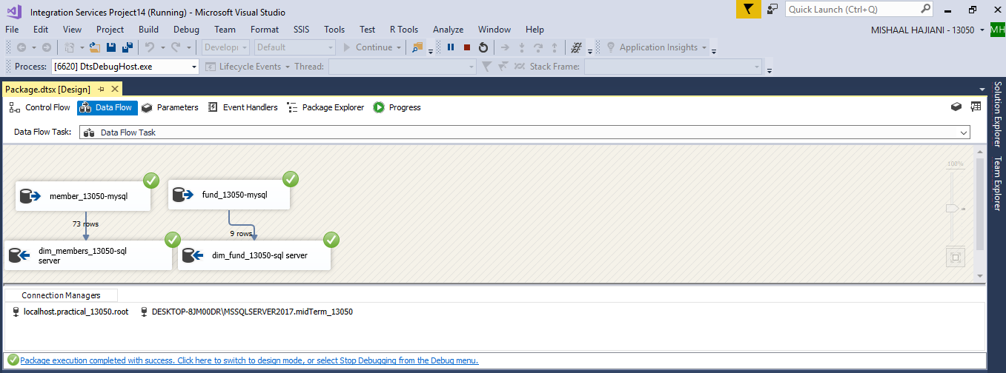

Slide 4
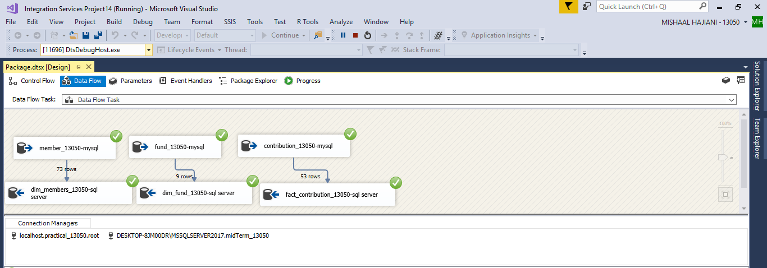

Slide 5
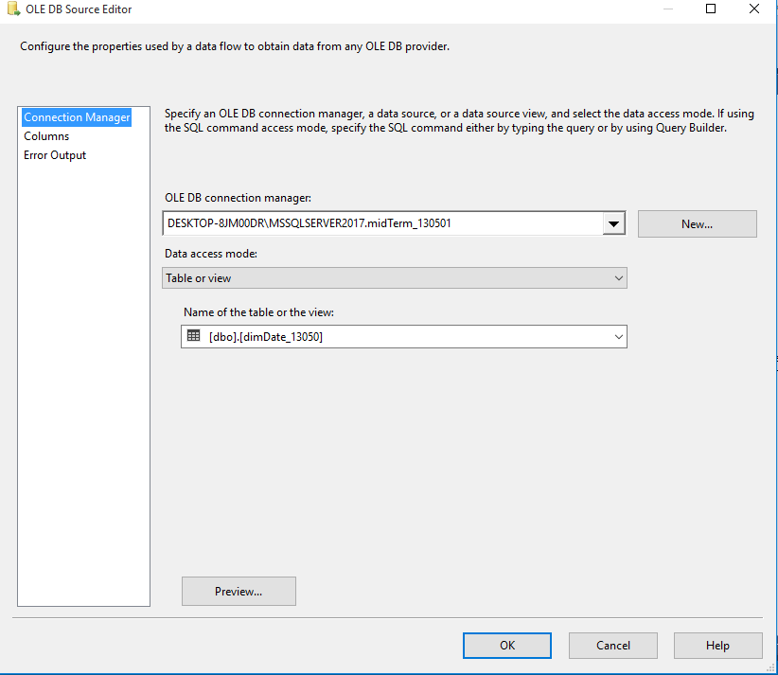
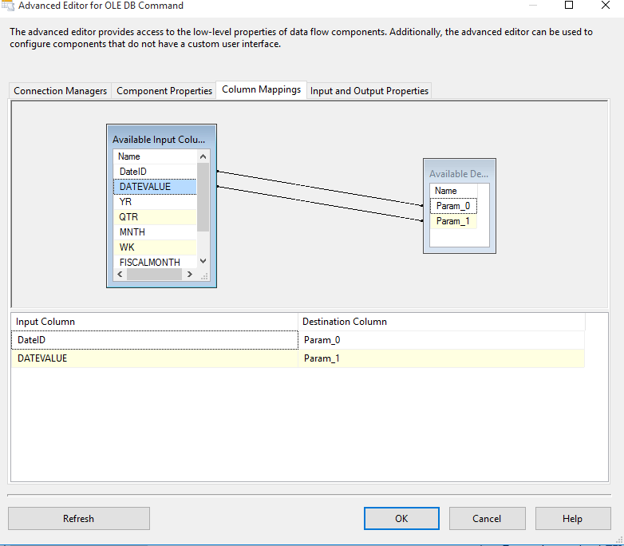

Slide 6
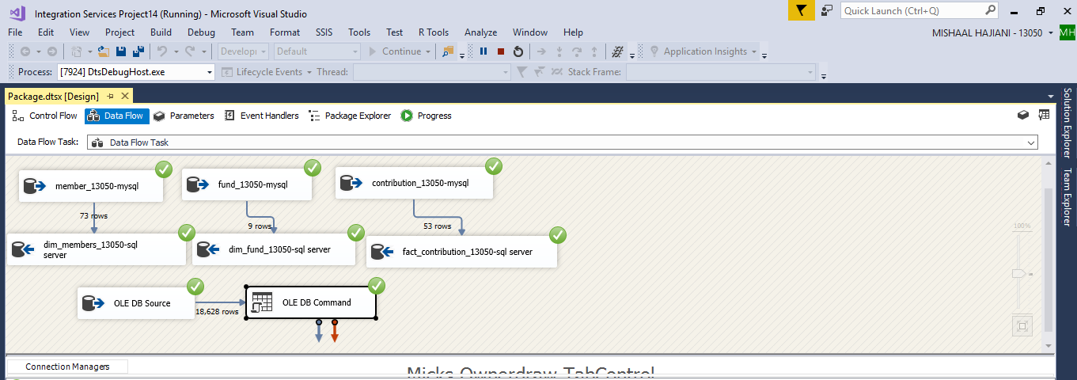

Slide 7
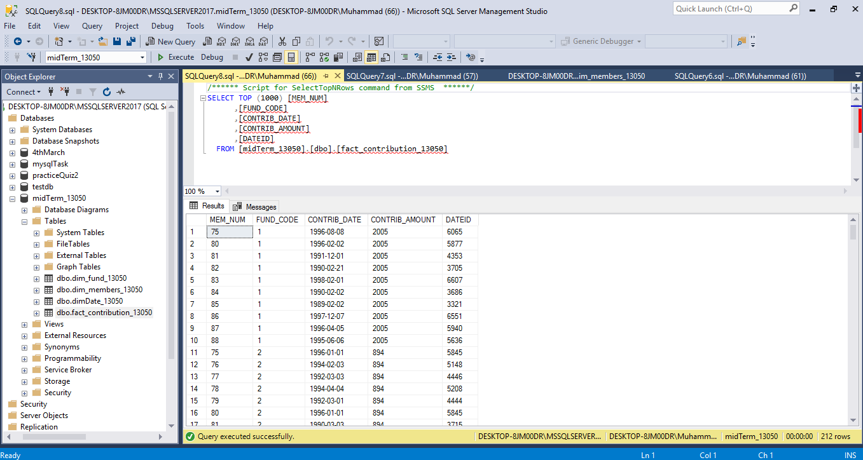

Slide 8
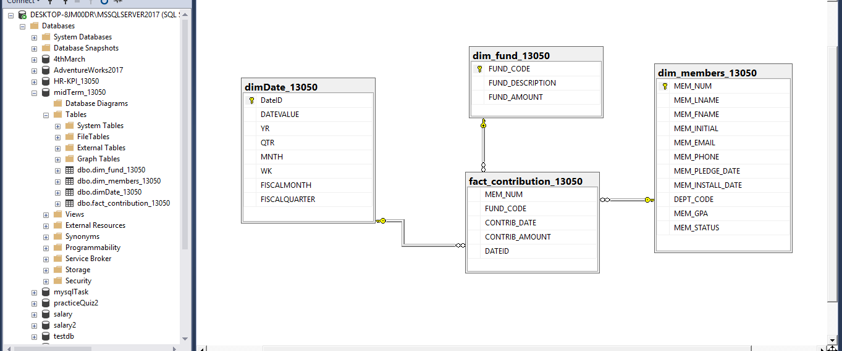

Slide 9
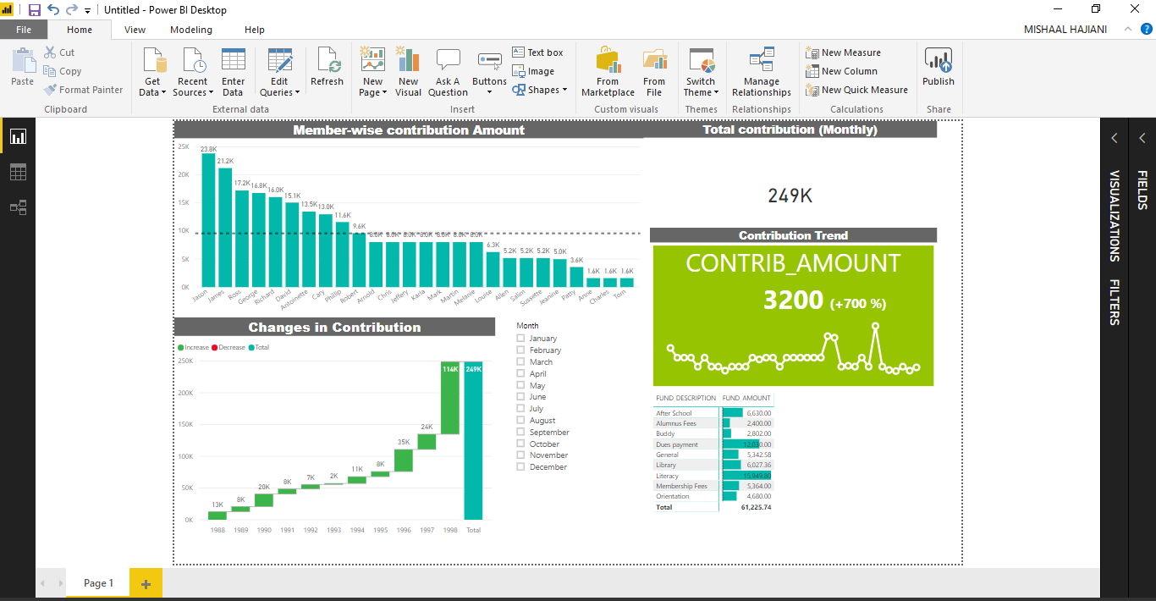

Slide 10
This dashboard walks through the story of XYZ university members funding. This data set ranges from year 1988-1998.Total amount of contribution for 10 years recorded were 249K. All over analysis says that highest amount of contribution was given by a member named ‘jason’ i.e. approximately 23.9K. The Least contribution was given by ‘Tom’ i.e. 1.6 K. It was also noticed that there is no consistency in funding by the members. Thus, the contribution trend is increasing both monthly any yearly, and overall. This depicts that the university is receiving good funding and hence, can use this funding for the betterment of the university (e.g. infrastructure or academics). The maximum contribution was collected in the month of February.
It is recommended that each month each member should contribute certain amount of money as fund.

