Slide 1
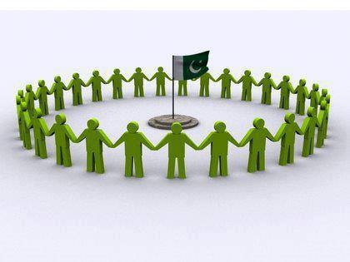
YOUTH OF PAKISTAN
Mishaal Aslam
BITF21M526

Slide 2
OUTLINE
1
What is Youth?
2
Types of Youth and their history
3
Importance of Youth
4
Role of Youth Today
5
Youth responsibilities and Rights
6
What Youth can do?

Slide 3

What is YOUTH?
Aslam 01
Youth is defined as a period during which a person prepares himself/herself to be an active and fully responsible member of the society(Zeeshan 01).
64 percent of Pakistani population is under 30 years, while 29 percent belongs to the 15-29 age bracket(Latif and Talib para 01).
64% Youth
64% Youth

Slide 4
Types of Youth
Aslam 02
Respectable Youth
Delinquent youth
Cultural Rebels
Politically Militant Youth
Avoid involvement in teen culture
Well behaved
Polite
Straight Youth
Careless
Impertinent
Trouble makers
Involved in illegal activities
Socially unconventional
Interested in and support Artists
Hippies
Interested in Politics
Have decision making skills
Protest for rights
(Duffy 02)

Slide 5


Importance of Youth
Aslam 03
Islam has given youth a high status. A verse from Quran says:
“Indeed, they were youths who believed in their Lord, and We increased them in guidance”(qtd in Dajani para 03).
We cannot always build the future for our youth, but we can build our youth for the future(qtd. in “Role of youth in development of Pakistan para 4).

Slide 6

Importance of Youth
Aslam 04
Young people not only represent future of a country, they are one of society’s main agent of change and progress development (Who are the Youth of today? Para 04).
Youth have great effect on economic development(Who are the Youth of today? Para 04).
Youth is our present as well as our future, the generation that will solve future crises, write policies and preserve or destroy democracies and system of justice(Our Youth, Our Future 01).
Youth is strength of nation(Our Youth, Our Future 01).
Youth is the structural and functional framework of nation.

Slide 7
HISTORY OF YOUTH
Aslam 05
IN ISLAM:
Khulafa-e-Rashdeen
Hazrat Abu Bakr Siddique(R.A)
Hazrat Umar Farooq(R.A)
Hazrat Usman Ghani(R.A)
Hazrat Ali(R.A)
Hazrat Ayesha Siddiqa(R.A)
Hazrat Ayesha Saddiqa R.A(the mother of beleivers) has been a teacher, political leader and a warrior.
(Usama 06)

Slide 8
HISTORY OF YOUTH
Aslam 06
Hazrat Asma(R.A)
Young Sahabiya Hazrat Asma(R.A) bint Abi Bakr al Siddique support Islam and Prophet(SAW) (Usama 08).
Hazrat Sumayyah(R.A)
Sumayyah bint Khabbab was one of those who stood fast and embraced Islam when Muslims were few and their success was only through patience upon the truth(Usama 10).
Ali ibn Abi Talib
He was first to accept Islam. His age at that time was ten(Usama 14).

Slide 9
HISTORY OF YOUTH
Aslam 07
Khalid bin al Walid(R.A)
He has the title of “Sayf Allah al maslul” (the Drawn sword of Allah) (Usama 16).
Mus’ab Bin Umair(R.A)
He was a gallent soldier, a fearless warior and has the duty to instruct Ansar who believe in Prophet(SAW) (Usama 15).
Salman Al Farsi(R.A)
At the battle of khandaq, he proved to be an innovator in military strategy(Usama 17).

Slide 10
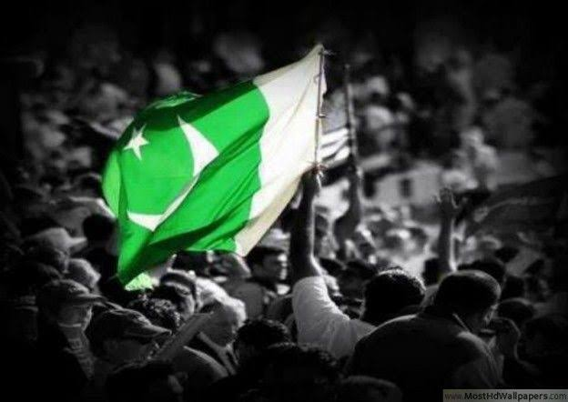
HISTORY OF YOUTH
Aslam 08
IN PAKISTAN MOVEMENT
Sir Syed Ahmad khan and many others
(Ali 04)

Slide 11
Role of Youth Today
Aslam 09
1
1
Professionals
(Farooq 06 )
5
Helpers
(Farooq 07)
1
2
Sportspersons
(Farooq 07)
6
Optimists
(Farooq 05)
1
Entrepreneurs
(Farooq 06 )
1
3
7
Speakers
(Farooq 06 )
1
Nation Builders
(Farooq 08)
8
Voters
(Farooq 05 )
4
(Youth the future lies in their hands

Slide 12

ROLE OF YOUTH TODAY
Aslam 10
Junaid Iqbal
Working as a trainer and advocate of education
Hazaram khan
Highlighting the issues of Balochistan.She is working as a vice president of Lyari Literary forum
Abdul Rehman
Working hard in pursuing his dreams and making his country proud
Lal Rai
Designed and lead multiple peace compaigns with diverse youth

Slide 13
Responsibilities of Youth
Aslam 11
1. Education
2. Respect of elders
3. Love for Country
4. Offer Prayers
5. Spend life according to
Islamic Rules
(Responsibilities of Youth para 01).

Slide 14

Aslam 12
O sublime cresent moon!
Active shinning sun at noon!
Amplify your energy with cheer;
Spread positive waves without fear
Muscles of iron like a beam;
Give wings to your ideal dream;
Faith of yours a guiding star;
Take Untrodden path afar

Slide 15

Problems of Youth
Aslam 13
Deficiencies and excesses in nutrient intake, imbalance of essential nutrients.
Malnutrition
01
(Malnutrition Para 01).
Bullying, child labour, child mariages and drug addiction
Mental Health
02
Mental Health
(10 Major Causes of Psychological problems in Pakistan
Para 01).
Polio or poliomyelitis is a disabling and life threatening disease caused by polio virus.
03
Polio
(What is Polio? Para 01).

Slide 16

RIGHTS OF YOUTH
Aslam 14
Shelter and Food Access
Freedom and liberty
Discrimination
To Work and use Money
Education and Learning
Employment
Social Justice
(Youth Rights)

Slide 17

What Youth can do?
Aslam 15
Power to make our country from developing nation to a developed nation
Youth hopes a world free of poverty, unemployment and inequality
Brave to make changes
Can bring economic Prosperity
Torchbearer of change and reforms
Future of nation
Provide direction to nation

Slide 18
Works Cited
Aslam 16
Dajani,Haneen. “Friday Sermon: The value of Youth”, The National, Nov 5,2015, www.thenationalnews.com,
Accessed November 30,2022,
Duffy,Daniel.“Youth Types”,Slideshare, April 24,2016, www.slideshare.net ,Accessed November 29,2022,
Farooq,Rida. “The role of Pakistani Youth today”,Slideshare,Aug 16,2015,www.slideshare.net, Accessed
November 29,2022,
Latif,Hamza, and Monimna Talib.“Youth Buldge:Demographic Dividend or Disaster?”,The
Friday Times, August 12,2022, www.thefridaytimes.com,Accessed November 30, 2022,

Slide 19
Works Cited
Aslam 17
“Malnutrition”,WHO,www.who.int,Accessed December 01,2022,
“Our Youth, Our Future”,Fair Planet, www.fairpanet.org ,Accessed December 01, 2022,
“Responsibilities of Youth”, Daily Parliament Times,December24,2021,www.dailyparliments.com,
Accessed December 01,2022,
Usama,Muhammad.“The role of Youth in making Islam Prevail”, Slideshare,Jan 11,2013,
www.slideshare.net, Accessed November 29,2022,

Slide 20
Works Cited
Aslam 18
“What are Youth Rights?”,Free Child,Jun 21,2022,www.freechild.org,Accessed November 29,2022
“Who are the Youth of Today?”,UNICEF,www.unicef.org,Accessed December 01,2022,
“Youth, the Future lies in their hands”,The news,Aug 14,2021,www.thenews.com.pk,Accessed
November 29,2022,
Zeeshan,Muhammad.“review of different youth organizations in pakistan”,Slideshare,Jan 20,2018,
www.slideshare.net ,Accessed November 29,2022,

Slide 21
تو شاہیں ہے پرواز ہے کام تیرا
ترے سامنے آسماں اور بھی ہیں
Thank you

