Slide 1

SERVICE LEARNING
DAKSH
Judicial Research and Court-Case Information Platform
Structured Court Data, Searchable Research & Intelligent Analytics
Community Partner: DAKSH
Community Organization
DAKSH Society
Bengaluru, Karnataka, India
Advancing Justice System Reforms & Judicial Research
Team Details (5BTCS AIML A):
Mishael Julian – 2462184
Steven Mathew – 2462157
Julius Thomas – 2462095
Abhishan Francis – 2462835
Rahul Prakash – 2462133
Core Values
Faith in God | Moral Uprightness | Love of Fellow Beings | Social Responsibility
Pursuit of Excellence
Mission
Christ University is a nurturing ground for an individual’s
holistic development to make effective contribution
Vision
Excellence and Service
to the society in a dynamic environment

Slide 2
ABSTRACT
EXECUTIVE SUMMARY
DAKSH: A Judicial Research and Court-Case Information Platform
System Overview: DAKSH is envisioned as an end-to-end judicial research platform that organizes publicly available court-case information into a structured, centralized, and searchable ecosystem. The project directly addresses the friction of repeatedly navigating fragmented court records when conducting empirical case-level research.
Data Acquisition Foundation: An automated data acquisition layer powered by Playwright systematically collects case details, party hierarchies, acts/sections, hearing histories, daily status business logs, and final orders/judgments from the eCourts portal.
Structured Information Storage: Collected information is normalized into structured database models that preserve complete case lifecycles, full relational linkages, and linguistic fidelity (including Kannada/vernacular scripts) with zero data loss.
Researcher-Centric Application: A dedicated web application provides researchers with intuitive multi-parameter filters, dropdowns, full-text case search, and a unified case workspace, eliminating tedious manual record compilation.
Future Intelligence Roadmap: The platform establishes a verified foundation for future analytical capabilities, including case similarity clustering, pendency trend analysis, and decision-support case prioritization.

Slide 3
COMMUNITY PROFILE & PROBLEMS FACED
STAKEHOLDERS & CONTEXT
Community Profile & Stakeholders
Community Partner: DAKSH (Bengaluru) — Leading civil society organization researching justice administration and court data transparency.
Target Users: Judicial researchers, empirical legal scholars, and policy analysts studying case pendency, delay patterns, and procedural flows.
Core Benefit: Enables researchers to spend time analyzing judicial trends rather than manually locating and copying basic records.
Ethical Boundaries: Operates strictly on public eCourts data; does NOT make judicial rulings or replace legal counsel.
Problems Faced by Judicial Researchers
Data Fragmentation: Crucial case details, hearing logs, process tables, and daily orders are scattered across multiple disparate web tabs and popups.
Separate Order Links: Daily business records and substantive orders must be clicked and inspected individually, requiring dozens of clicks per case.
Lack of Relational Querying: eCourts does not support querying across multi-variable parameters (e.g., comparing disposal stages across case types).
Scalability Bottleneck: Manual copy-pasting is error-prone and practically impossible for large-scale empirical studies across hundreds of cases.

Slide 4
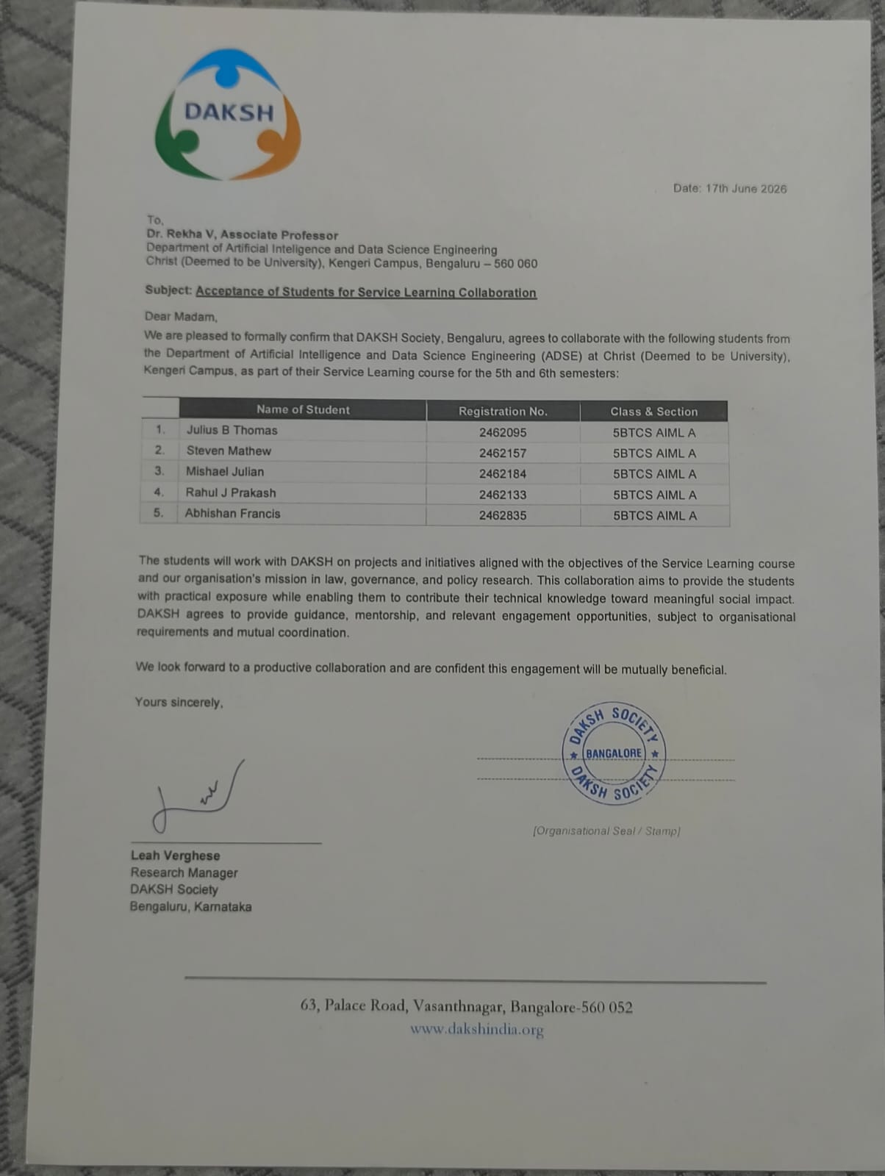
CONFIRMATION LETTER

Slide 5
NEED ANALYSIS
LOGICAL PROGRESSION
1. CURRENT STATE — Researchers navigate individual eCourts portal pages and disparate case tabs manually.
2. STRUCTURAL CHALLENGE — Relevant information is highly fragmented across case details, hearings, processes, and orders.
3. MANUAL BURDEN — Repetitive manual lookup, note-taking, and copying cause severe human fatigue and transcription error.
4. SCALABILITY BOTTLENECK — Empirical legal research cannot scale beyond small sample sizes due to massive labor overhead.
5. SYSTEMIC NEED — A centralized, structured, and auditable judicial research information system.
6. DAKSH SOLUTION — End-to-end platform: Automated Data Layer + Structured Database + Researcher Workspace.

Slide 6
IMPACT IF THE PROBLEM REMAINS UNSOLVED
CONSEQUENCE ANALYSIS
Research & Institutional Consequences
Perpetual Manual Inefficiency: Researchers will continue spending over 80% of project time on routine portal navigation and copy-pasting instead of data analysis.
Severe Sample Size Limitations: Judicial studies remain restricted to 20–50 cases, preventing macro-level empirical evaluation of court administration.
Fragmented Institutional Datasets: Every research team compiles isolated, ad-hoc spreadsheets without standardized schemas, hindering cross-study comparison.
Incomplete Historical Context: Failure to systematically capture daily status transcripts leads to lost procedural insights regarding case adjournments.
Policy & Civic Consequences
Delayed Evidence-Based Insights: Policy think tanks and reform advocates lack aggregated empirical evidence to recommend procedural improvements.
Barriers to Transparency: Public court information remains technically public but practically inaccessible for comprehensive empirical auditing.
Inability to Track Case Lifecycles: Execution Petitions (EX) and pending decrees cannot be tracked longitudinally across years and court complexes.
High Opportunity Cost: Substantial academic funding and researcher effort are wasted on redundant manual data extraction.

Slide 7
PROBLEM STATEMENT
CORE FORMULATION
Formal Problem Formulation
“Judicial researchers investigating court administration and case workflows are severely hindered by the fragmented, multi-page structure of public court portals. The lack of a centralized, structured database and researcher-centric query workspace turns large-scale case analysis into an error-prone, repetitive, and labor-intensive manual endeavor. There is an urgent need for an integrated judicial research platform that systematically acquires, validates, and normalizes public eCourts data into structured records, providing an intuitive workspace for rich search, multidimensional filtering, and downstream analytical exploration.”
• Data Fragmentation: Disjointed storage across multiple HTML pages and popups without unified indexing.
• Manual Friction: High manual overhead for CAPTCHAs, search navigation, and spreadsheet transcription.
• Platform Necessity: Requirement for an end-to-end system: Ingestion → Normalized Database → Researcher UI/UX.

Slide 8
PROJECT OBJECTIVES
PLATFORM GOALS
1. Automated Data Acquisition
Systematically collect publicly available case records, hearing histories, daily status logs, processes, and orders from the eCourts portal using Playwright automation.
2. Structured Information Modeling
Organize extracted case details into normalized, strongly-typed relational records (CNR, registration details, parties, acts, hearings, business transcripts).
3. Relational Storage Architecture
Develop a structured database schema and export pipeline preserving complete case context with zero data loss and full Unicode (Kannada) fidelity.
4. Intuitive Researcher UI/UX
Design a centralized web workspace providing multi-parameter search, dynamic court/case-type dropdowns, and tabbed case inspection views.
5. Elimination of Manual Overhead
Dramatically reduce repetitive manual lookup time, enabling empirical researchers to focus on data analysis rather than data retrieval.
6. Foundation for Future AI/ML
Establish an auditable data foundation capable of supporting future case similarity clustering, pendency trend analytics, and researcher-defined prioritization.

Slide 9
PROPOSED SYSTEM ARCHITECTURE
MULTI-TIER PLATFORM
TIER 1: PUBLIC DATA SOURCE → Official eCourts Services Portal (District Courts / City Civil Court Complexes)
TIER 2: DATA ACQUISITION LAYER → Python 3.12 + Playwright Automation | Session Lifecycle & Human-in-the-Loop CAPTCHA
TIER 3: PARSING & VALIDATION → BeautifulSoup4 DOM Extraction | 100% Zero-Loss Field Audit Suite & Parity Verifier
TIER 4: STRUCTURED STORAGE → Normalized Data Models | Relational Schema, JSON Records, Consolidated Master CSV/XLSX
TIER 5: DAKSH APPLICATION CORE → Query Engine, Multi-Parameter Filters, Case Workspace Router & Aggregation APIs
TIER 6: RESEARCHER UI/UX WORKSPACE → Search Bar, District/Type Dropdowns, Case Details, Hearing History, Daily Status & Orders
TIER 7: FUTURE AI / ML INTELLIGENCE → Case Clustering, Pendency Trend Analytics & Decision-Support Case Priority Queue [FUTURE]

Slide 10
DATA ACQUISITION LAYER
FOUNDATIONAL INGESTION TIER
Automated Navigation & Ingestion
Role in Hierarchy: Scraping is strictly the data acquisition foundation — not the final research application.
Target Portal: eCourts Case Status Portal (Search by Case Type / Complex).
State & District Selection: Automated dropdown selection for Karnataka / BENGALURU City Civil Court Complex.
Establishment & Case Type: PRL. CITY CIVIL AND SESSIONS JUDGE / EX – Execution Petition Under Order.
CAPTCHA Handling: Clean pause workflow for human-in-the-loop CAPTCHA entry to ensure reliability.
Deep Section Extraction Workflow
Case Details: Filing/Registration numbers, CNR, first hearing, decision date, case status, judge.
Parties & Advocates: Complete petitioner and respondent hierarchies with assigned legal counsel.
Acts & Sections: Exhaustive extraction of statutory provisions and sections invoked.
Case History: Every hearing row: Judge, Business Date, Hearing Date, Purpose of Hearing.
Orders & Daily Status: Visits EVERY order hyperlink; extracts complete judicial business transcripts.
Zero Data Loss Audit: Automated parity auditor verifies Web DOM == JSON == CSV == XLSX.

Slide 11
STRUCTURED DATABASE & INFORMATION MODEL
RELATIONAL SCHEMA
Core Entities & Relational Schema
CASE Entity (Master): CNR Number (PK), Registration No, Filing Date, Decision Date, Status, Nature of Disposal, Court/Judge.
Parties & Counsel: 1-to-many relationship: Petitioners, Respondents, and Advocates linked to Case ID.
Acts & Provisions: Statute names, section numbers, and legal classifications.
Hearing History: Chronological table: Business Date, Next Hearing Date, Purpose of Hearing (Notice, Summons, Disposal).
Daily Status & Business: Complete verbatim transcripts of daily orders with disposal remarks.
Processes & Transfers: Process ID, Title, Issue Date, Transferring & Receiving Courts.
Data Integrity & Architectural Benefits
Relational Querying: Enables SQL/indexed querying across complex multi-variable judicial parameters.
Linguistic Preservation: Full UTF-8 with BOM support preserving English, Kannada, and vernacular notations without corruption.
Standardized Export Formats: Provides clean JSON, relational CSVs, and Excel outputs for downstream statistical software.
Extensible Data Foundation: Engineered to seamlessly support future API endpoints, web dashboards, and AI analytics models.

Slide 12
PROPOSED RESEARCHER UI/UX WORKSPACE
PROPOSED APPLICATION UI
Search & Multi-Parameter Filter Panel
Global Search Bar: Direct lookup by CNR Number, Case Number, Party Name, or Advocate Name.
Dynamic Dropdowns: Hierarchical selection: State → District → Court Complex → Establishment.
Case Classification Filters: Filter by Case Type (EX, OS, CC), Filing Year, Decision Year, and Case Status (Pending/Disposed).
Stage & Purpose Filters: Filter cases by specific hearing purposes (e.g., Summons, Evidence, Arguments, Orders).
Interactive Results Grid: Displays matching cases with summary metrics: duration, hearing count, and last order date.
Case Information Workspace (Tabbed View)
Tab 1: Case Overview: Summary cards showing registration metadata, judge, court complex, and disposal nature.
Tab 2: Hearing Chronology: Interactive timeline of all hearing dates, business dates, and recorded hearing purposes.
Tab 3: Daily Status Transcripts: Synchronized transcript viewer displaying daily judicial business notes.
Tab 4: Parties & Advocates: Structured party hierarchy with legal representation history.
Tab 5: Orders & Documents: Centralized repository of all interlocutory and final orders with download options.

Slide 13
RESEARCHER USER JOURNEY
END-TO-END WORKFLOW
1. Open DAKSH Platform → Researcher accesses the centralized judicial research web application.
2. Select Search Parameters → Selects Court Complex (e.g., Bengaluru City Civil), Case Type (EX), and Year range (2010–2023).
3. Apply Research Filters → Applies granular filters by disposal nature, specific statutory act, or pending duration.
4. Inspect Results Explorer → Reviews matching case cards displaying case age, total hearings, and latest stage.
5. Open Case Workspace → Opens a unified workspace displaying synchronized hearing histories, daily notes, and orders.
6. Analyze & Export → Performs cross-case comparison and exports structured datasets (CSV/JSON) for empirical analysis.

Slide 14
FUTURE SCOPE: ANALYTICS & PRIORITIZATION
FUTURE SCOPE — DECISION SUPPORT
AI/ML Judicial Analytics [FUTURE]
Case Clustering: Unsupervised grouping of cases by procedural milestones, stage durations, and statutory provisions.
Pendency & Delay Modeling: Statistical analysis identifying procedural stages causing prolonged case pendency.
Adjournment Pattern Detection: Analyzing hearing intervals and adjournment frequency across case types.
Semantic Retrieval: Vector search across unstructured judicial daily status transcripts and order texts.
Case Prioritization Queue [PROPOSED]
Decision Support Focus: Designed to help researchers organize, rank, and filter large case cohorts for empirical study.
Multi-Factor Scoring: Configurable weights based on case age, total hearings, stage intervals, and statutory importance.
Transparent & Auditable: Every score is fully traceable to explicit features; no black-box predictions.
Human Governance: Strictly an academic decision-support tool; does NOT alter court scheduling or judicial rulings.

Slide 15
TECHNICAL EVIDENCE & CURRENT STATUS
EXECUTION & MILESTONES
Completed & Validated
[CURRENT SYSTEM]
Playwright Automation: Dynamic portal navigation, search execution & human-in-the-loop CAPTCHA.
Multi-Section Parser: Exhaustive extraction of case metadata, parties, acts, hearings & orders.
Daily Status Extraction: Automated opening and scraping of every order hyperlink and business text.
Benchmark Dataset: Gold-standard 2010 Bengaluru City Civil Court EX dataset produced.
In Development
[PROPOSED APP]
Relational DB Modeling: Structuring PostgreSQL / SQLite schema for indexed search.
Researcher UI/UX: Designing frontend with multi-parameter filter dropdowns and case tabs.
Case Workspace Prototyping: Building synchronized timeline viewer for hearing logs and daily orders.
Scaling Pipeline: Scaling extraction from 2010 to 2023–2025 datasets.
Future Scope
[ROADMAP]
AI/ML Judicial Analytics: Case similarity clustering and pendency bottleneck modeling.
Priority Queue Engine: Decision-support scoring for researcher cohort prioritization.
Semantic Search: Vector embeddings for full-text querying across judicial business notes.
Multi-Court Expansion: Scaling pipeline across South Indian district and High Courts.

Slide 16
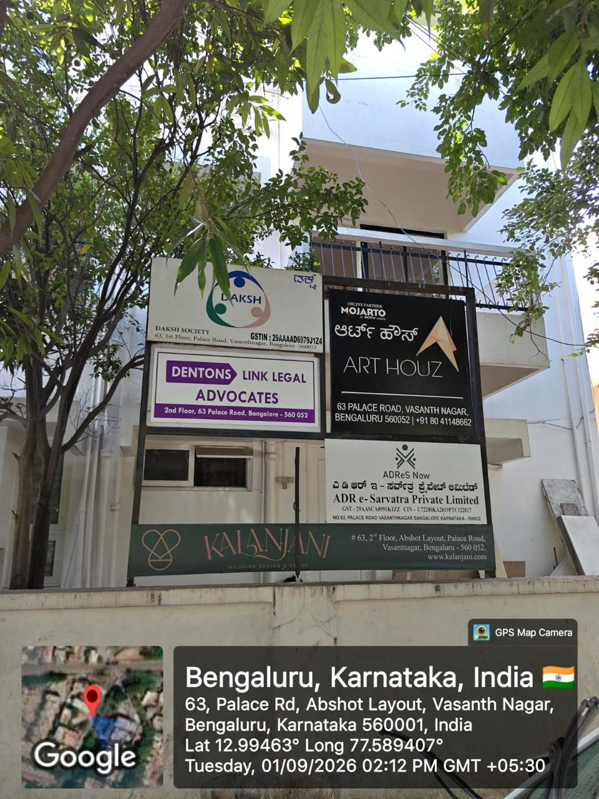
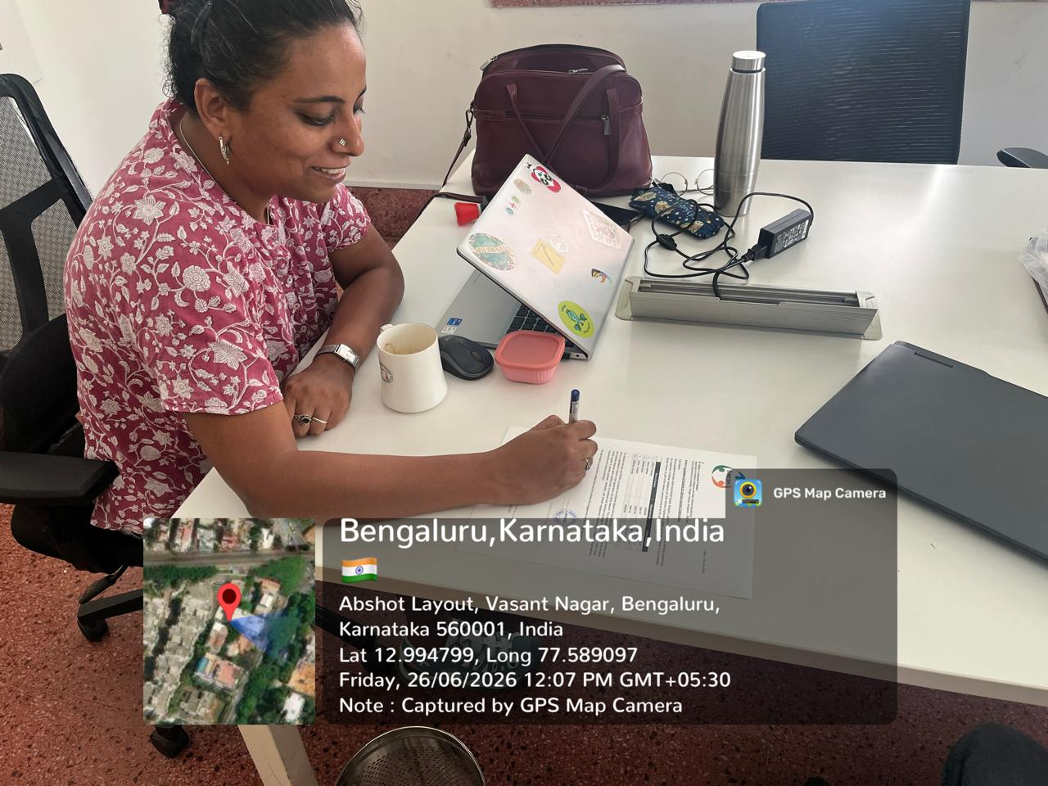
GEOTAG PHOTOS

Slide 17
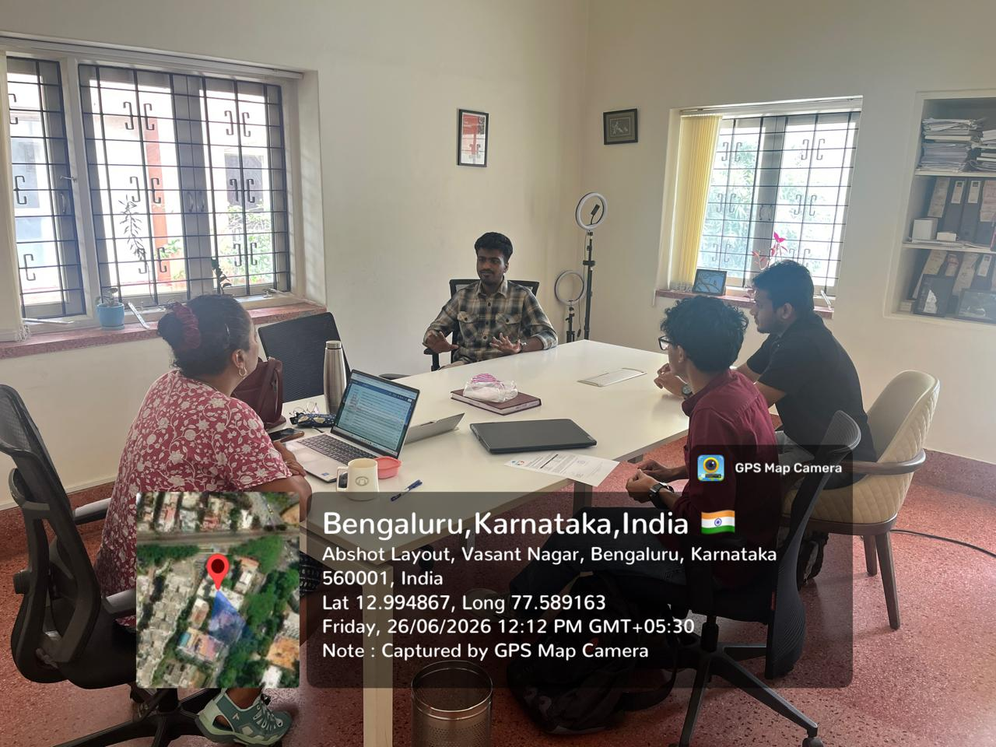
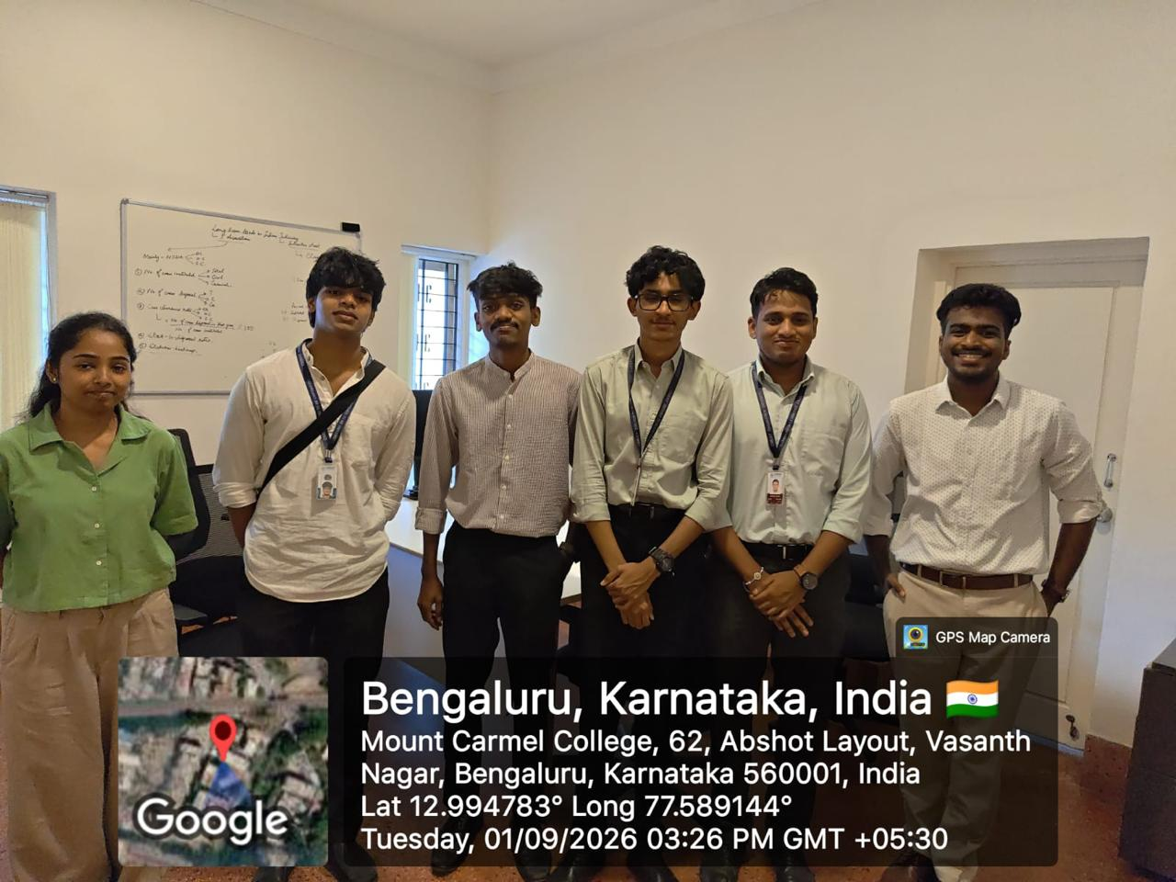
GEOTAG PHOTOS

Slide 18
CONCLUSION & THANK YOU
DAKSH — Judicial Research and Court-Case Information Platform
Transforming Court Information into Empirical Judicial Intelligence
Service Learning Project in Collaboration with DAKSH, Bengaluru
Team: Mishael Julian | Steven Mathew | Julius Thomas | Abhishan Francis | Rahul Prakash (5BTCS AIML A)
Department of Computer Science and Engineering | CHRIST (Deemed to be University), Bengaluru

