Slide 1

SERVICE LEARNING
Ecocare– Smart E-Waste Management and Intelligent System
EcoParadigm
Community Location
#968A, 5th Cross, 11th Main Road,
Vijaya Bank Layout, Bilekahalli, Bengaluru-560076, Karnataka, India.
Team Details:
Ashutosh Dash – 2362044
JV Bhavyasree – 2362093
Sohini Ghosh – 2362170
Sudanshu Sreedhara Belavarthy – 2362177
Core Values
Faith in God| Moral Uprightness Love of Fellow Beings | Social Responsibility
Pursuit of Excellence
Mission
Christ University is a nurturing ground for an individual’s
holistic development to make effective contribution
Vision
Excellence and Service
to the society in a dynamic environment

Slide 2


ABSTRACT
E-waste collection centers struggle with inaccurate manual sorting, high labour costs, and low recovery of valuable materials. This work proposes a plug-and-play Smart E-Waste Sorting & Recovery System combining an AI-based visual identification unit, a guided smart-sorting interface, and integrated inventory tracking. The system identifies device types, hazardous components, and reuse/recycle categories directly on the edge without cloud dependence. Guided bin-lighting and automated logging streamline worker decisions while improving accuracy and throughput. The expected impact is higher material recovery, reduced sorting errors, lower operational cost, and improved regulatory compliance.

Slide 3

INTRODUCTION TO THE COMMUNITY
Community Profile
Location: Bilekahalli, Vijaya Bank Layout, Bengaluru – 560076
An NGO actively involved in sustainable development initiatives, including safe e-waste handling and community awareness programs.
High electronic consumption and turnover due to proximity.
Problems Faced by the Community
Manual sorting inefficiency →frequent misclassification of devices.
Low recovery of valuable materials (PCBs, metals, reusable parts).
High labour dependence →fatigue, inconsistent accuracy, training difficulty.
Safety risks from undetected hazards (swollen batteries, toxic parts).
Poor tracking & documentation →inaccurate logs, CPCB compliance issues.
No affordable automation →robotic systems too costly; cloud-based tools unreliable.
Operational delays due to lack of guided sorting or standardized workflow.

Slide 4
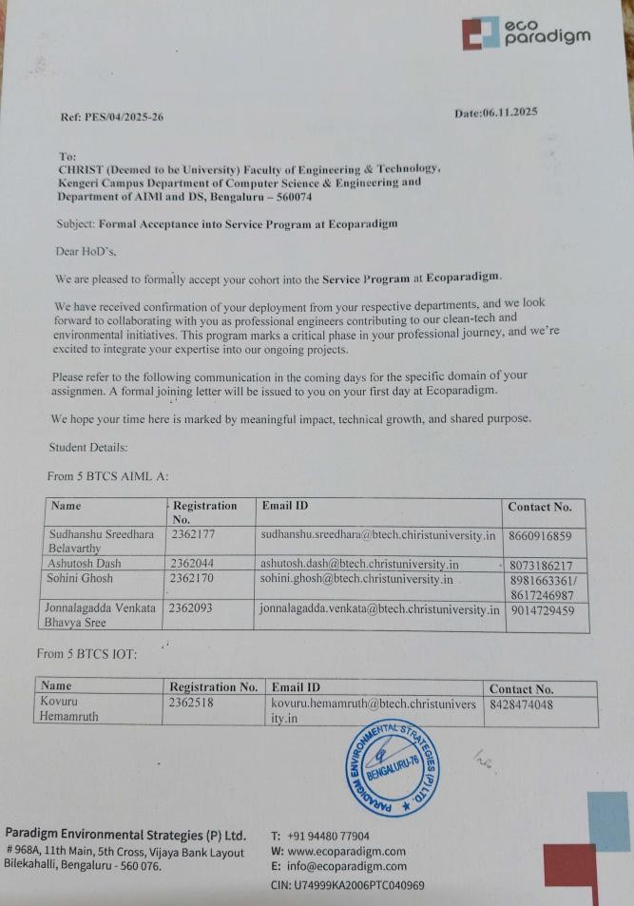
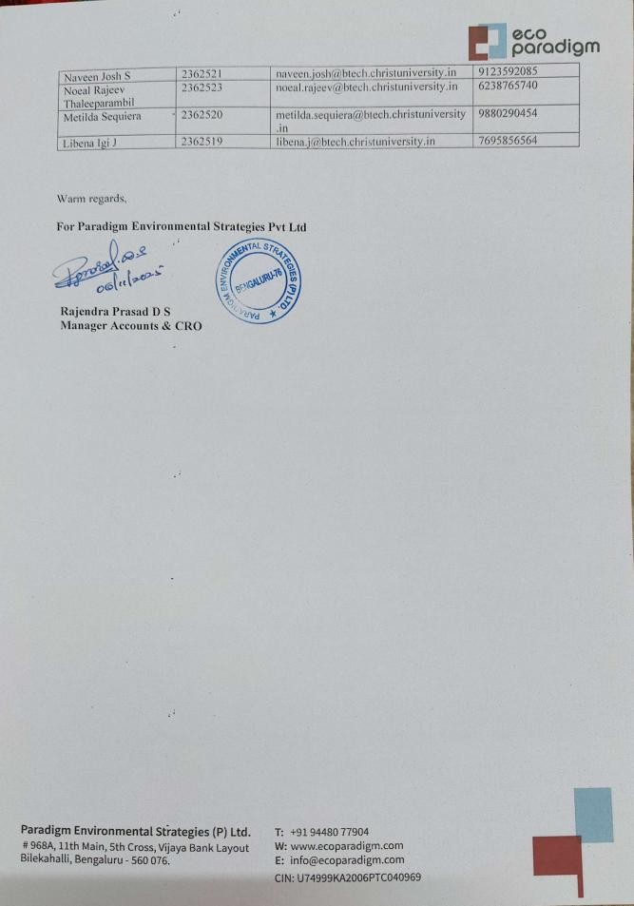
CONFIRMATION LETTER

Slide 5

NEED ANALYSIS
Why This Solution Is Necessary
Manual sorting in local e-waste centers is slow, inaccurate, and labour-intensive.
Workers cannot reliably identify brands, hazardous parts, or refurbishable components by visual inspection alone.
Lack of automation leads to low recovery of valuable materials, reducing income for recyclers and refurbishers.
Hazard detection (swollen batteries, cracked screens) requires AI assistance to prevent accidents.
Current systems have no integrated tracking, making compliance and reporting difficult.
Evidence / Observations From the Community
E-waste workers in Bilekahalli and surrounding areas report:
  Frequent misclassification of items (phones, PCBs, chargers, mixed plastics).
  Human fatigue causing errors, especially with high daily waste volume.
  Difficulty separating reusable vs recyclable vs scrap categories.
  Safety incidents involving damaged batteries and sharp components.
  No reliable data on item counts, weight, accuracy, or material recovery.
Workshops lack funds for robotic systems; they require a low-cost, plug-and-play alternative.

Slide 6

NEED ANALYSIS
Impact If the Problem Remains Unsolved
Continued loss of valuable materials, reducing revenue for recyclers.
Increase in hazardous incidents, including battery swelling, smoke, or minor fires.
Persistent labour overload, leading to slow operations and higher costs.
Poor compliance documentation may result in penalties or rejection by CPCB-certified recyclers.
E-waste will continue to be improperly segregated, contributing to environmental pollution burden.
and increased landfill

Slide 7

PROBLEM STATEMENT
Problem Explanation
E-waste collection centers in areas like Bilekahalli still depend heavily on manual sorting, where workers visually
inspect every device—phones, chargers, batteries, cables, and PCBs. Because the process is entirely human-driven,
workers often misidentify items, fail to notice hazardous components, or miss valuable reusable parts. This leads to low material recovery, safety issues, and high labour fatigue.
Additionally, there is no proper tracking system for weight, item count, or segregation accuracy, making compliance
and documentation difficult for recyclers.
Final Problem Statement
A plug-and-play hardware +software platform designed to help e-waste collection centers, recyclers, and refurbishers increase throughput, reduce labour costs, and recover more valuable materials.

Slide 8

OBJECTIVES
To develop an AI-driven visual identification system that can accurately detect device type, brand/model, and minerals present in real time.
To design a guided Smart Ewaste Managament System which will store the history of all the devices scanned and completely make the system automated.
To implement an integrated tracking and inventory system that logs the device into a database and maintain an history.
To reduce manual errors, labour load, and safety risks by providing a low-cost, plug-and-play solution suitable for small and mid-scale recycling centers.

Slide 9
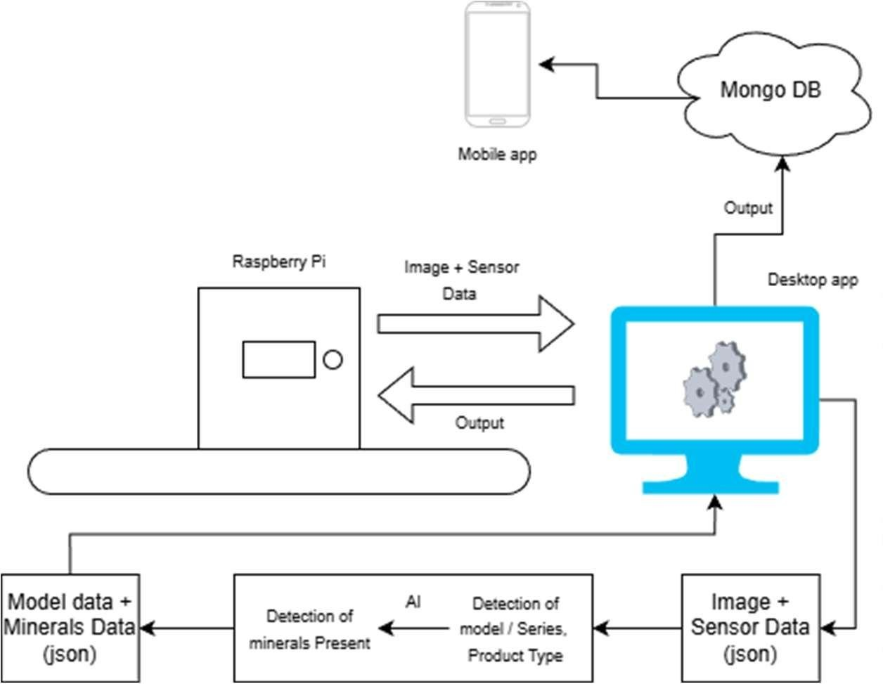
PROPOSED SOLUTION

Slide 10
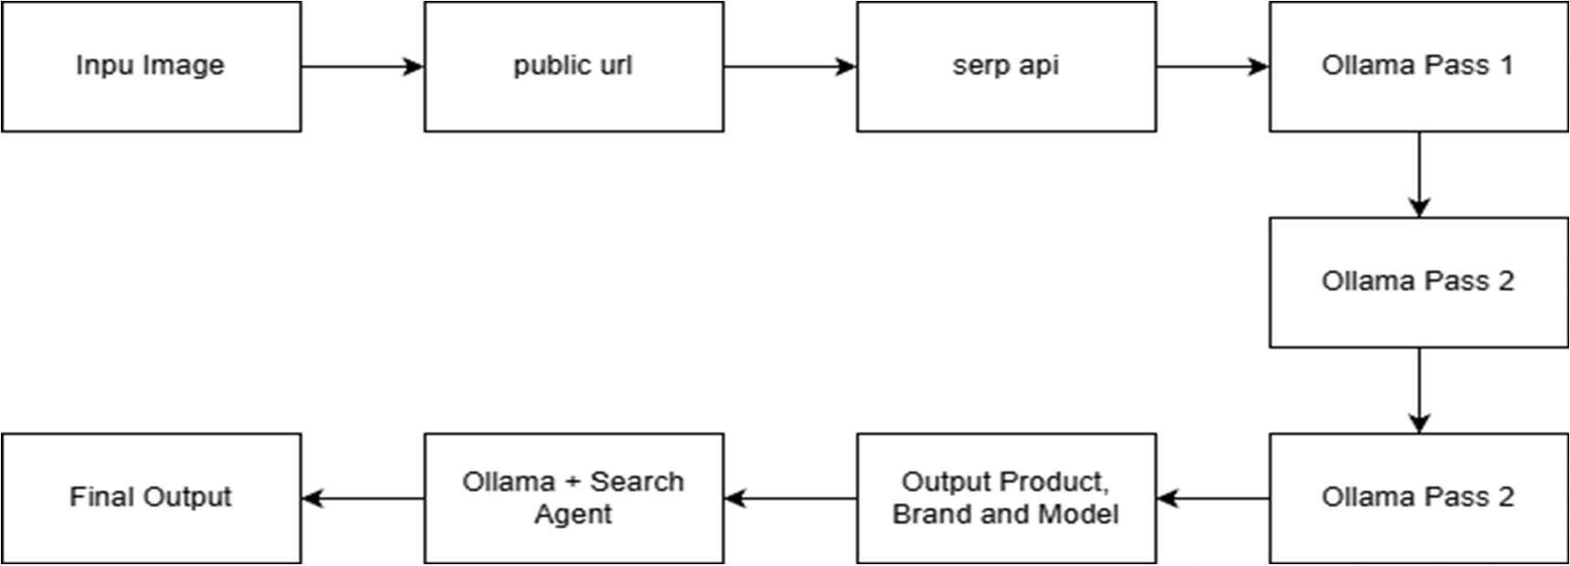
AI PIPELINE OF IMPLEMENTATION

Slide 11

PROPOSED SOLUTION
The proposed system is an AI-driven material identification and monitoring solution in which a camera mounted on a Raspberry Pi continuously captures images along with sensor data and sends them to a central processing engine. This engine uses artificial intelligence to split the analysis into two parallel tasks: one model detects the product brand or model, while another identifies the metals and minerals present in the object.
The processed results are continuously stored in a MongoDB database, which also acts as a reference layer where the AI checks whether similar data already exists, enabling validation, reuse, and consistent detection. The database maintains a complete history of detected items with timestamps and metadata. A desktop application and a mobile application are connected to the database to monitor real-time detections and view historical records, while a small local display on the system shows immediate output, enabling seamless real-time tracking and long-term analysis of detected products and materials.

Slide 12

REQUIREMENTS
Software Requirements
Python 3.8+ for model training and backend automation
LLM Knowledge to run models like Ollama
OpenCV for image capture, preprocessing, and frame handling
FastAPI / Flask for lightweight API integration
microcontroller firmware (ESP32/Arduino code) for sensor testing
Rule Engine Logic Module for classification decisions (simple Python rules)
Local Database (SQLite / TinyDB) for logging items, results, and tracking
Transformer-based AI Search Agent API (local or cloud-enabled) for spare-part lookup and repairability checks
Dashboard GUI for displaying detection results and bin guidance
React / Flutter for Application Development

Slide 13

REQUIREMENTS
Hardware Requirements
AI Camera Module (USB webcam, Pi Camera, or industrial camera)
Edge Compute Device (Raspberry Pi 4 )
Microcontroller (Raspberry Pi ) for sensor management
Digital Weight Scale Module (HX711 +load cell)
Display/Monitor for showing detection and sorting instructions
Stable Power Supply for sensors, camera, and compute unit

Slide 14
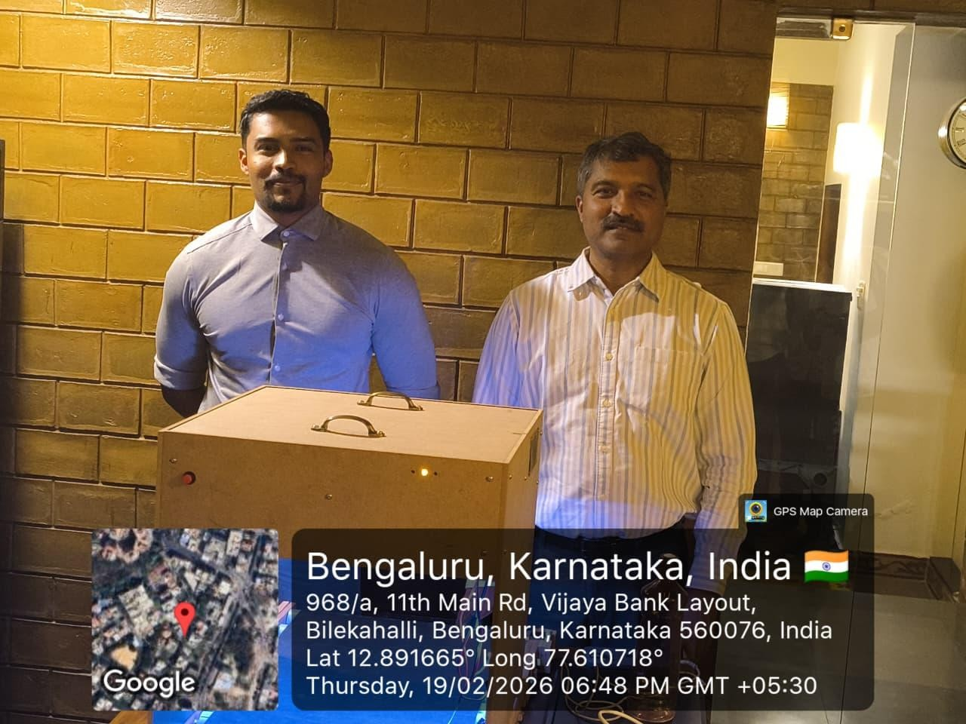
GEO TAG PHOTOS

Slide 15
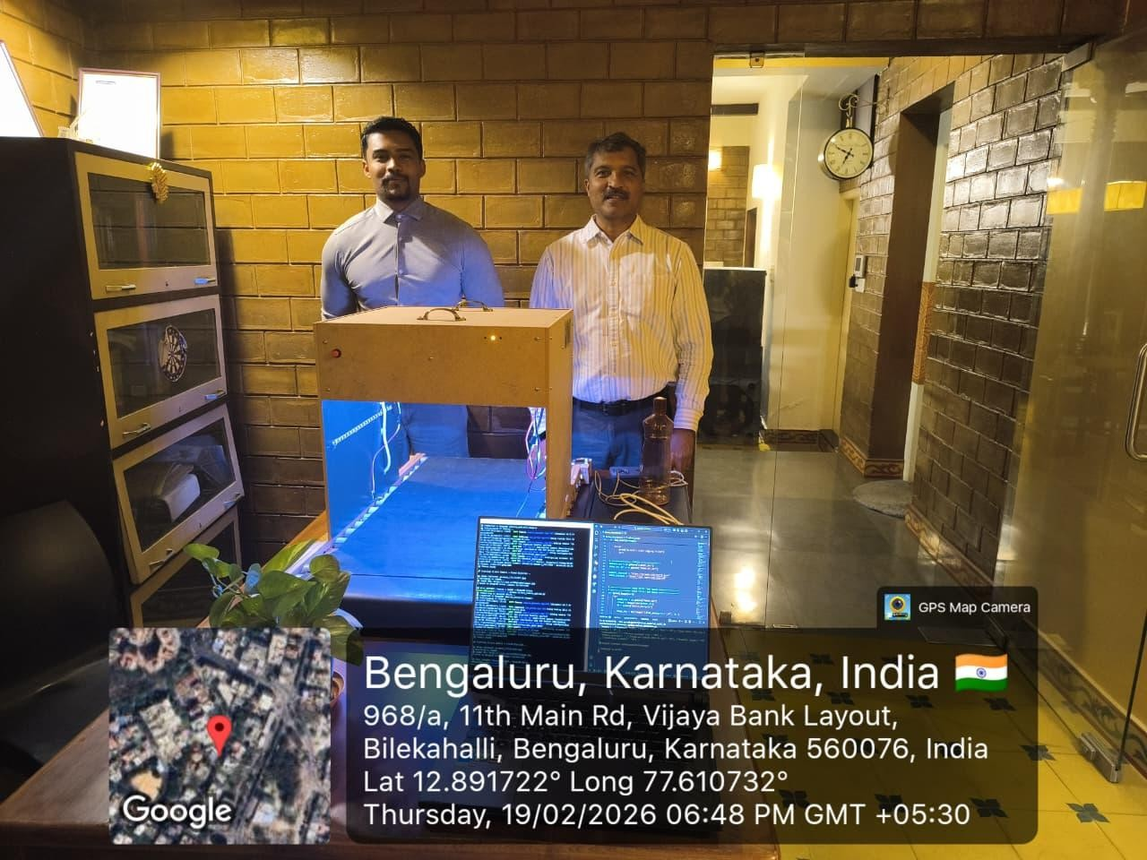
GEO TAG PHOTOS

Slide 16
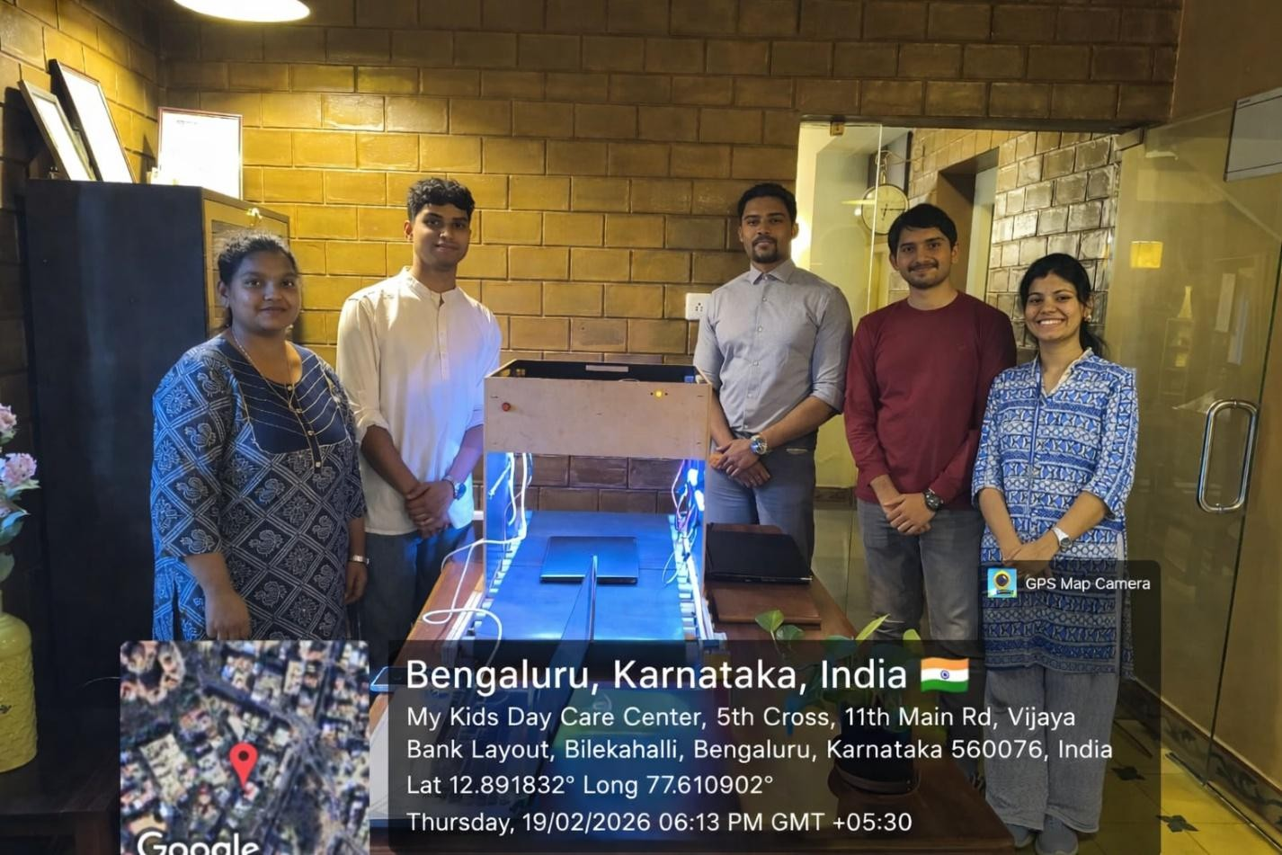
GEO TAG PHOTOS

