Slide 1
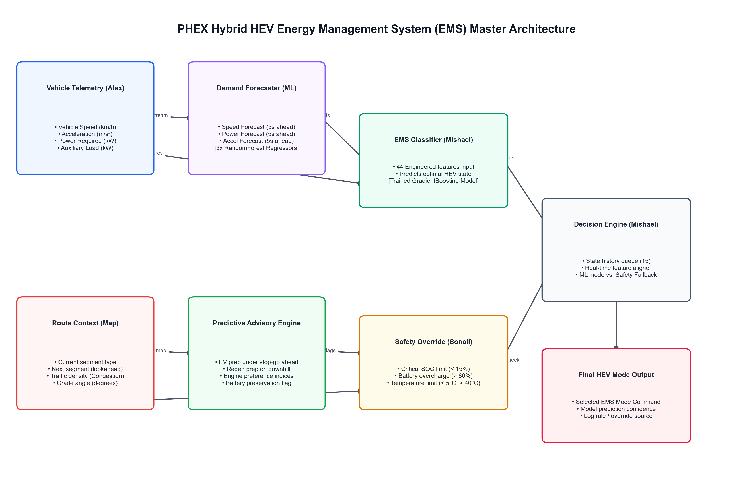
PHEX HEV Energy Management System
AI-Assisted Supervisory Control Proof-of-Concept
Technical Progress Review | Predictive Supervisory Controller for Hybrid Electric Vehicles
Mishael Julian | Project PHEX Internship | 2026
1 / 13
Notes:
Welcome to the PHEX HEV Energy Management System technical review.
This presentation covers the AI supervisory controller proof-of-concept developed during the internship.
We will walk through the system architecture, demand forecasting layer, ML classifier, safety overrides, and simulation validation results.

Slide 2
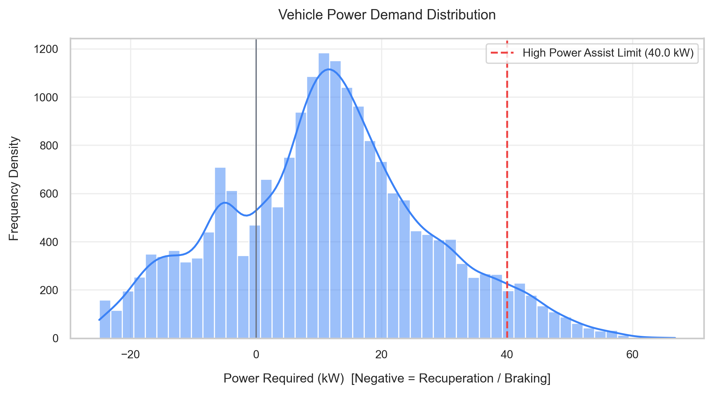
Why Hybrid Energy Management Needs Intelligence
• Hybrid vehicles constantly switch between
battery and engine power sources
• Poor switching strategies reduce overall
drivetrain efficiency by 8-15%
• Aggressive driving patterns cause
excessive energy waste and battery stress
• Urban traffic creates highly dynamic
and unpredictable power demands
• Rule-based EMS cannot anticipate
future demand — only react to current state
Vehicle Power Demand Distribution (kW)
? Key Insight: Reactive controllers leave 8–15% efficiency on the table in urban driving
2 / 13
Notes:
This slide establishes why traditional rule-based energy management is insufficient.
Key point: reactive EMS controllers cannot anticipate future driving conditions, leading to suboptimal mode switching. Our power demand distribution shows the wide range of operating conditions the system must handle — from regenerative braking (negative power) to high-demand acceleration events exceeding 30 kW.

Slide 3
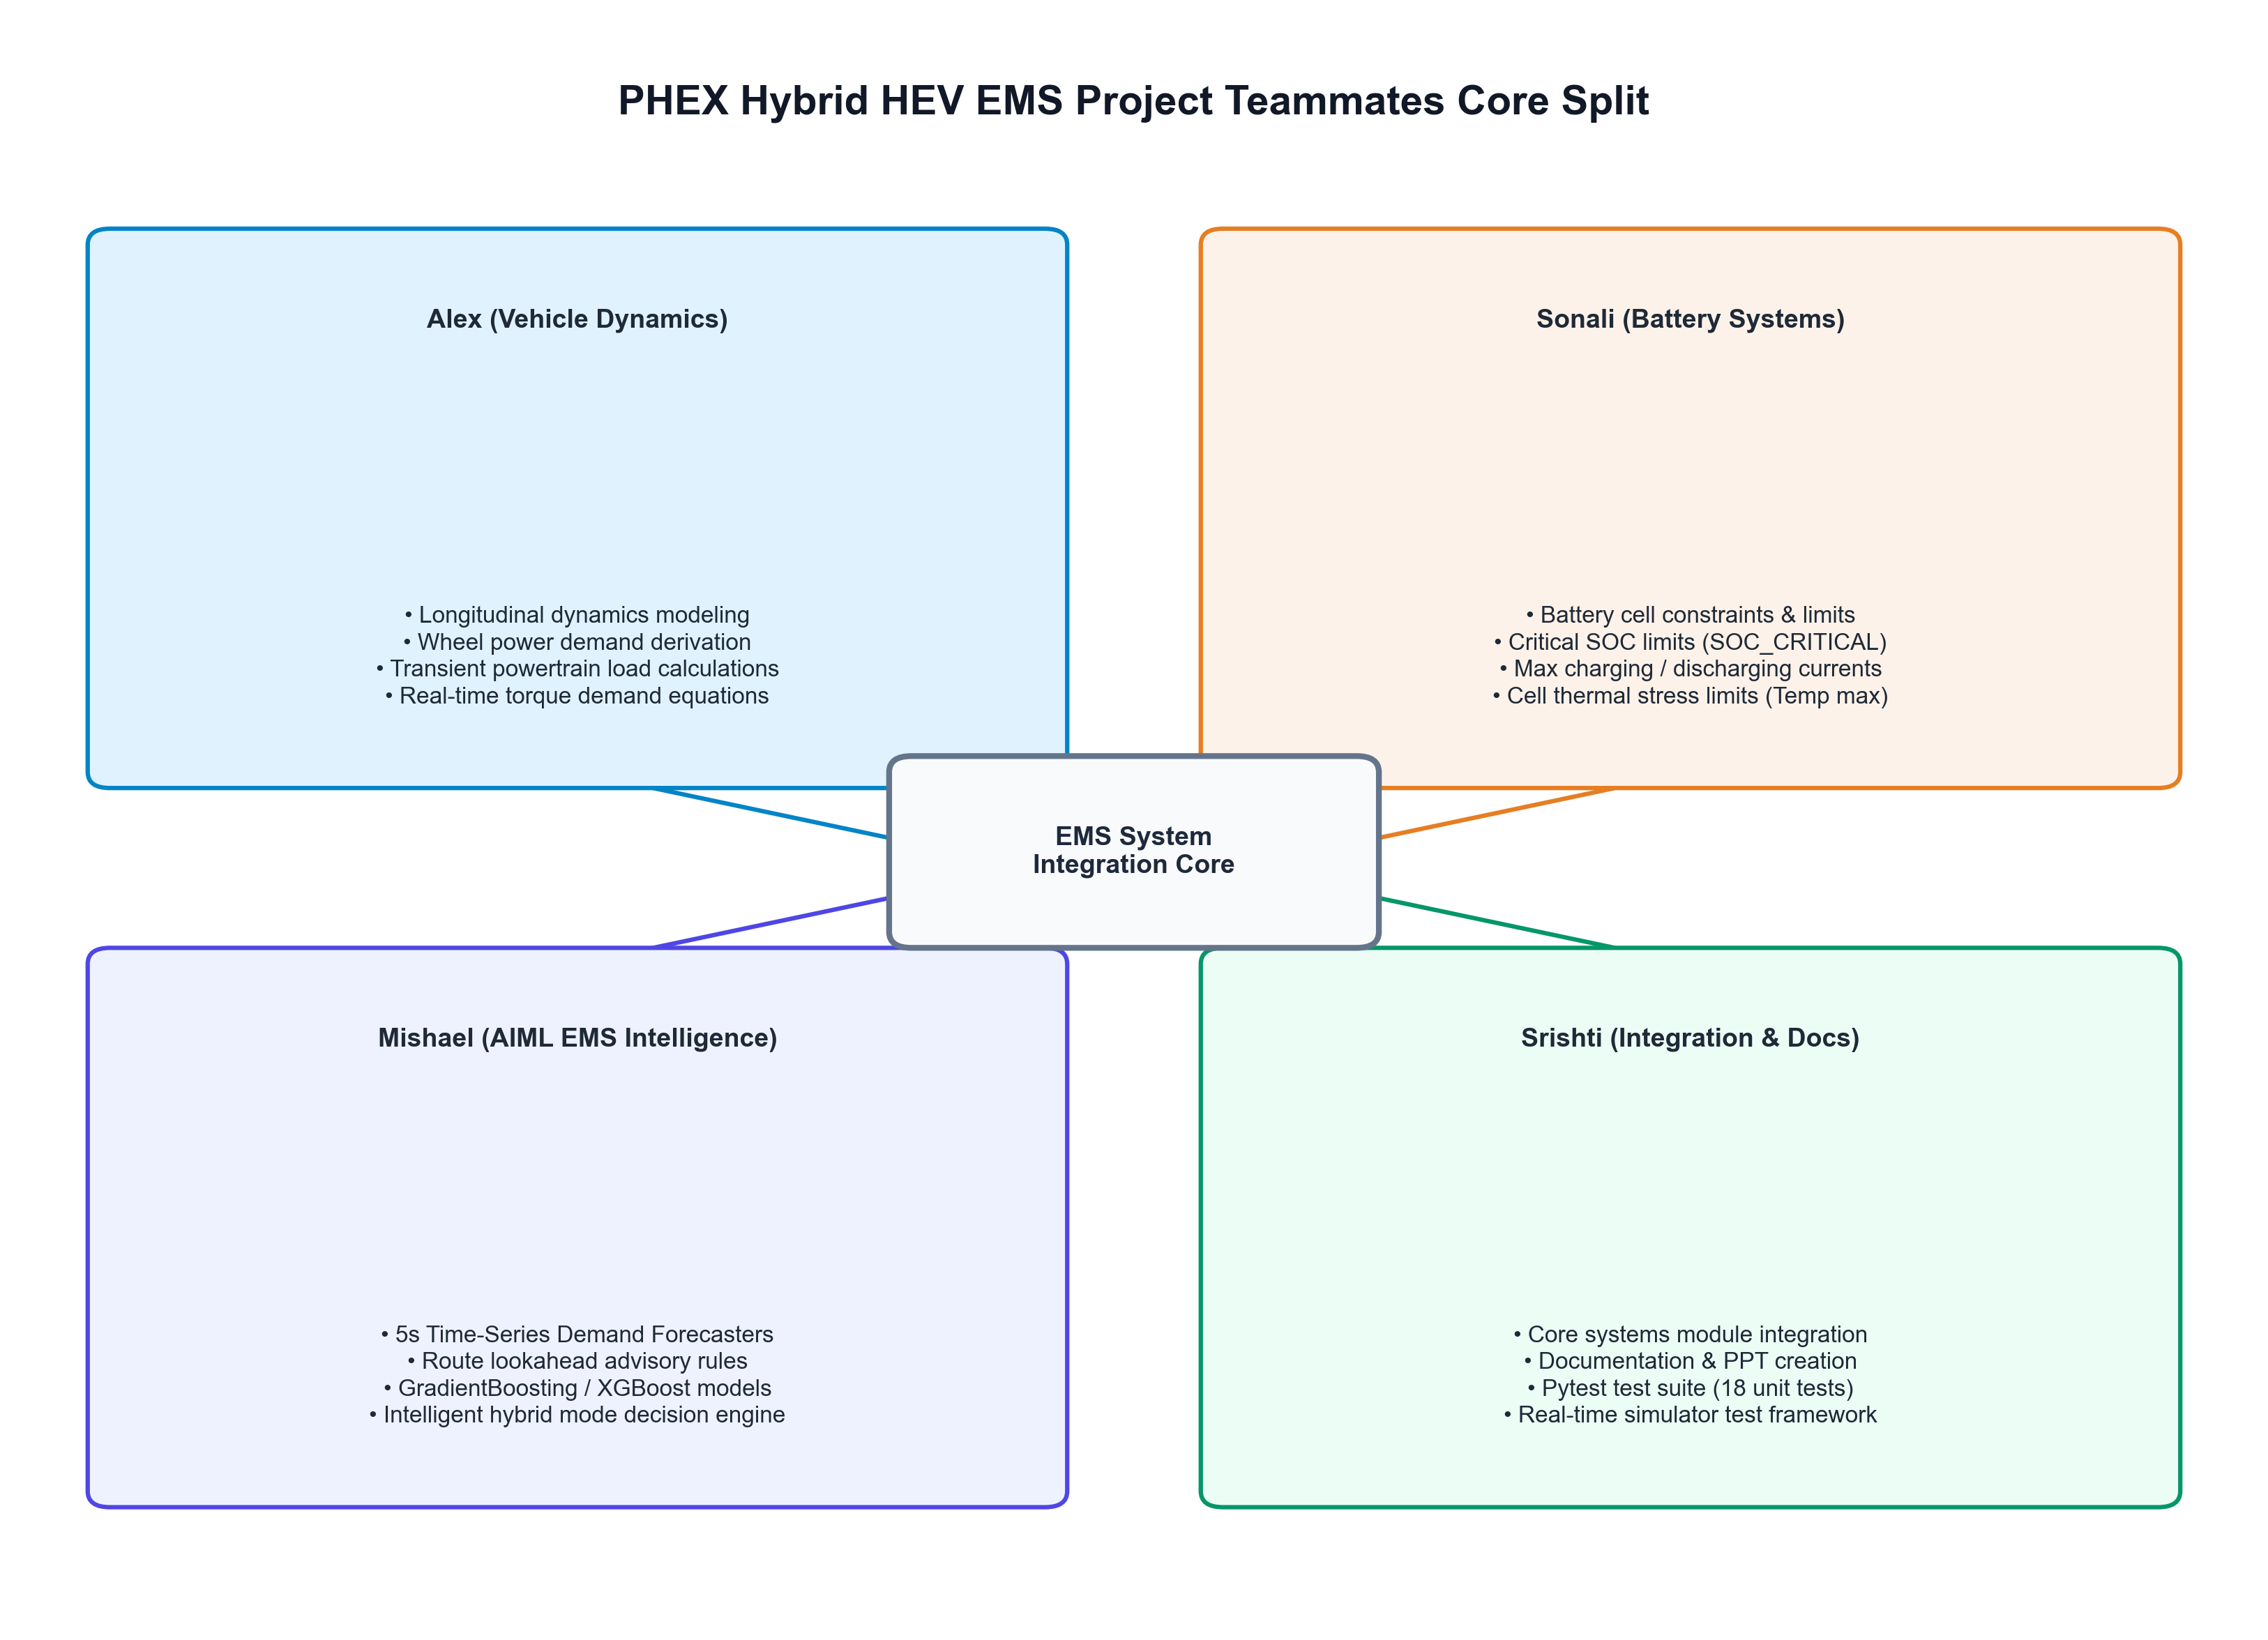
Proof-of-Concept Objective
Build a predictive AI supervisory controller
? Interpret real-time vehicle telemetry
(speed, SOC, power, temperature)
? Forecast near-future demand
(5-second predictive horizon)
? Select optimal HEV operating mode
from 6 possible powertrain states
? Enforce battery safety constraints
(SOC limits, thermal protection)
? Adapt to urban traffic conditions
(Bangalore commute scenarios)
6 HEV Operational Modes:
BATTERY_ONLY
ENGINE_ONLY
HYBRID_ASSIST
ENGINE_CHARGE
REGEN
IDLE_STOP
3 / 13
Notes:
The core objective is building a predictive supervisory controller — not a simple rule-matching engine. The system must handle 6 distinct powertrain operating modes and make real-time decisions that balance efficiency, battery longevity, and safety.
The team architecture diagram shows how four team members contribute complementary subsystems that integrate into the central EMS intelligence module.

Slide 4
System Architecture Overview

