Slide 1
Bike-Share Trends
June 2021
Mish-Al Abdullah

Slide 2
Overview
We will cover how over company can make the casual riders in to member riders.

Slide 3


Graph
The below graph shows the no,of member riders who rode bikes in a given week
Notes:
`

Slide 4
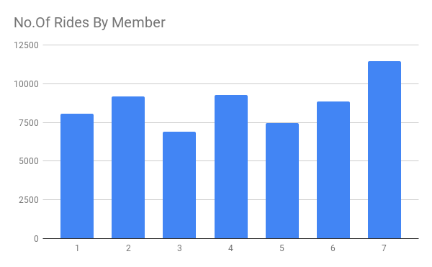
The Google Translate app can repeat anything you say in up to NINETY LANGUAGES from German and Japanese to Czech and Zulu

Slide 5
2. Graphs
The below graph shows the no,of Casual riders who rode bikes in a given week

Slide 6
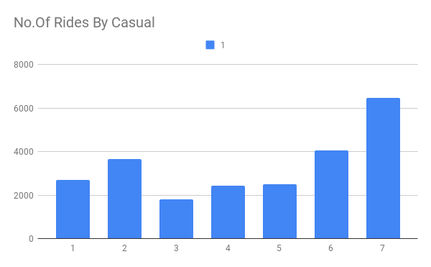

Slide 7

In both the above graphs we could find that both the casual and member riders ride more on sundays
INSIGHT

Slide 8
My Recammendations
Other type of audience such as who are more health conscious
And who are more focused in to reduce their carbon-foot print
We need to target Audience who would Commute daily to work,school .

