Slide 1











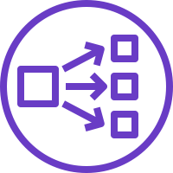

AWS Cloud
Availability Zone 1
Availability Zone 2
Availability Zone 3
VPC
Public subnet
Public subnet
Public subnet
NAT gateway
NAT gateway
NAT gateway
Auto Scaling group
Bastion host
Bastion host
Bastion host
Private subnet
Private subnet
Private subnet
Amazon EFS
Auto Scaling group
User
Amazon EKS
cluster
Network Load Balancer
Kubernetes nodes
Kubernetes nodes
Kubernetes nodes

