Slide 1


IT349: WIRELESS COMMUNICATION AND MOBILE COMPUTING
December 2019 – April 2020
Chapter – 5
TRANSPORT AND APPLICATION LAYER

Slide 2
CONTENT
TCP-mechanisms
Classical approaches
Indirect TCP
Snooping TCP
Mobile TCP
Fast retransmit/recovery
Transmission freezing
Selective retransmission
Transaction oriented TCP

Slide 3
TRADITIONAL TCP
Stream oriented, not transaction oriented
Network friendly: time-out
Congestion
slow down transmission
Well known – TCP wrongly assumes congestion in wireless and mobile networks when
Packet losses due to transmission errors
Packet loss due to change of network
Result
Severe performance degradation

Slide 4
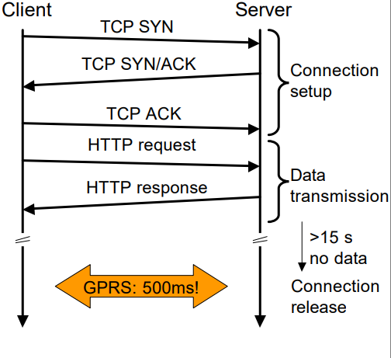
TRADITIONAL TCP

Slide 5
TRADITIONAL TCP
Transport protocols are typically designed for
Fixed end-systems
Fixed, wired networks
Research activities to be carried out is to find:
How to improve TCP performance in wireless networks
Maintain congestion control behavior
Efficient retransmissions
TCP congestion control in fixed networks
Timeouts/Packet loss typically due to (temporary) overload
Routers discard packets when buffers are full
TCP recognizes congestion only indirectly via missing ACKs.

Slide 6
TRADITIONAL TCP
TCP slow-start algorithm
Sender calculates a congestion window for a receiver
Start with a congestion window size equal to one segment (packet)
Exponentially increase congestion window till congestion threshold, then linear increase
Timeout/missing acknowledgement causes reduction of congestion threshold to half of the current congestion window
congestion window starts again with one segment

Slide 7
TRADITIONAL TCP
TCP fast retransmit/fast recovery
TCP sends an ACK only after receiving a packet
If sender receives duplicate ACKs, this is due to gap in received packets at the receiver.
Receiver got all packets up to the gap and is actually receiving packets.
Conclusion: packet loss is not due to congestion so, retransmit the packet and continue with current congestion window (do not use slow-start)

Slide 8
TRADITIONAL TCP
TCP assumes congestion if packets are dropped.
In wireless networks, the concept is false because here we often have packet loss due to transmission errors.
Additionally, mobility can cause packet loss, if e.g. a mobile node roams from one access point (e.g. foreign agent in Mobile IP) to another while packets in transit to the old access point and forwarding is not possible

Slide 9
INDIRECT TCP
Indirect TCP or I-TCP segments the connection
no changes to the TCP protocol for hosts connected to the wired Internet, variants of the systems use this protocol.
optimized TCP protocol for mobile hosts
splitting of the TCP connection at, e.g., the foreign agent into 2 TCP connections, no real end-to-end connection any longer
hosts in the fixed part of the net do not notice the characteristics of the wireless part

Slide 10
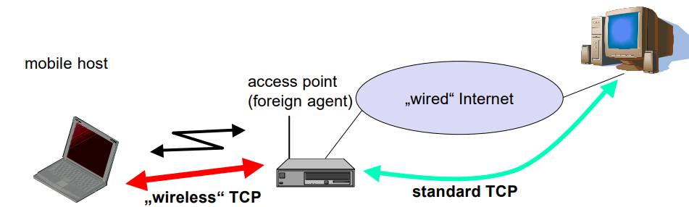
INDIRECT TCP
Reference : Prof. Dr.-Ing. Jochen Schiller, http://www.jochenschiller.de/

Slide 11
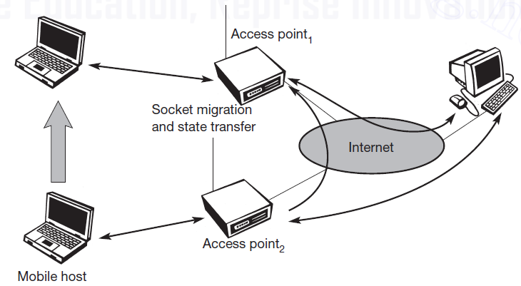
INDIRECT TCP
Reference : Prof. Dr.-Ing. Jochen Schiller, http://www.jochenschiller.de/

Slide 12
INDIRECT TCP
Advantages
No changes in the fixed network necessary, no changes for the hosts (TCP protocol) necessary, all current optimizations to TCP still work
Wireless link transmission errors isolated from those in fixed network
simple to control, mobile TCP is used only for one hop between, e.g., a foreign agent and mobile host
therefore, a very fast retransmission of packets is possible, the short delay on the mobile hop is known

Slide 13
INDIRECT TCP
Disadvantages
loss of end-to-end semantics, an acknowledgement to a sender does now not any longer mean that a receiver really got a packet, foreign agents might crash.
higher latency possible due to buffering of data within the foreign agent and forwarding to a new foreign agent.

Slide 14
Early approach: Snooping TCP I
Transparent“ extension of TCP within the foreign agent
buffering of packets sent to the mobile host
lost packets on the wireless link (both directions!) will be retransmitted immediately by the mobile host or foreign agent, respectively (so called “local” retransmission)
the foreign agent therefore “snoops” the packet flow and recognizes acknowledgements in both directions, it also filters ACKs
Changes of TCP only within the foreign agent

Slide 15
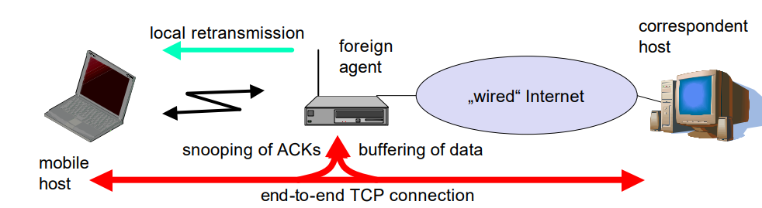
Early approach: Snooping TCP I
Reference : Prof. Dr.-Ing. Jochen Schiller, http://www.jochenschiller.de/

Slide 16
Early approach: Snooping TCP I
Data transfer to the mobile host
Foreign Agent buffers data until it receives ACK of the Mobile Host, Foreign Agent detects packet loss via duplicated ACKs or time-out.
Fast retransmission possible, transparent for the fixed network.
Data transfer from the Mobile Host.
Foreign Agent detects packet loss on the wireless link via sequence numbers
Foreign Agent answers directly with a negative acknowledgement to the Mobile Host.
Mobile Host can now retransmit data with only a very short delay.

Slide 17
Early approach: Snooping TCP
Integration with MAC layer
MAC layer often has similar mechanisms to those of TCP. Thus, the MAC layer can already detect duplicated packets due to retransmissions and discard them
Disadvantages:
Snooping TCP does not isolate the wireless link as good as I-TCP
Snooping might be tough if packets are encrypted

Slide 18
Early approach: M-TCP
Special handling of lengthy and/or frequent disconnections M-TCP splits as I-TCP does.
unmodified TCP fixed network to supervisory host (SH)
optimized TCP SH to Mobile Host
Supervisory host
no caching, no retransmission
monitors all packets, if disconnection detected
set sender window size to 0
sender automatically goes into persistent mode
old or new Supervisory Host reopen the window

Slide 19
Early approach: M-TCP
The advantages of M-TCP are the following:
It maintains the TCP end-to-end semantics. The Supervisory Host does not send any ACK itself but forwards the ACKs from the Mobile Host.
If the Mobile Host is disconnected, it avoids useless retransmissions, slow starts or breaking connections by simply shrinking the sender’s window to 0.
Since it does not buffer data in the Supervisory Host as I-TCP does, it is not necessary to forward buffers to a new Supervisory Host . Lost packets will be automatically retransmitted to the new Supervisory Host .

Slide 20
Early approach: M-TCP
The lack of buffers and changing TCP on the wireless part also has some disadvantages:
As the Supervisory Host does not act as proxy as in I-TCP, packet loss on the wireless link due to bit errors is propagated to the sender. M-TCP assumes low bit error rates, which is not always a valid assumption.
A modified TCP on the wireless link not only requires modifications to the Mobile Host protocol software but also new network elements like the bandwidth manager.

Slide 21
Fast retransmit/fast recovery
Change of foreign agent often results in packet loss.
TCP reacts with slow-start although there is no congestion
Forced fast retransmit
As soon as the mobile host has registered with a new foreign agent, the MH sends duplicated acknowledgements on purpose
This forces the fast retransmit mode at the communication partners
Additionally, the TCP on the MH is forced to continue sending with the actual window size and not to go into slow-start after registration.

Slide 22
Fast retransmit/fast recovery
Advantages
Simple changes result in significant higher performance.
Disadvantage
Cooperation required between IP and TCP, no transparent approach.

Slide 23
Transmission/time-out freezing
Mobile hosts can be disconnected for a longer time
no packet exchange possible, e.g., in a tunnel, disconnection due to overloaded cells or mux. with higher priority traffic
TCP disconnects after time-out completely
TCP freezing
MAC layer is often able to detect interruption in advance
MAC can inform TCP layer of upcoming loss of connection
TCP stops sending, but does now not assume a congested link
MAC layer signals again if reconnected.

Slide 24
Transmission/time-out freezing
Advantage
Scheme is independent of data
Disadvantage
TCP on mobile host has to be changed, mechanism depends on MAC layer

Slide 25
Selective retransmission
TCP acknowledgements are often cumulative
ACK n acknowledges correct and in-sequence receipt of packets
up to n
if single packets are missing quite often a whole packet sequence
beginning at the gap has to be retransmitted (go-back-n), thus wasting bandwidth
Selective retransmission as one solution
RFC2018 allows for acknowledgements of single packets, not only acknowledgements of in-sequence packet streams without gaps
sender can now retransmit only the missing packets

Slide 26
Selective retransmission
Advantage
much higher efficiency
Disadvantage
more complex software in a receiver, more buffer needed at the receiver.

Slide 27
Transaction oriented TCP
TCP phases
connection setup, data transmission, connection release
using 3-way-handshake needs 3 packets for setup and release, respectively
thus, even short messages need a minimum of 7 packets!
Transaction oriented TCP
RFC1644, T-TCP, describes a TCP version to avoid this overhead
connection setup, data transfer and connection release can be combined.
Thus, only 2 or 3 packets are needed.

Slide 28
Transaction oriented TCP
Advantage
Efficiency
Disadvantage
requires changed TCP
mobility not longer transparent

Slide 29
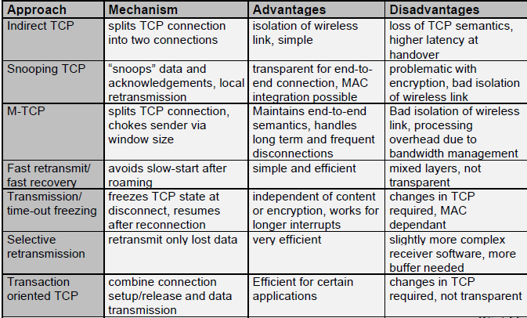
Comparison of different approaches for “mobile” TCP

Slide 30


