Slide 1
Flights Delay Prediction
By: Mishari Alharbi

Slide 2
TABLE OF CONTENTS
01
02
Introduction
Data Preparation
03
04
Model Buliding
Conclusion
Why I chose the problem to be solve?
Steps before the model buliding.
Why was Linear regression the best possible solution?
The final result of the project.

Slide 3
01
Introduction
Why I chose the problem to be solved?

Slide 4
INTRODUCTION
It’s a treasure in form of 6 Million rows dataset waiting desperately to be processed and analyzed to find answers for the million $ question,
IS MY FLIGHT GOING TO BE DELAYED?

Slide 5
5.8M
31
14
Number of raws in the dataset
Number of feature before the cleaning process
Number of airlines in the dataset

Slide 6
WHOA!
Did you notice that in USA alone, every minute passes, 11 airplanes takeoff/land!

Slide 7
Sample of the Dataset

Slide 8
Next Steps
Due to the size of the dataset, We’ll work on January data which have 480k flights.
We’ll predict American Airline flights for the last week of Jan.
We’ll create our own columns based on the features to simplify the process.

Slide 9
02
Data Preparation
We’ll go through data cleaning, EDA and preprocessing.

Slide 10
Tools
Pandas
1
3
2
Seaborn
NumPy
4
5
Matplotlib
Sklearn

Slide 11
Data Cleaning Steps
Dropping Unused Columns
Merge and Compute new columns
Dropping missing data
Neptune
Jupiter
Mars
Neptune is the farthest planet from the Sun
Jupiter is the biggest planet in the Solar System
Despite being red, Mars is a cold place, not hot

Slide 12
Cleaned Dataset

Slide 13
EDA

Slide 14
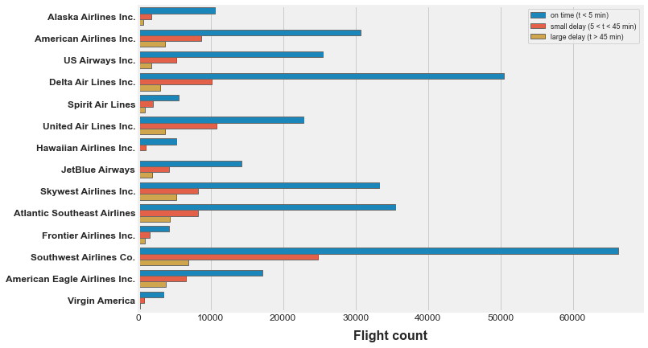
Delays per Airline

Slide 15
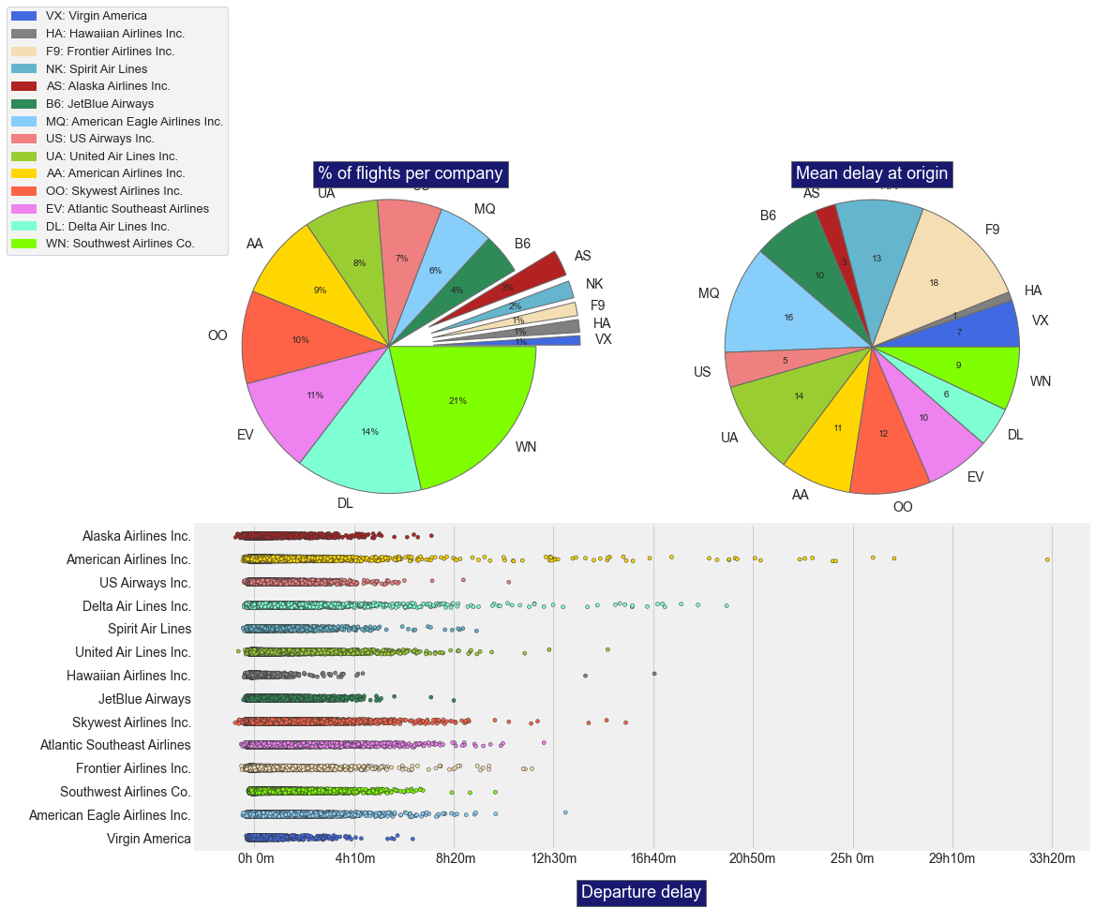

Slide 16
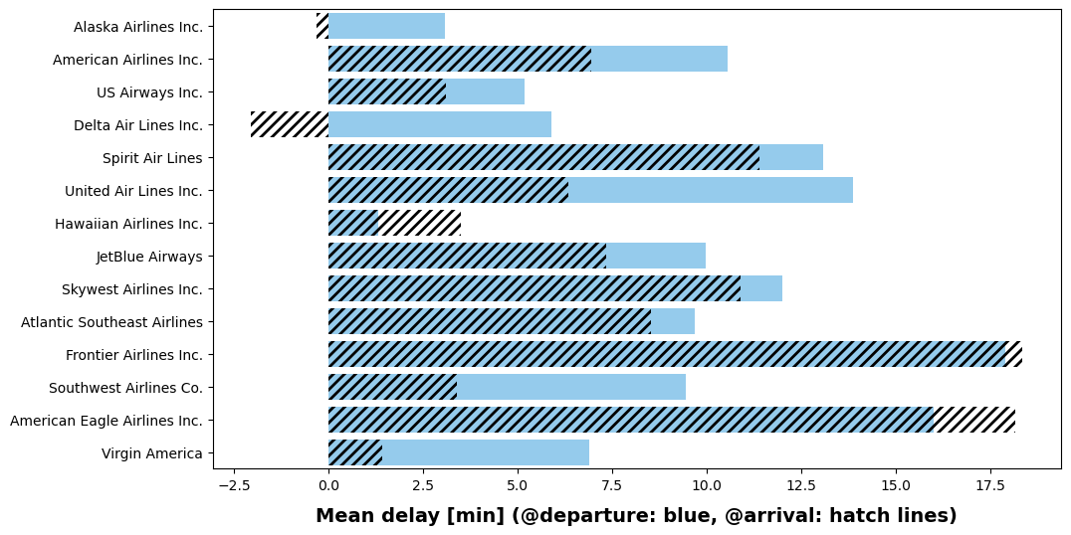
Delays at arrival are generally lower than at departure. This indicates that airlines adjust their flight speed in order to reduce the delays at arrival

Slide 17
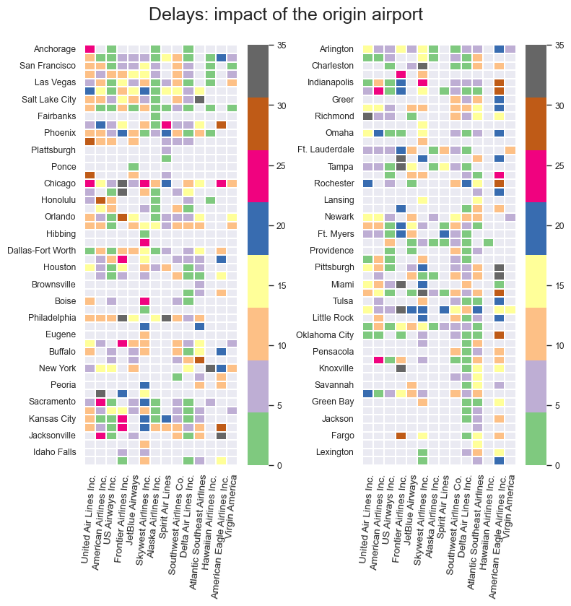
Impact of Delays To The Origin Airport

Slide 18
03
Model Building
Why linear regression?

Slide 19

Linear Regression
Since the targer was to predict SCHEDULED_DEPARTURE against DEPARTURE_DELAY, Linear Regression is the model to use for that task.

Slide 20
Model
All Airports
American Airline

Slide 21
53.7%
Mean Squared Error

Slide 22

04
Conclusion

Slide 23
Why MSE is a bit high?
Overall inconsistency for flights to be delayed.
There are so many factors affecting flights to be delayed.
If we want to predict January flights, We need to give the model similar data to work on, such as same month but next year.

Slide 24
THANKS
Any questions?

