Slide 1
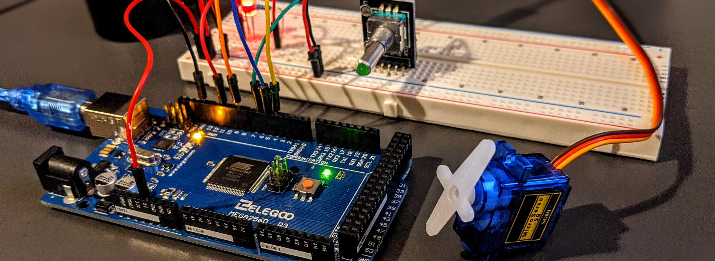
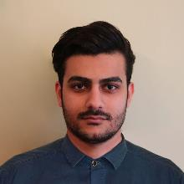
AI Driven Bangla Braille Learning Device
A TinyML system that teaches Bangla Braille and reasons about the learner entirely offline on a $10 device.
1,734 params
trainable parameters (dual-head net)
6,936 B
raw float32 model weights
98.6% / 91.4%
teaching / confidence accuracy (real-only)
50 / 50
BNBC Braille characters verified
Team · Group 08 · Section A2
Santu Nag · 2106055
Md. Adib Hasan Audhi · 2106056
Mishat Hasan Milon · 2106059
Khalid Mehebub · 2106065
EEE 416 — Final Project Demo · Group 08 · Section A2 · Dept of EEE, BUET

Slide 2
Outline
1
Summary
6
Reflection
2
Introduction
7
Communication
3
Design (Methodology)
8
Cost & Management
4
Implementation
9
Future Work
5
Analysis & Evaluation
10
References

Slide 3
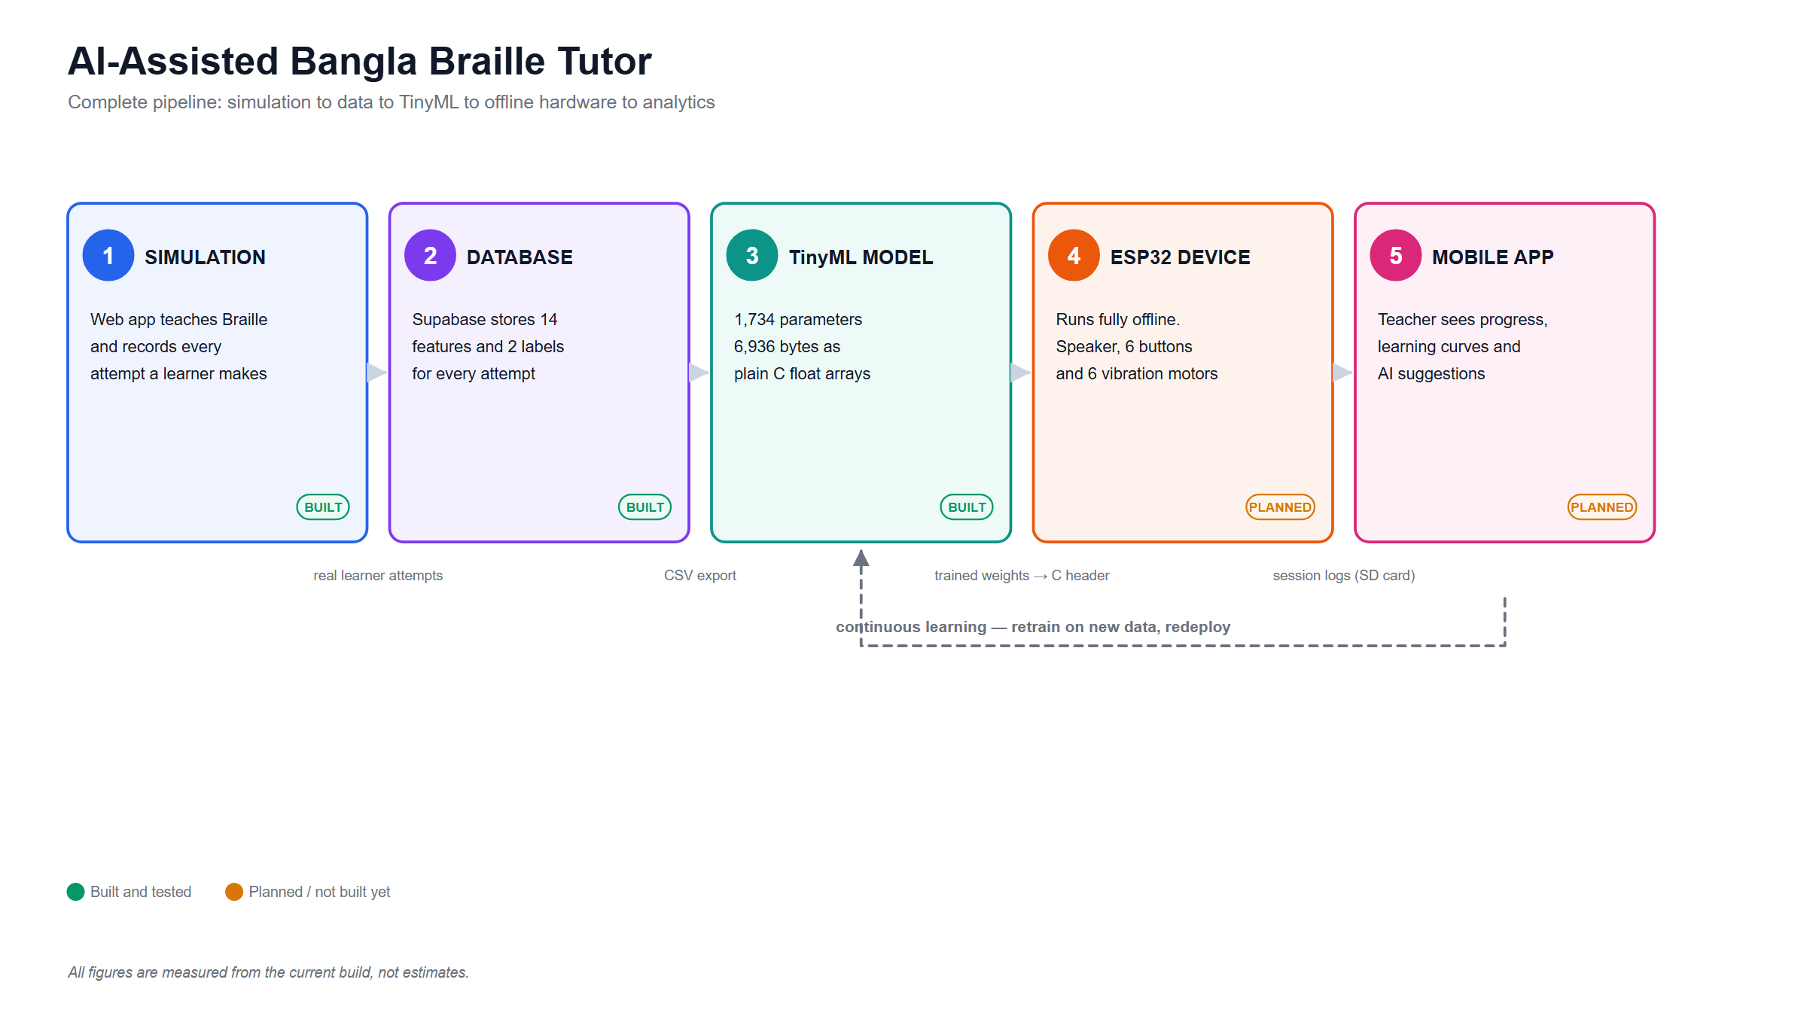
1. Summary / Abstract
The system teaches Bangla Braille through synchronized audio and vibration feedback, logging every attempt as 14 behavioral features. A small adaptive dual-head network is trained on that logged data and deployed fully offline on an ESP32 microcontroller — no cloud, no network dependency.
Stated plainly: the model reproduces a hand-written teaching-policy rule engine (98.6% / 91.4% real-only agreement) — a genuine embedded-ML compression result, not autonomous discovery of teaching strategy.
System overview: sensing → on-device model → teaching action

Slide 4
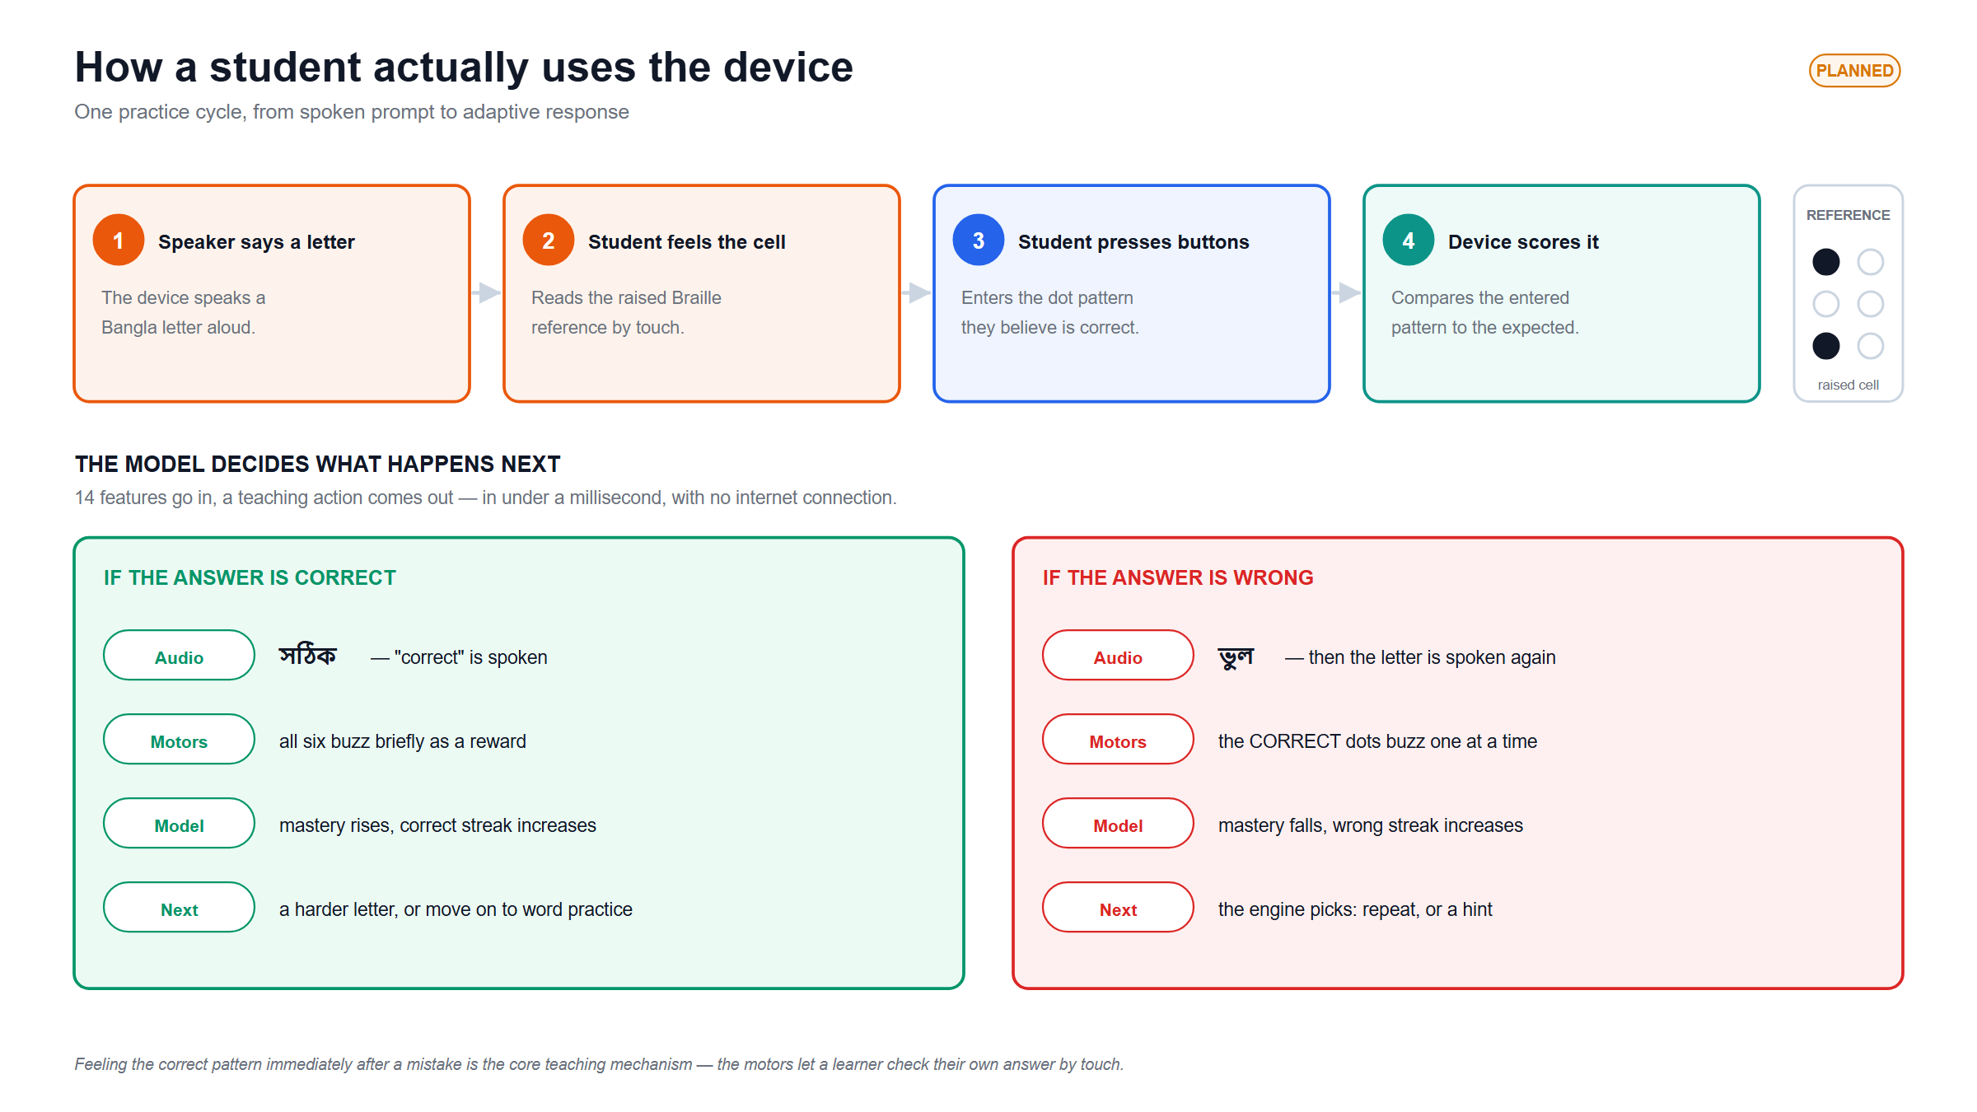
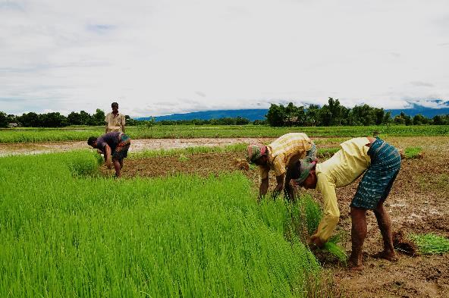
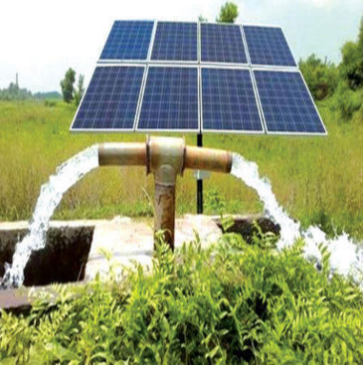
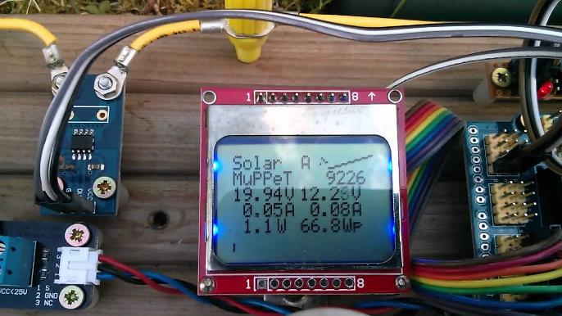
2. Introduction
The problem: Bangla-speaking visually-impaired learners lack an affordable, adaptive Braille-learning tool.
Existing hardware kits (see literature review) are either costly, lack practice/testing modes, or have no adaptive intelligence.
This project's angle: low-cost ESP32 hardware + an on-device model that adapts REPEAT / HINT / NORMAL_PRACTICE teaching decisions to the individual learner.

Slide 5
3.1.1 Problem Formulation: Identification of Scope (PO(b))
In scope
Explicitly out of scope
Teach and assess all 50 BNBC Braille characters
Log interaction data suitable for model training
Run inference fully offline with zero network dependency
Keep total BOM cost under ~1,300 BDT (~$11)
Multi-language Braille support
Refreshable / multi-cell physical Braille display
Therapist-facing analytics dashboard (partially covered by the planned teacher app)

Slide 6
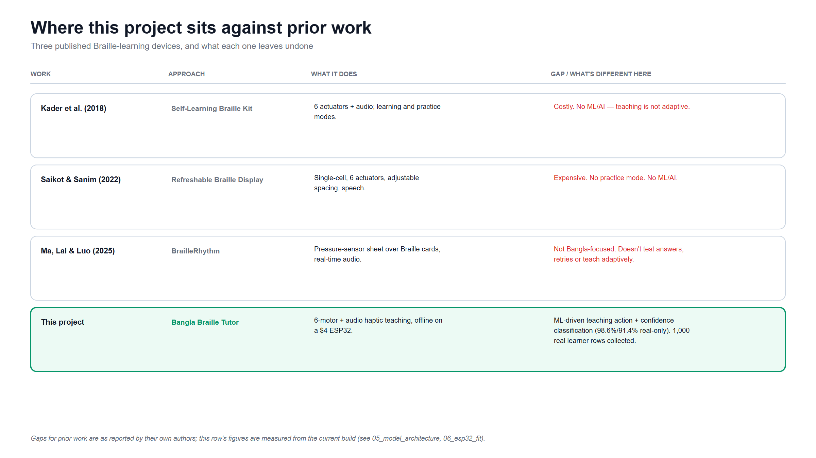
3.1.2 Literature Review (PO(b))
The gap this project fills: none of the three prior works combine Bangla-specific content, adaptive ML-driven teaching decisions, AND a low-cost fully-offline embedded deployment.

Slide 7
3.1.3 Formulation of Problem (PO(b))
Given a stream of per-attempt behavioral features, select a teaching action and estimate learner confidence in real time — under a hard constraint of on-device inference with no cloud round-trip and a memory budget under 10 KB.
Behavioral features
response time, retries,
streaks, mastery
On-device model
<10 KB · no cloud
round-trip
Decision output
teaching action +
confidence state
Teaching action (3 classes): REPEAT, HINT, NORMAL_PRACTICE
Confidence state (3 classes): CONFIDENT, HESITANT, GUESSING

Slide 8
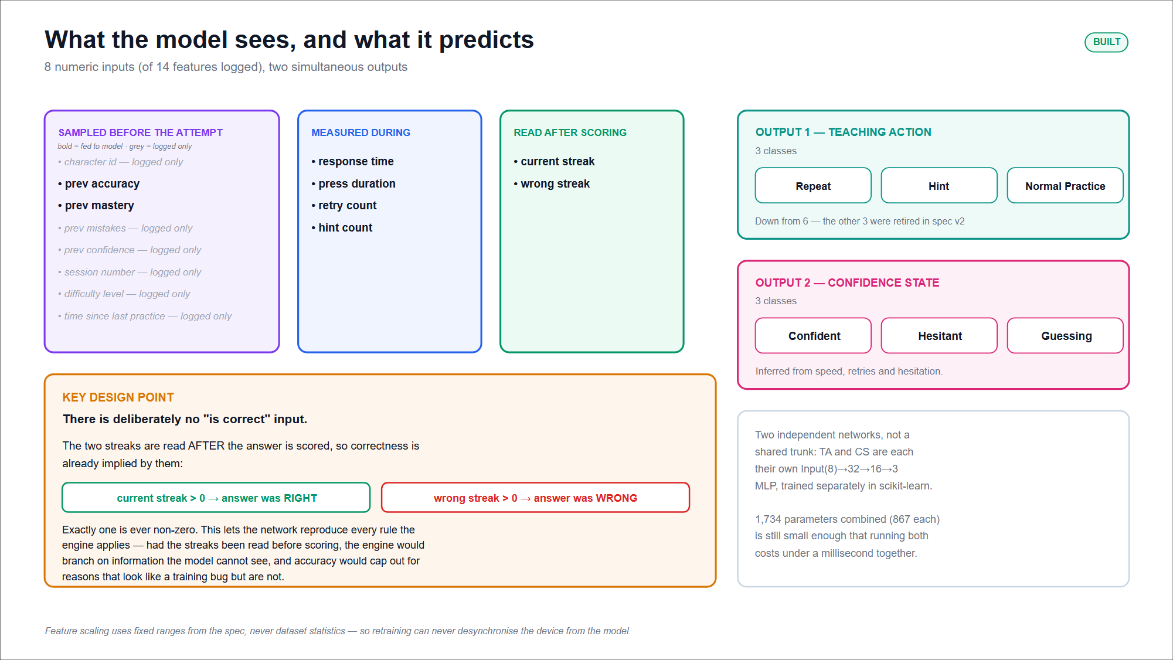
3.1.4 Analysis (PO(b))
Key engineering insight
There is deliberately NO “is_correct” input feature. current_streak / wrong_streak are sampled AFTER scoring, so correctness is already implied (exactly one is non-zero). This is what lets the network reproduce every rule the engine applies without being told the answer directly.

Slide 9
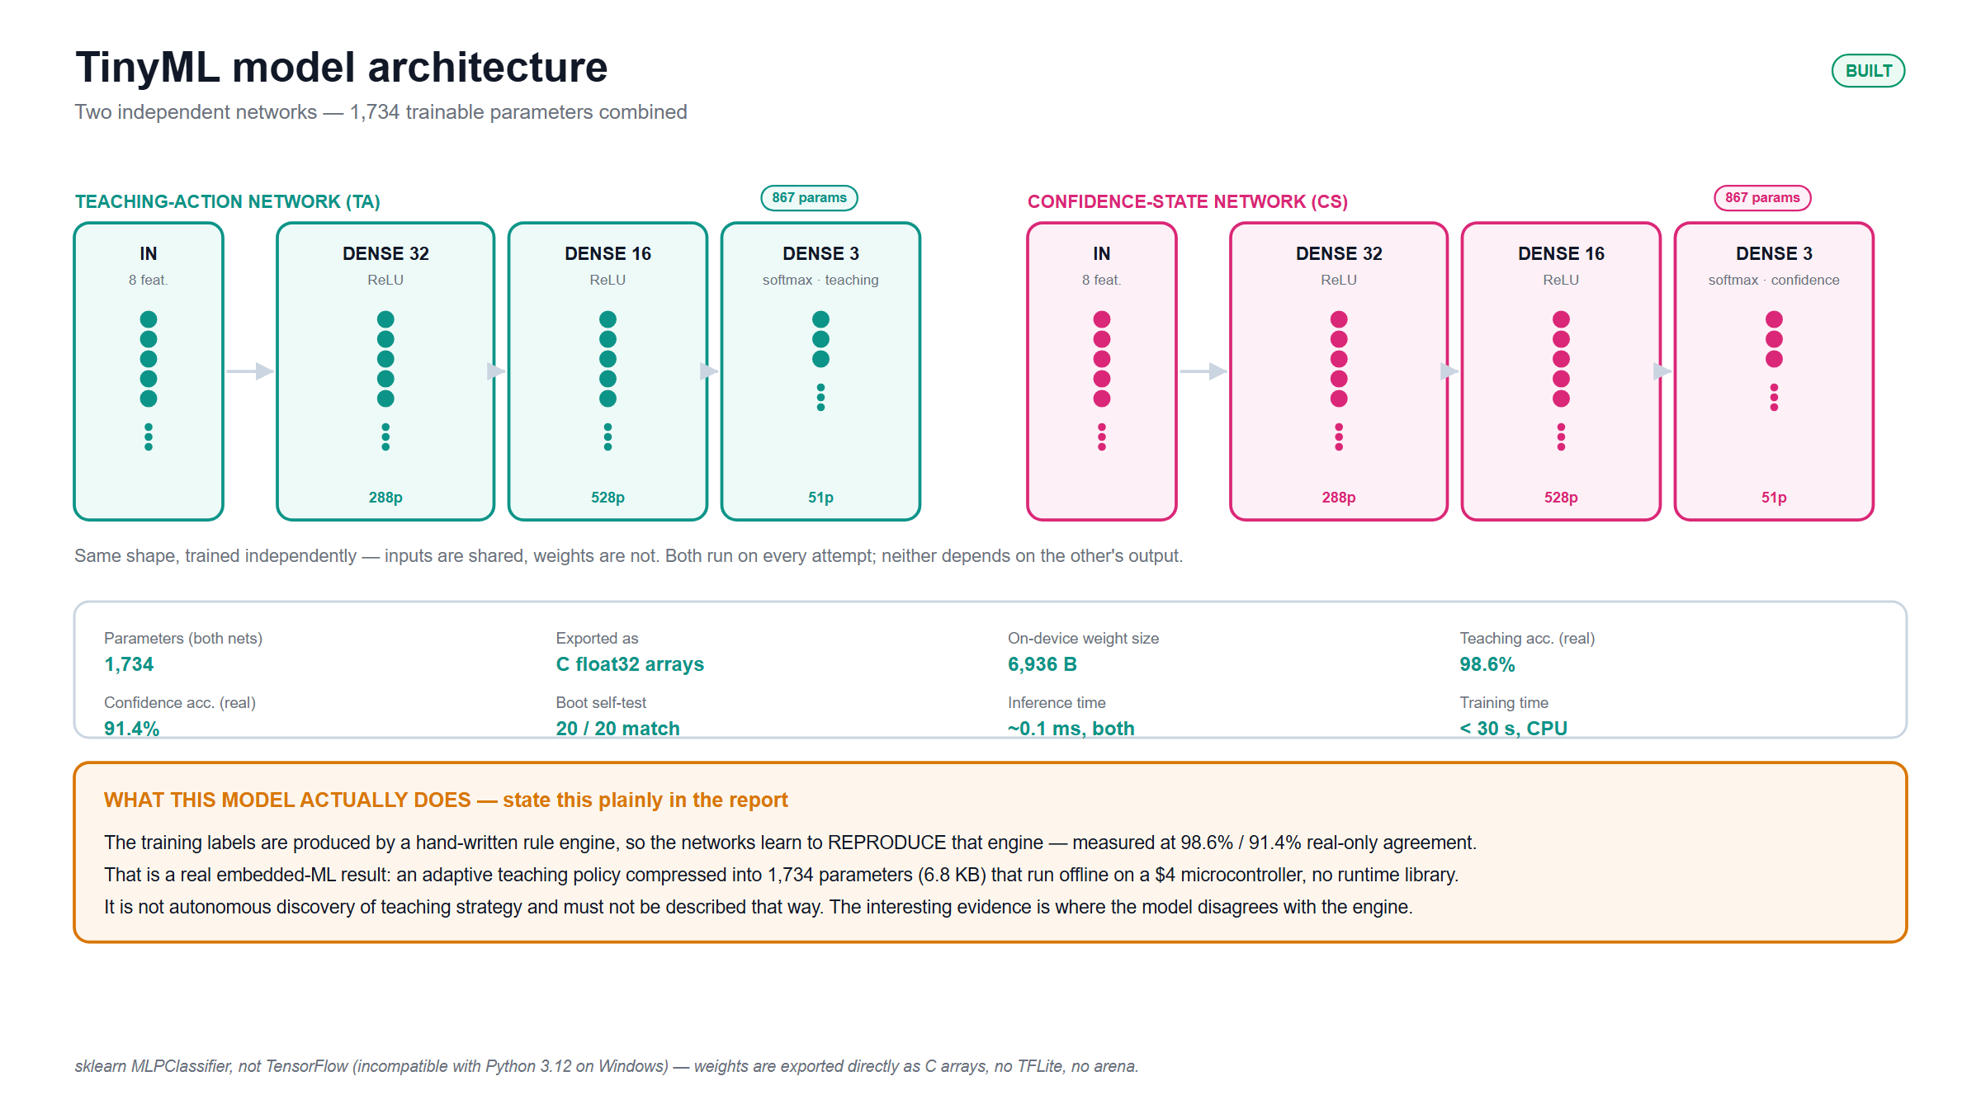
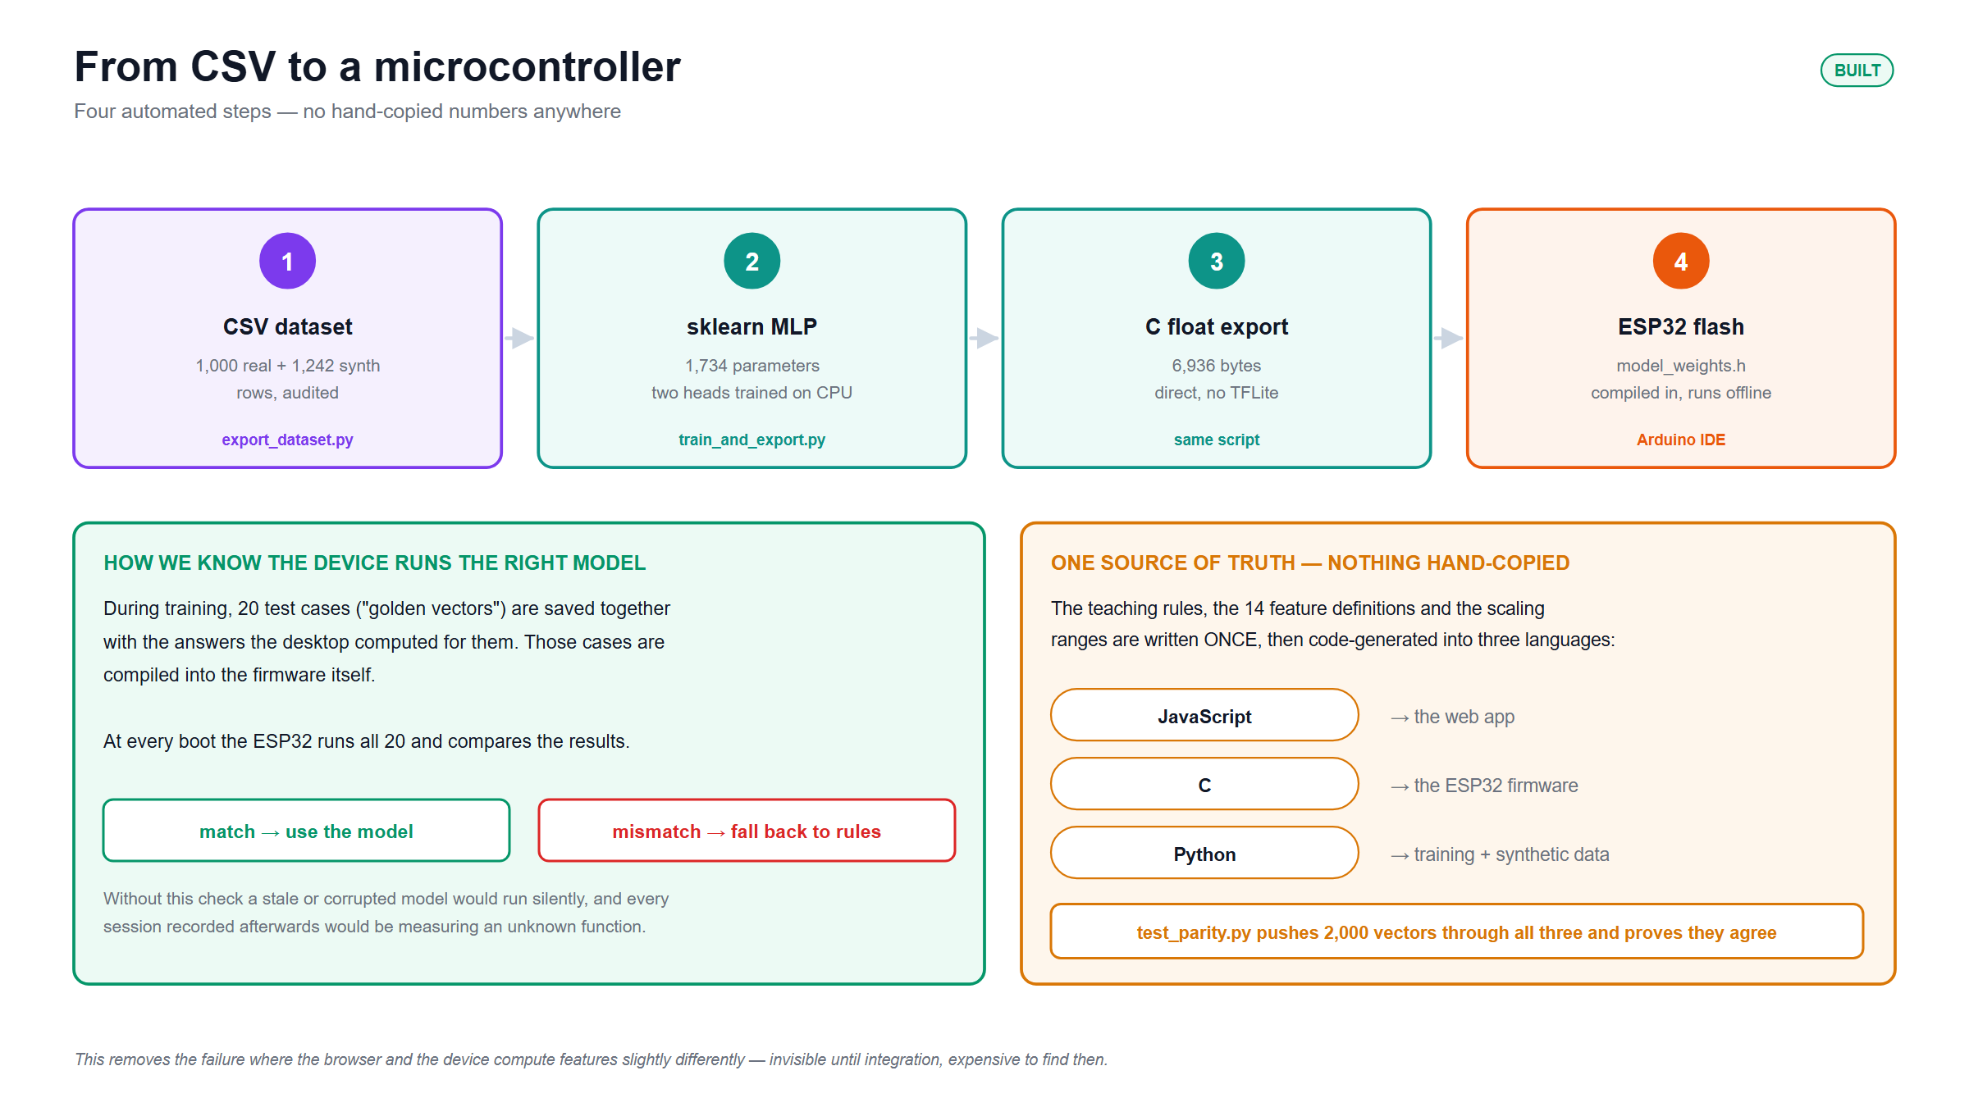
3.2 Design Methods (PO(a))
Architecture: two independent networks (not a shared trunk) — Teaching-Action net and Confidence-State net, each Input(8) → Dense(32, ReLU) → Dense(16, ReLU) → Dense(3, softmax).
Model choice: sklearn MLPClassifier — TensorFlow is incompatible with Python 3.12 on this Windows dev box.
Pipeline: collect logs → train sklearn MLPs → export as raw C float32 arrays → flash firmware for on-device inference.

Slide 10
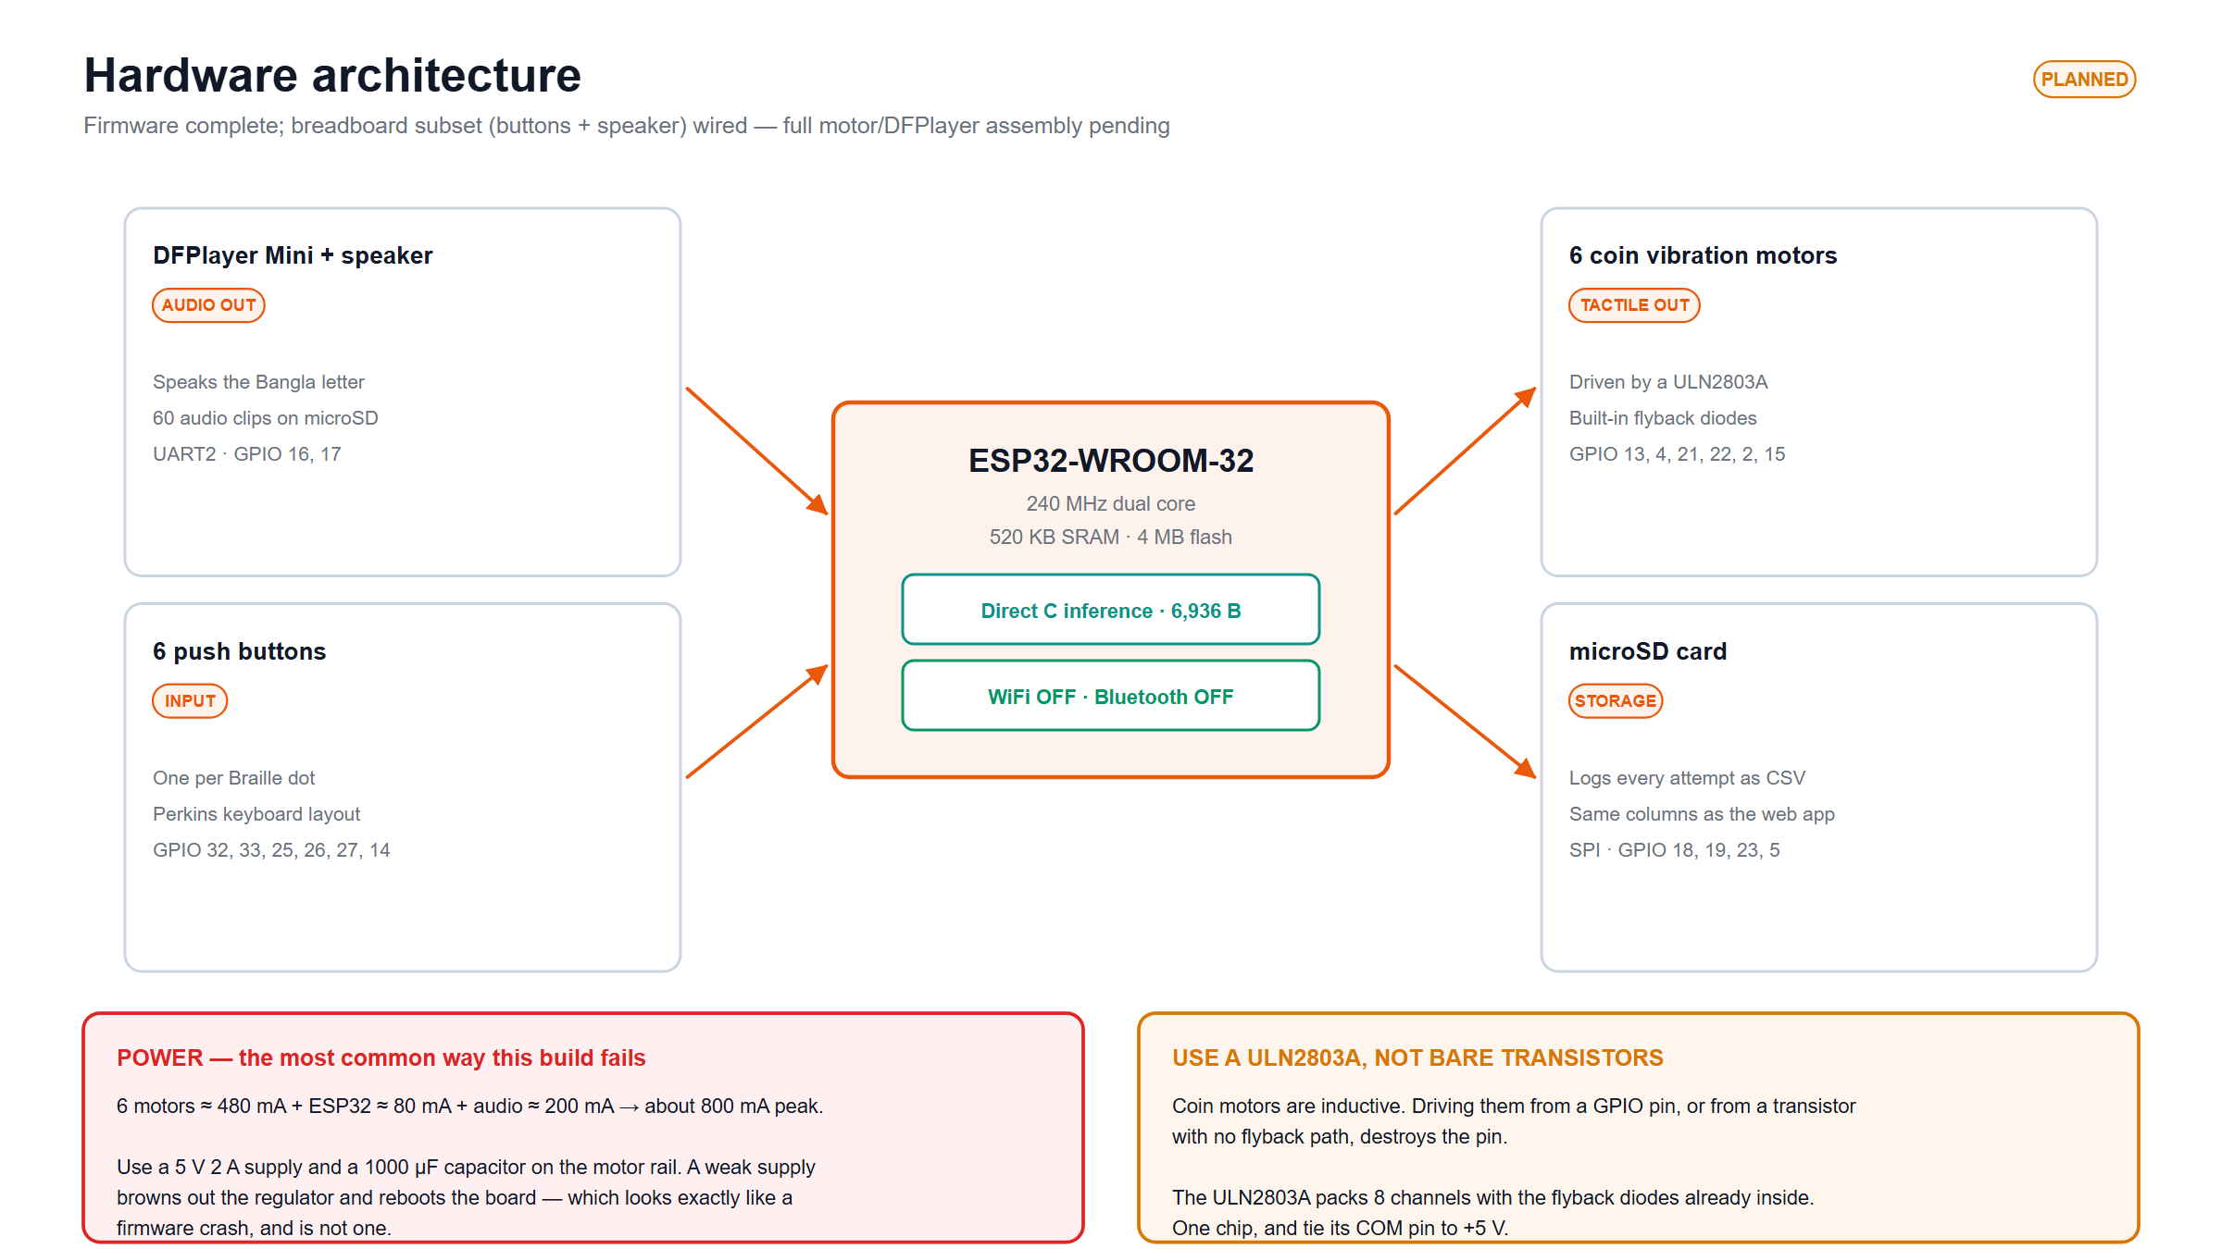
3.3 Design: Circuit Diagram
Buttons (dots 1-6): GPIO 32, 33, 25, 26, 27, 14
Motors 1-6 → ULN2803A: GPIO 21, 13, 22, 2, 15, 4
Submit (strapping pin): GPIO 12 — must read LOW at boot
DFPlayer UART2: RX = 16, TX = 17
microSD (VSPI): CLK 18, MISO 19, MOSI 23, CS 5
Power budget: ~800 mA peak (6 motors ~480 mA + ESP32 ~80 mA + DFPlayer ~200 mA); needs 5V/2A supply + 1000 µF cap across the motor rail.
Protection: ULN2803A has built-in flyback diodes (COM tied to +5V) — without it, driving inductive coin motors off bare GPIO destroys pins.

Slide 11
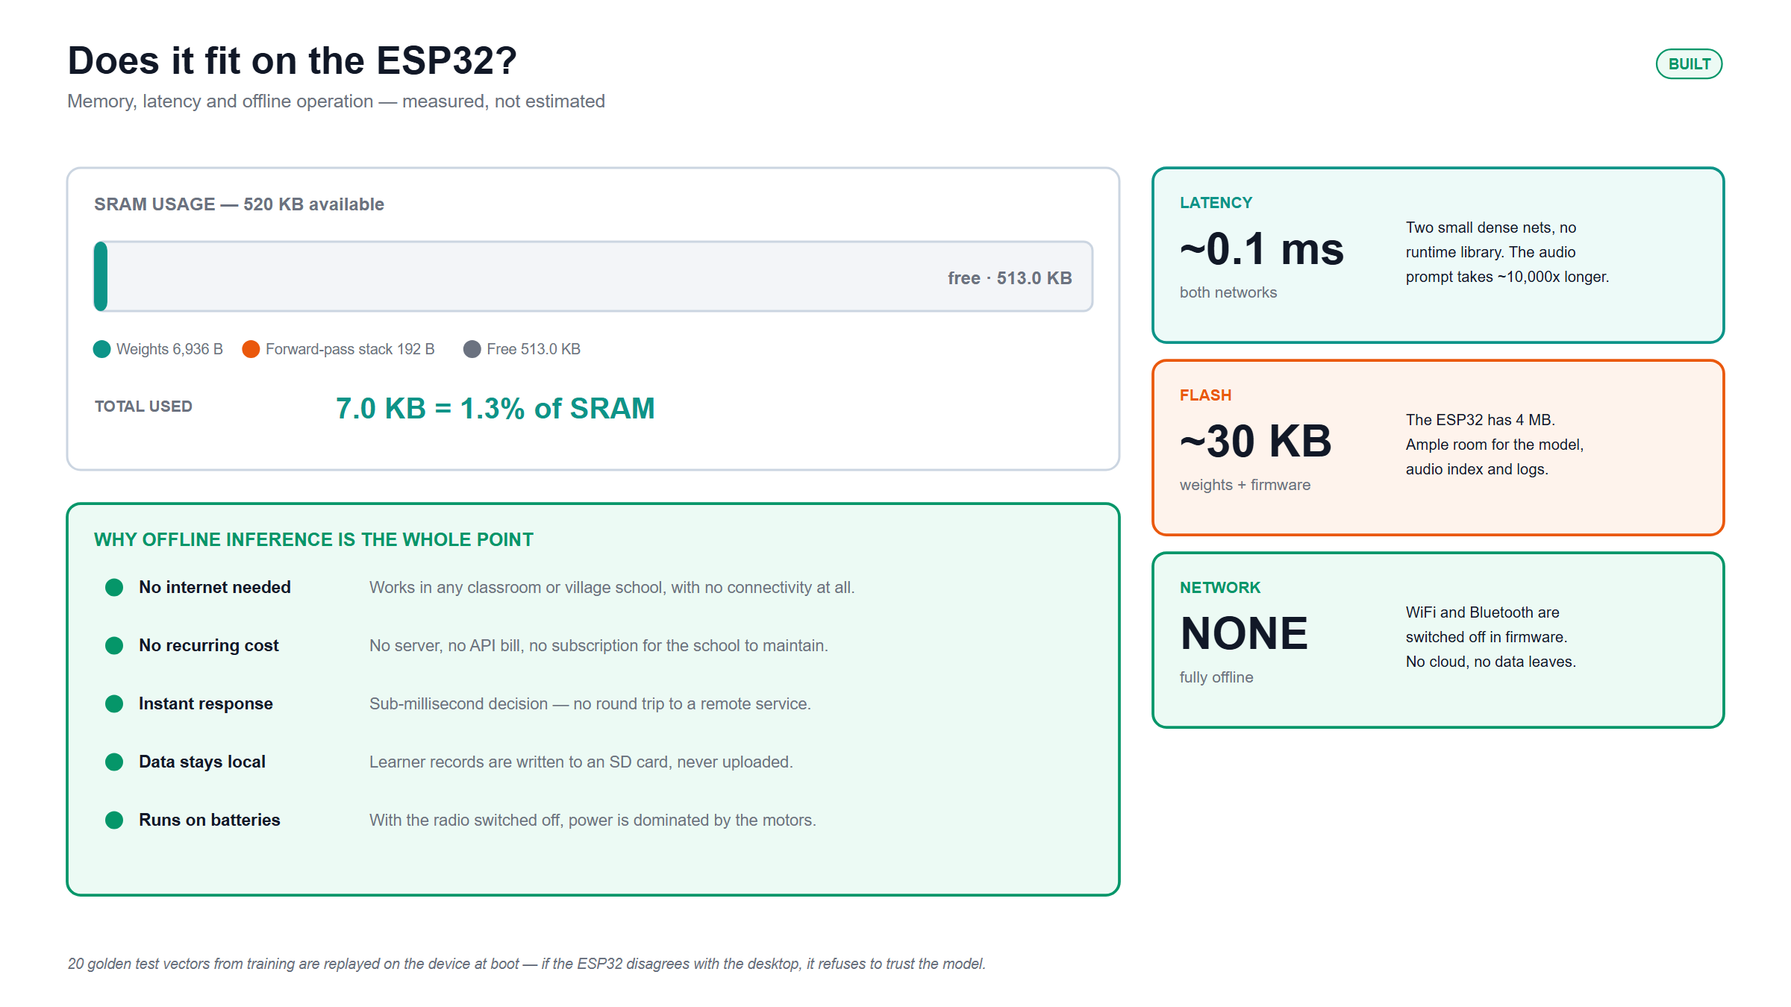
3.5 CAD / Hardware Design — Bill of Materials
ESP32-WROOM-32 dev board
DFPlayer Mini + speaker
ULN2803A Darlington driver
6 × coin vibration motors
6 dot buttons + 1 submit button
microSD module
5V / 2A power supply + 1000 µF cap
Resistors; optional DS3231 RTC
[ Insert hardware photo here ]
Three failure modes to avoid
No flyback protection destroys GPIO pins
Under-powered supply reboots the board mid-session
Wiring everything at once creates undebuggable multi-symptom failures

Slide 12
3.5 CAD / Hardware Design — Bring-Up Sequence
Peripherals are brought up one at a time — never flash the main sketch first.
[ Insert hardware photo here ]
1
t1_blink_serial
2
t2_buttons
3
t3_motors
4
t3b_braille_patterns
5
t4_dfplayer
6
t5_sd

Slide 13
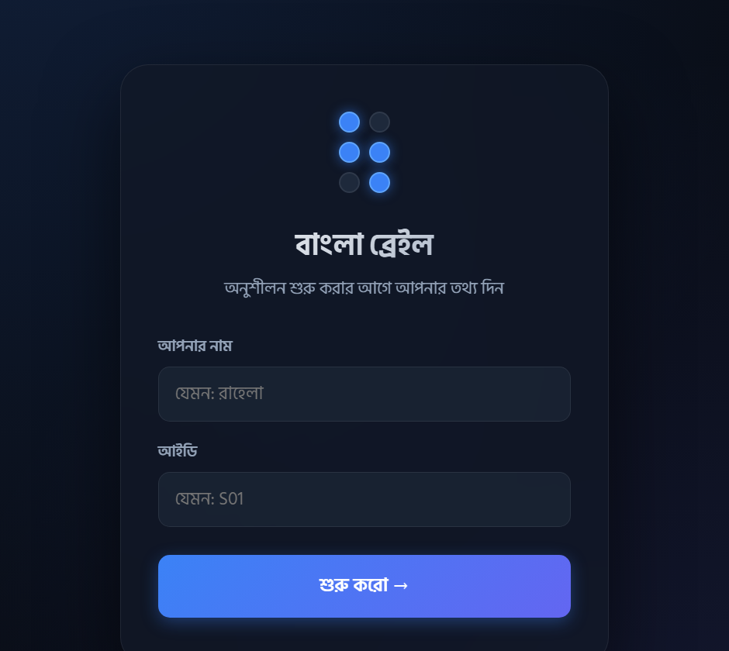
4. Implementation: Demonstration
[ Insert hardware photo here ]
Live web data-collection tool — deployed at eee-416.vercel.app

Slide 14
4.1 Implementation: Photo Gallery
[ Insert hardware photo here — angle 1 ]
[ Insert hardware photo here — angle 2 ]
[ Insert hardware photo here — in use ]

Slide 15
5. Design Analysis and Evaluation
5.1 Novelty
5.2 Design Considerations (PO(c))
5.3 Investigations (PO(d))
5.4 Limitations of Tools (PO(e))
5.5 Impact Assessment (PO(f))
5.6 Sustainability and Environmental Impact Evaluation (PO(g))
5.7 Ethical Issues (PO(h))

Slide 16
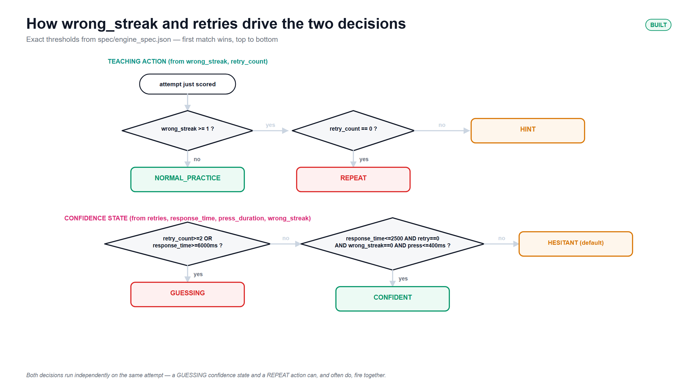
5.1 Novelty
The on-device adaptive teaching decision — not just haptic playback like prior Braille kits. A rule-based teaching policy is compressed into a 1,734-parameter network that runs in ~0.1 ms with no cloud, applied specifically to Bangla Braille (11 vowels + 39 consonants + combining marks, per BNBC).

Slide 17
5.2 Design Considerations (PO(c))
Safety
Cultural
Societal / Accessibility
5V DC low-voltage design
Zero RF during teaching mode — no WiFi/BT active
Gentle, calibrated haptic motors
All 50 BNBC characters supported
Native Bangla audio prompts
Affordable alternative to imported refreshable Braille displays
Self-paced learning

Slide 18
5.3 Investigations (PO(d))
(a) Braille pattern extraction
Reference-image projection-profile band detection. A bug was found where naive uniform-sixths sampling gave only a 7-grey-level confidence margin instead of the full 127 — fixed by real row/column band detection.
(b) Rule-engine parity
2,000 feature vectors were pushed through the JS / C / Python implementations, asserting identical output on both labels and every normalized feature, including values sitting exactly on decision thresholds.
(c) ঋ / র dot-pattern collision
ঋ (ri) and র (ra) share dot pattern [1,2,3,5] genuinely, per the BNBC standard. Resolved by making ঋ a two-cell character with a disambiguating dot-5 prefix vibration.

Slide 19
5.4 Limitations of Tools (PO(e))
!
Physical hardware not fully assembled — breadboard subset only
!
Audio is synthetic (espeak-ng), not human-recorded
!
No RTC yet: time_since_last_practice is a declared assumption across power-cycles (rows stamped rtc_present=0 for auditability)
!
Dataset skews toward 3 of 4 real participants (P04 has only 1 row)
!
Teaching-action class distribution depends on how sessions were collected, not a controlled trial

Slide 20
5.5 Impact Assessment (PO(f))
Societal
Health / Safety
Legal / Privacy
Accessibility for Bangla-speaking visually-impaired learners
Self-paced learning without constant 1-on-1 supervision
Low voltage design
Gentle haptics
Zero RF exposure during teaching mode
The deployed teaching device runs fully offline, zero network connection
The web data-collection tool (development only) syncs anonymized logs by participant code to a private RLS-protected database

Slide 21
5.6 Sustainability and Environmental Impact Evaluation (PO(g))
✓
Paperless — replaces single-use embossed Braille paper
✓
Energy-efficient — no continuous WiFi/cloud calls in teaching mode; ~800 mA peak only while motors fire
✓
Low-cost alternative reduces e-waste from expensive imported displays
✓
Durable, solid-state components

Slide 22
5.7 Ethical Issues (PO(h))
Honesty in claims: this is explicitly not described as “autonomous AI discovering teaching strategy.” It imitates a rule engine — stating that plainly is itself the ethical practice.
Data minimization: only a participant code is stored during data collection, never names.
Offline vs. online: the deployed teaching device is fully offline; only the development-time web tool syncs anonymized logs.

Slide 23
6. Reflection on Individual and Team Work
Individual Contribution · Mode of Teamwork and Diversity · Project Logbook

Slide 24
6.1 Individual Contribution of Each Member
Approximate division of primary responsibility (exact hour-logs are not available)
Member | ID | Primary responsibility
Santu Nag | 2106055 | Literature review; hardware BOM & methodology writeup; initial objectives
Md. Adib Hasan Audhi | 2106056 | Web data-collection platform; progress documentation; breadboard bring-up
Mishat Hasan Milon | 2106059 | ML model design, training pipeline & firmware inference; repo engineering; testing & deployment
Khalid Mehebub | 2106065 | Design considerations (safety/cultural/societal/environmental); sustainability evaluation; cost analysis; project management

Slide 25
6.2 Mode of TeamWork and Diversity
Cross-functional split across hardware, firmware, ML, and web development
Regular sync check-ins across the team
Shared GitHub repository as the single source of truth for all generated artifacts
One spec file drives 3 rule engines (JS / C / Python), preventing browser/firmware divergence

Slide 26
6.3 Logbook of Project
[ Insert logbook screenshot here ]

Slide 27
7. Communication to External Stakeholders (PO(j))
GitHub Repository
https://github.com/Mishatmilon059/eee_416
[ Insert demo video link here ]

Slide 28
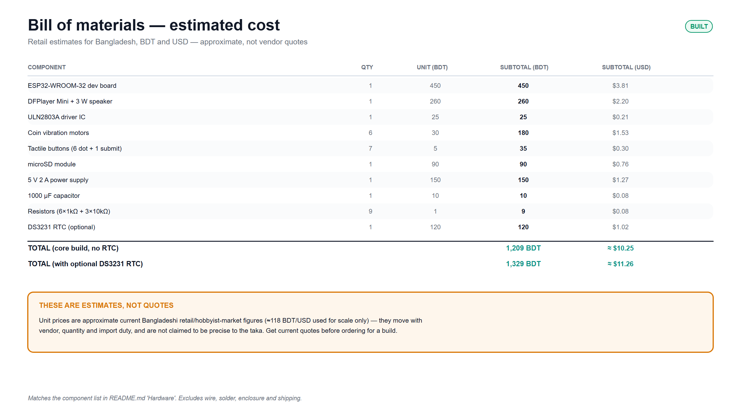
8. Project Management and Cost Analysis (PO(k))
Rough estimate, not a quote — per-unit cost at production scale would drop meaningfully by sourcing the bare ESP32-WROOM-32 module instead of a dev-kit board and bulk-pricing the motors/buttons.

Slide 29
9. Future Work (PO(l))
→
Complete full hardware assembly — wire all 6 motors + DFPlayer together
→
Re-record audio with a human voice (drop-in replacement, same track numbering)
→
Build the teacher-facing mobile app (web teacher panel already exists)
→
Add a DS3231 RTC (~$1) to remove the time-since-last-practice assumption
→
Continue collecting real data to broaden the participant pool beyond the current 4

Slide 30
10. References
[1] Kader, M. A. et al. (2018). “Developing A Self-Learning Braille Kit for Visually Impaired People.”
[2] Saikot, M. & Sanim, K. R. R. (2022). “Refreshable Braille Display With Adjustable Cell Size for Learners With Different Tactile Sensitivity.”
[3] Ma, X., Lai, C., & Luo, Y. (2025). “BrailleRhythm: Enhancing Braille Character Recognition and Learning via Real-time Tactile Sensing and Audio Feedback.”
[4] Bangladesh National Braille Code (BNBC) standard — cross-referenced against Wikipedia's Bengali Braille table.
[5] ESP32-WROOM-32 datasheet (Espressif Systems).
[6] DFPlayer Mini datasheet (DFRobot).
[7] ULN2803A datasheet (Texas Instruments).
[8] Project GitHub repository (self-citation): https://github.com/Mishatmilon059/eee_416

