Slide 1
AI-Assisted
Bangla Braille Tutor
A TinyML system that teaches Braille and runs completely offline on a microcontroller
1,161
5,928 B
2.7%
< 1 ms
model parameters
quantized size
of ESP32 memory
inference, offline
EEE 416 · Department of Electrical and Electronic Engineering
Notes:
This project teaches Bangla Braille using a small neural network that runs entirely offline on a four-dollar microcontroller. The whole pipeline is built: a simulation that collects real learner data, a training pipeline, and firmware. What remains is collecting data from real learners and assembling the hardware.

Slide 2
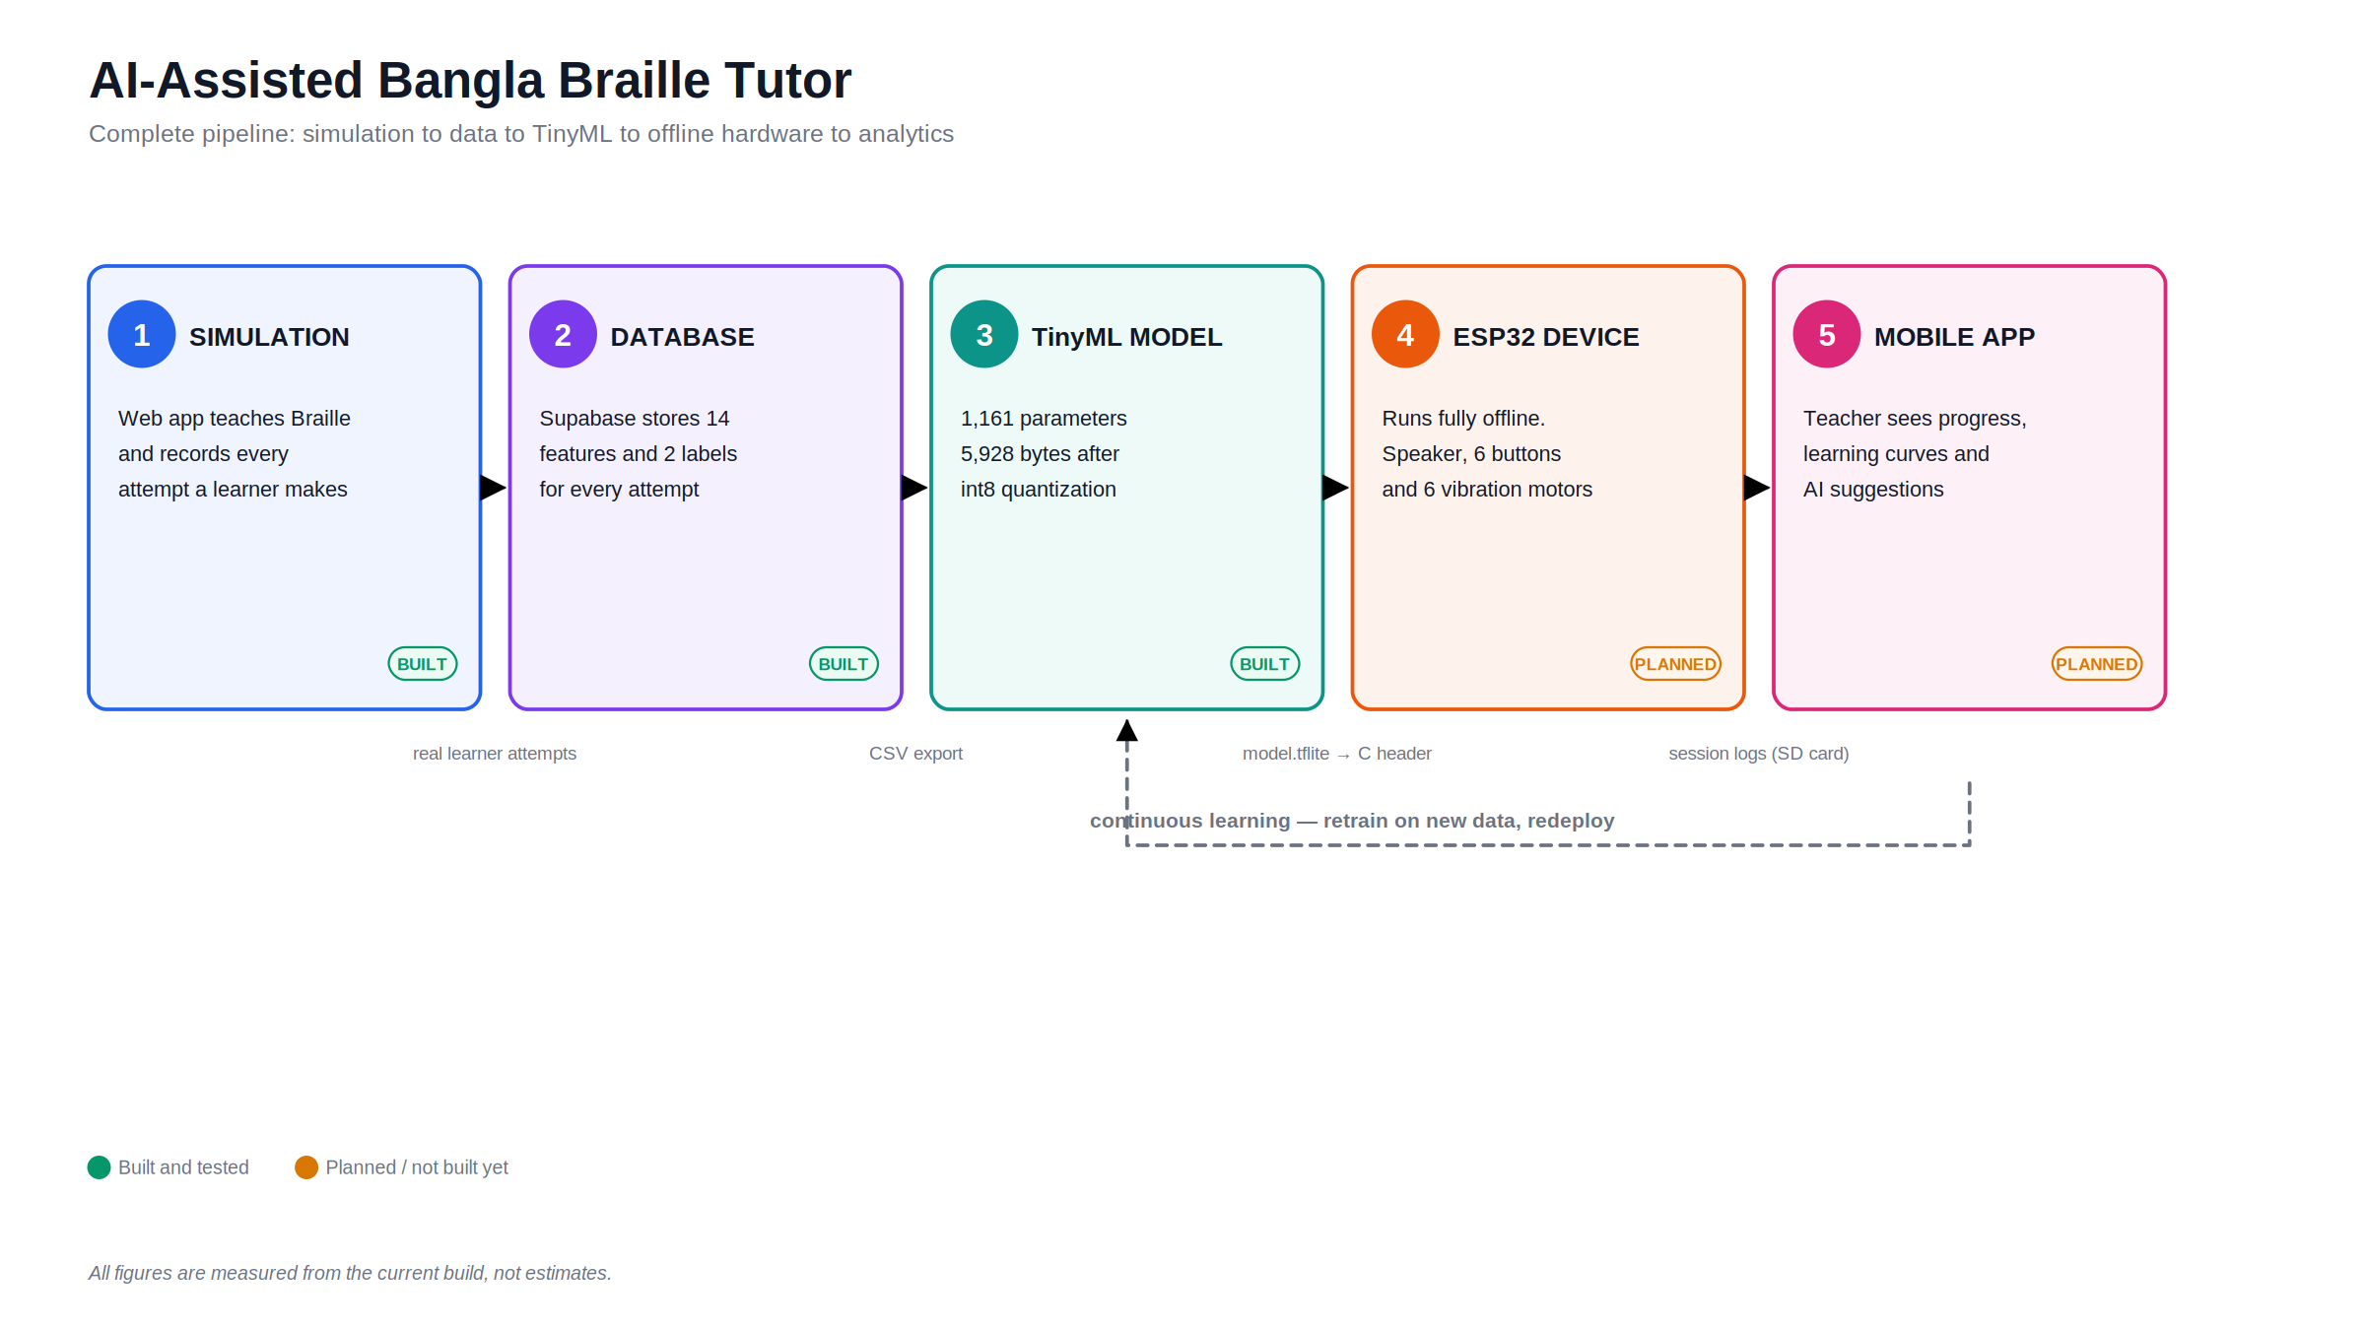
Notes:
The whole system in one view. Five stages: a web simulation collects real learner data, Supabase stores it, a tiny model is trained on it, that model runs offline on an ESP32, and a mobile app shows teachers the results. Three stages are built and tested today; the device and the app are designed but not yet built.

Slide 3
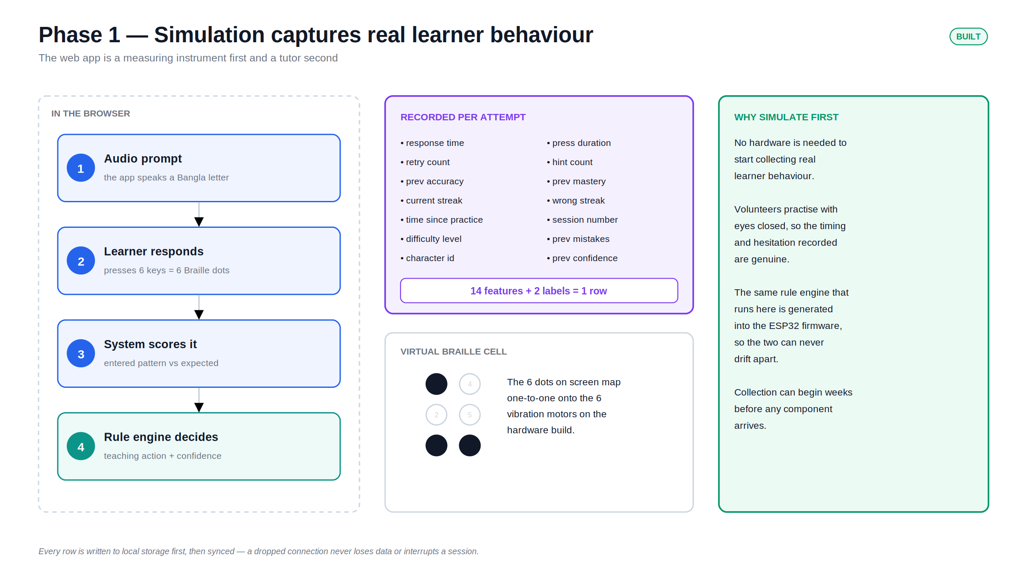
Notes:
Phase one is a measuring instrument, not a toy. It teaches Braille in the browser and records 14 numbers for every single attempt. Because no hardware is needed, data collection can start weeks before any component arrives — and the same rule engine here is generated into the firmware, so the two can never disagree.

Slide 4
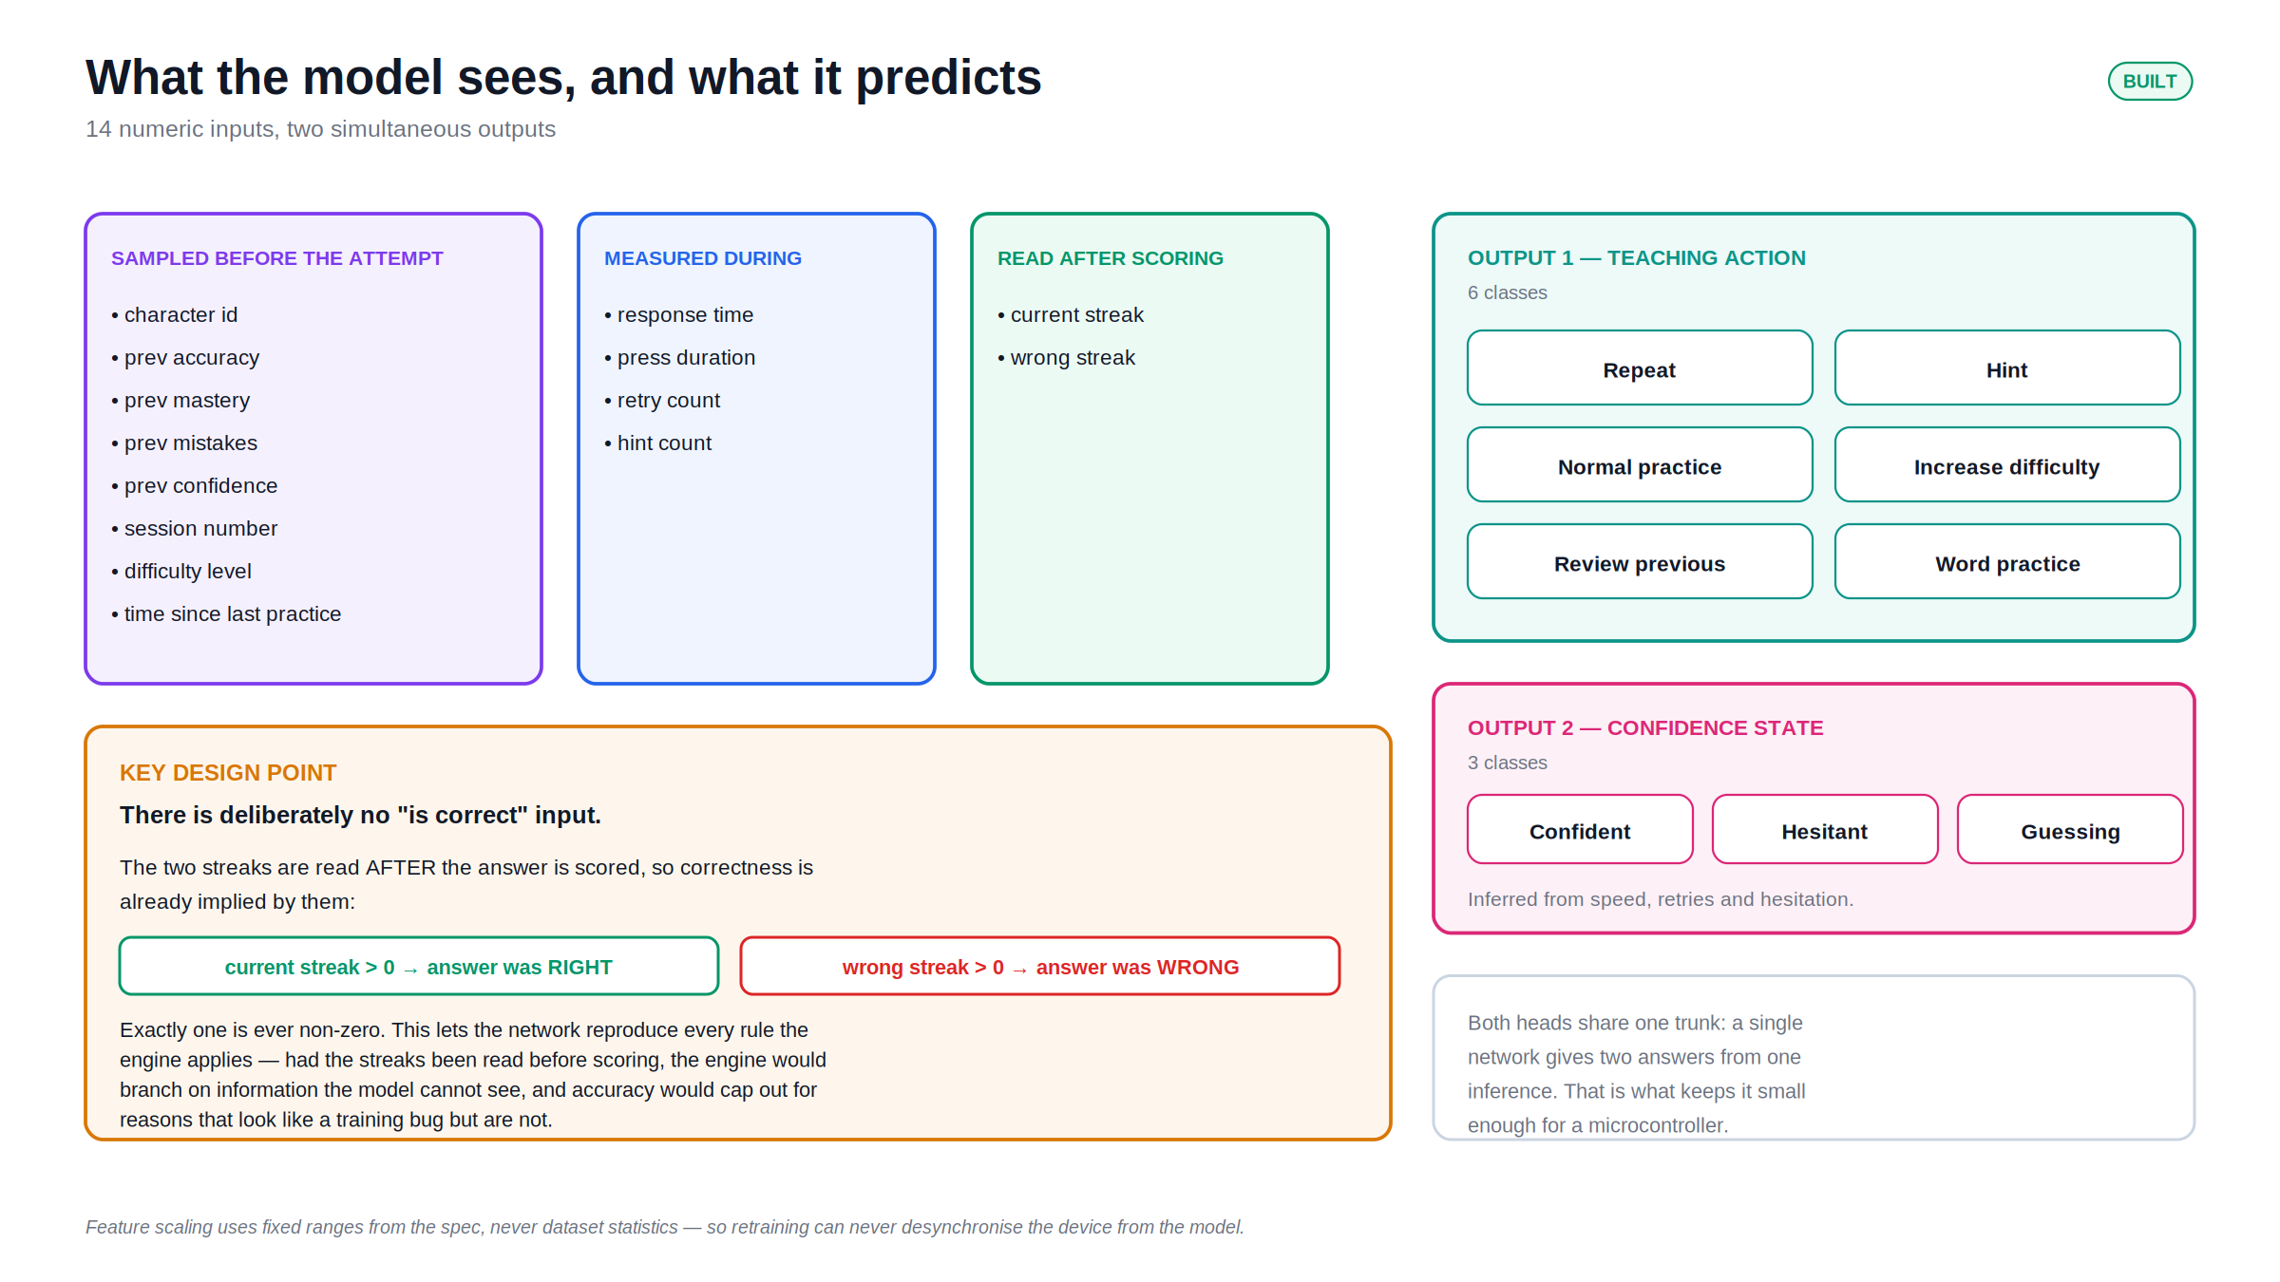
Notes:
The 14 inputs and the 2 outputs. The important design point is on the left: there is no "is correct" input. The two streaks are read after scoring, so correctness is already implied by them. That is what lets the network reproduce every rule the engine applies.

Slide 5
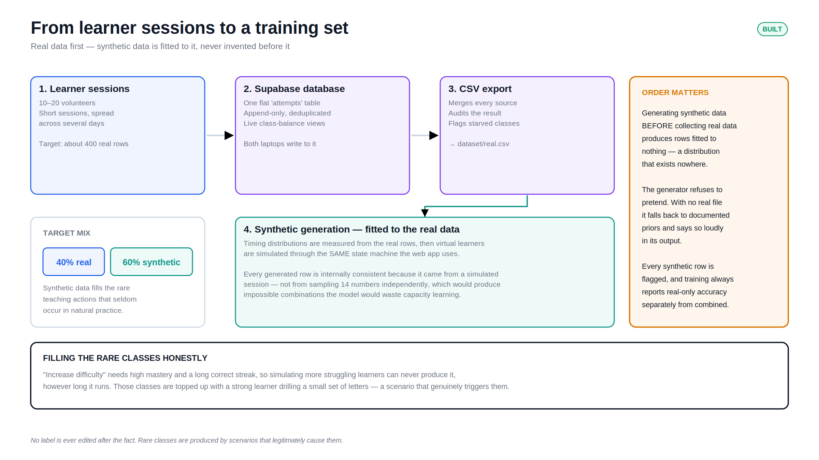
Notes:
How the training set is built. The order is deliberate: collect real data first, measure its timing distributions, then generate synthetic data fitted to those measurements. Generating synthetic data first would produce rows fitted to nothing.

Slide 6
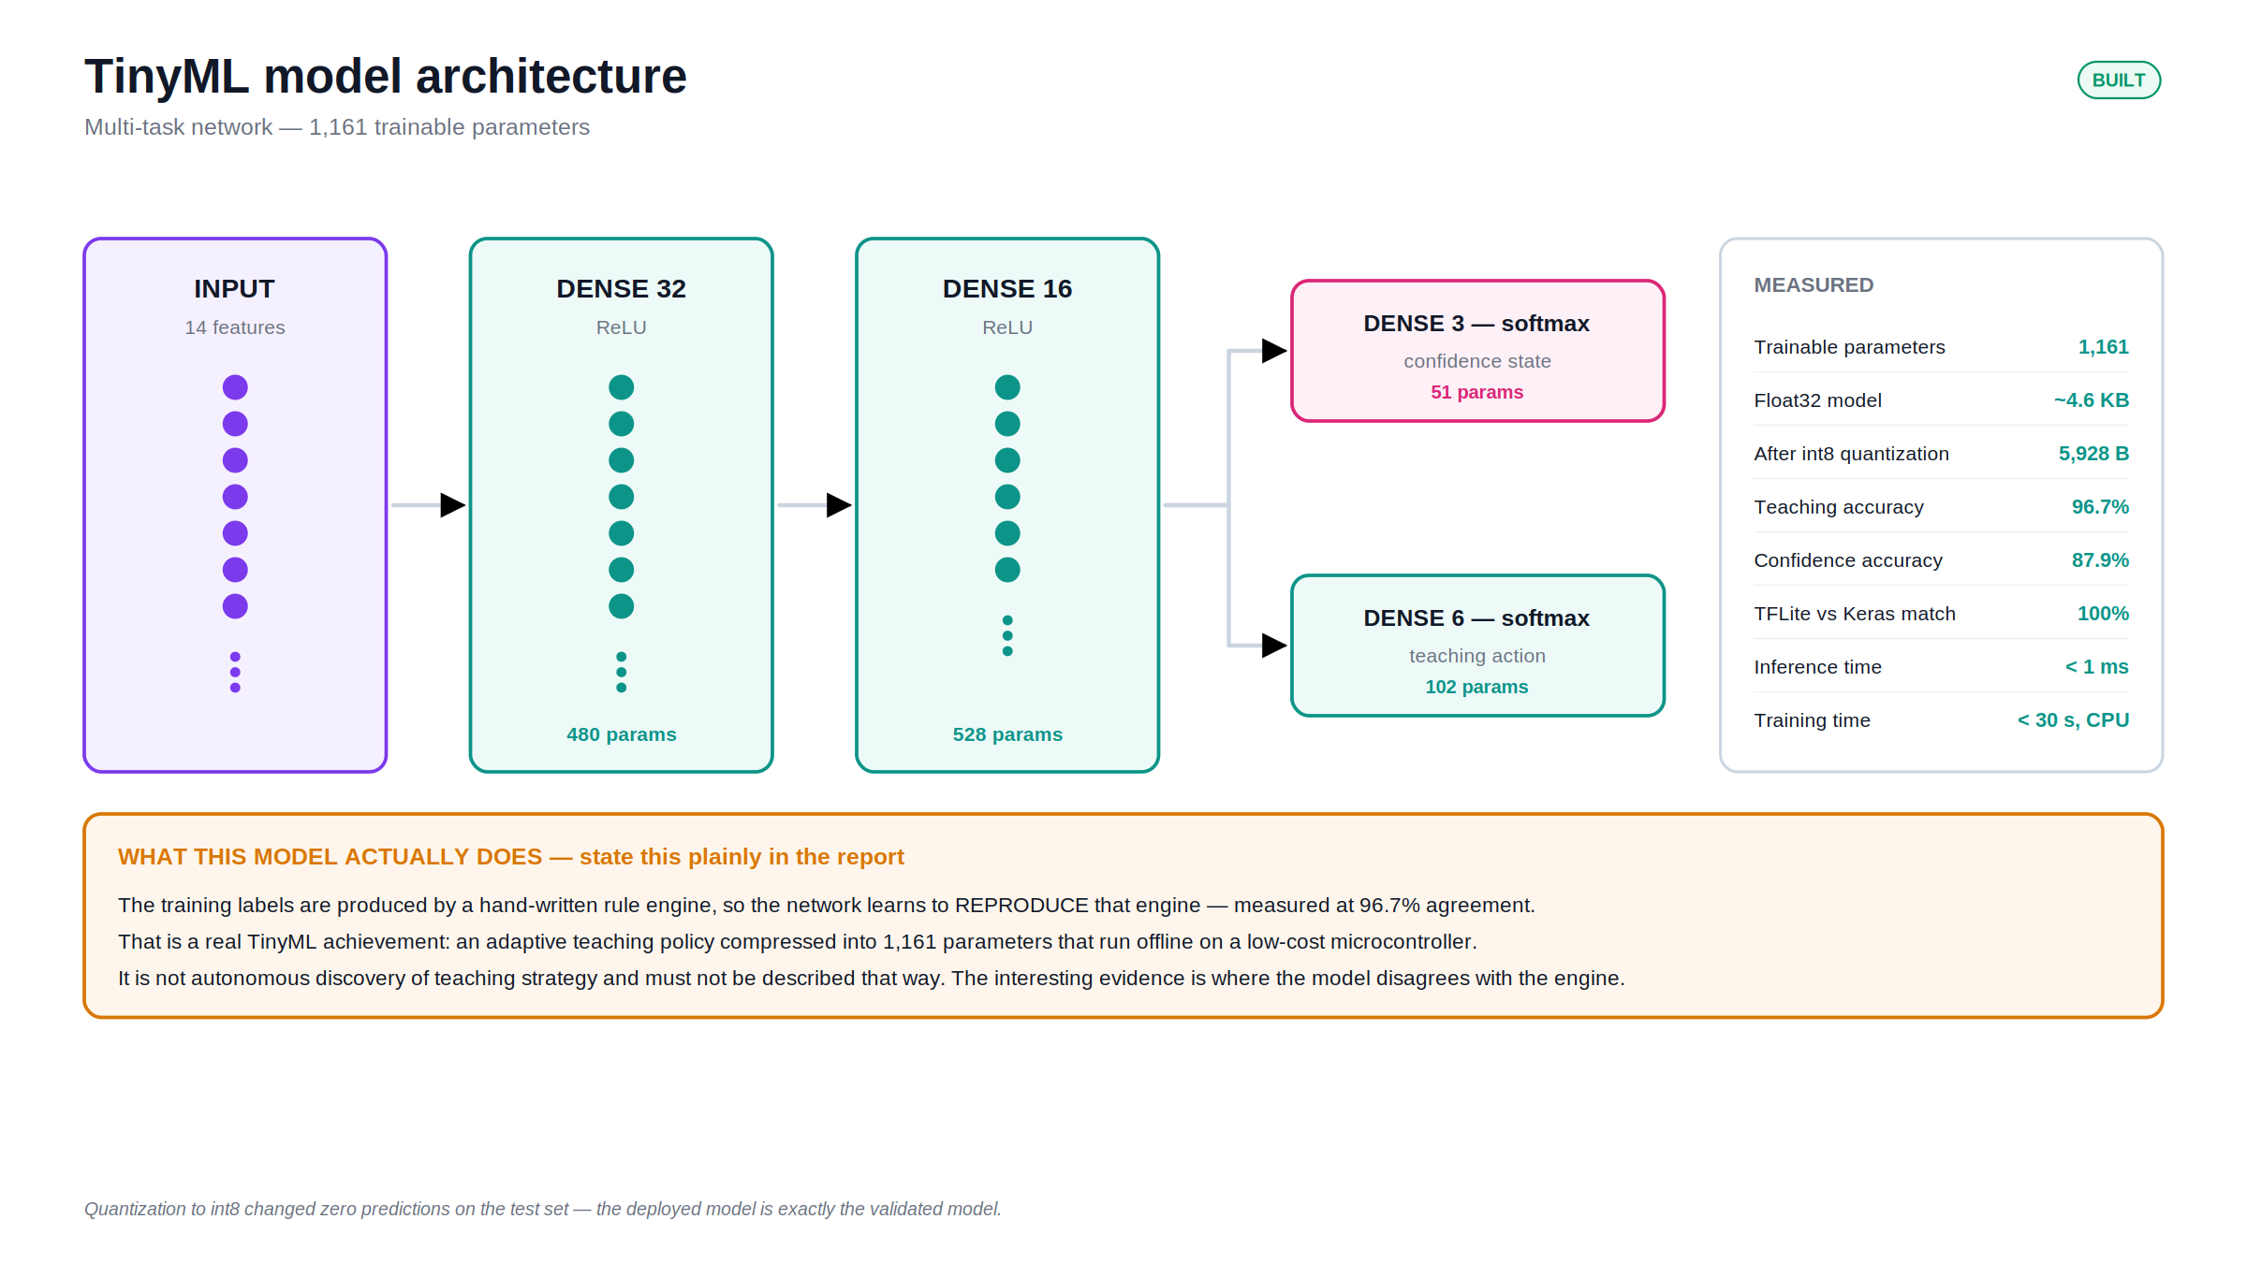
Notes:
The model itself. 1,161 parameters, 5,928 bytes after quantization. The amber band at the bottom is the honest framing: the labels come from a hand-written rule engine, so the network learns to reproduce that engine at 96.7 per cent. That is a real achievement in compression, not autonomous discovery of teaching strategy.

Slide 7
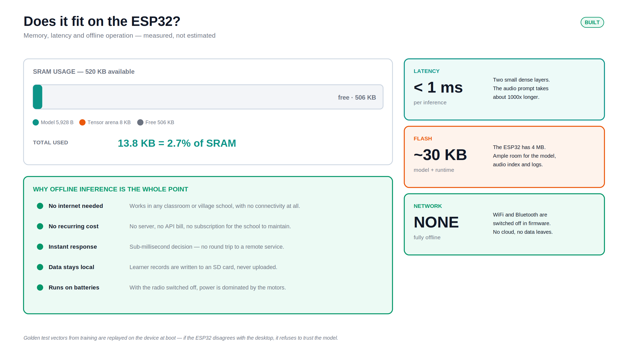
Notes:
Does it fit? Comfortably. 13.8 KB of 520 KB — under three per cent of the memory. Inference is under a millisecond. And it runs with the radio switched off, so the device needs no internet, costs nothing to run, and keeps every learner record local.

Slide 8
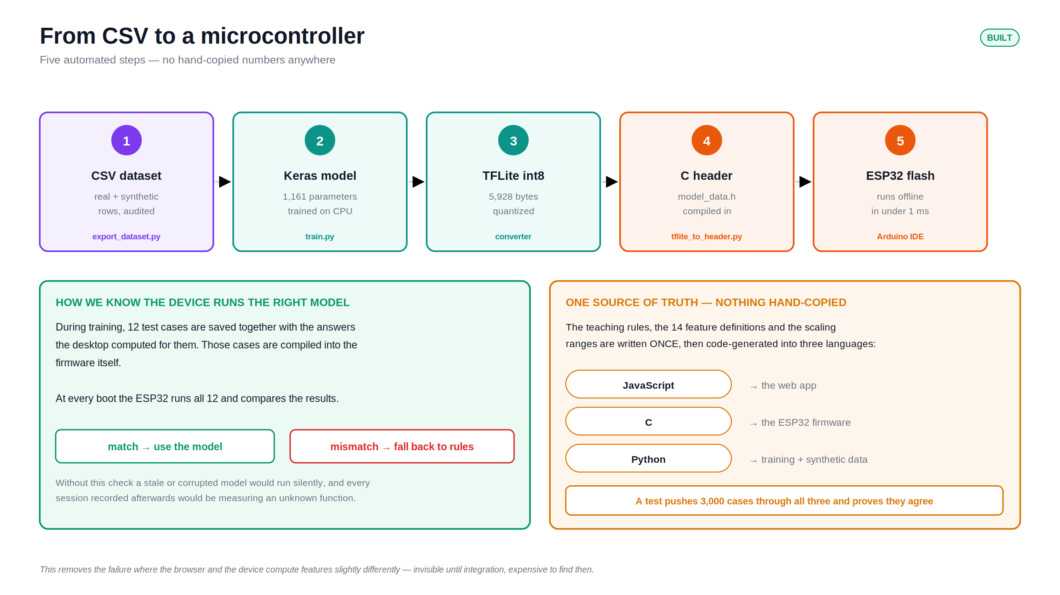
Notes:
Five automated steps from CSV to a flashed microcontroller, with no hand-copied numbers. Two safeguards matter: golden test vectors are replayed on the device at boot, and the rules exist in one place then generate into three languages, proven equal across 3,000 test cases.

Slide 9
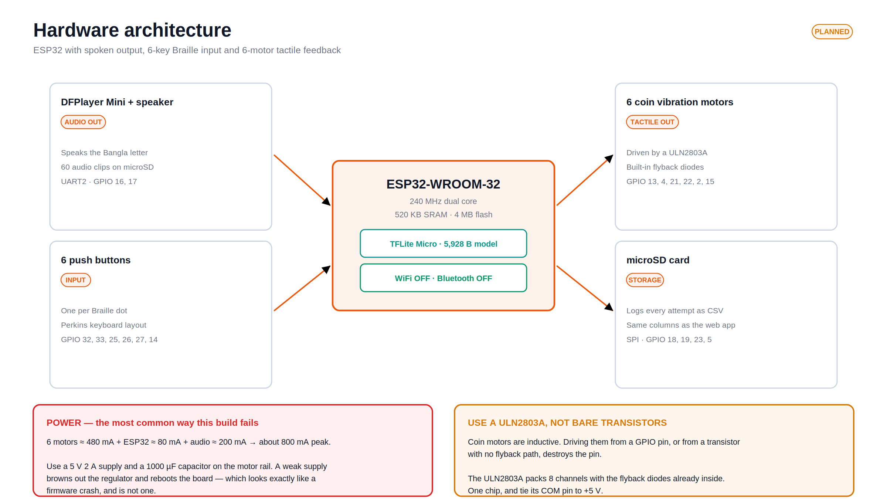
Notes:
The hardware. An ESP32 with a speaker, six buttons, six vibration motors and an SD card. The two red and amber boxes are the failure modes that most often kill a build like this: an under-powered supply that reboots the board mid-session, and driving inductive motors without flyback protection.

Slide 10
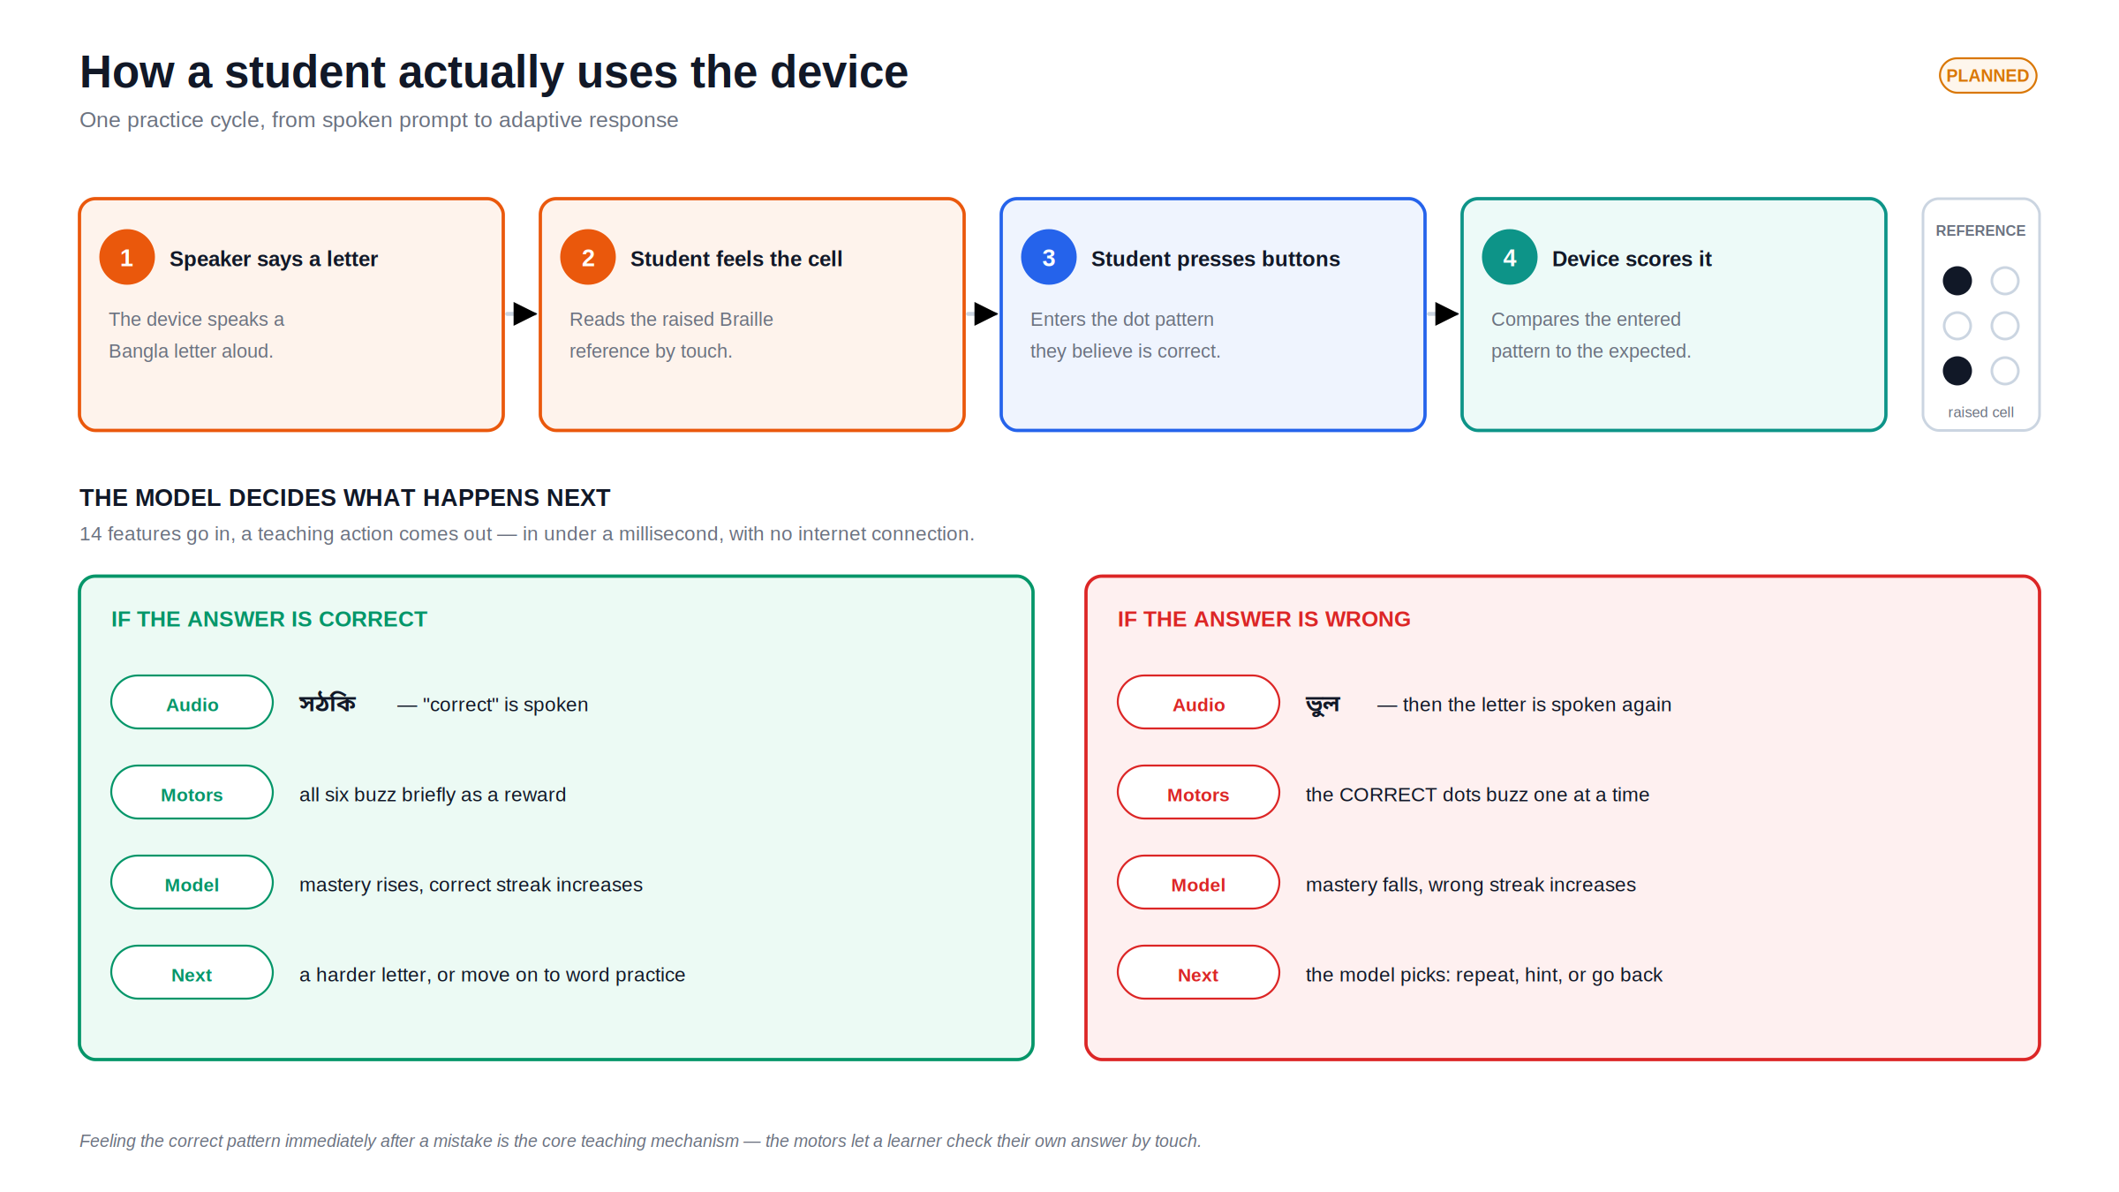
Notes:
What a student actually experiences. The device speaks a letter, they feel the raised reference, they press the dots they believe are right. If wrong, the correct dots buzz one at a time — that is the core teaching mechanism, letting a blind learner check their own answer by touch.

Slide 11
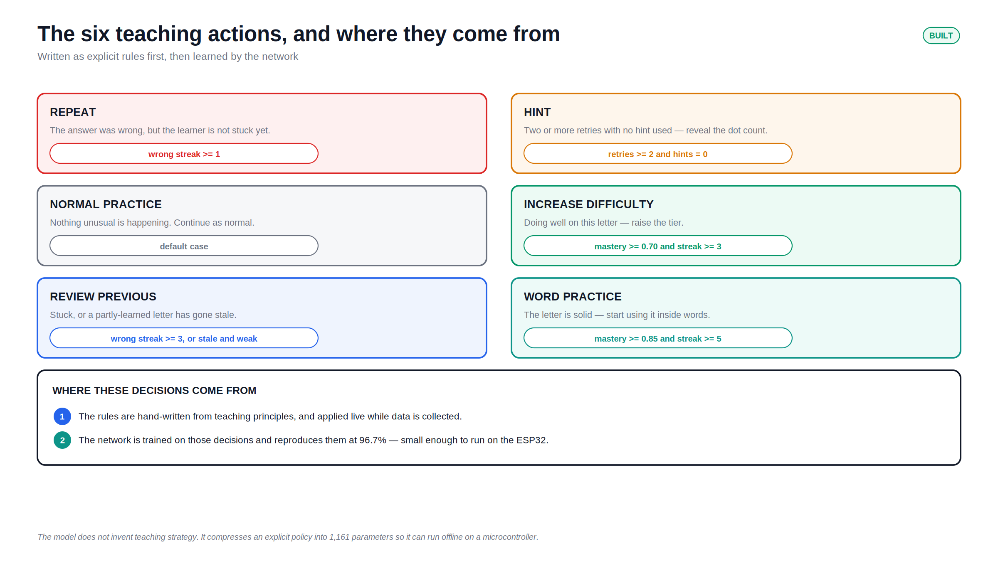
Notes:
The six decisions the system can make, and the exact rule that triggers each one. Note the two steps at the bottom: the rules are written first from teaching principles, and the network is then trained to reproduce them small enough to run on the microcontroller.

Slide 12
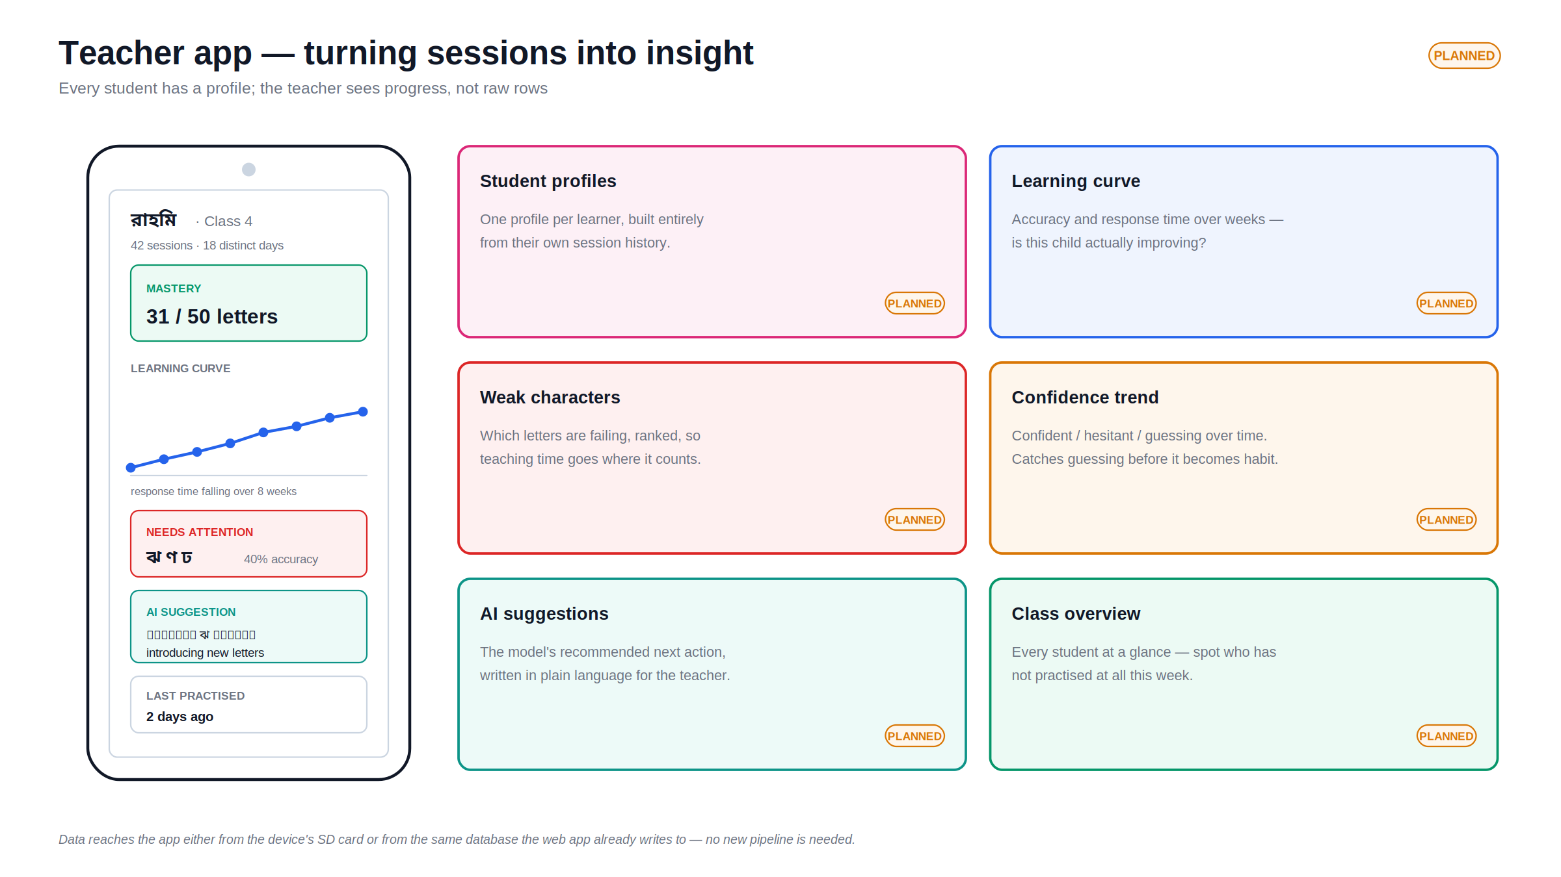
Notes:
The planned teacher app. A teacher does not want raw rows — they want to know who is improving, which letters are failing, and what to do next. The data needs no new pipeline: it comes from the SD card or the same database the web app already writes to.

Slide 13
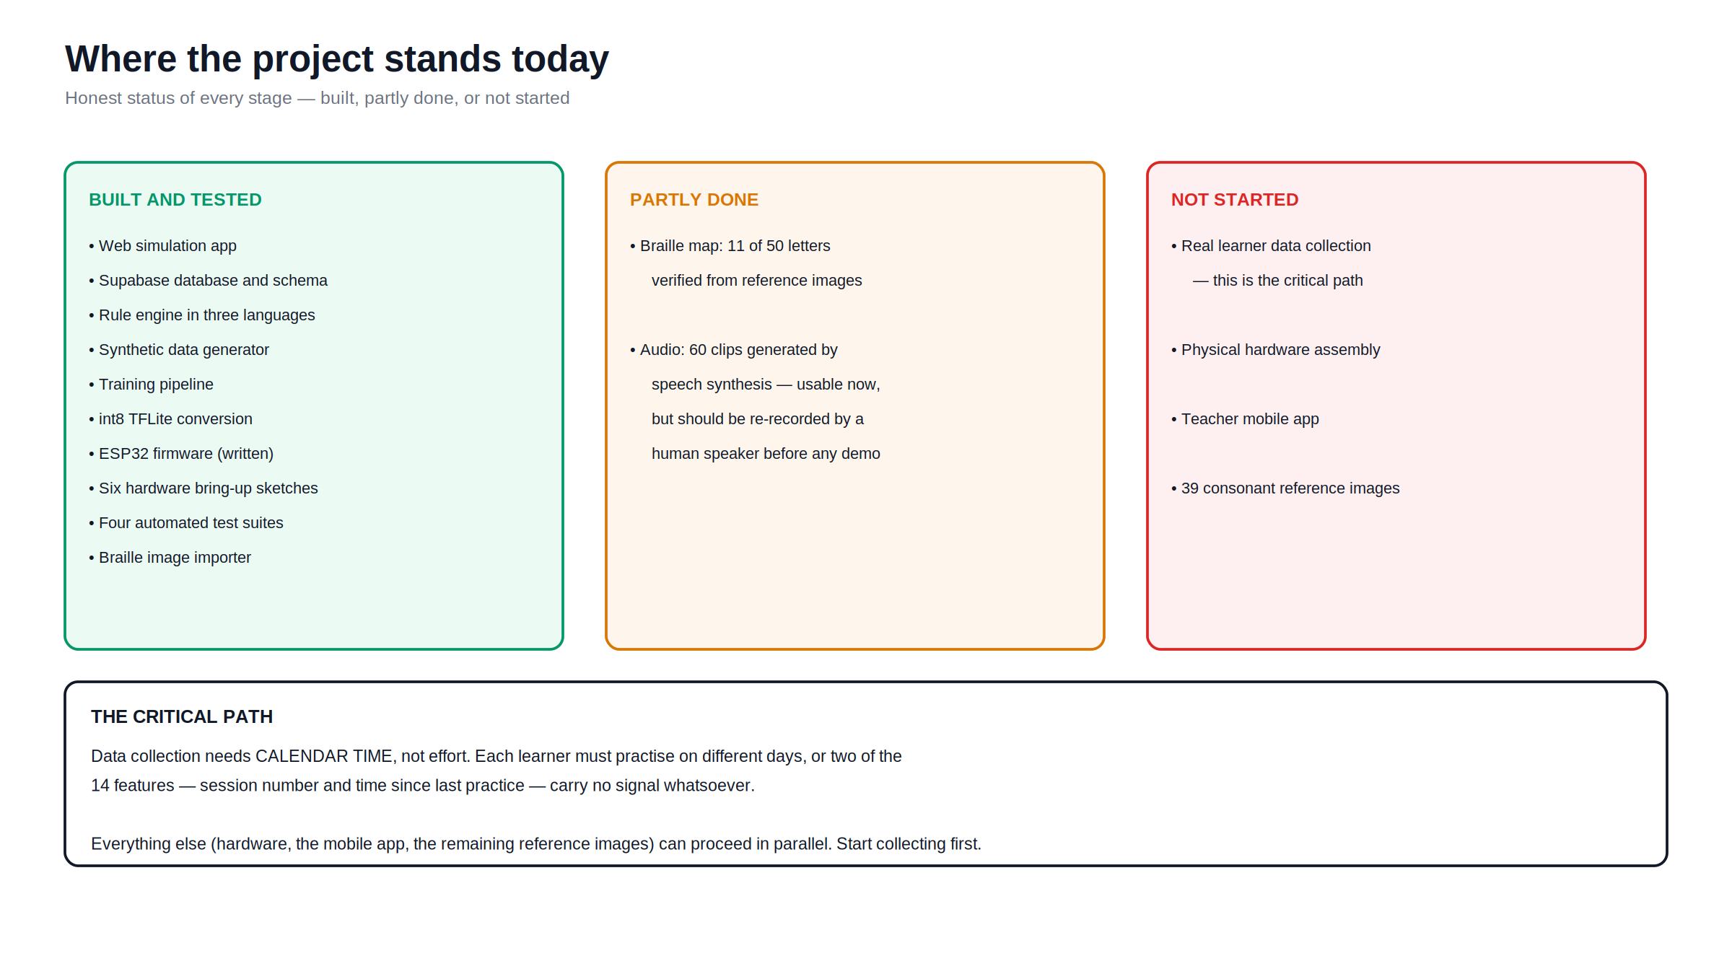
Notes:
Honest status. The software is built and tested. The Braille data is partly verified. Real learner data, the hardware and the app have not been started. The critical path is data collection, because it needs calendar time — learners must practise on different days — and no amount of effort compresses that.

Slide 14
What this project has NOT yet shown
Stating these plainly is stronger than being asked about them
No real learner data yet
Every accuracy figure comes from a synthetic pipeline test. Those rows were simulated and labelled by the same rule engine the model reproduces, so the numbers are circular.
Only 11 of 50 characters verified
The 11 vowels were read from reference images. The 39 consonants are still placeholder patterns. Of 11 vowel guesses, one was wrong — so roughly 3 or 4 consonants are likely wrong too.
The model imitates a rule engine
It reproduces hand-written rules at 96.7 per cent. That is compression of an explicit policy into 1,161 parameters — a genuine TinyML result, but not autonomous discovery of teaching strategy.
The hardware has never been assembled
The firmware is written and its generated headers compile and self-check, but no physical device exists. Nothing has run on real silicon.
Notes:
These four limitations belong in the presentation, not hidden in an appendix. An examiner who finds them missing will assume they were concealed. Stated up front, they show the project is understood rather than oversold. Each one has a clear route to being resolved.

Slide 15
What happens next
One task is on the critical path. Everything else runs in parallel.
CRITICAL PATH · start today
Collect real learner data
Each learner must practise on DIFFERENT DAYS. Two of the 14 features — session number and time since last practice — carry no signal at all if every session happens in one sitting. This is calendar time, and no amount of effort compresses it.
IN PARALLEL
Supply 39 consonant images
Order and assemble hardware
Drop them in, run one command. Fixes the remaining Braille patterns.
Work through the six bring-up sketches, one peripheral at a time.
Re-record the audio
Retrain on real data
Replace synthetic speech with a human voice. Same filenames, drop-in.
One day of work once the sessions exist. Then reflash the device.
Notes:
The single most important point: data collection cannot be rushed at the end. It needs learners practising across multiple days, so it must start immediately and run while the hardware is being built. Everything in the lower half can happen at the same time.

