Slide 1
Traffic Monitoring Using Low-Cost Doppler Radar
Mishay Naidoo

Slide 2
Recap!
Goal of 4022: Design a low-cost traffic monitoring system using Continuous Wave Doppler Radar units
The system had to count the number of vehicles in a single lane of traffic and accurately estimate vehicle speeds
Cost less than 100 USD

Slide 3
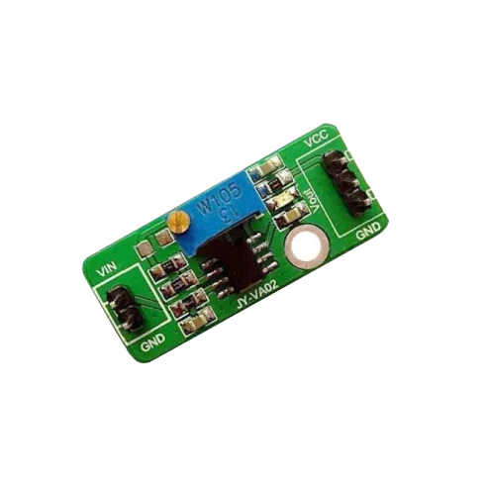
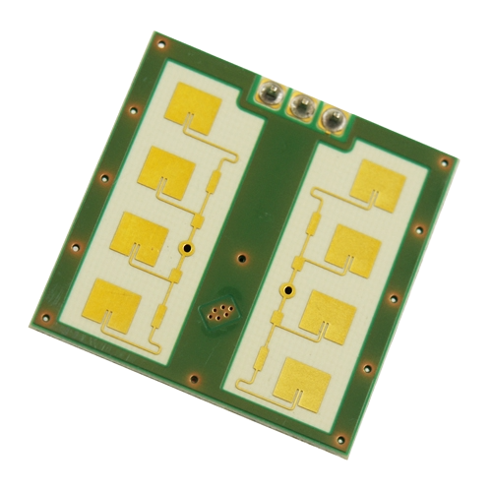
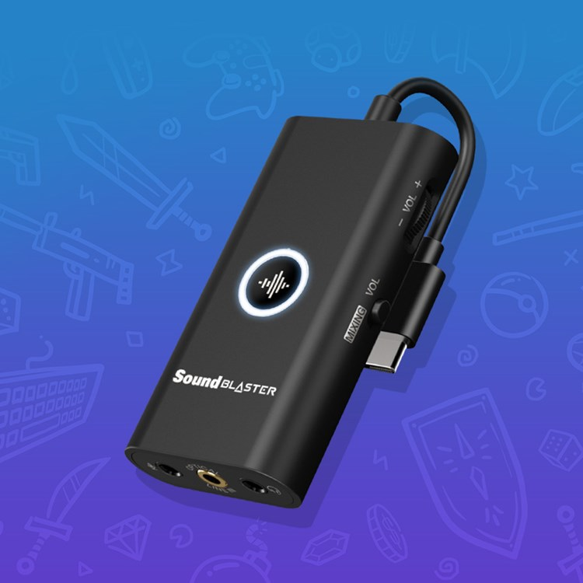

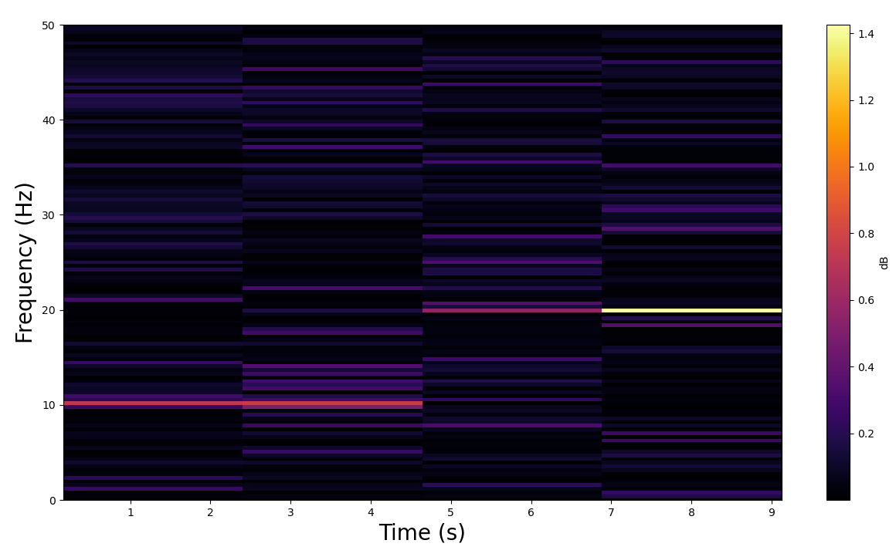
My System
+
+
CDM324/IPM-165
LM358 Amplifier
Soundcard
+
+
Audacity
Spectrogram

Slide 4
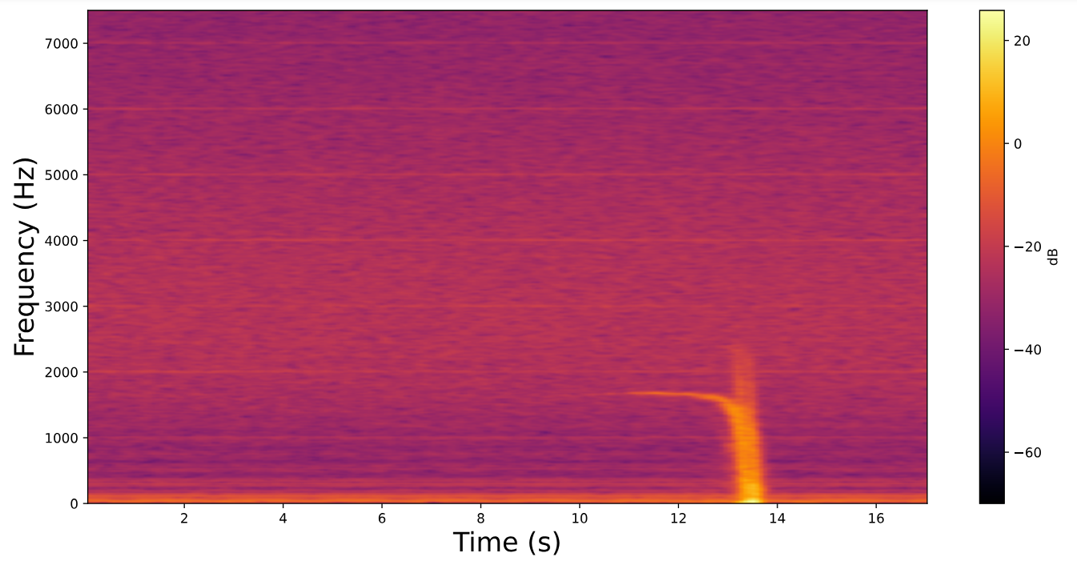
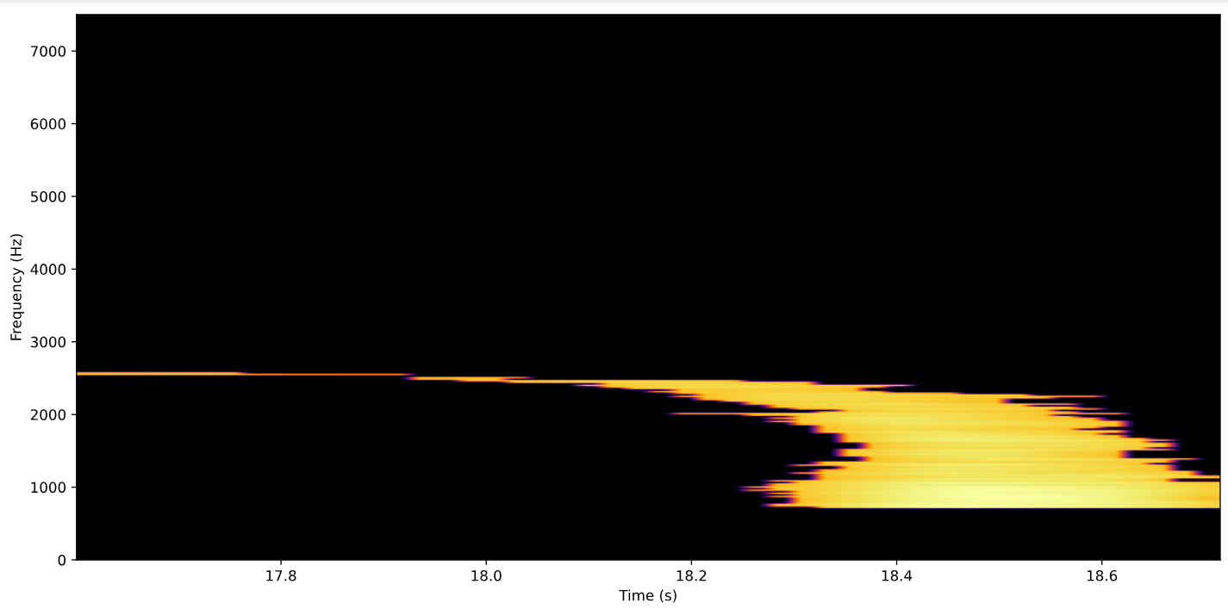
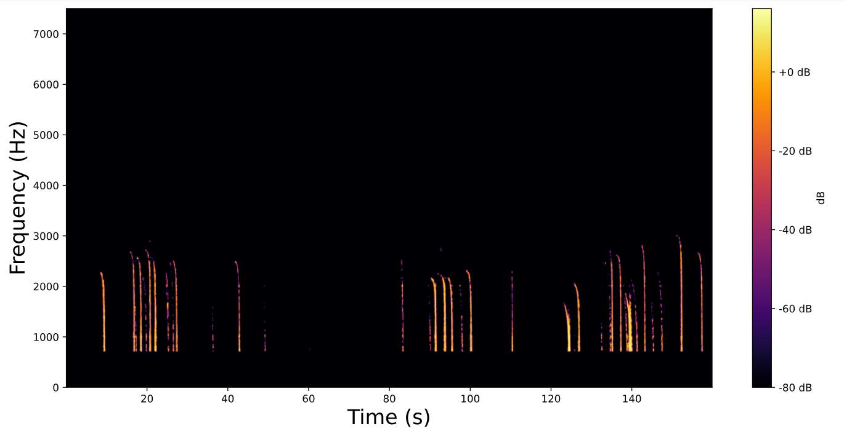
Two types of tests were conducted:
Controlled tests with a single vehicle moving at known speeds
Tests on a busy road with a speed limit of 60km/h

Slide 5
Pros:
Cons:
Controlled tests obtained speed estimates with an error of <=5.75%
The system was tested on only a single public road for a short duration
The system identified all but one vehicle in the uncontrolled test and had speed prediction that agreed with the road speed limit.
Used a very expensive soundcard (68 USD)
Required a laptop for data acquisition and processing
Total cost: 91.33 USD

Slide 6
Plan for Masters
Sample the data using a cheaper ADC
Design a PCB to reduce the number of freestanding components
Make the system completely portable (run off of Pi, battery powered)
Obtain much more data
Extract as much information as possible from the data

Slide 7
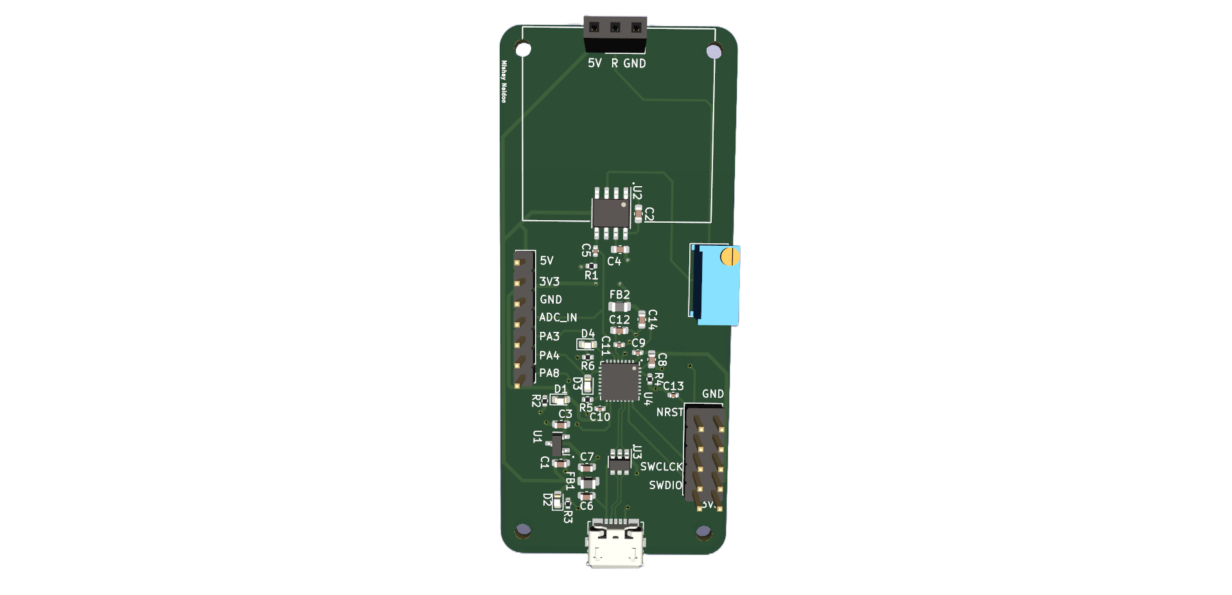
Current Progress
Sampling the data using the STM32F4 chip
Integrated the sampling setup with a Raspberry Pi 4
Designed and ordered a PCB with an STM32L4, amplifier circuitry and USB for data transmission

Slide 8
Near Future Work
Make a temporary testing setup using the STM32F4 Discovery Board while waiting for the PCB
Deploy testing setup in various locations for long durations
Test the PCB on arrival and if need be redesign
Look in to data processing techniques

Slide 9
THANK YOU!

Slide 10

NEXT UP:

