Slide 1
HEALTH INFORMATION SYSTEM
Software Engineering Intern task Submission.
Name: Anami Misheni Augustine
Date: April 26, 2025
Project Overview: A RESTful API and frontend for managing health programs and clients.

Slide 2
Problem Statement.
Challenge: Doctors need an efficient system to
Create and manage health programs(eg TB, Malaria, HIV)
Register and track clients.
Enroll clients in programs.
Search for clients and view their profiles including enrolled programs.
Expose clients profiles via an API for integration with other systems.
Goal: Build a secure, user-friendly and scalable solution with clean code and RESTful APIs

Slide 3
Solution Overview
Backend: Laravel(PHP) with RESTful APIs, Mysql database, Sanctum authentication.
Frontend: HTML, CSS(Bootstrap), Javascript(vanilla S with Fetch API)
Key features:
Create health programs.
Register clients.
Enroll clients.
Search clients with fuzzy matching
View client profiles with enolled programs.
Secure API with token-based authentication.

Slide 4
Endpoints
Method | Endpoint | Description
POST | /api/programs | Create a program
GET | /api/programs | List programs
POST | /api/clients | Register a client
GET | /api/clients?search={query} | Search clients
GET | /api/clients/{id} | View client profile
POST | /api/enrollments | Enroll client in a program
POST | /api/login | Authenticate doctor

Slide 5
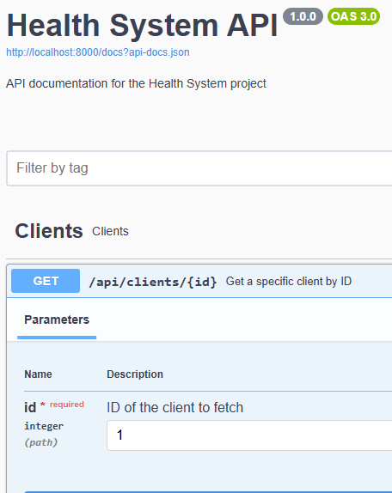
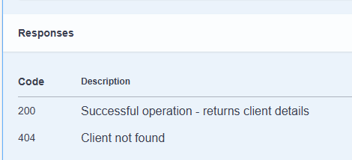
Generated Documentation for the APIs

Slide 6
Implementation Details
Framework: Laravel 11with PHP 8.1
Authentication: Laravel sanctum for token-based API security.
Database: Mysql with eloquent ORM and CRUD operations.
Key Components:Models: Program, Client, Enrollment, AuditLog with relationships (e.g., belongsToMany).Controllers: ProgramController, ClientController, EnrollmentController for API logic.Form Requests: StoreProgramRequest, StoreClientRequest, StoreEnrollmentRequest for input validation.Routes: Defined in routes/api.php with auth:sanctum middleware.Security:Input validation to prevent invalid data.Token authentication for doctor-only actions.Audit logging for traceability (e.g., client registration, enrollment).

Slide 7
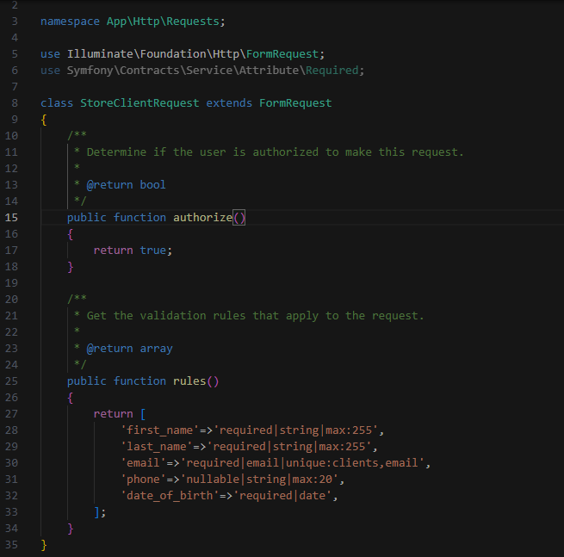
Code snippet for slide 5

Slide 8
Continuation…
Implementation details: Frontend.
Tech stack: HTML, CSS(Bootstap) JS(vanilla with fetch API)
Login form for doctor authentication (dynamic token handling).Forms for creating programs, registering clients, and enrolling clients.Search input with real-time fuzzy matching.Profile view displaying client details and enrolled programs.Integration: Communicates with backend via RESTful APIs using Fetch API.User Experience: Responsive design with Bootstrap, clear alerts for success/errors.

Slide 9
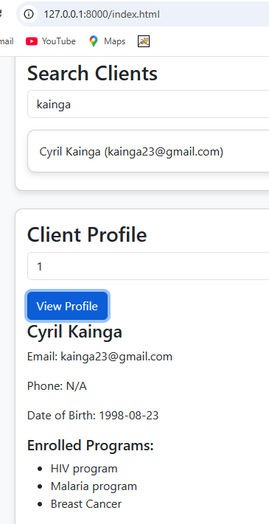
Code snippets
When you search a client with name or email it displays the matching results and you can view the profile of the respective client using the client_id.

Slide 10
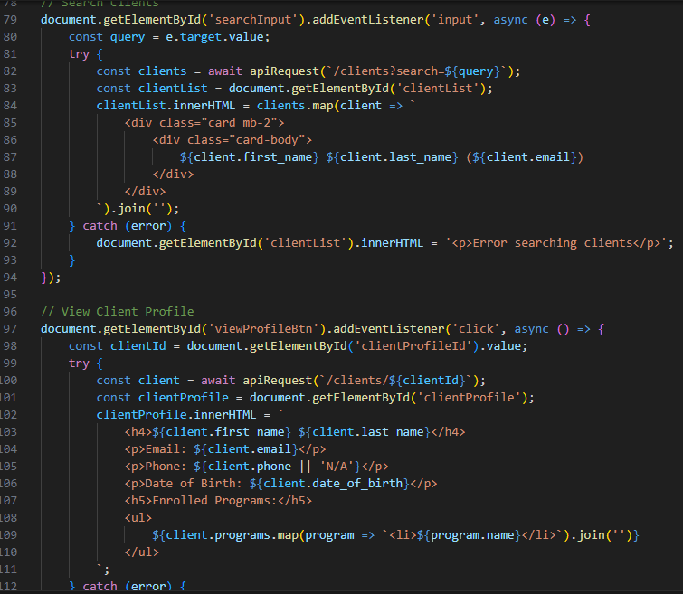
Code snippet for app.js

Slide 11
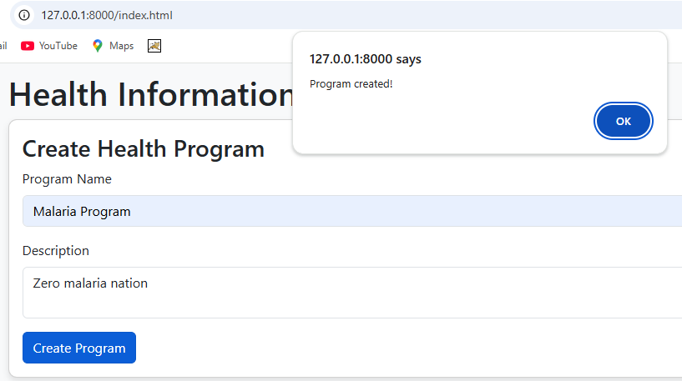
Adding a program

Slide 12
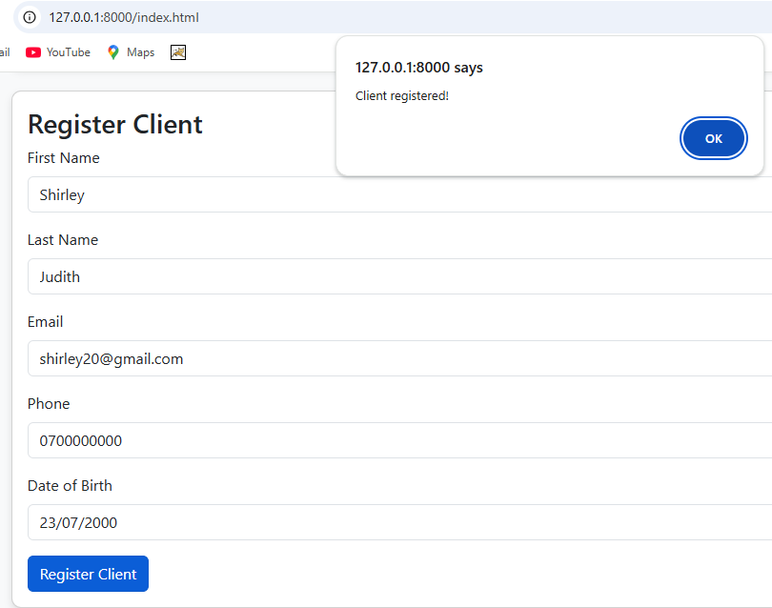
Registering client

Slide 13
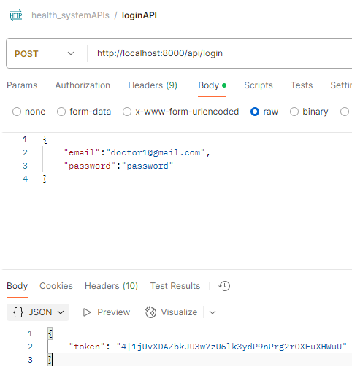
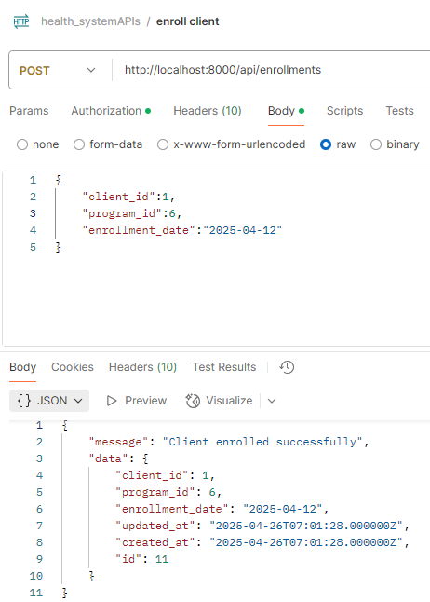
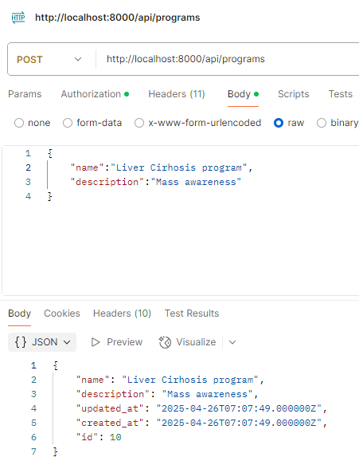
API calls via postman snippets
Login API token generation, create program and enroll clients.

Slide 14
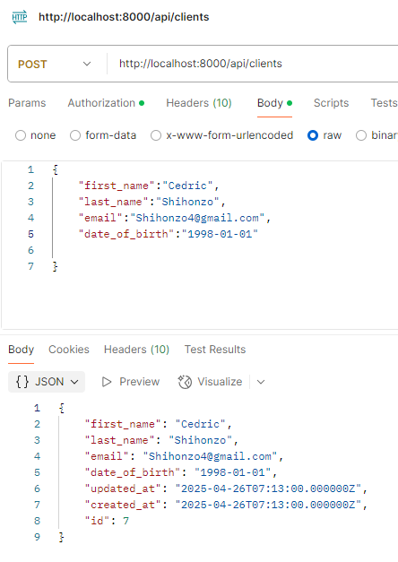
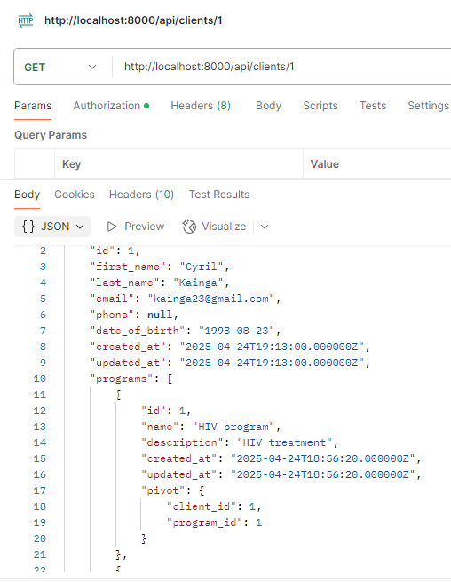
API calls via postman continued…
register, search and display client profiles

Slide 15
Future improvements
Role-based access: Add admin and doctor roles with different permissions.
Advanced reporting: Generate reports on program enrollment or client demographics.
Mobile App: Develop mobile app with flutter.
Enhanced search: by date, date of birth.
Security: Implement rate limiting and password policies.
Performance optimization: cache API response for faster searches.

Slide 16
Conclusion
Delivered a fully functional health system meeting all requirements.
RESTful APIS for program and client management.
User-friendly frontend and login.
Secure, tested and deployed solution.
Thank you.

