Slide 1
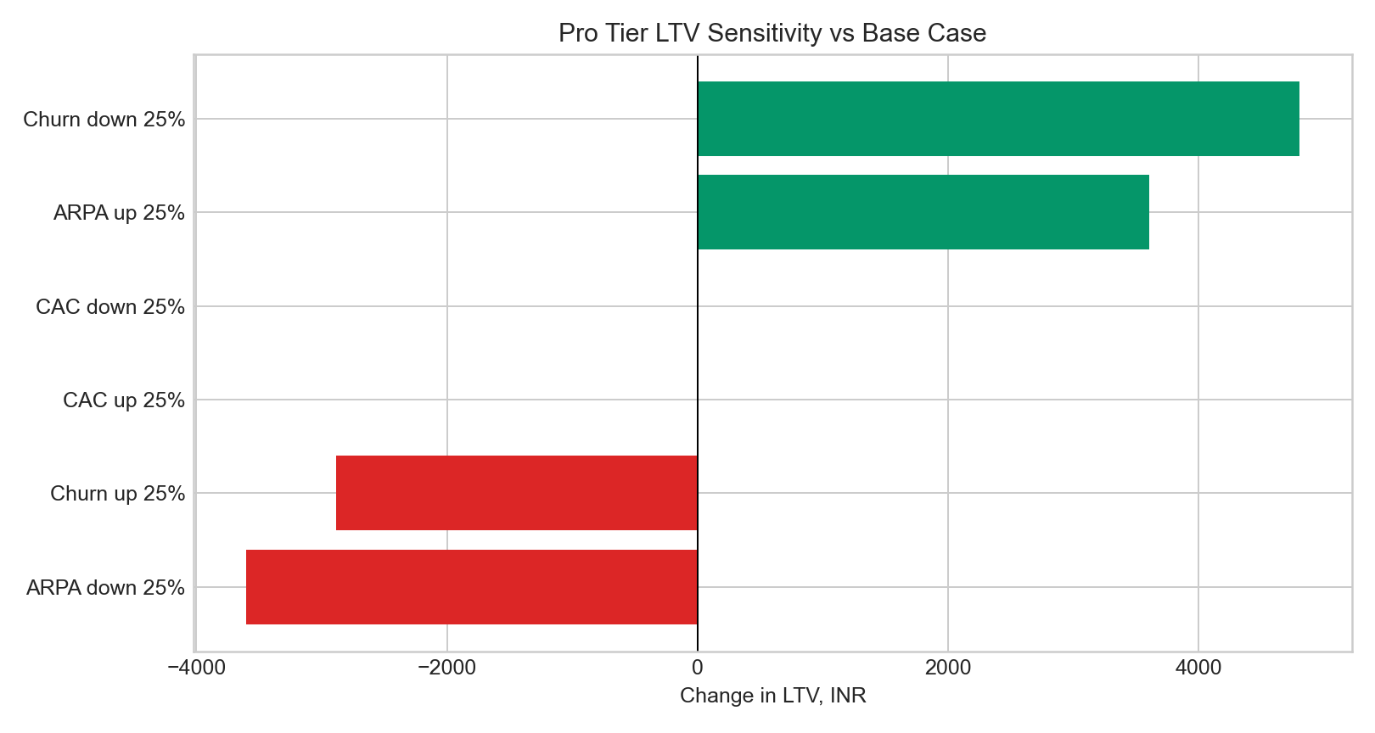
FLOWFINANCE
Enter through financial clarity, not lending
MSME credit-readiness and cashflow analytics | modeled market-entry case
10+
one-month free pilots; no revenue claimed
Recommendation case • pricing, LTV and payback are modeled assumptions pending paid validation
Notes:
[Sources]
- D:/GITHUB/STRATEGY/flowfinance_market_entry_case/docs/market_entry_deck.md
- D:/GITHUB/STRATEGY/flowfinance_market_entry_case/docs/public_product_evidence.md
- D:/GITHUB/STRATEGY/flowfinance_market_entry_case/figures/ltv_sensitivity_tornado.png

Slide 2
CUSTOMER PROBLEM
MSMEs need interpretation before they need more financial products
Transaction data exists
Analytics-first wedge
Boundary
But cashflow visibility, categorization, receivables discipline and lender-ready evidence remain fragmented.
Health score, cash forecast, invoicing and explainable transaction intelligence create an operating layer before underwriting.
Do not originate loans. Do not present the score as credit approval. Keep consent and auditability explicit.
Positioning: borrower-readiness and operating intelligence, not regulated credit decisioning
Notes:
[Sources]
- D:/GITHUB/STRATEGY/flowfinance_market_entry_case/docs/market_entry_deck.md
- D:/GITHUB/STRATEGY/flowfinance_market_entry_case/docs/case_report.md

Slide 3
MARKET SIZING
The market is large; the reachable wedge is an assumption to validate
Modeled assumptions
• 63M Indian MSMEs
• 35% digitally reachable
• 18% serviceable share
• ₹7,200 blended annual ARPA
• 2,500 year-one customers
Validate willingness-to-pay and partner distribution before using the SOM operationally.
TAM/SAM/SOM values are modeled, not realized market share
Notes:
[Sources]
- D:/GITHUB/STRATEGY/flowfinance_market_entry_case/docs/market_entry_deck.md
- D:/GITHUB/STRATEGY/flowfinance_market_entry_case/models

Slide 4
UNIT ECONOMICS
Pro is the modeled entry tier; partner distribution controls the risk
₹799/mo
Pro modeled price
2.14 months
modeled CAC payback
No revenue has been generated; paid conversion remains the decisive test.
Pricing, CAC, LTV and payback are scenario assumptions—not audited operating outcomes
Notes:
[Sources]
- D:/GITHUB/STRATEGY/flowfinance_market_entry_case/docs/market_entry_deck.md
- D:/GITHUB/STRATEGY/flowfinance_market_entry_case/models

Slide 5
SENSITIVITY
Paid conversion and retention matter more than headline LTV
• Bear-case payback remains below four months in the model
• Partner-led CAC discipline is the largest controllable lever
• Retention and gross margin dominate modeled LTV
• Free-pilot return behavior is encouraging but not paid retention
Decision rule
Do not scale acquisition until paid cohort retention validates the model.
Sensitivity is modeled; free pilots cannot establish paid LTV
Notes:
[Sources]
- D:/GITHUB/STRATEGY/flowfinance_market_entry_case/figures/ltv_sensitivity_tornado.png
- D:/GITHUB/STRATEGY/flowfinance_market_entry_case/docs/market_entry_deck.md

Slide 6
LAUNCH PLAN
Use 90 days to turn free-pilot evidence into a paid go/no-go decision
Days 1–30
Days 31–60
Days 61–90
Validate pain, consent flow, categorization quality and review frequency.
Test paid Pro conversion, activation, weekly usage and support burden.
Secure partner pilots and test lender-readiness export demand.
Go/no-go gates
Paid conversion • 30/60-day retention • categorization accuracy • CAC payback • partner activation
The next milestone is paid evidence, not a larger modeled market
Notes:
[Sources]
- D:/GITHUB/STRATEGY/flowfinance_market_entry_case/models/launch_plan_90_days.csv
- D:/GITHUB/STRATEGY/flowfinance_market_entry_case/docs/market_entry_deck.md

Slide 7
FINAL RECOMMENDATION
Proceed with a controlled paid test—without lending claims
• Keep the wedge: credit-readiness and cashflow-health analytics
• Convert a small pilot cohort to paid Pro before scaling acquisition
• Use accountants and consultants as the first distribution partners
• Track activation, repeat reviews, paid retention and support cost
• Treat the health score as decision support, never credit approval
Current evidence
10+ one-month free pilots
10+ repeat financial reviews
Public deployment reachable
No revenue claimed
Next proof
Paid conversion and retention
Recommendation conditioned on paid validation and consented financial-data handling
Notes:
[Sources]
- D:/GITHUB/STRATEGY/flowfinance_market_entry_case/docs/public_product_evidence.md
- https://www.flowfinancebusiness.com
- D:/GITHUB/STRATEGY/flowfinance_market_entry_case/docs/market_entry_deck.md

