Slide 1
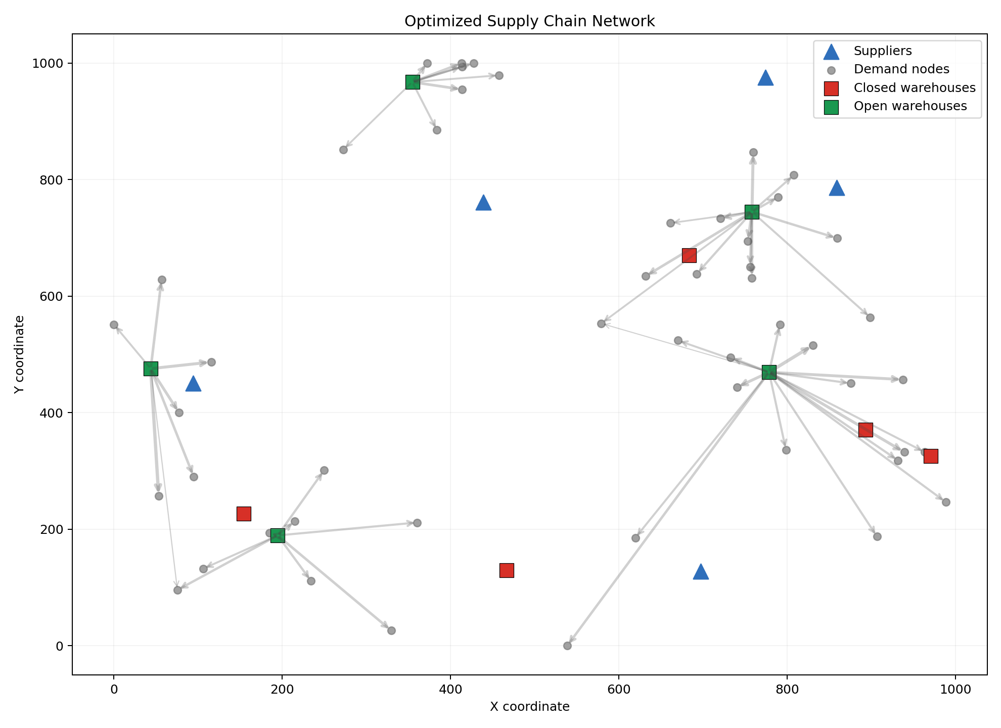
SUPPLY CHAIN NETWORK DESIGN
A lower-cost network that remains defensible under stress
65-node facility-location case | PuLP MILP | real shipment calibration | decision evidence
Decision case • modeled network economics, explicitly separated from realized savings
Notes:
[Sources]
- D:/GITHUB/STRATEGY/supply_chain_network_optimization/docs/RECRUITER_SUMMARY.md
- D:/GITHUB/STRATEGY/supply_chain_network_optimization/docs/REAL_DATA_VALIDATION.md
- D:/GITHUB/STRATEGY/supply_chain_network_optimization/docs/assets/network_map.png

Slide 2
DECISION CONTEXT
The decision is where to open capacity without sacrificing service
65
10
2,500
network nodes
candidate warehouses
continuous flows
• Objective: fixed facility cost + transport cost
• Constraints: capacity, demand coverage and service radius
• Decision controls: demand, carbon and freight stress scenarios
Model outputs are planning evidence; implementation still requires site, contract and lane validation
Notes:
[Sources]
- D:/GITHUB/STRATEGY/supply_chain_network_optimization/docs/MODEL_ASSUMPTIONS.md
- D:/GITHUB/STRATEGY/supply_chain_network_optimization/README.md

Slide 3
ECONOMIC EVIDENCE
The optimized network outperforms three operating heuristics
20.60%
lower modeled cost
than greedy assignment
19.00% vs open-all
14.34% vs k-means
Cost index normalized to greedy = 100; differences are model outputs, not realized savings
Notes:
[Sources]
- D:/GITHUB/STRATEGY/supply_chain_network_optimization/docs/RECRUITER_SUMMARY.md
- D:/GITHUB/STRATEGY/supply_chain_network_optimization/results

Slide 4
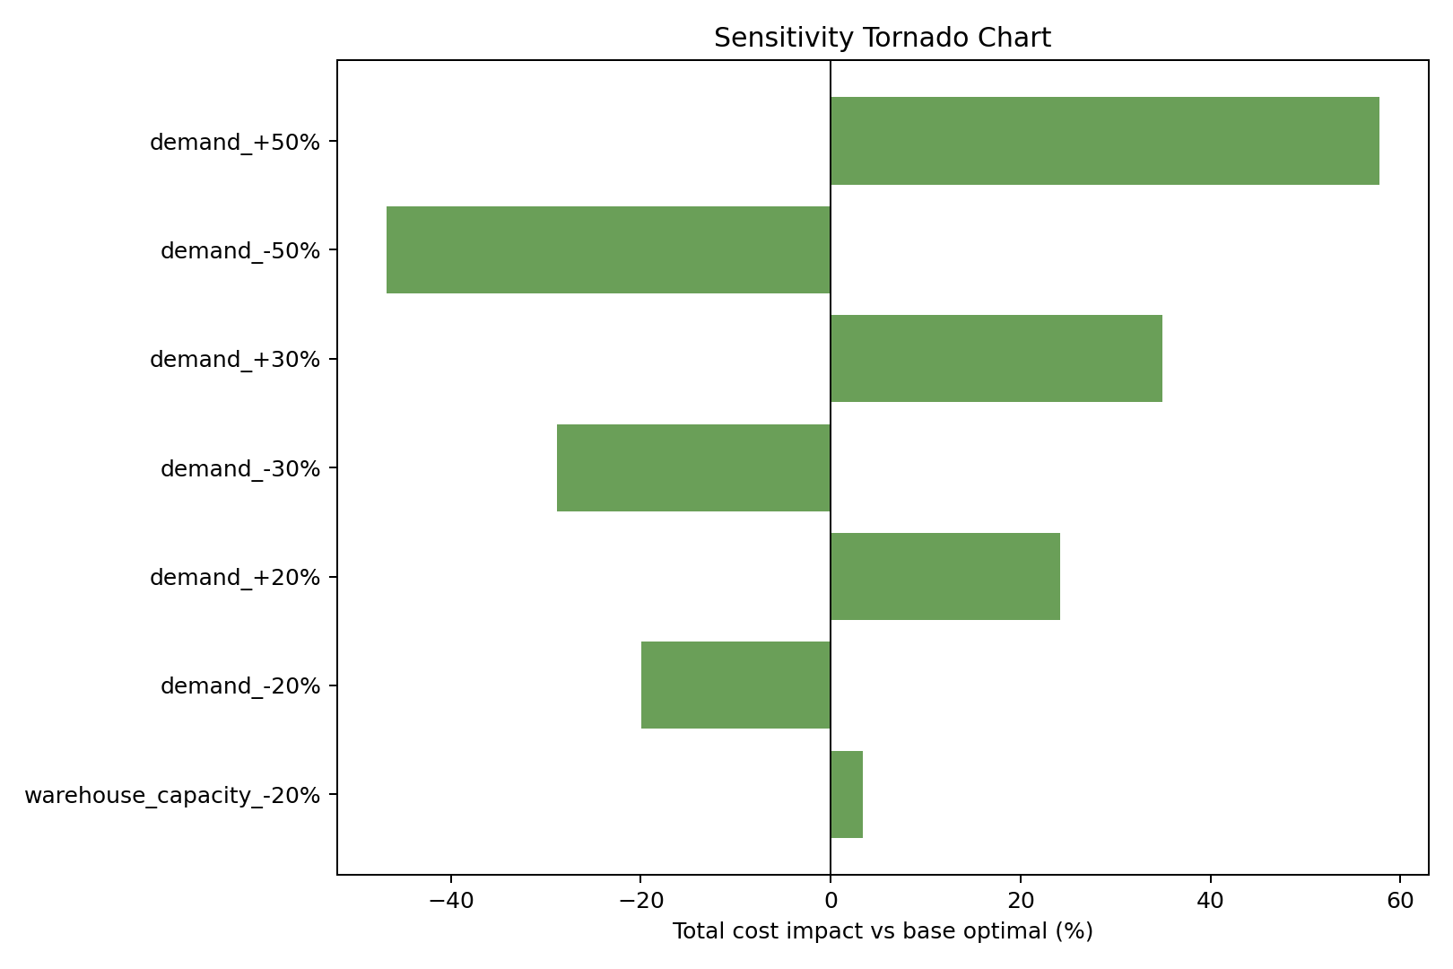
STRESS AND ROLLOUT
Four sites stay robust; two require staged commitment
• Demand, capacity, service-radius and carbon shocks are evaluated separately
• 10,324 USAID shipments calibrate lead-time and freight priors
• Four robust warehouses anchor rollout; two marginal sites remain contingent
Recommendation
Commit robust capacity first; gate marginal sites on volume and service evidence.
Real shipment data calibrates priors; the 65-node facility network remains modeled
Notes:
[Sources]
- D:/GITHUB/STRATEGY/supply_chain_network_optimization/docs/REAL_DATA_VALIDATION.md
- D:/GITHUB/STRATEGY/supply_chain_network_optimization/docs/assets/sensitivity_tornado.png

Slide 5
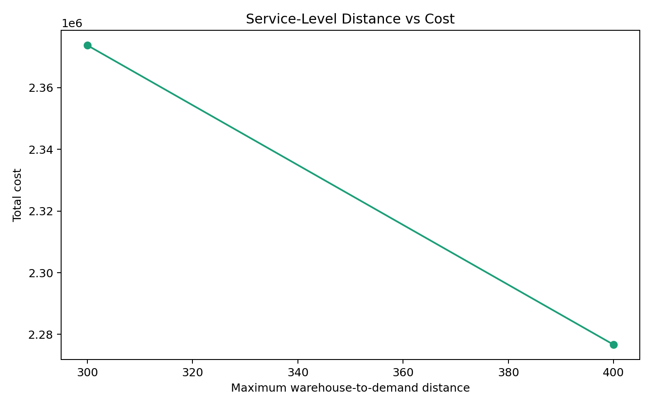
MANAGEMENT LAYER
The copilot explains decisions; it does not replace the optimizer
• Retrieves model assumptions, policy notes, sensitivity tables and prior scenarios
• Cites evidence used in each executive memo
• Separates optimizer outputs from narrative interpretation
• Retrieval questions are benchmarked before recommendation generation
Operating principle
Optimize first. Retrieve evidence second. Keep human approval at the decision boundary.
Hybrid retrieval supports auditability; warehouse choices remain MILP outputs
Notes:
[Sources]
- D:/GITHUB/STRATEGY/supply_chain_network_optimization/docs/ATS_SCREENING_PACK.md
- D:/GITHUB/STRATEGY/supply_chain_network_optimization/docs/rag_eval_questions.csv
- D:/GITHUB/STRATEGY/supply_chain_network_optimization/docs/assets/service_cost_tradeoff.png

Slide 6
RECOMMENDATION
Proceed in stages, with evidence gates before capital commitment
1
Validate
2
Pilot
3
Scale
Confirm lane rates, service targets, site feasibility and demand ownership.
Open robust sites first and measure OTDR, utilization, cost-to-serve and emissions.
Approve marginal sites only when volume, service and payback thresholds are met.
Decision gates
Demand confidence • site feasibility • contract rates • service compliance • payback under stress
Recommended next action: validate assumptions with operators before treating modeled savings as realizable
Notes:
[Sources]
- D:/GITHUB/STRATEGY/supply_chain_network_optimization/docs/RECRUITER_SUMMARY.md
- D:/GITHUB/STRATEGY/supply_chain_network_optimization/docs/SUPPLIER_SLA_POLICY.md

