Slide 1
Report on Electrical Characterisation of 1-layer MoS2 thin film transistors under X-ray radiation (15/12/2023)
The measurement was performed on a specific sample indicated as Sample12 device3 of the whole Batch2 set.

Slide 2
Samples structure and characterization
MoS₂
Top contact / Bottom gate
Note: If you need, you can scratch the surface of the substrates to access the gate.
Au/Cr 45/3 nm
BCB layer 50 nm
SiO_{x} 278 nm
MEASUREMENTS
n-type semiconductor
Low stability in aire, storage in glove box
Electrical measurements were performed reaching V_{DS} = 1 V, and V_{GS} = -60 to 60 V
Delay 100 ms and ΔV_{GS} = 0.5 V
Si

Slide 3
Review on X-ray measurements on the 22/11/2023
In the following two slides results from the past X-ray measurements performed on the 22/11/2023 are presented in order to demonstrate some instability of the samples.
According to the table, the Sample12_device3 transistor had the sensitivity of ≈ 3 * 10^11 uC/(Gy*cm^3) at VGate = 30 V and 40 V, and the negative sensitivity of ≈ -30 * 10^11 uC/(Gy*cm^3) at VGate=50V.
Since such results seem quite strange in comparison with the sensitivity obtained on the 15/12/2023, the latest results are considered as reliable ones.

Slide 4
Table (Samples 1-8)
Results from X-ray measurements on the 22/11/2023
Common features: • Batch 2 • No encapsulation • Thickness of SiO2 insulator layer = 278 nm
• Capacitance per unit area Ci = 0.0124 (uF/cm^2)
Sample_device | W (um) | L (um) | MoS2 thick (nm) | ON/OFF (#/10^6) | SS (V/dec) | Vth (V) | mu (cm^2/(V*s)) | Sensitivity per Volume (C/(Gy*m^3))
S1_d1 | 19.8 | 2.6 | 4.5±0.5 | 0.22 | 4.32±0.16 | -8.75±0.11 | 0.2156±0.0013 | No drain current
S1_d2 | 11.6 | 2.3 | 5.4±0.7 | 0.04 | 12.67±0.08 | 6.87±0.13 | 0.01684±0.00010
S1_d3 | 21.2 | 2.7 | 6.0±0.6 | 3.23 | 2.71±0.05 | -32.1±-.7 | 0.0049±0.0002 | No peaks, steps downwards
S1_d4 | 17.6 | 2.3 | 2.6±0.3 | 0.01 | 8.70±0.12 | 4.6±0.3 | 0.01091±0.00002
S1_d5 | 14.1 | 2.7 | 2.9±0.7 | No current | No current | No current | No current
S4_d1 | 13.6 | 2.3 | 2.4±0.3 | 11.30 | 2.85±0.04 | -43.0±0.6 | 0.478±0.012 | No drain current
S5_d1 | 21.8 | 2.3 | 8.9±0.9 | No current | No current | No current | No current
S5_d2 | 20.9 | 2.2 | 5.8±0.9 | 0.04 | 5.085±0.26 | -4.62±0.08 | 0.01113±0.00006
S5_d3 | 16.4 | 2 | 2.8±0.4 | No current | No current | No current | No current
S5_d4 | No data | No data | 3.1±0.5 | No current | No current | No current | No current
S6_d1 | 24.5 | 2.3 | 8.3±0.9 | 14.20 | 4.98±00.10 | -15.61±0.07 | 0.96±0.007 | No peaks, steps downwards
S6_d3 | 21.1 | 2.1 | 10.8±0.6 | No current | No current | No current | No current
S6_d5 | 14.7 | 2.1 | 6.3±0.6 | 20.70 | 4.66±0.10 | -6.30±0.10 | 0.26280±0.0014 | No peaks are seen
S7_d1 | 10 | 1.9 | 2.8±0.4 | 3.18 | 5.92±0.07 | -3.2±0.2 | 0.0483±0.0005 | No peaks are seen (only small steps downwards)
S7_d4 | 13.8 | 2.2 | 3.8±0.4 | 0.00 | 6.5±0.3 | -9.23±0.08 | 0.00919±0.00004
S7_d5 | 32.1 | 1.3 | 5.7±0.3 | No current | No current | No current | No current
S8_d1 | 8.2 | 2 | 6.2±0.6 | 0.02 | 9.57±0.12 | 10.76±0.16 | 0.2443±0.0016 | No peaks are seen

Slide 5
Table (Samples 9-14)
Results from X-ray measurements on the 22/11/2023
Common features: • Batch 2 • No encapsulation • Thickness of SiO2 insulator layer = 278 nm
• Capacitance per unit area Ci = 0.0124 (uF/cm^2)
Sample_device | W (um) | L (um) | MoS2 thick (nm) | ON/OFF (#/10^6) | SS (V/dec) | Vth (V) | mu (cm^2/(V*s)) | Sensitivity per Volume (uC/(Gy*cm^3))
S9_d2 | 20.6 | 2.4 | 7.8±0.7 | Not reliable | 4.03±0.03 | Not reliable | 0.028581272
S9_d3 | 39.6 | 2.2 | 10.8±1.4 | 0.82 | 4.19±0.05 | -14.14±0.09 | 0.784±0.006 | Short circuit
S10_d1 | 12.4 | 3 | 3.9±0.5 | No contact between the sample and the tips | No contact between the sample and the tips | No contact between the sample and the tips | No contact between the sample and the tips
S10_d2 | 16.6 | 2.6 | 2.6±0.3 | 0.50 | 10.2±1.0 | 22.3±0.8 | 0.0197±0.0006
S10_d3 | 27.8 | 3.3 | 8.7±0.4 | 0.21 | 2.54±0.05 | -28.37±0.08 | 0.713±0.004 | No drain current
S10_d5 | 14.4 | 3.2 | 8.0±0.5 | No current | No current | No current | No current
S10_d6 | 14.8 | 4.4 | 9.4±0.5 | 0.01 | 8.50±0.17 | -45.0±0.4 | 0.329±0.005 | Short circuit
S11_d1 | 14.8 | 3.3 | 3.6±0.4 | 0.00 | 13.9±0.10 | 20.2±0.7 | 0.0309±0.0008
S11_d3 | 8.6 | 2.9 | 9.2±0.8 | 6.44 | 3.66±0.07 | -25.02±0.9 | 0.3481±0.0017 | No sense
S12_d1 | 9.9 | 2.9 | 4.8±0.6 | No current | No current | No current | No current
S12_d2 | 13.2 | 3.1 | 2.4±0.3 | 0.07 | 6.50±0.09 | 5.1±0.3 | 0.1231±0.0019 | Too high VGate for reaching photoconductive gain (VGate=50V)
S12_d3 | 20 | 3.8 | 3.3±03 | 0.00 | 8.62±0.11 | -8.11±0.09 | 0.0677±0.0004 | (3.8±0.2)*10^11(VGate=30V) (3.1±1.0)*10^11 (VGate=40V) (-30±7)*10^11 (VGate=50V) – NEGATIVE SENSITIVITY!
S12_d4 | 18.5 | 3.1 | 4.8±0.3 | 1.08 | 6.411±0.004 | -10.20±0.10 | 0.0331±0.0003 | (-1164±73)*10^11 (VGate=50V) NEGATIVE SENSITIVITY!
S14_d1 | 20.1 | 3.5 | 4.8±0.6 | 9.18 | 4.18±0.11 | -10.31±0.10 | 0.353±0.003 | No signal is seen
S14_d2 | 15.5 | 3.2 | 2.4±0.3 | 15.80 | 2.83±0.03 | -42.1±0.5 | 0.288±0.006 | No signal is seen
S14_d3 | 21.1 | 3.7 | 3.3±0.3 | 12.10 | 3.58±0.03 | -13.22±0.05 | 0.1267±0.0003 | (6.5±0.7)*10^11 (VGate=50V)
S14_d4 | 16.4 | 3.2 | 4.8±0.3 | 15.70 | 2.67±0.03 | -55.3±0.7 | 0.274±0.007 | (-123±24)*10^11 (VGate=1V) NEGATIVE SENSITIVITY!

Slide 6
X-ray measurements conditions
The following experimental setup and the calibration plot were equally used during the X-ray measurements both on the 22/11/2023 and on the 15/12/2023.
X-ray tube with Be window.
Distance between the samples and the Be window ≈30 cm.
Height (both the Be window and the samples) ≈ 22.5 cm.
The samples were placed in the Nextron box with tips.
During all the measurements the Nextron box with the samples was covered by Al foil.
The gate voltage was applied in the range between -50V and +50V.

Slide 7
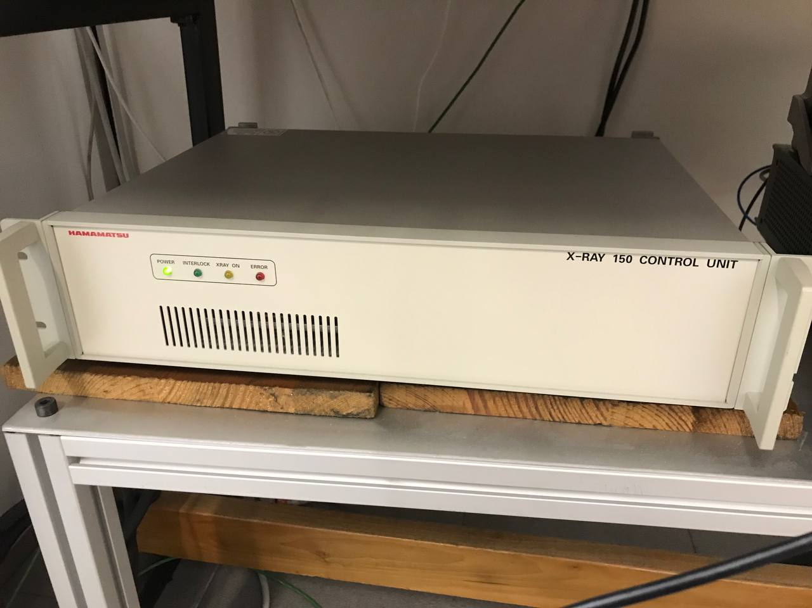
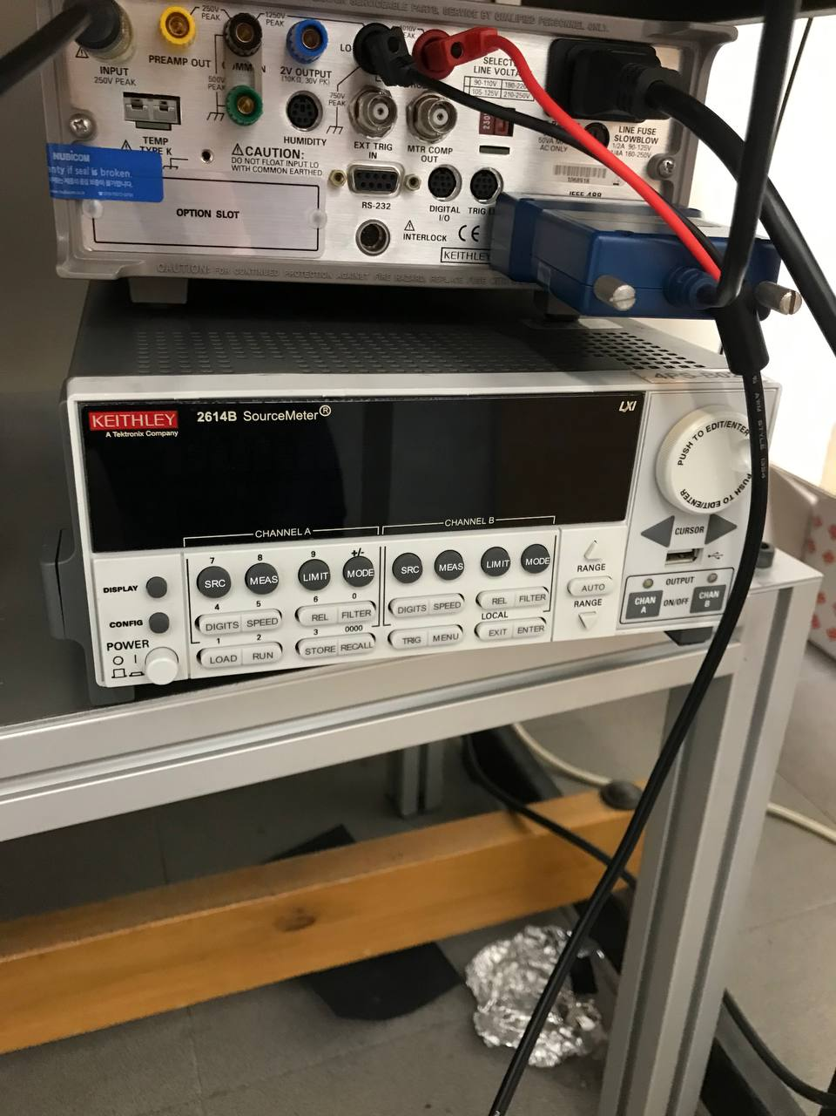
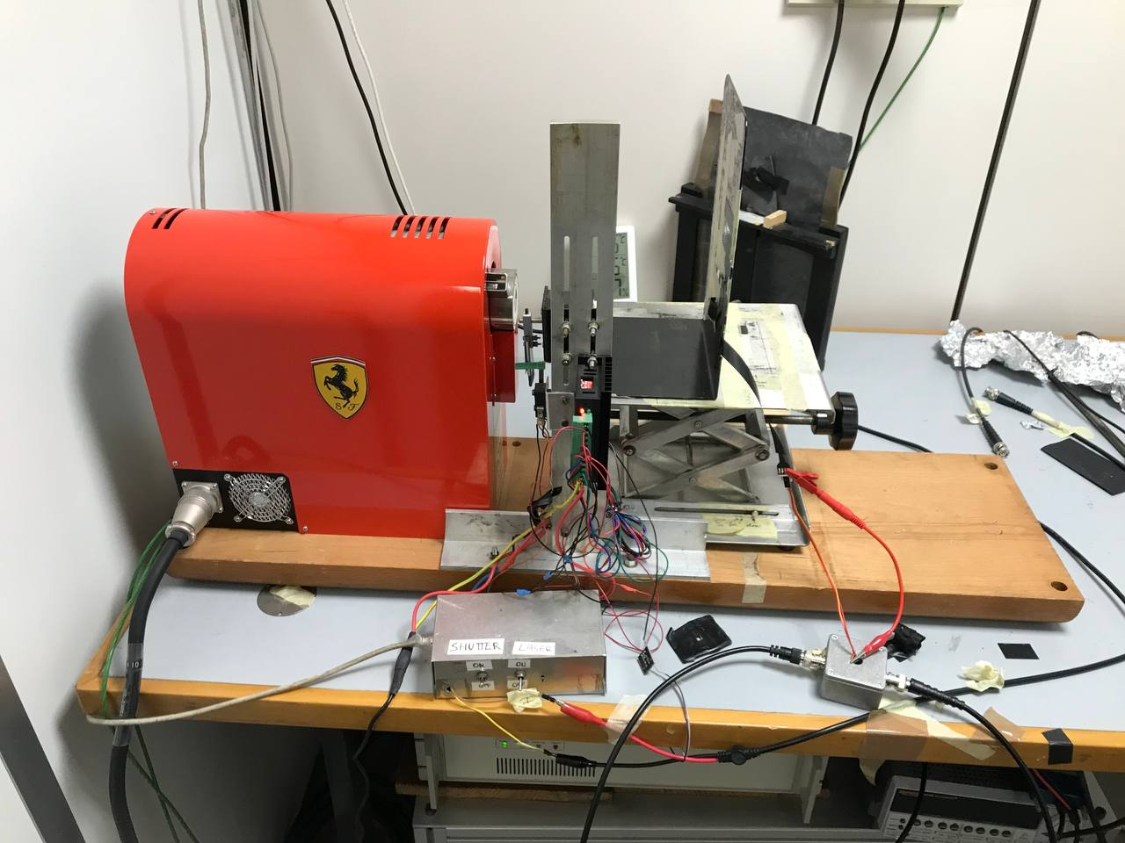
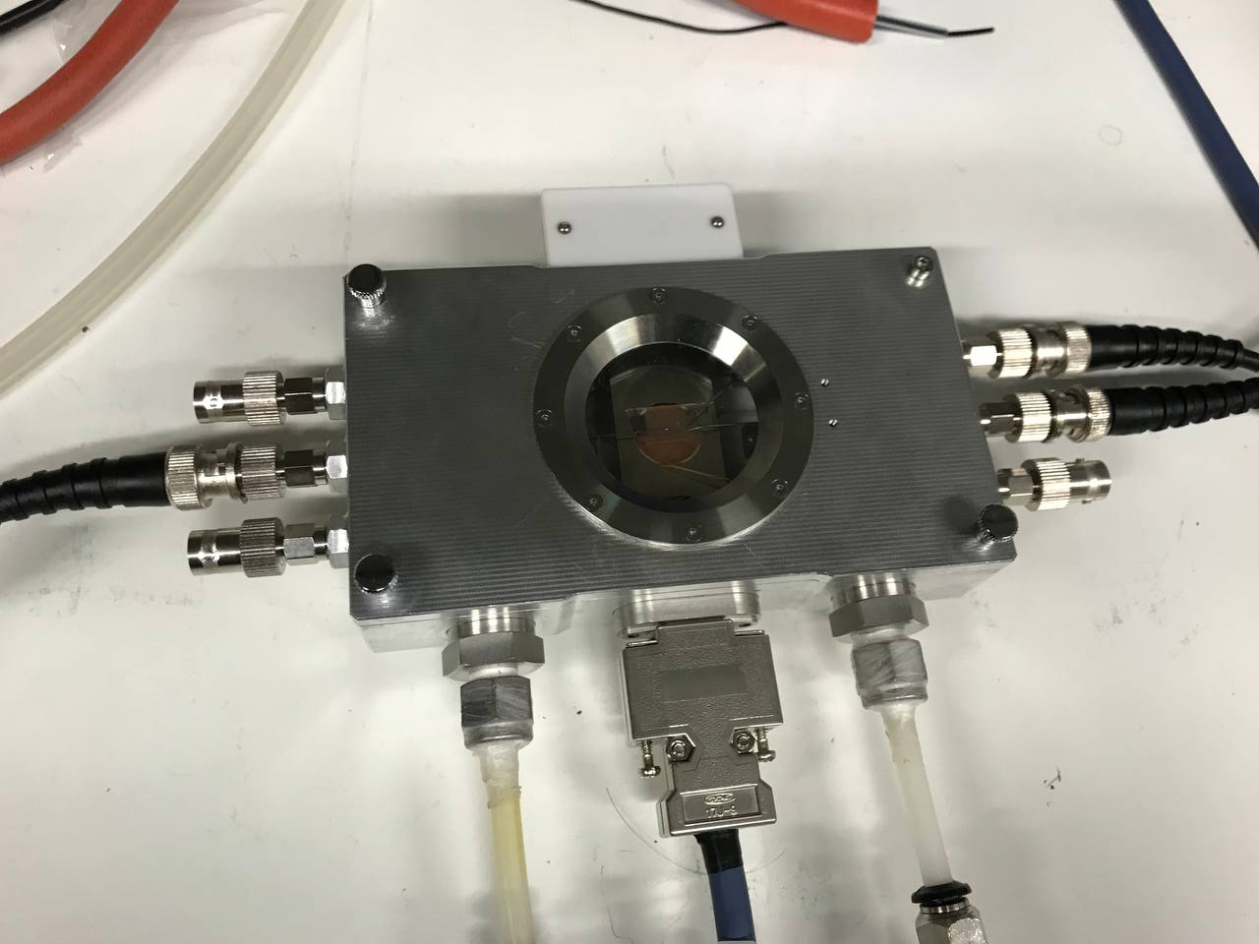
Experimental setup
(b)
(c)
(a)
(d)
Fig: (a) Experimental setup; (b) X-ray tube control unit; (c) SMU;
(d) Nextron box.

Slide 8
Calibration Plot (distance 32 cm from the chassis)

Slide 9
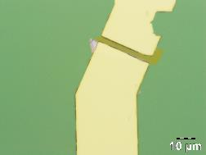
Sample12_device3
Device 3
Comments:
The initial transfer characteristics seems acceptable even though there is a significant leakage of IGate through the insulator.

Slide 10
Sample12_device3
(3.3±0.3)*10^11 uC/(Gy*cm^3)
Comments: Both IGate and IDrain peaks are rectangular, the decrease of the dark IDrain is minimal. The peaks could be explained as the response of metal electrodes to radiation.
(3.3±0.3)*10^11 uC/(Gy*cm^3)
Comments: The photoresponse is similar to the one at VGate=1V. The sensitivity is almost the same.

Slide 11
Sample12_device3
(3.0±0.3)*10^11 uC/(Gy*cm^3)
Comments: The photoresponse is similar to the one at VGate=1V. The sensitivity slightly decreases from 3.3*10^11 to 3.0*10^11 C/(Gy*m^3).
(2.8±0.3)*10^11 uC/(Gy*cm^3)
Comments: The photoresponse is similar to the one at VGate=1V. The sensitivity continues to decrease. The relaxation of IDrain is more visible.

Slide 12
Sample12_device3
(2.2±0.3)*10^11 uC/(Gy*cm^3)
Comments: The IDrain peaks start to change their form from rectangular to more “knife”- like with slower increase and sharp ending. The sensitivity continues to decrease. The IDrain relaxation becomes more explicit.
(2.0±0.2)*10^11 uC/(Gy*cm^3)
Comments: The IDrain peaks have their new form and become higher. The sensitivity continues to decrease. IDrain relaxes more slowly.

Slide 13
Sample12_device3
(2.0±0.3)*10^11 uC/(Gy*cm^3)
Comments: The IDrain peaks are more noisy, thus, increasing the photocurrent error. The sensitivity stays the same as for VGate=15V.
(1.5±0.3)*10^11 uC/(Gy*cm^3)
Comments: The IDrain peaks tend to be more noisy increasing the photocurrent error. The sensitivity continues to decrease down to 1.5*10^11 C/(Gy*m^3). The relaxation of IDrain is slower, so the normalization for the peaks at 100uA was used.

Slide 14
(0.92±0.09)*10^11 uC/(Gy*cm^3)
Comments: The IDrain peaks become more noisy which gives significant sensitivity error. The sensitivity continues to decrease. The relaxation of IDrain is quite slower, so in subsequent measurements I increased the relaxation time from 300 s to 400 s.
(2.0±1.2)*10^11 uC/(Gy*cm^3)
Comments: The IDrain peaks barely give us linear dependence. The sensitivity suddenly rises up to 2.0*10^11 C/(Gy*m^3), which also could be explained by huge standard deviation error.

Slide 15
The Photocurrent plot is not linear
Comments: The IDrain peaks are so unstable, that the linear dependence of the photocurrent on the dose rate is not seen.
(0.9±0.7)*10^11 uC/(Gy*cm^3)
Comments: Slight linear dependence is seen, so the sensitivity could be calculated even with a significant error.

Slide 16
(4.2±0.5)*10^11 uC/(Gy*cm^3)
Comments: The sensitivity suddenly rises up to 4.2*10^11 C/(Gy*m^3), even with a significant standard deviation error.
Comments:
The picture is highly unstable and unclear.
The measurements of the Sample12_device3 on the 15/12/2023 differ from the same measurements on the 22/11/2023.
At VGate below 10V the peaks of IDrain have the rectangular form and slowly decrease from 3*10^11 to 2*10^11 C/(Gy*m^3). At VGate above 10V the IDrain peaks have more “knife”-like form which could be the unfinished photocurrent peak. In this case it may be necessary to increase the time of irradiation (the original one is 10 s).
IDrain constantly decreases down to 10^(-10) A at constant VDrain and VGate which contradicts the transfer characteristics.
The IDrain curve itself is quite noisy which increases the standard deviation error while calculating the photocurrent at different dose rates.
While increasing VGate from 1V to 50V the sensitivity does not increase as expected, but generally tends to decrease having the same magnitude of 10^11 C/(Gy*m^3).

Slide 17
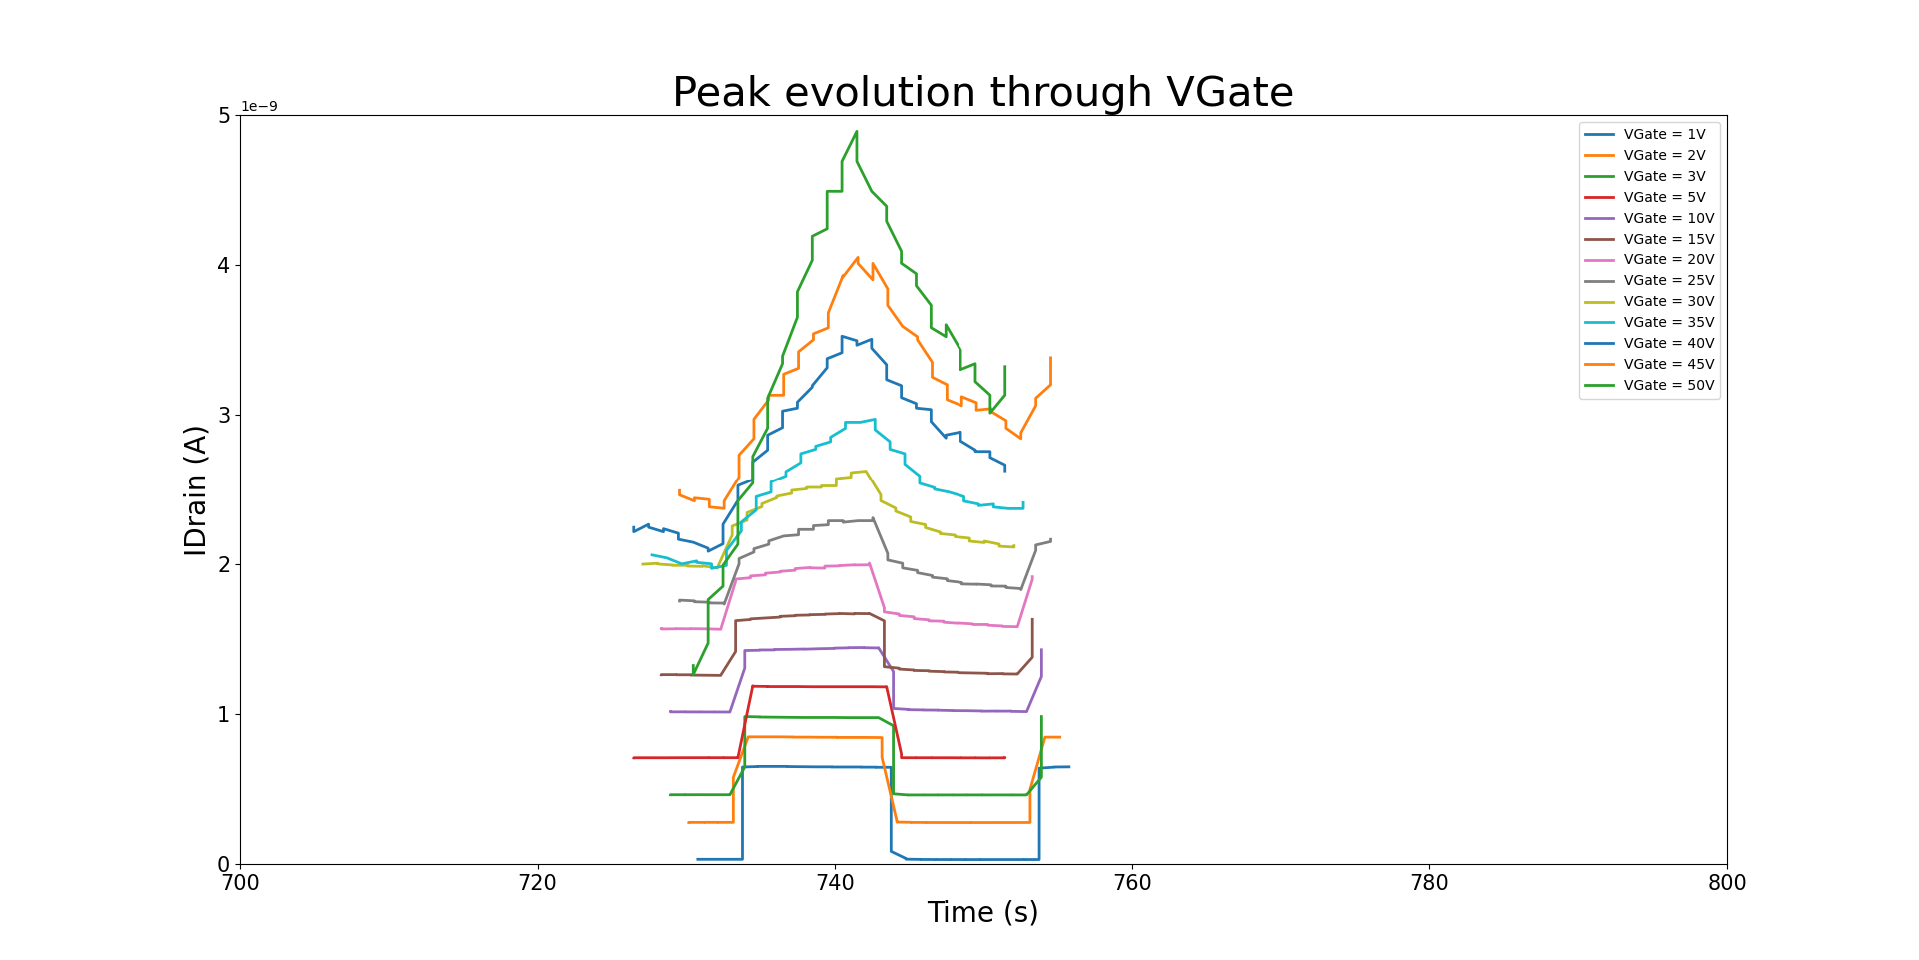
Main Results:
Comments:
For each VGate from 1 V to 50 V the magnitude of the sensitivity per unit volume is 10^11 uC/(Gy*cm^3).
Sensitivity of the active channel generally decreases with increasing VGate, which does not coincide with the theory.
As VGate increases, the sensitivity error also increases, which is the result of mory noisy IDrain peaks.
At VGate=50V the sensitivity abruptly increases, which could be explained as the instability of the device.
As VGate increases, the peaks change their shape from the rectangular one to the angular shape with slower increase of IDrain when the radiation is ON and slower relaxation when the radiation is OFF.
Each peak is taken from the first peak at I_Xray=500uA

Slide 18
Evolution of Transfer Characteristics in Saturation Regime:
Comments:
Through the X-ray measurements the curve shifts in the right direction.
The maximum value of IDrain at VGate=50V slightly decreases when increasing VGate at X-ray measurements.
Such tendency could be explained as slight degradation of the transistor characteristics under X-rays.

Slide 19
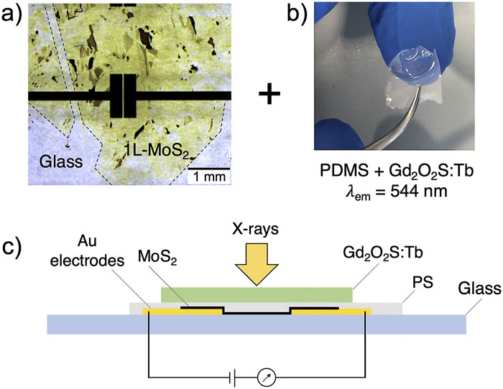
Comparison with the data from literature:
Alberto Taffelli, Max Heyl, Matteo Favaro, Sandra Dirè, Lucio Pancheri, Emil J. W. List-Kratochvil, Alberto Quaranta, Giovanni Ligorio; Demonstrating the high sensitivity of MoS₂ monolayers in direct x-ray detectors. APL Mater. 1 August 2023; 11 (8): 081101. https://doi.org/10.1063/5.0151794
Deposition method – exfoliation method
Polysterene (PS) film th ∝ 1 um
Au electrodes th = 100 nm
Active channel area = 0.03 mm²
Active channel th = 0.9 nm
Fig: A schematic cross-section of the final device exposed to x ray and connected to an external source meter unit.
Main parameters:
Sensitivity/volume = 10⁸ – 10⁹ uC/(Gy*cm³)
Sensitivity/area = 10 – 100 uC/(Gy*cm²)
Results from Batch2 (S12_d3 and S14_d3):
S12_d3 Sensitivity/volume = (3.8±0.2)*10^11 uC/(Gy*cm³) (VGate=30V)
S12_d3 Sensitivity/volume = (3.1±1.0)*10^11 uC/(Gy*cm³) (VGate=40V)
S14_d3 Sensitivity/volume = (6.5±0.7)*10^11 uC/(Gy*cm³) (VGate=50V)

Slide 20
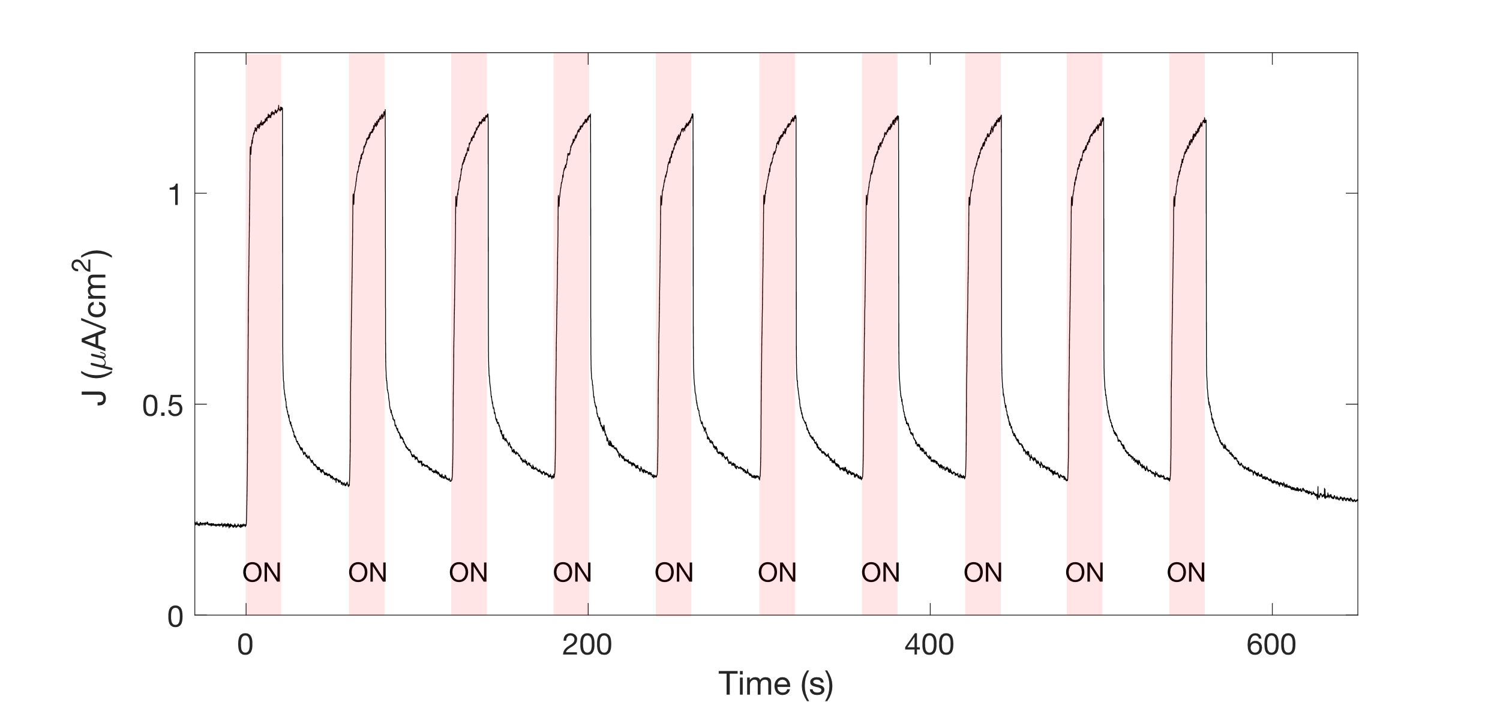
Comparison with the data from literature:
Form of the peaks under the X-rays produced
by the monolayer MoS2 TFT under the scintillator film (see previous slide)
Figure S5: Current density of the detector based on 1L-MoS₂ incorporating the scintillator during subsequent irradiations for 20 s of X-rays produced at 100 kV and dose rate 7.05 mGy/s. The detector was operated at 5 V during the measurement.

