Slide 1

xAPI Dashboard
<name>
ADL R&D Team
<date>

Slide 2
xAPI in 30 Seconds
Each meaningful interaction between the learner and content is logged via xAPI calls
Interaction statements take from “I did this”
Logged via simple REST API
An internet-enabled device can participate
Enables big-data analytics on learner data
Notes:
https://github.com/adlnet/xAPI-Spec

Slide 3
Why bother?
It can track everything SCORM does
Quiz answers, course progress, etc.
Also tracks things that SCORM can’t
Simulations, native apps, live experiences, etc.
Opens up learner records and prevents lock-in
Non-LMS systems can view/publish records

Slide 4
Sample Statement
{
"actor": {
"mbox": "mailto:gia.creech@myschool.edu",
"name": "Gia Creech" },
"verb": {
"id": "http://adlnet.gov/expapi/verbs/answered",
"display": { "en-US": "answered" } },
"object": {
"definition": { "name": "final/q49" },
"id": "http://myschool.edu/xapi/cop-3223/final/q49" },
"result": { "success": false },
"context": { "contextActivities": { "parent": [ {
"id": "http://myschool.edu/xapi/cop-3223/final"
} ] } }
}

Slide 5
LRS Querying
Basic querying available through the LRS
Intended to be basic to put less stress on the LRS
Adds more work for data processing for Learning Record Consumers

Slide 6
xAPI Dashboard
Data manipulation
Basic set operations enable infinite querying combinations
Data aggregation
Example:group statements by actor name, then calculate the number of statements produced by each group
Visualizations
Create rich reports using activity data from your LRS

Slide 7
xAPI Dashboard (cont.)
Uses xAPIWrapper
Composed of two parts (Collection and Dashboard)
Collection class allows SQL-like queries, filters and aggregations over xAPI data
Dashboard class generates numerous types of charts and visualizations
Notes:
https://github.com/adlnet/xAPIWrapper

Slide 8
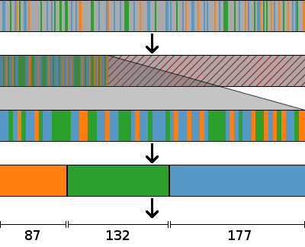
Processing xAPI Statements
Separate relevant statements from irrelevant
Raw xAPI statements
Throw out irrelevant statements
Gather like statements into groups
Aggregate each group into a single meaningful value

Slide 9
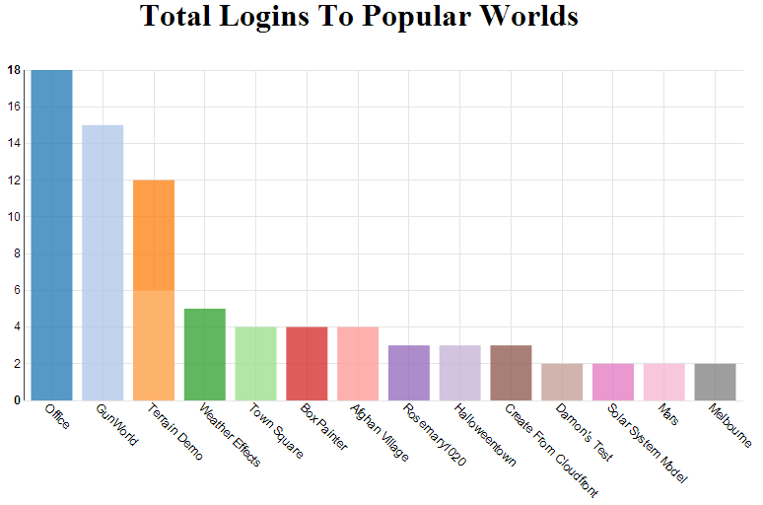

Slide 10
Questions?

Slide 11
Thank you!

