Slide 1

Team Name : BlackGriffin(NIT Rourkela)
Team Details: Mokshyada Mishra Sharmistha Pattnaik

Slide 2
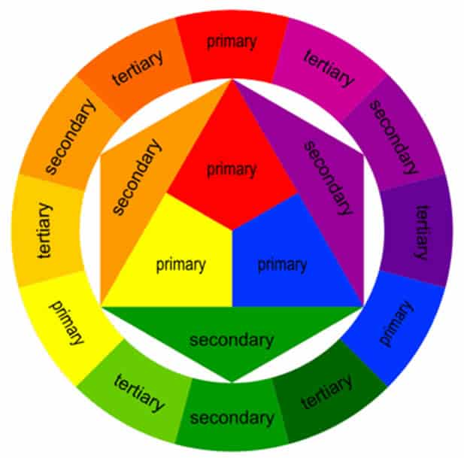
Problem Statement and Solution
Enhancing Fashion Choices Through Personalized Color Theory Recommendations
CONTEXT:
In the fashion retail industry, especially within the fast fashion segment, customers often face challenges in selecting clothing colors that complement their unique skin tones. This difficulty can lead to dissatisfaction, reduced confidence in their fashion choices, and ultimately, lower engagement and conversion rates on retail platforms.
STATEMENT:
Despite the availability of a wide range of clothing options, customers struggle to identify and choose colors that enhance their natural appearance based on their skin tones. This lack of personalized guidance results in less satisfactory shopping experiences and can contribute to increased return rates and reduced customer loyalty.
SOLUTION:
We propose an integrated shopping platform feature that enhances user experience through personalized color guidance:
Skin Tone Detection,Personalized Color Palette that generates tailored clothing color recommendations based on detected skin tone,Influencer Collaboration that showcases style recommendations from influencers with similar skin tones for inspiration & Seasonal Color Analysis that provides seasonal color recommendations to keep wardrobes current and trendy.

Slide 3
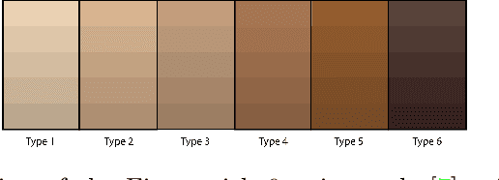
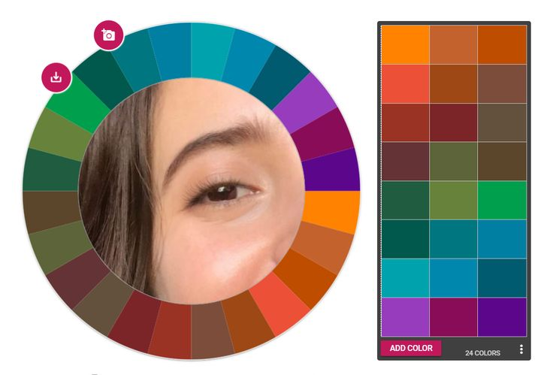
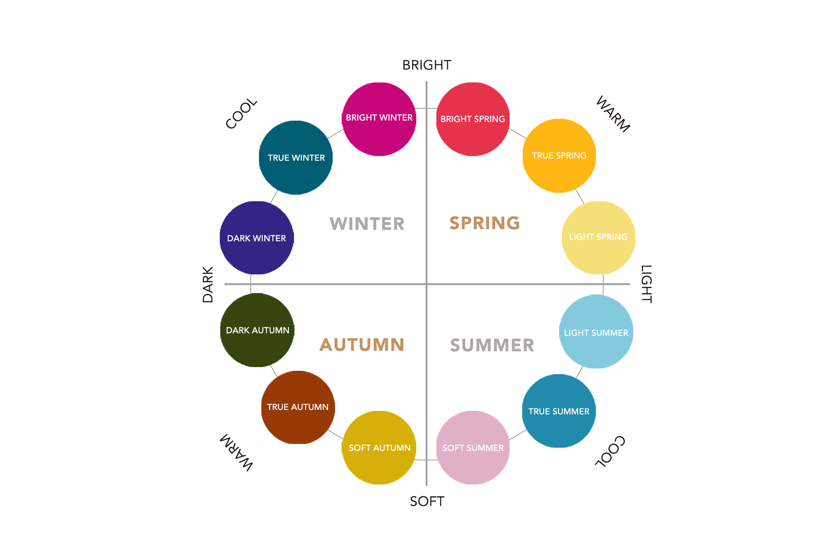
Key Aspects and Uniqueness
1.Combining Detection and Recommendation: The integration of YOLO for object detection and KMeans for color extraction creates a robust pipeline that not only detects clothing items but also provides personalized color recommendations.
2.Skin Tone-Based Customization: By analyzing skin tones and combining this with clothing color extraction, the system offers highly personalized and relevant color recommendations, enhancing user satisfaction.
3.Dynamic and Adaptive: The solution can dynamically update its color recommendations based on real-time analysis of uploaded images, making it highly adaptive to users' changing wardrobes and preferences.
4.Potential for Expansion: The modular structure allows for easy expansion to include educational content, influencer collaborations, and seasonal color analysis, making it a versatile tool for enhancing the shopping experience.

Slide 4
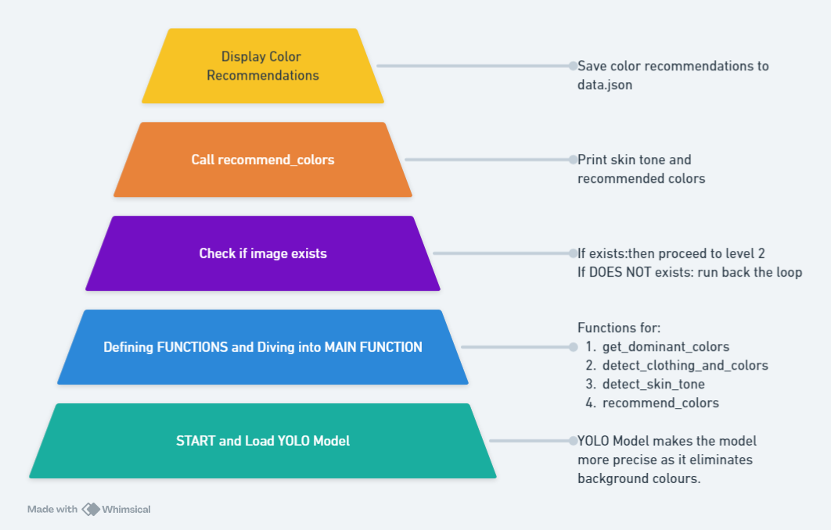
System at a Glance
The integrated shopping platform enhances user experience through personalized color guidance by detecting the user's skin tone and generating tailored clothing color recommendations.
It utilizes YOLO for precise clothing detection and face detection for accurate skin tone analysis.
The flow involves initializing the YOLO model, defining key functions, verifying image existence, executing color recommendations, and displaying the results, ensuring a cohesive and personalized shopping experience.

Slide 5
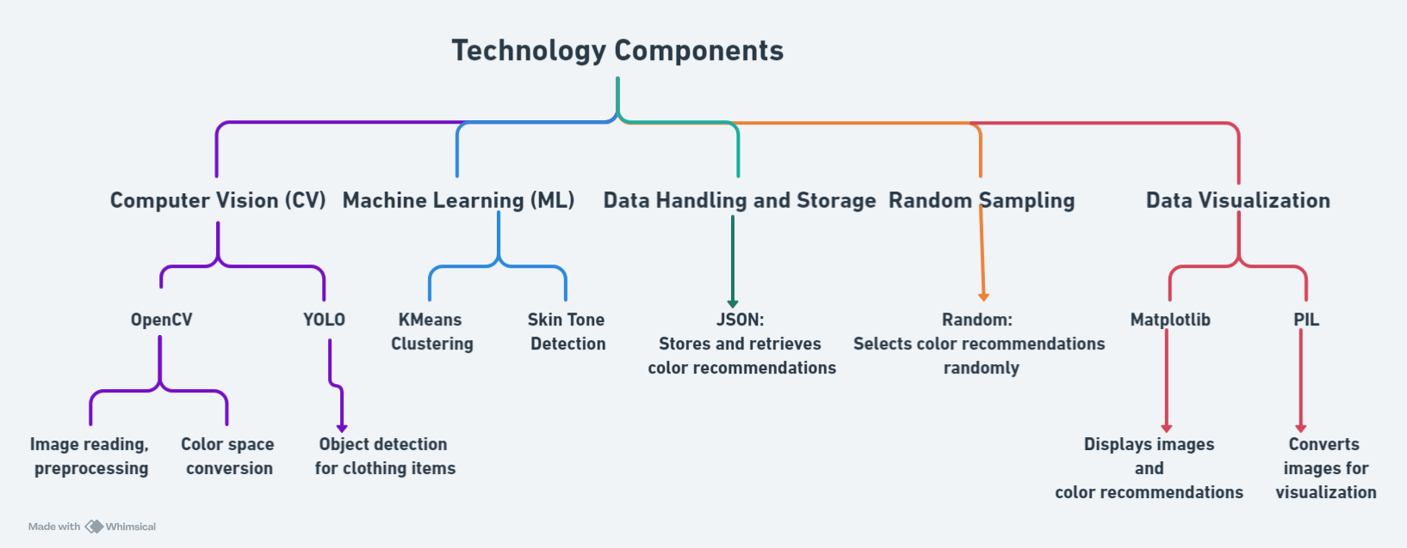
Integrated Shopping Platform: Technology Components

Slide 6



Benefits
Enhanced Customer Satisfaction: By receiving personalized color recommendations, customers will feel more confident and satisfied with their fashion choices.
Increased Engagement: Interactive and personalized features will lead to higher user engagement and app usage.
Higher Conversion Rates: Tailored recommendations will drive higher conversion rates and sales.
Reduced Return Rates: Customers are less likely to return items that complement their appearance, reducing return rates and associated costs.
Brand Loyalty: A unique and personalized shopping experience will foster greater customer loyalty and repeat business.
PROJECT CODE LINKS:1.Github: https://github.com/Mishra-0709/Myntra-BlackGriffin
2.Collaboratory: https://colab.research.google.com/drive/1mxbTz-bgfuP8EjBuyHe71lIHuTW6MCNq?usp=sharing
3.Dataset:Colorful Fashion Dataset For Object Detection (kaggle.com)

