Slide 1





AI-powered Traction Control and Torque Compensation System for EV
Kinjal Bhattacharyya
Pradeepta Behera
Sharmistha Pattnaik
Mokshyada Mishra
National Institute of Technology, Rourkela
Rourkela, Odisha
Mentor Name:- Jogesh Chandra Dash

Slide 2

Challenge Statement
Performance of Electric Vehicles is often compromised on rough terrains due to torque gaps, which occur during gear shifts or motor speed variations. These torque interruptions can affect vehicle stability, ride comfort, and overall driving experience, especially on challenging terrains.

Slide 3
Concept / Solution
The solution focuses on developing an AI-powered Automatic Gear Shifting and Traction Control System to enhance vehicle stability on rough terrains and during speed variations. Real-time sensor data, including acceleration, gyroscope readings, brake pressure, and throttle position, will be integrated with GPS data to detect conditions like slopes, sharp turns, and rough patches. The AI model, based on a neural network architecture, will be trained using global data with continuous learning, allowing the system to adapt and improve over time. This model will be fine-tuned for specific locations or use cases using transfer learning, optimizing computation costs. Sensor and GPS mapping will enhance fault tolerance and improve terrain-specific decision-making. Implementation will involve edge computing for real-time processing without internet dependency, and cloud technology for large-scale data storage. Hardware components like Neural Network accelerators, on board cameras, IR sensors along with robust software using Python will work together to process sensor inputs, manage decision-making algorithms, and control the vehicle’s mechanics. The system will be simulated in MATLAB, where vehicle plane stability plots will be analyzed to refine performance. These simulations will aid in evaluating how the system responds to varying terrains and conditions, ensuring optimal ride comfort.

Slide 4
Pros and Cons of the solution
Pros
Enhanced Stability and Comfort: Real-time torque management reduces interruptions during gear shifts or motor speed variations, improving vehicle stability and ride comfort.
Terrain Adaptability: AI-driven decision-making allows the system to respond dynamically to varying terrains, including slopes, sharp turns, and rough patches.
Continuous Learning: The use of a neural network with continuous learning ensures the system improves over time, adapting to new terrains and driving conditions.
Localized Optimization: Transfer learning tailors the model for specific locations, optimizing performance without requiring excessive computational resources.
Fault Tolerance: Integration of sensor and GPS data improves fault tolerance, ensuring robust operation in challenging conditions.
Real-Time Processing: Edge computing ensures real-time decision-making, critical for maintaining stability and safety during operation.
Cons
High Development Cost: Initial setup, including hardware (neural network accelerators, cameras, and sensors) and software, may be expensive.
Complexity: The integration of AI, sensors, edge computing, and cloud storage adds system complexity, potentially increasing maintenance challenges.
Dependence on Sensor Accuracy: The system’s performance heavily relies on the accuracy of sensor data; any failure could degrade functionality.
Server Dependency: Requirement of big data collection processing and continuous learning of the ML model would require efficient cloud servers.

Slide 5
Technical Description
The Fuzzy Logic-based Traction Control system calculates braking torque based on longitudinal velocity and slip ratio. This braking torque is then used to estimate the energy required for braking, with the assumption that energy is proportional to the product of braking torque and velocity. By adjusting the slip ratio, the system generates energy profiles and identifies the optimal conditions for minimizing energy consumption.
The Neural Network-based Torque Compensation system is designed to activate during gear shifts. Trained on test data from multiple locations, the model continuously learns and adapts to changing conditions. It ensures that compensatory torque is provided by one motor while the other undergoes a gear shift. The system is optimized for edge computing, allowing it to operate efficiently with regular updates to model weights, tailored to region-specific learning parameters. This approach ensures smooth operation and performance across diverse environments.

Slide 6
Implementation Plan
The implementation plan for the AI-powered Traction Control and Torque Compensation System involves several stages:
Data Collection: Gather real-time sensor data (accelerometer, gyroscope, brake pressure, throttle position) and GPS data from various terrains. Supplement with global datasets for training the AI model.
AI Model Development: Design a neural network-based AI model for decision-making. Train the model with global datasets and fine-tune it using transfer learning for specific terrains or conditions.
Software Development: Develop Python-based software to process sensor inputs, manage decision-making algorithms, and interface with vehicle control systems.
Simulation: Use MATLAB to simulate vehicle stability and refine the AI model based on performance analysis.
Hardware Integration: Install sensors, GPS, onboard cameras, IR sensors, and neural network accelerators. Ensure hardware compatibility with the vehicle’s electronics.
Testing and Validation: Conduct on-road testing across diverse terrains to validate system performance.
Deployment: Optimize for edge computing, enabling real-time, internet-independent operation. Implement periodic updates for continuous improvement.

Slide 7
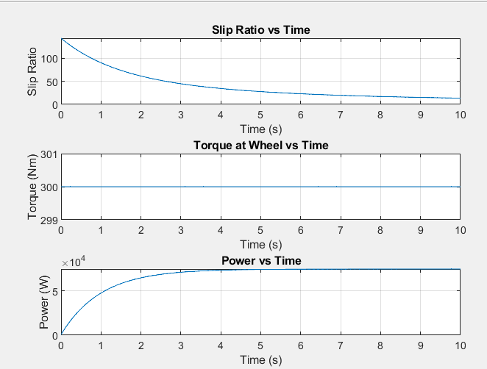
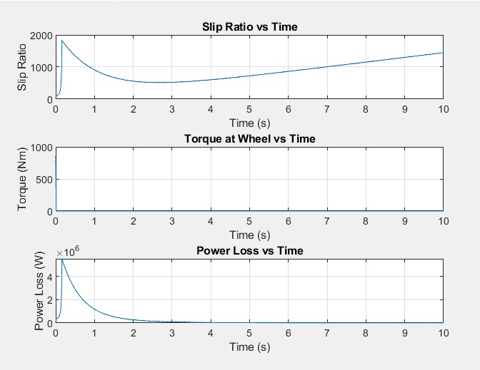
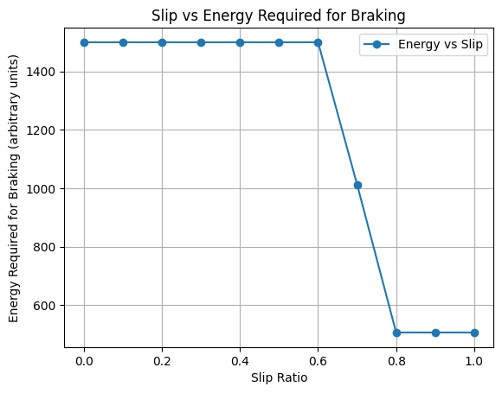
Validation / Testing / Analysis
Fuzzy logic based traction control for braking torque optimization:-
Output: Braking torque required for respective slip data points of compensated system fed to ML model.
Without Compensation
With Compensation

Slide 8
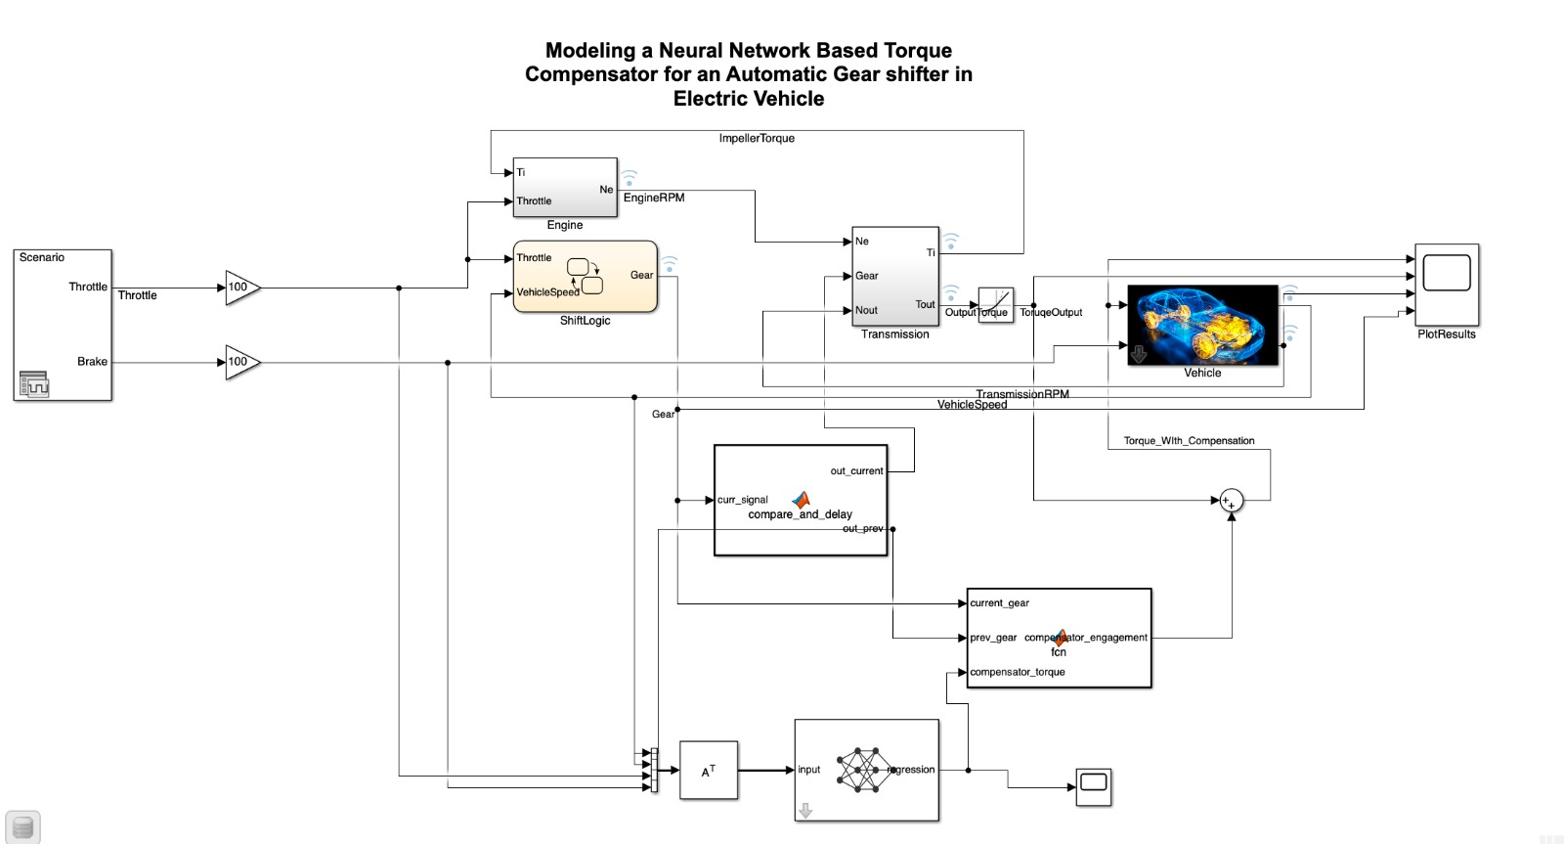
Validation / Testing / Analysis Contd.
Simulink Model Of the Vehicle Including the Neural Network for Torque Compensation

Slide 9
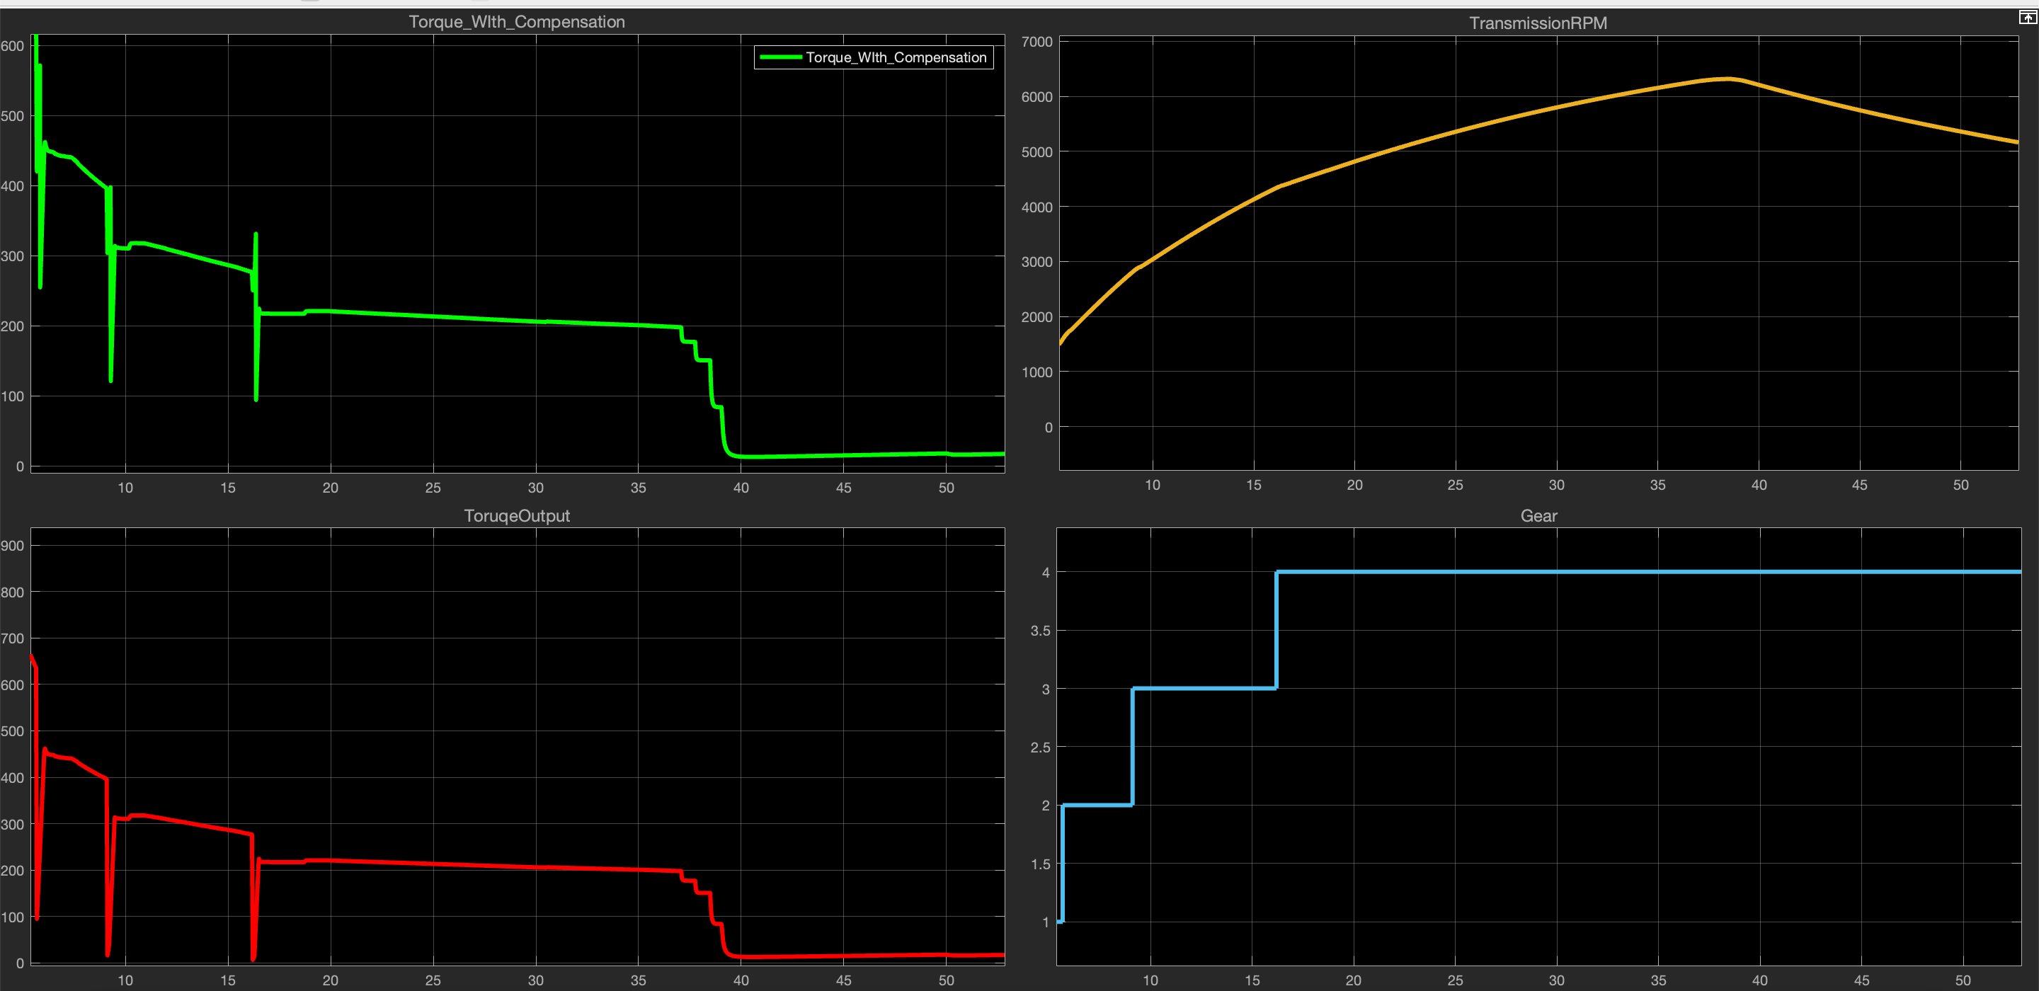
Validation / Testing / Analysis Contd.
During gear shifts, the torque gap is significantly reduced when compensatory torque is applied.
The compensatory torque mechanism reduces the torque gap by 36.67% during 3 → 4 shifts and 23.5% during 2 → 3 shifts.
This improvement enhances vehicle stability and driving comfort, particularly during dynamic transitions between gears.
Top-Left: Torque After Compensation Top-Right: Transmission R
Bottom-left: Torque without Compensation Bottom-Right: Gear Shifts

Slide 10
Cost Estimate
The Cost estimate is done by taking into account the Hardware and Server Costs pertaining to a single vehicle equipped with the system installed
Items | Specifications | Subtotal(₹) | Total(₹) | Percentage of Total Cost
Hardware | Microcontroller With Neural Network accelerator and WiFi module. | 17000 | 20000 | 34.2%
 | Sensors ( Gyroscope, Camera module, Wheel speed sensor etc. ) | 3000
Software | Cloud computing Servers with ML capabilities ( per year) | 38,477 | 38,477 | 65.8%
Total Cost |  |  | 58477

Slide 11
Assumptions
The modelled electric vehicle assumes an automatic gear-shifting mechanism, unlike many personal electric vehicles that utilize single-speed transmissions.
Standard sensors such as the throttle position sensor, brake pressure sensor, and GPS locator are widely included in most electric vehicles, so their installation costs are excluded from the estimate.
Internet connectivity is assumed to be provided via the driver’s mobile device, avoiding the need for additional external hardware.
Maintenance and licensing costs are not factored into this cost estimation.

Slide 12
References
https://ieeexplore.ieee.org/document/9338571/figures#figures
https://www.mathworks.com/help/ident/ug/modeling-a-vehicle-dynamics-system.html
https://www.researchgate.net/figure/Compensation-torque-calculation-process-with-a-certain-accelerator-pedal-opening_fig11_284546618
https://journals.sagepub.com/doi/abs/10.1177/09544070221085384
https://www.mechanics-industry.org/articles/meca/full_html/2021/01/mi200249/mi200249.html

Slide 13
Thank You

