Slide 1
J.a.r.v.i.s
The voice assistant
Presented By-:
SHUBH MISHRA
191500794

Slide 2
outline
About the Project
Objective
Requirements
Snapshots from the project

Slide 3
About THE PROJECT
This Mini project is the voice assistant that can handle all the basic operation that a user wants his assistant can do . It is implemented in Python Programming Language . It is well backed with a live GUI which is fully functional as well and intuitive
User can ask for anything as a query like-:
Open Notepad
Play Music
Close Music
Where Am I?
Weather
Set Alarm ….etc.

Slide 4
objective
Simple to Use & Interactivity
One of the primary Objectives of this project was to built
something that is functional with the ease of use by any
individual with a certain level of interaction which is Live
(GUI)
Experience
This project also provides an immersive experience to the user
as he/she can have a sort of interaction with the user Like it
responds to when asked how are you,etc.

Slide 5
REQUIREMENTS
Software Specification Used:-
Languages/Technologies Used: Python 3.8 and QT5 Designer
IDE Used: Visual Studio Code, PyCharmIDE

Slide 6
Hardware Used:
Processor Used: Intel i5
Operating System: Windows 10
RAM: 8 GB (minimum)
Hardware Devices: Computer System
Hard Disk: 256 GB

Slide 7
WORKING SNAPSHOT WITH OUTPUT
Hope you will like it :)

Slide 8
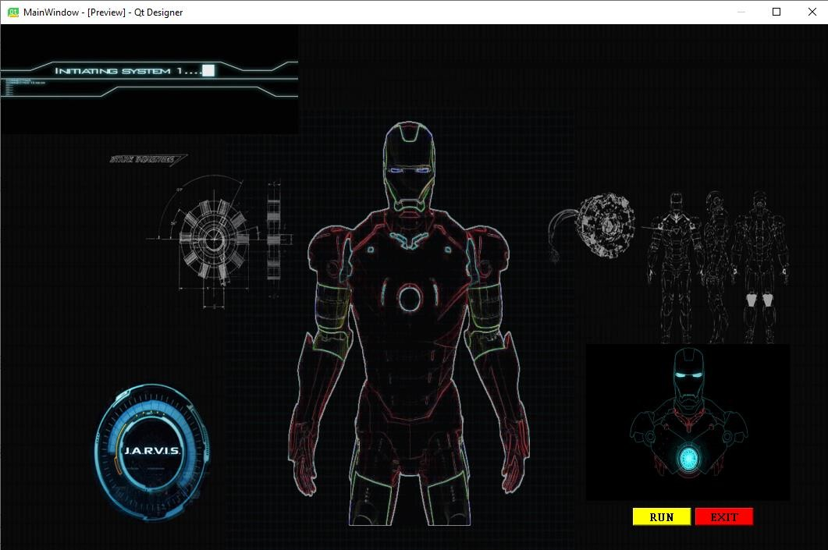
MAIN WINDOW

Slide 9
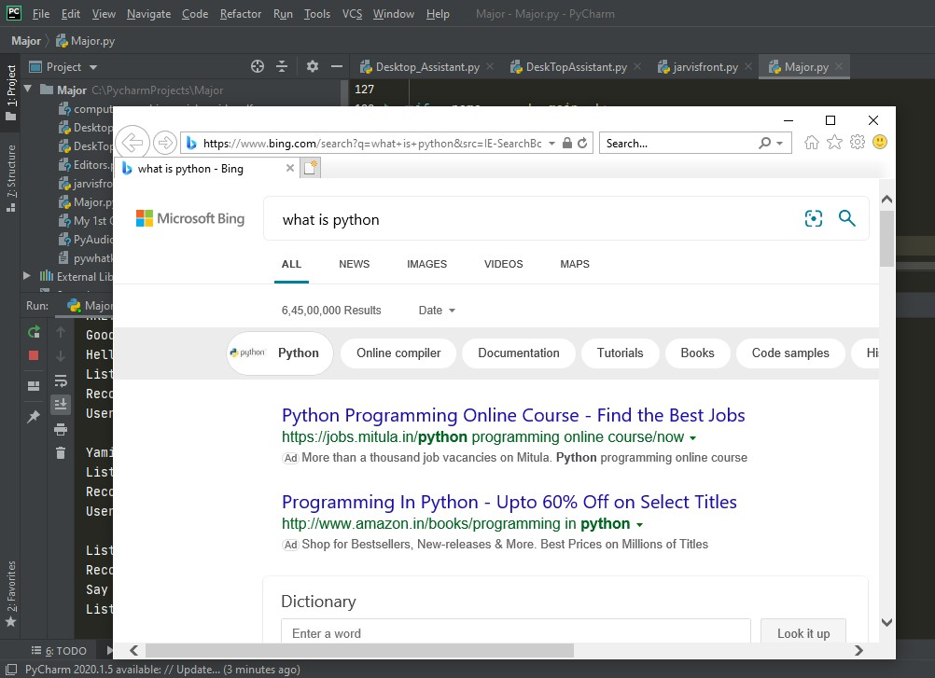
Output for google search

Slide 10
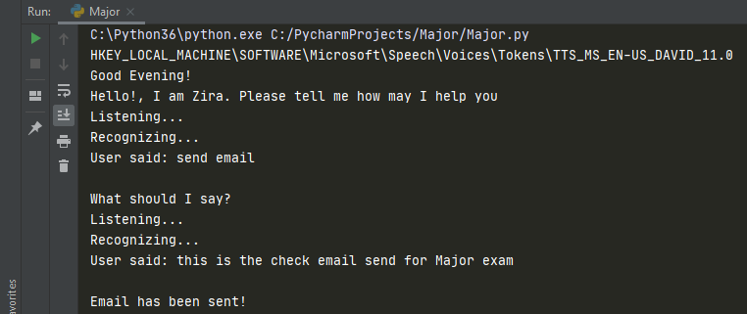
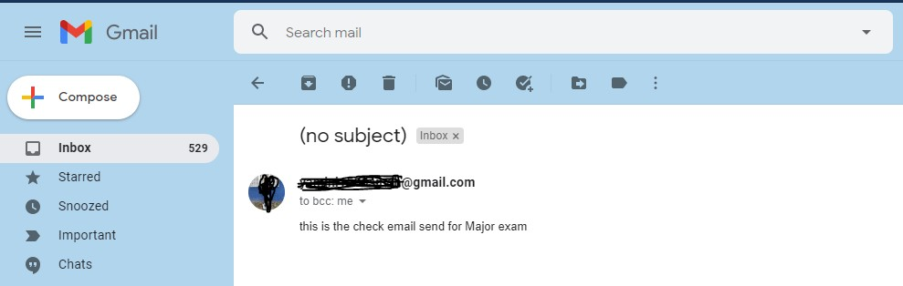
Input to send Email
Output of Email Sent

Slide 11
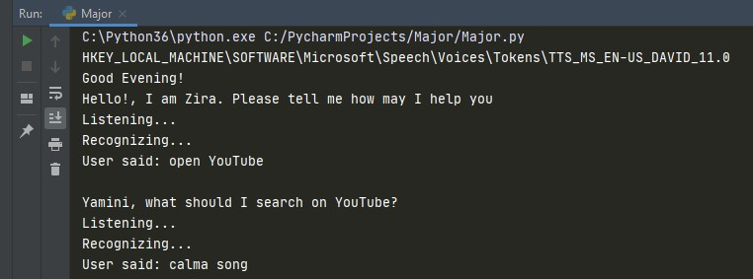
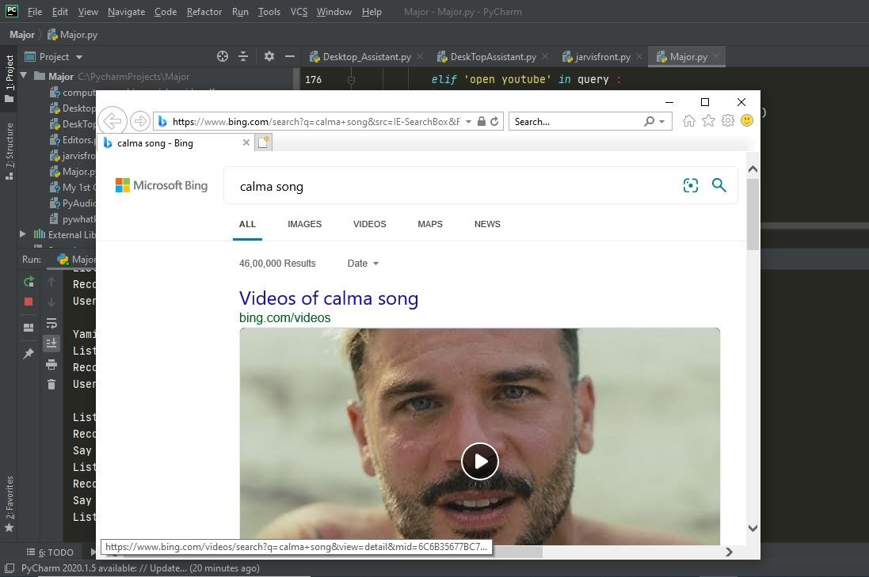
Input of Searching on YouTube
Output of Search on YT

Slide 12
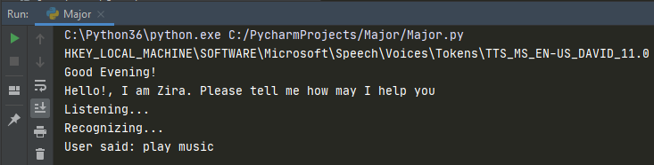
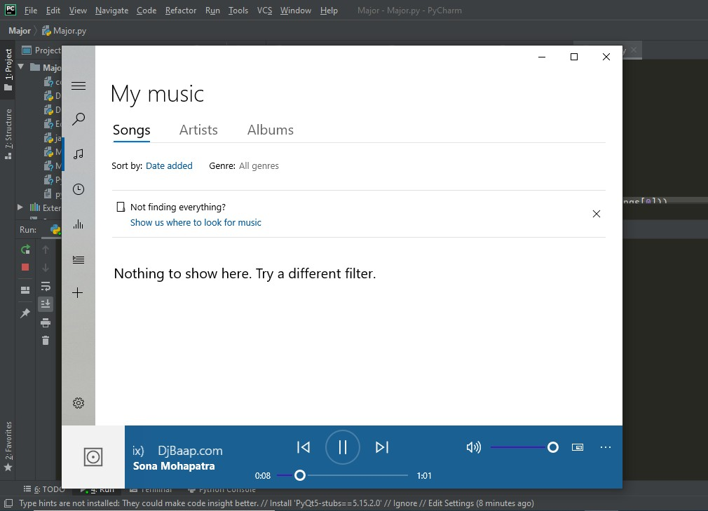
Play music functionality
Outcome of the Command

Slide 13
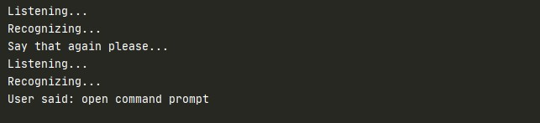
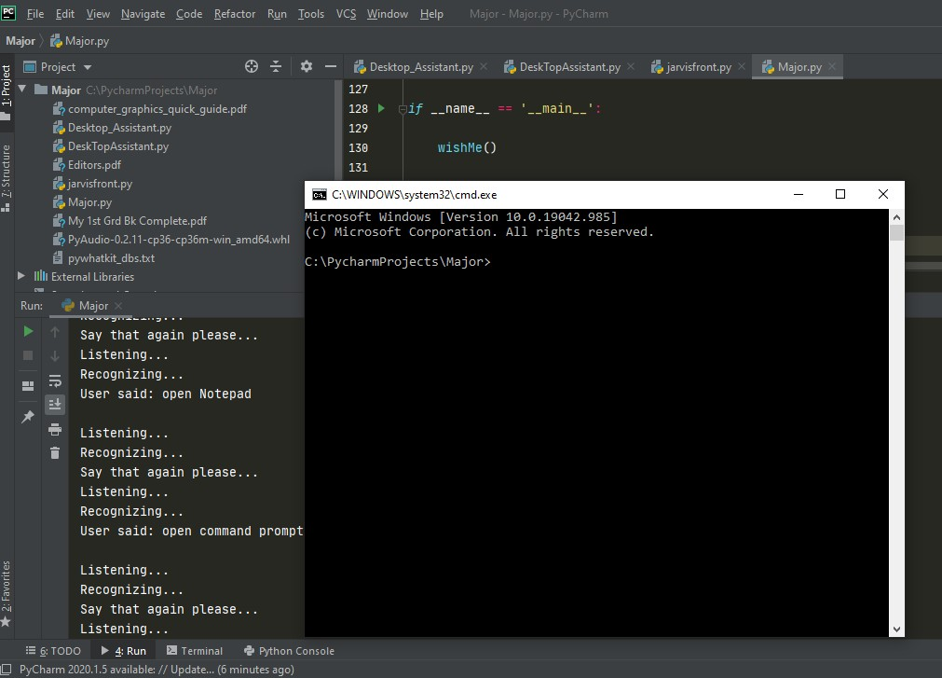
Open command prompt
Outcome of the query

Slide 14
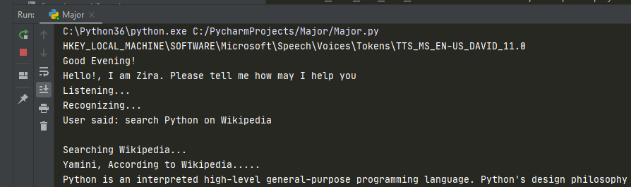
Searching on Wikipedia about Wikipedia

