Slide 1

Project Title - Seasonal Agriculture Performance Analysis
Name: Aditya Mishra
College: JB Knowledge Park
AICTE STU ID: STU6a5e58bbc984a1784567995

Slide 2

PROBLEM STATEMENT
Agricultural performance is influenced by seasonal changes in environmental conditions, farming practices, resource availability, and market conditions.
Raw agricultural data does not directly show how performance changes from one season to another.
The project analyzes seasonal agricultural data to identify meaningful patterns, trends, relationships, and differences.
The goal is to support evidence-based understanding of seasonal performance variation

Slide 3
Project Description
This project performs data analytics on seasonal agriculture data.
The dataset includes farm-level records across seasons, crops, states, districts, environmental factors, resource usage, production, and economic outcomes.
The analysis focuses on understanding how agricultural performance varies across Kharif, Rabi, and Zaid seasons.
The project uses descriptive statistics, data visualization, and comparison-based analysis to derive insights.
No machine learning or dashboard development is included; the focus is purely on data analytics.

Slide 4
Project Objectives
Explore and understand the agricultural dataset.
Clean and prepare the data for analysis.
Examine seasonal variation in agricultural performance.
Identify important patterns and trends across seasons.
Investigate relationships between environmental conditions and agricultural outcomes.
Compare performance across seasons and relevant groups.
Develop evidence-based insights and recommendations.

Slide 5
Dataset Overview
Records: 4,000 rows
Columns: 28 features
Seasons: Kharif, Rabi, Zaid
Crops: Rice, Wheat, Maize, Pulses, Cotton, Chilli, Groundnut, Sugarcane
Key variables include rainfall, temperature, humidity, soil pH, soil moisture, fertilizer, pesticide, seed quality, yield, production, market price, cost, revenue, profit, and water usage.
The dataset supports seasonal comparison and performance analysis

Slide 6

WHO ARE THE END USERS?
Farmers and farming communities
Agricultural planners and policymakers
Government agriculture departments
Agri-business and supply-chain stakeholders
Students and researchers working in agriculture analytics

Slide 7

Technology Used
Python – Pandas, NumPy (data cleaning & analysis)
Matplotlib, Seaborn – data visualization
Google Colab – development environment / notebook execution
Excel – initial data inspection / cross-verification (optional, only if you actually used it)

Slide 8
Analysis Approach
Loaded and inspected the dataset.
Checked missing values, duplicates, and data types.
Performed data cleaning and median-based missing value treatment.
Conducted descriptive statistical analysis.
Performed univariate, bivariate, and multivariate visual analysis.
Interpreted seasonal patterns and prepared findings)

Slide 9
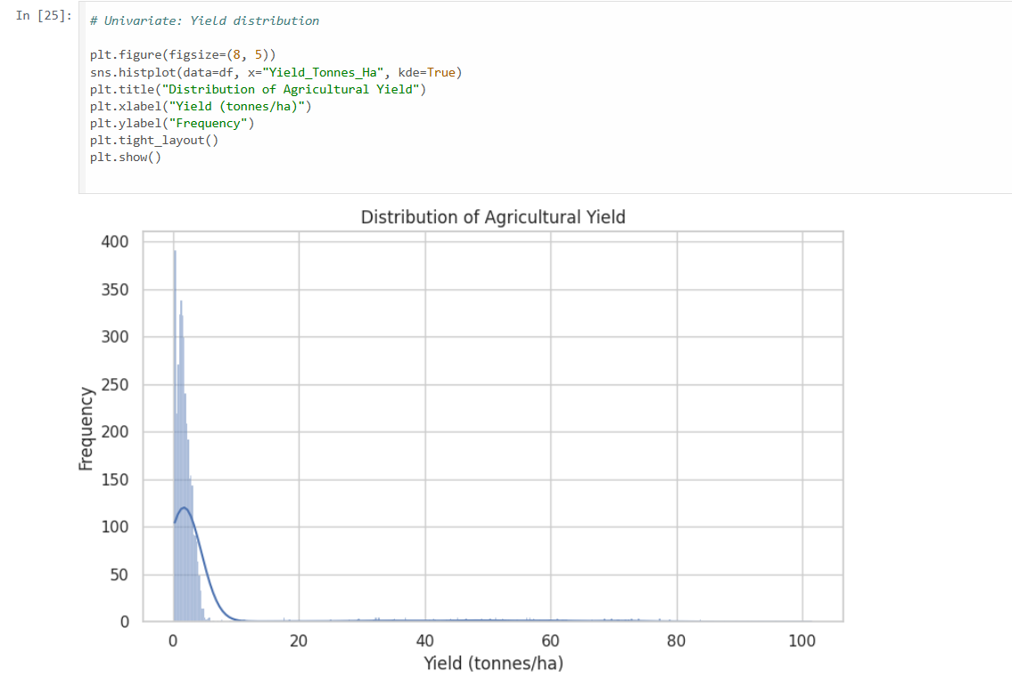
Result 1: Distribution of Agricultural Yield
• The histogram shows how yield values are distributed across farms.
• Most farms have low to moderate yield.
• A small number of farms show very high yield values, indicating uneven performance

Slide 10
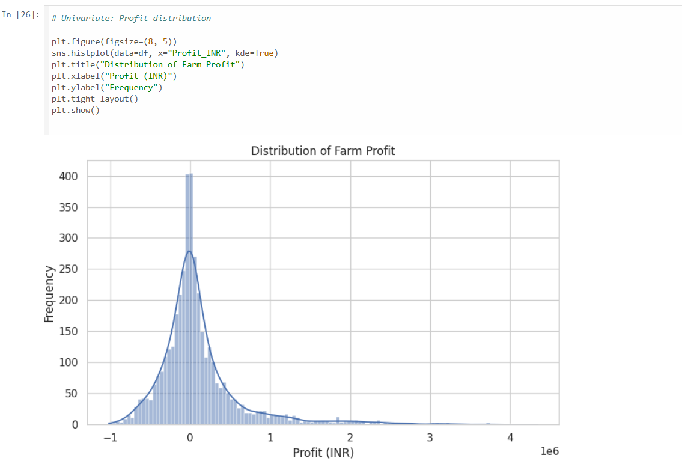
Result 2: Distribution of Farm Profit
• The profit distribution shows variation in farm earnings.
• Many farms are close to low profit or near break-even.
• Some farms achieve very high profits, showing strong performance differences.

Slide 11
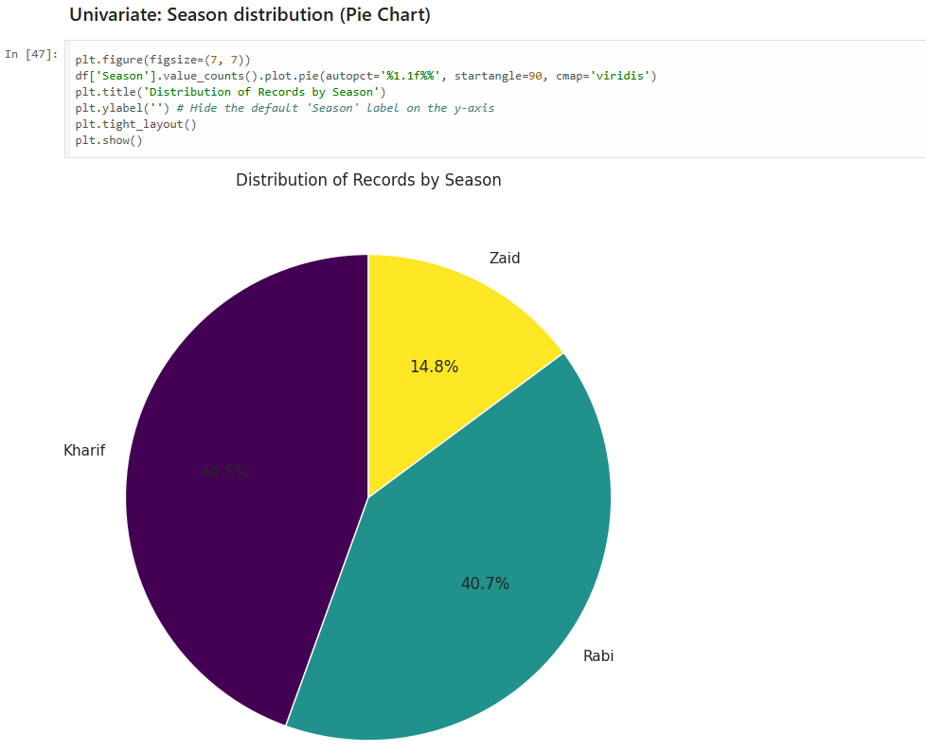
Result 3: Distribution of Records by Season
• Kharif has the highest share of records.
• Rabi is the second largest season in the dataset.
• Zaid has the smallest share, indicating lower representation in the data

Slide 12
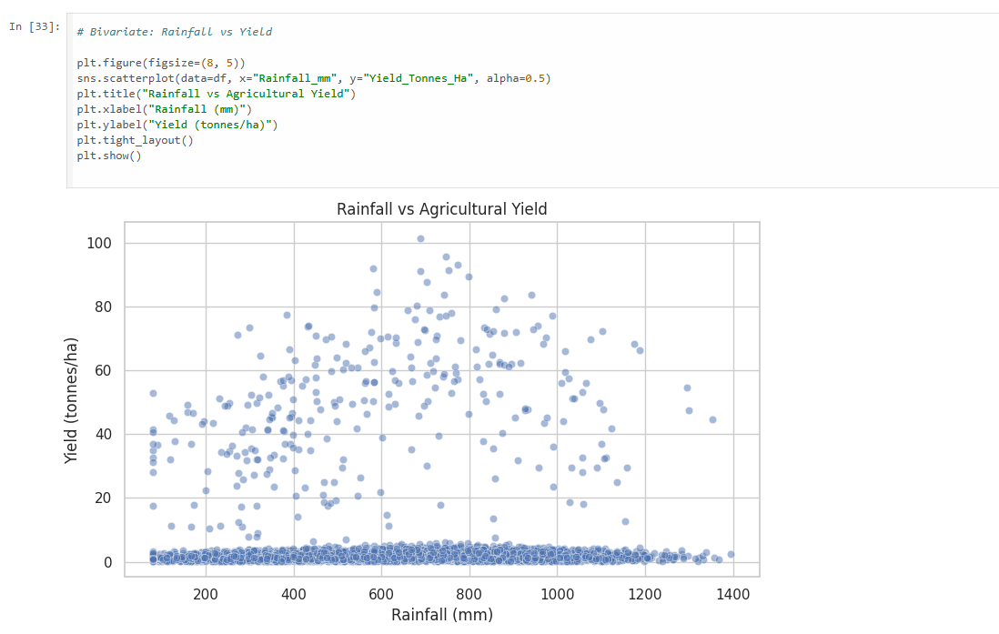
Result 4: Rainfall vs Agricultural Yield
• The scatter plot shows the relationship between rainfall and yield.
• It helps identify whether higher rainfall is associated with better agricultural output.
• The plot also highlights variation in yield across different rainfall levels.

Slide 13
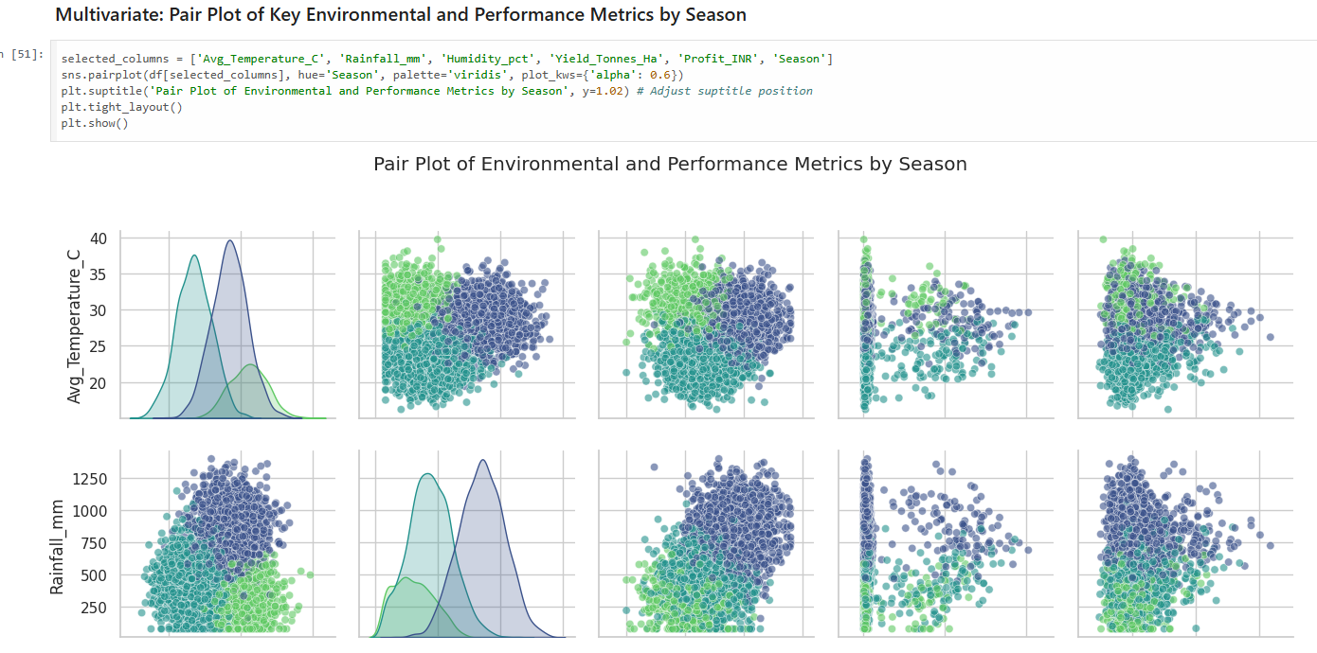
RESULT 5 : Pair Plot of Key Metric by Season
• The pair plot compares temperature, rainfall, humidity, yield, and profit by season.
• It helps visualize seasonal clusters and relationships among variables.
• This supports the identification of seasonal patterns and differences in agricultural performance.

Slide 14
Key Findings
Agricultural performance varies noticeably across seasons.
Kharif is the most represented season in the dataset.
Yield and profit are unevenly distributed across farms.
Environmental factors such as rainfall, temperature, and humidity play an important role in performance variation.
Season-wise visualization helps identify meaningful patterns and differences in agricultural outcomes

Slide 15
Recommendations
Season-specific planning should be used for better agricultural decision-making.
Resource usage such as water, fertilizer, and pesticide should be optimized based on seasonal conditions.
Regions and crops with weak performance should be studied further for improvement.
Data-driven insights can help stakeholders improve productivity and reduce losses.

Slide 16
Future scope
Add predictive analytics for yield and profit estimation.
Build an interactive dashboard for seasonal agriculture monitoring.
Include real-time weather and market price data.
Extend the analysis to region-wise crop recommendation and policy planning.

Slide 17
GitHub Link
https://github.com/Mishra-adi01/Seasonal-Agriculture-Performance-Analysis
The repository contains the project code, analysis notebook, and related project files.

Slide 18
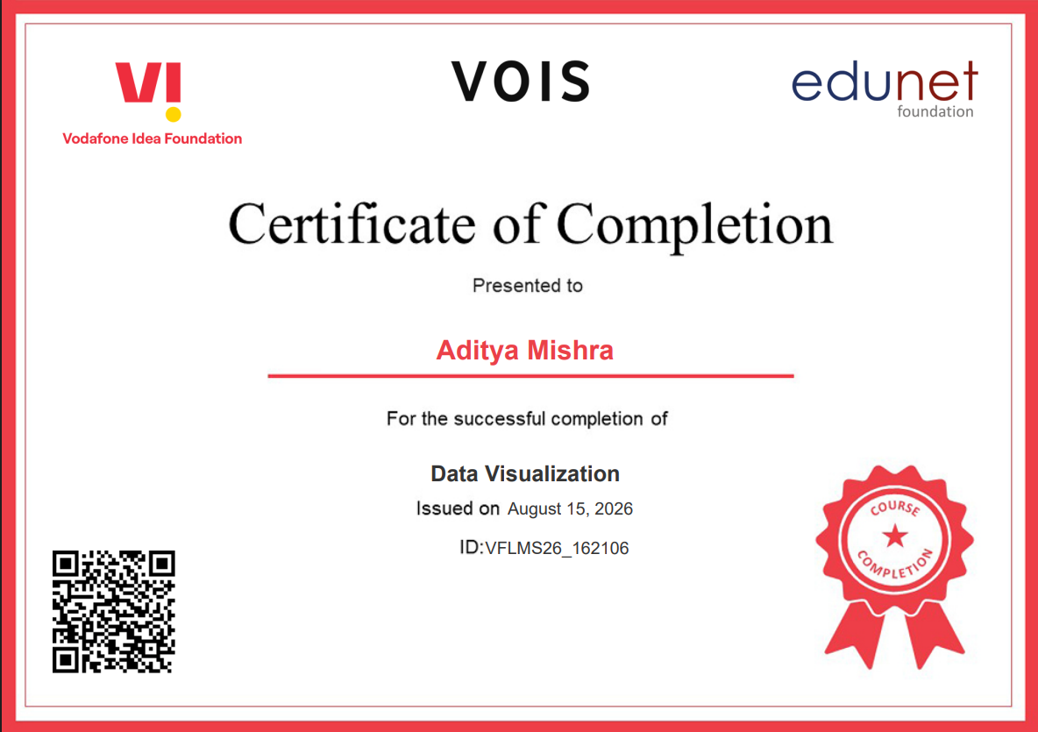
VOIS Course completion certificate -
Course name- Data Visualization

Slide 19
Thank you
Seasonal Agriculture Performance Analysis | Aditya Mishra
.
.

