Slide 1
LMS - Grievances Module (ADMIN & Student)

Slide 2
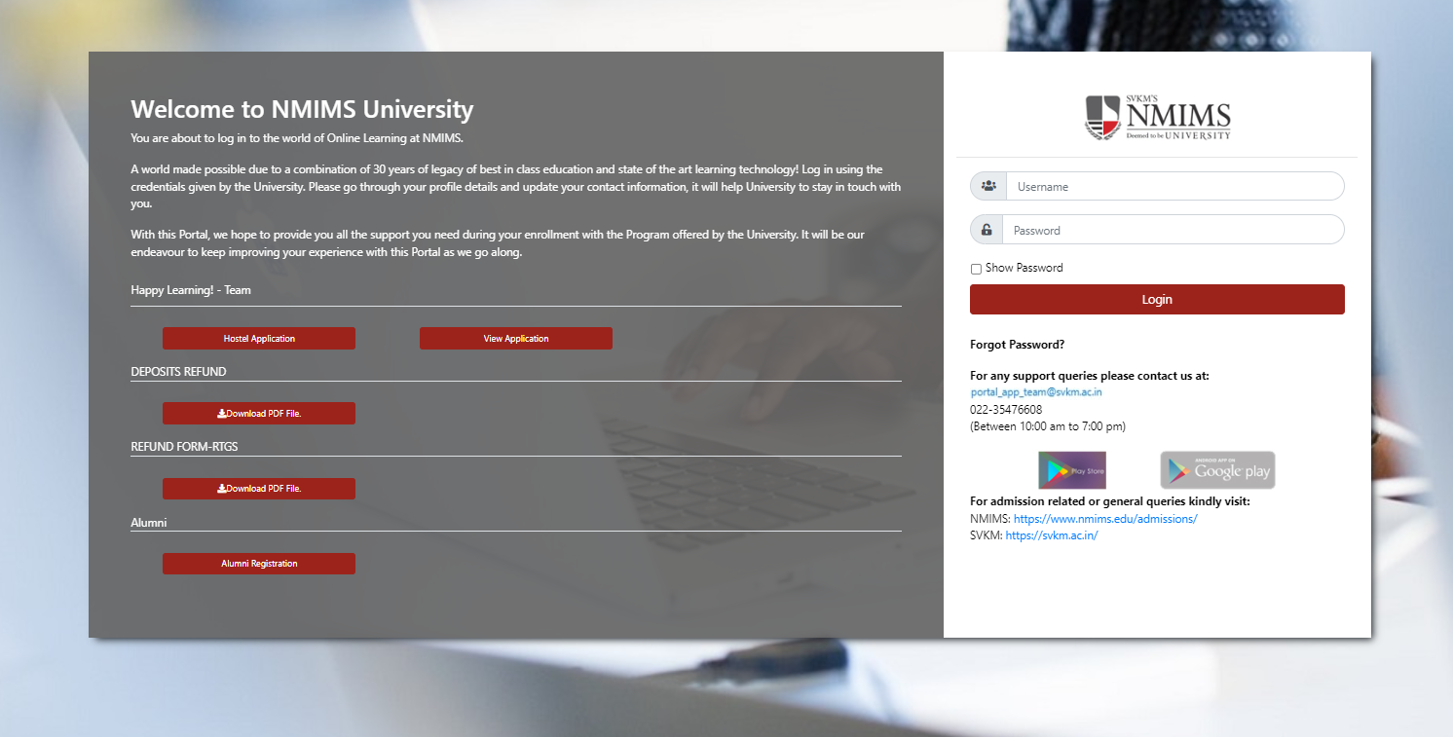
Login Page
URL : https://portal.svkm.ac.in/usermgmt/login
Enter valid credentials and click on the "Login" button.

Slide 3
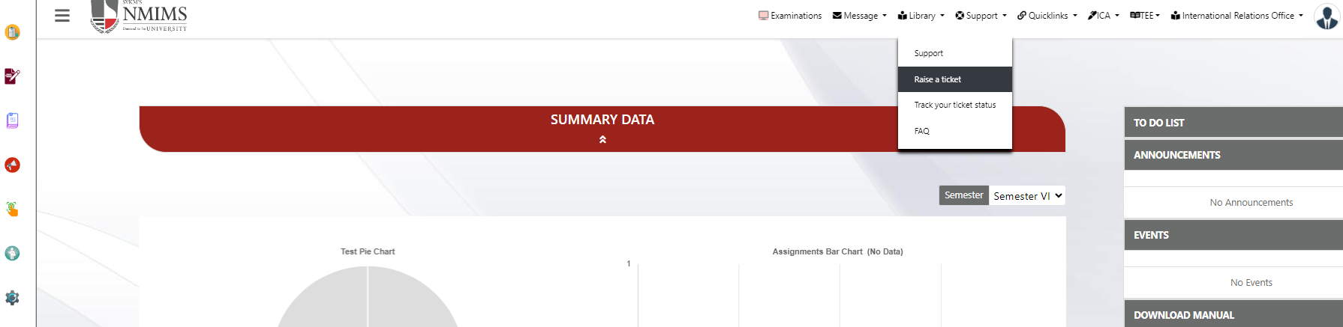
Student Dashboard
From the Dashboard, For filling Grievances, Student have to go to Support Tab/Icon and select Raise a Ticket.

Slide 4
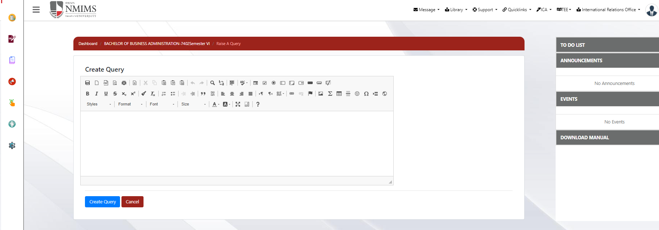
Raise a Ticket
Once the "Raise a Ticket" option is selected, a new comment box will appear. Students can then enter their respective queries in the comment box and click on the "Create Query" button for submitting.
Whenever any Student raise a query or file a grievances, Respective Course coordinator will get System Generated Email regarding same along with AR and DR.

Slide 5
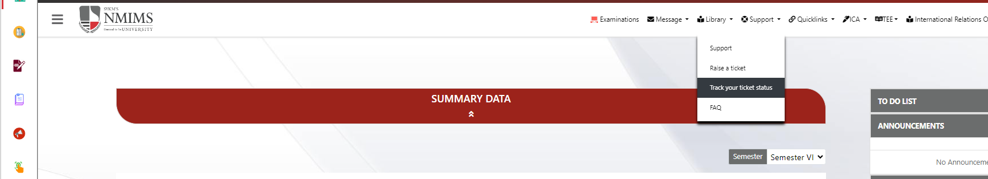
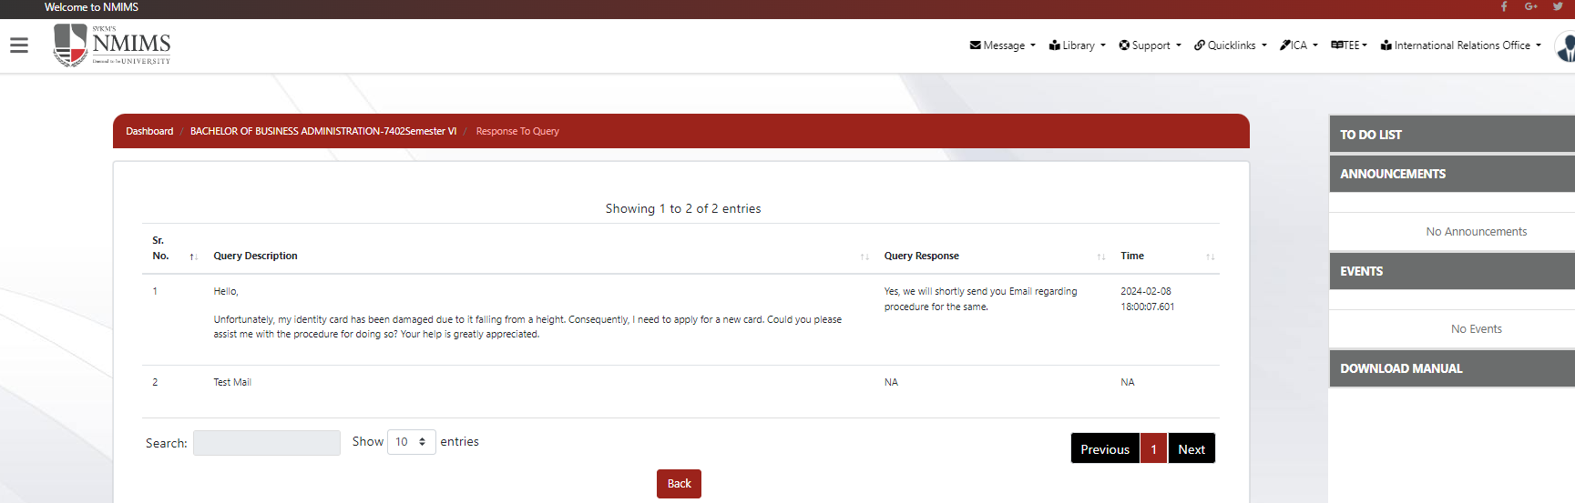
Track Ticket Response.
From the Dashboard, Student have to go to Support Tab/Icon and select Track your ticket status.
New Window will open where list of queries will reflect along with their Response status.

Slide 6
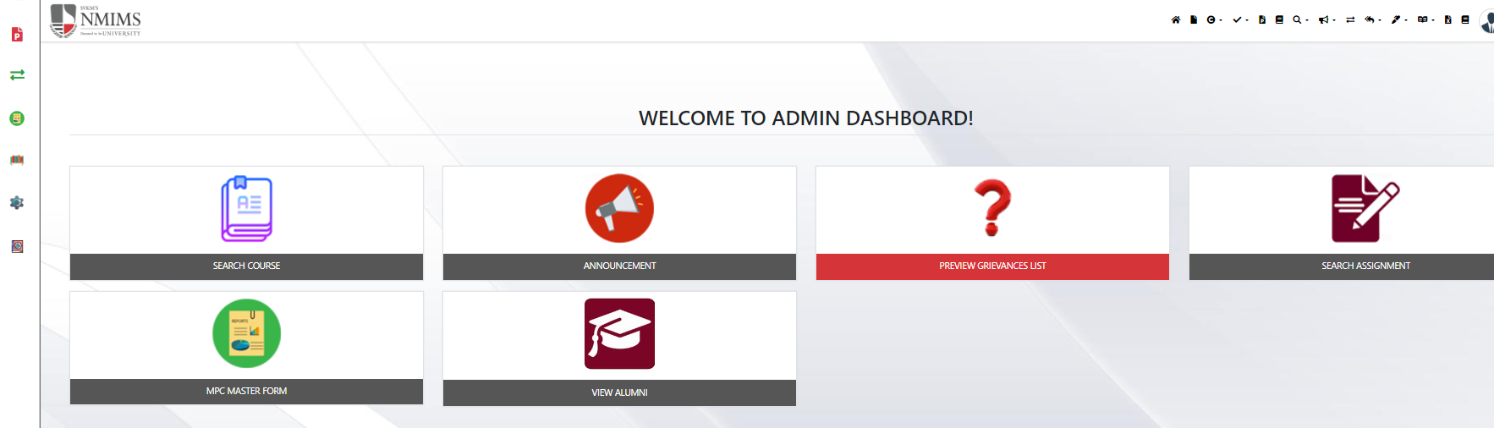
ADMIN Dashboard
From the Dashboard, Admin have to go to “Preview Grievances List” Tab to See and provide Response.

Slide 7
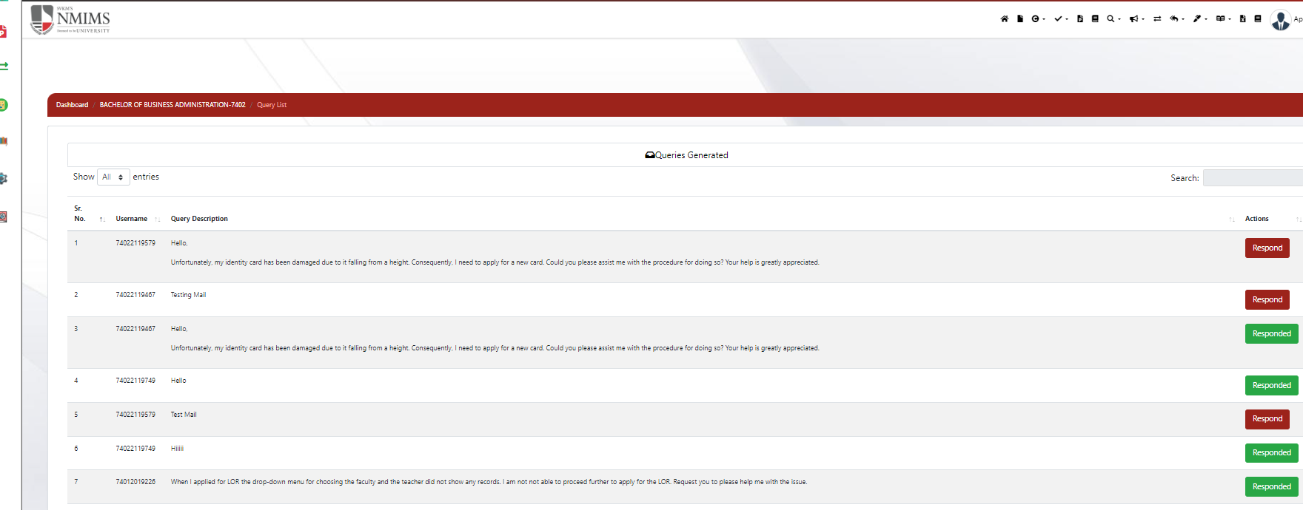
Preview Grievances List
List of all the Grievances will reflect here along with their status.
In the Action Column, unresolved queries will be highlighted in 'Red Color,' indicating a need for a response. To record or address grievances, the Admin must click on this button.
In the Action Column, resolved queries will be highlighted in ‘Green Color,' indicating as Responded. To view the grievances response, the Admin must click on this button.
Note: Response to the grievances will be recorded only once.

Slide 8
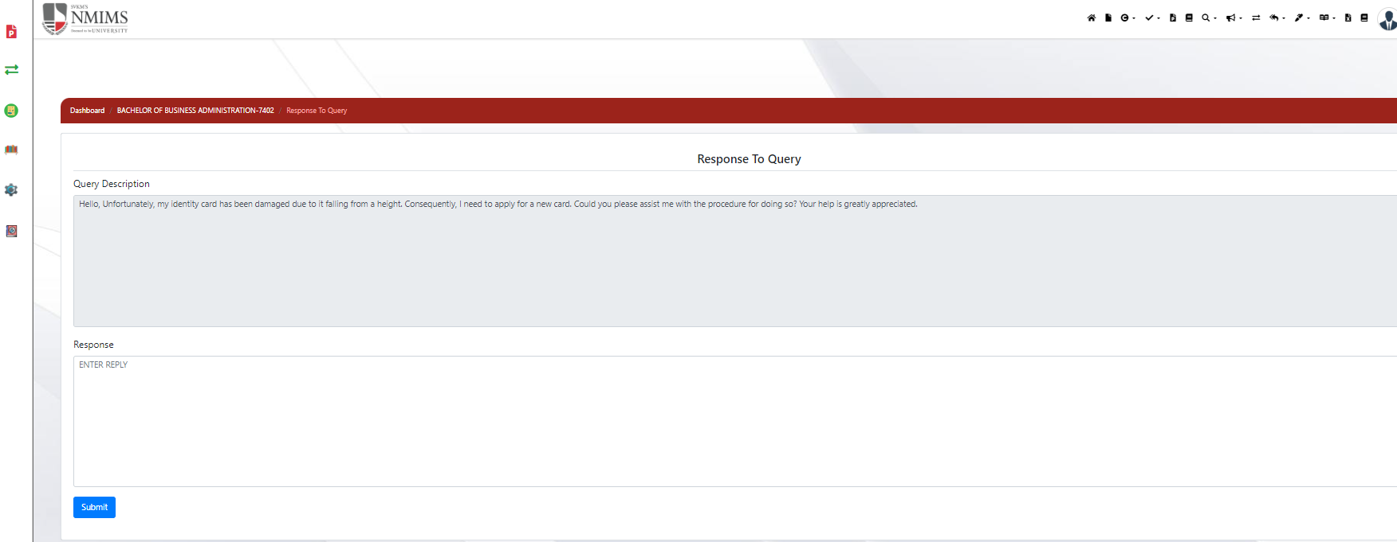
Response to Grievances
After selecting ‘Response’ button, New Page along with raised Grievances and Comment box will appear, Admin can then enter their respective response in the comment box and click on the “Submit" button.
Whenever Admin addresses and submit the grievance/query, respective student will get System Generated Email regarding same.

Slide 9
THANK YOU

