Slide 1
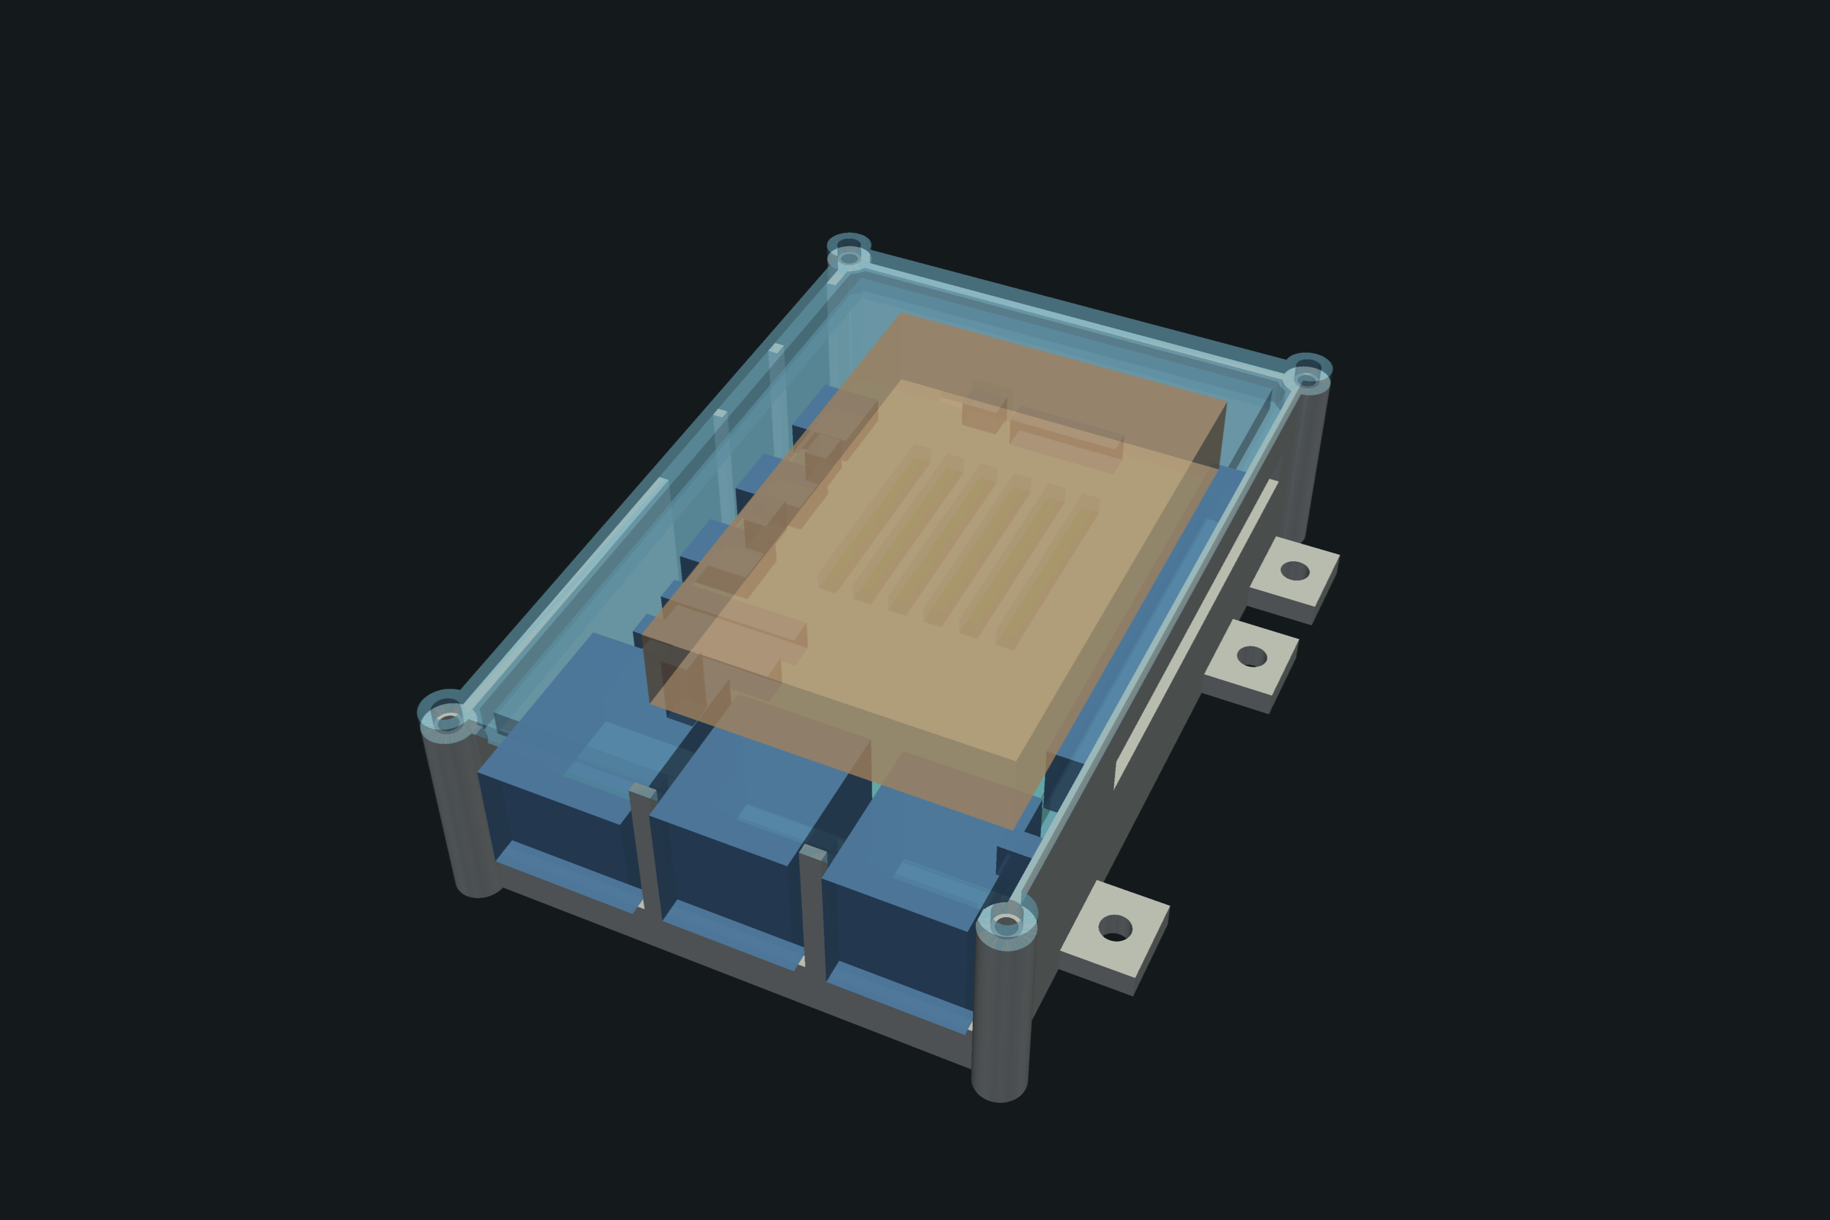
SCIENCECLAW · MIT SCIENCECLAW HACKATHON
Agents that design print-ready parts
Four specialist AI agents design a 3D-printed Raspberry Pi 5 case together, with no boss, and check it in Formlabs PreForm before it is printed.
TEAM
Mohamed Essadak Rakah (Launch Lead): enclosure agents
Ashutosh Mishra
Quang Tuong Van Nguyen
Jash Kotadiya: brackets, CalculiX simulation
1
Notes:
Hi, we are team ScienceClaw. Our project: AI agents that design parts which are ready to print, and check them before printing. My part, which I'll show, is a Raspberry Pi 5 case designed by four specialist agents. My teammates built the same idea for load-bearing brackets with a finite-element simulation.

Slide 2
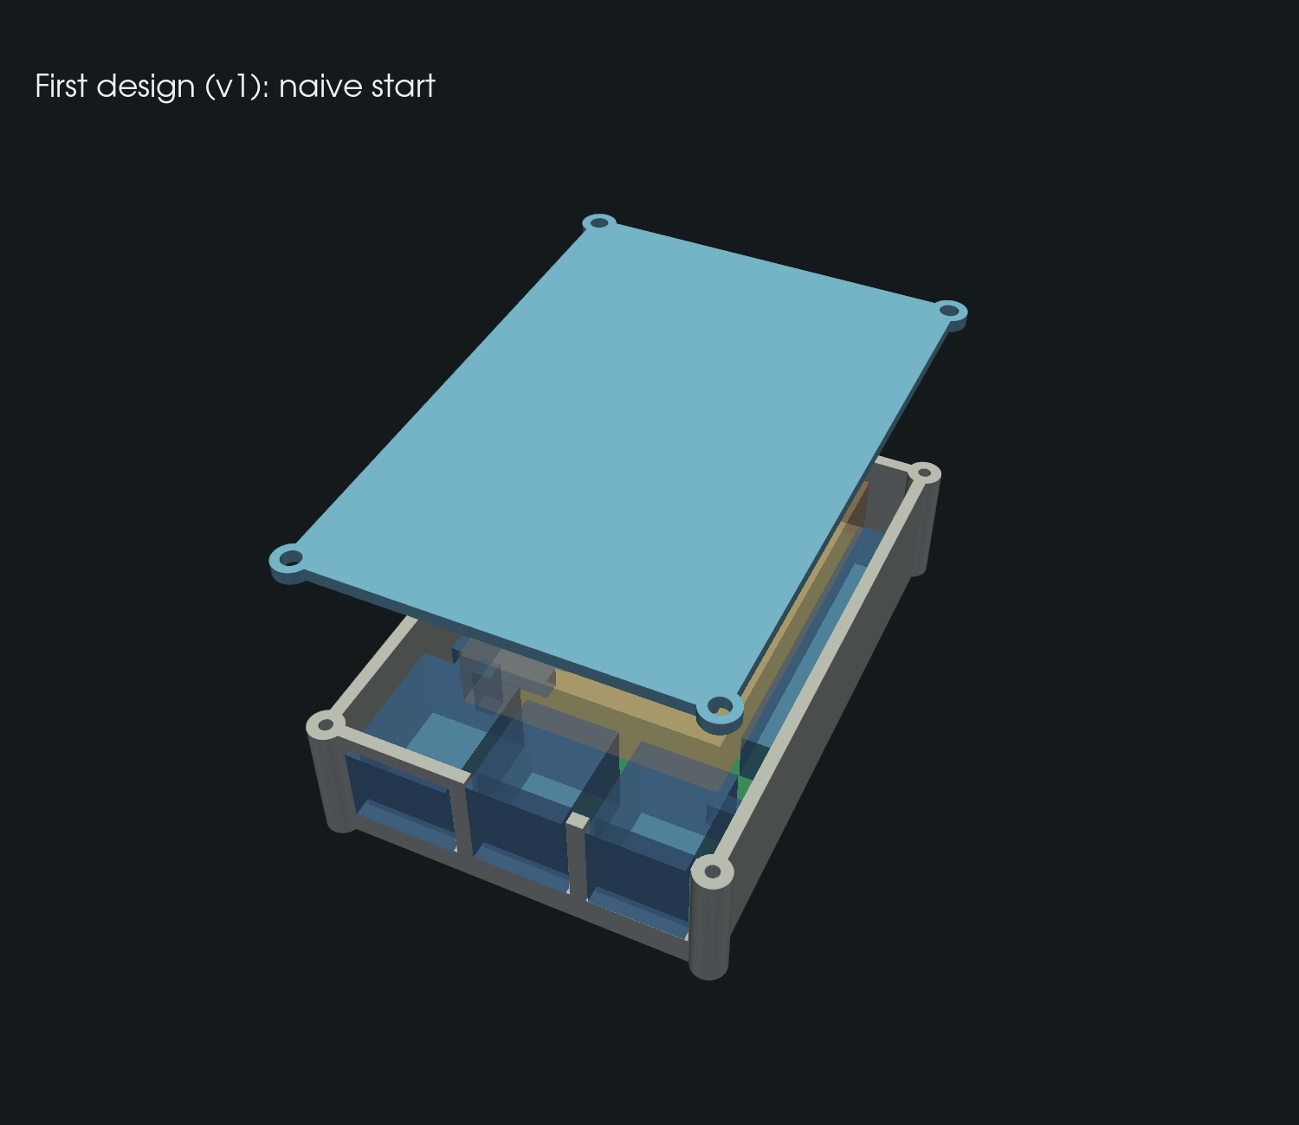
THE PROBLEM
A part that looks right in CAD often doesn't fit or print
20
check failures in the naive starting design (same start for every mode)
The board can't drop in: connectors hit the walls
The lid sits on the USB stack; no vent over the fan
Board screws can't grip: posts too short
Resin-trapping cups only show up in the slicer
Clearances depend on the printer and resin
The naive design (v1): closed box with port cutouts, low lid, short standoffs, no tabs, vents or cable slots.
One AI call can draw a box. Making it fit a real board, print without defects and assemble needs several kinds of expertise and real tools.
2
Notes:
Here is the starting design every mode gets: a closed box with port cutouts. Our checks find 20 problems: the board can't be lowered in, the lid sits on the USB ports, the screws have nothing to bite into. Some problems only appear in the printer software, like resin cups. And the right clearance depends on the printer and resin. That's several kinds of expertise, each with its own tool.

Slide 3
THE IDEA
Specialist agents, each owning a real tool, no boss
Design
Assembly
Manufacturing
Fit
OWNS
OWNS
OWNS
OWNS
name, board kit
box, ports, slots, tabs, lid screws
walls, ribs, vents, drain holes
clearances, standoffs, fasteners
TOOL
TOOL
TOOL
TOOL
CadQuery generator
assembly check: drop-in, lid gap, plugs, screws
printability, Formlabs PreForm, orientation tool
fit rules: design guide or measured test plate
No boss: each agent can only change its own keys (enforced in code)
A fix in someone else's part becomes a need to that owner; an edit is kept only if no check gets worse
Objections must carry numbers; the protocol (plain code) decides, not a model
3
Notes:
Our idea: split the job like a real engineering team. Four agents, each owns part of the design spec and one real tool. Assembly runs a geometric assembly check, Manufacturing runs Formlabs PreForm, Fit owns clearances. Nobody is in charge: if a fix lies in someone else's part, you post a need to them. And plain code, not a model, decides whether an edit is kept: only if no check gets worse.

Slide 4
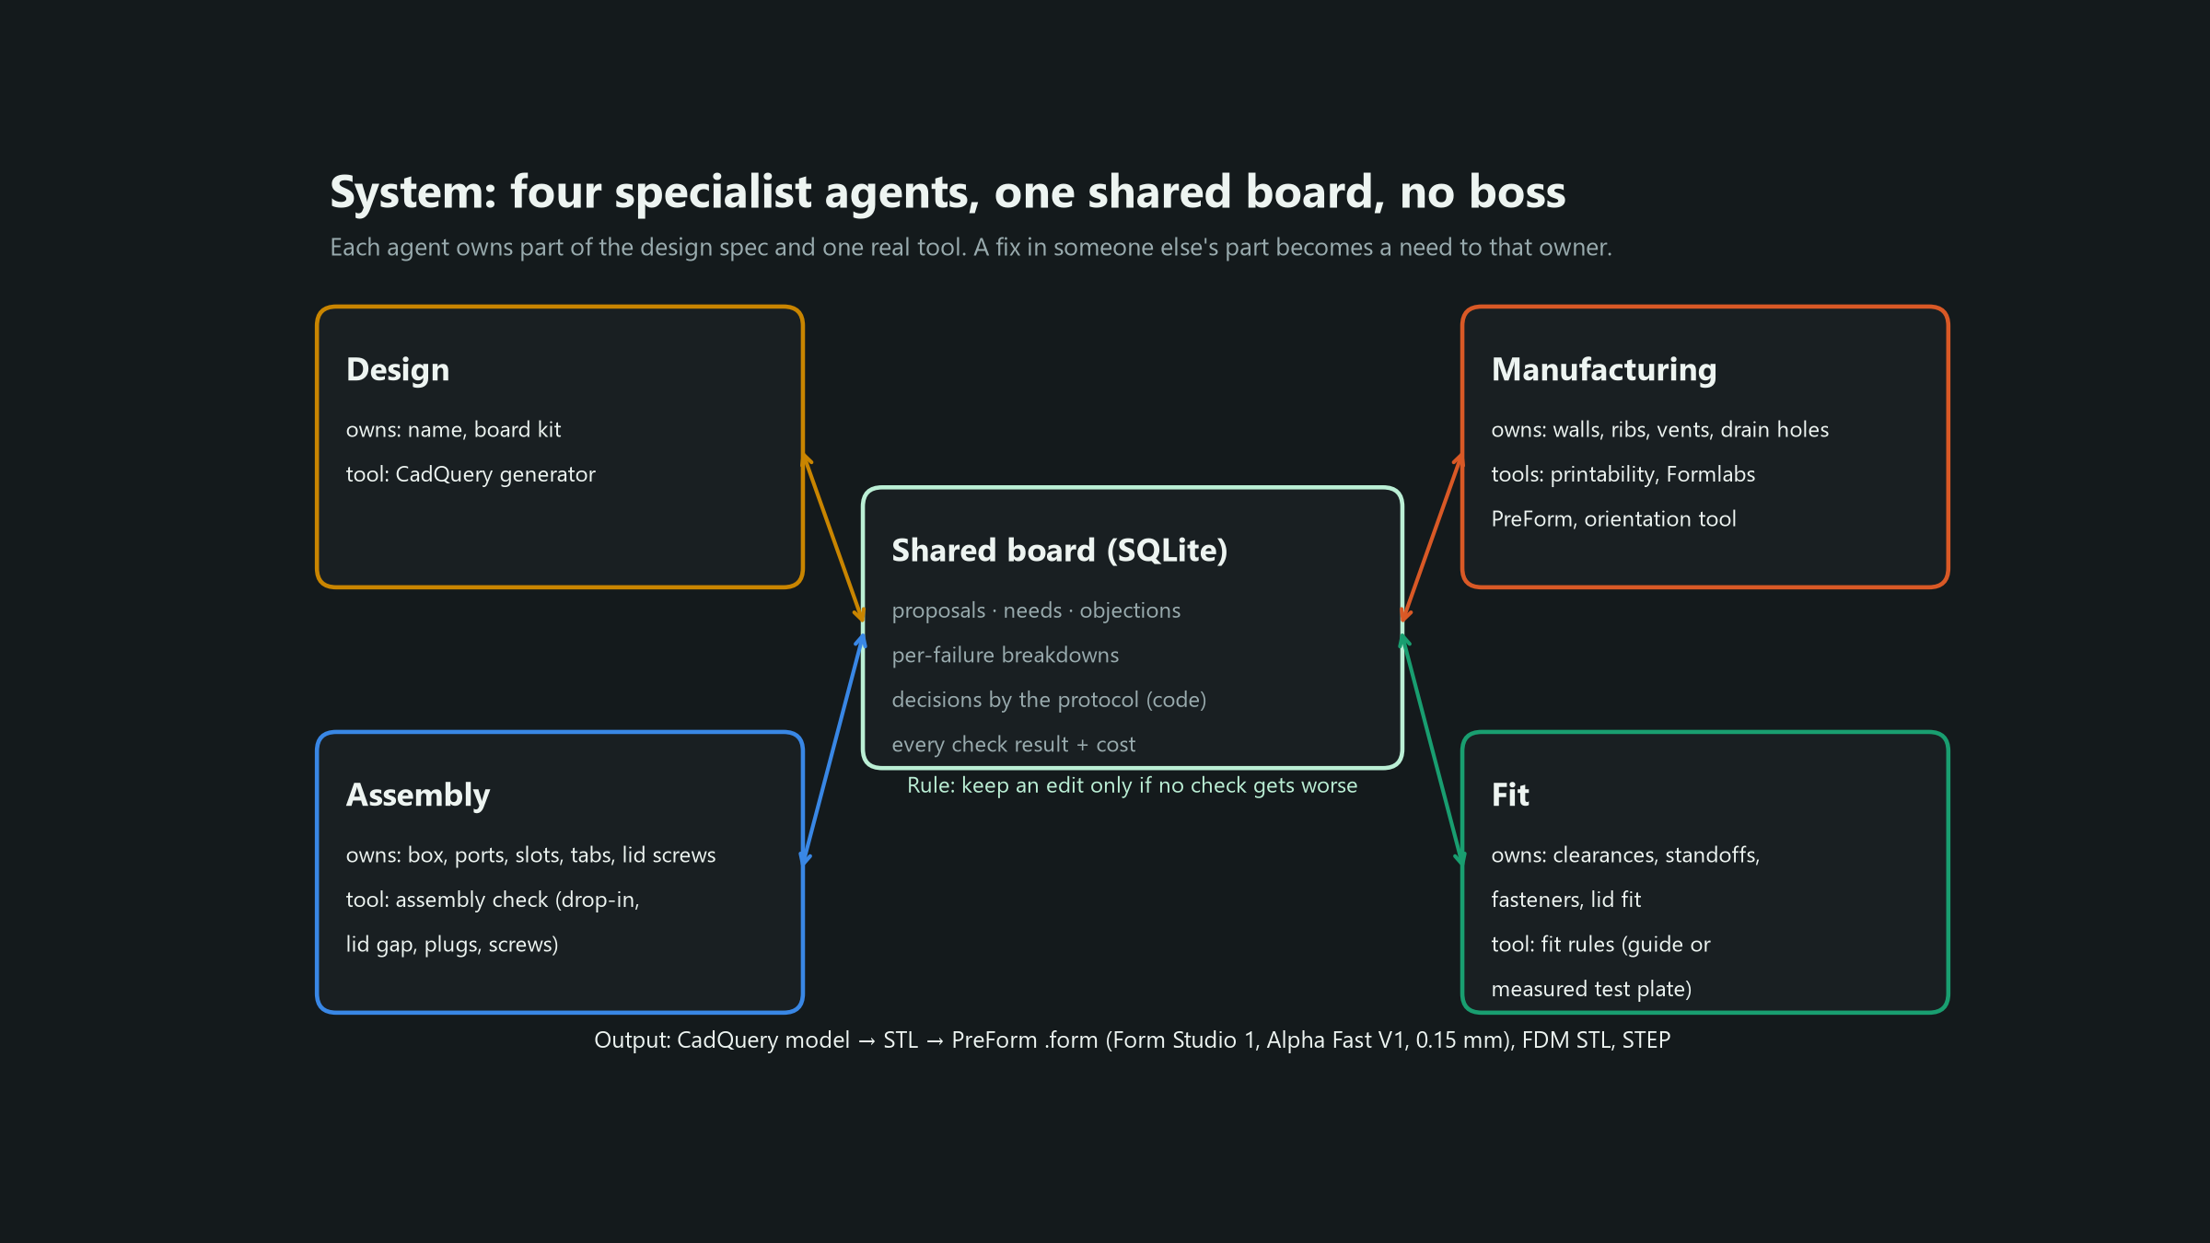
SYSTEM
How it works
4
Notes:
Everything goes through a shared board in SQLite: proposals, needs, objections, the per-failure breakdown of every edit, and the protocol's decision. The output is a CadQuery model, exported to STL and to a PreForm .form file for the Form Studio 1 with Alpha Fast resin at 0.15 mm, plus FDM STL and STEP.

Slide 5
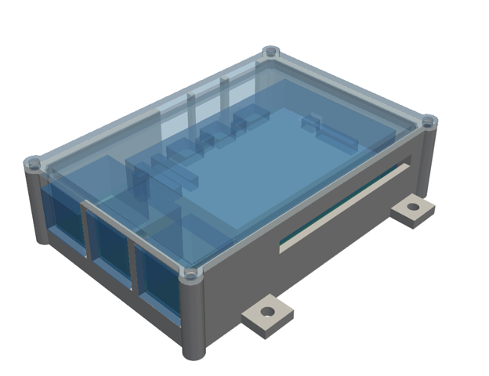
HOW THE AGENTS WORK TOGETHER
A real exchange from the log
1 · ASSEMBLY'S CHECK (v1)
board_screw_1: no stock length gives 4.0 mm engagement within 3.5 mm of post
2 · NEED: ASSEMBLY → FIT
the fix is in Fit's keys, so a need is posted: suggest standoffs/height 2.9
3 · FIT'S FIX (v3)
raise standoffs 1.5 → 2.9 mm: problems 13 → 5, fixed 8, broke 0. Accepted: no check got worse
Quoted from the run log of the print candidate (Sonnet, 4 agents). This run had no objections; the decline is how Fit argued back.
4 · COUNTER-ARGUMENT WITH NUMBERS (v5)
Fit declines a later need to lower them to 2.0 mm: it "would bring back the 0.3 mm base overlaps with microsd_socket and both cooler pin tips"
5
Notes:
This is a real exchange, quoted from the log. Assembly's check says the board screws can't grip. The fix is the standoff height, which Fit owns, so Assembly posts a need. Fit raises the standoffs from 1.5 to 2.9 mm: problems go from 13 to 5, nothing breaks, so the protocol keeps it. Later another need asks to lower them again, and Fit declines with numbers: that would bring back the overlaps it just fixed. To be accurate: this run had no formal objections; the decline is the pushback.

Slide 6
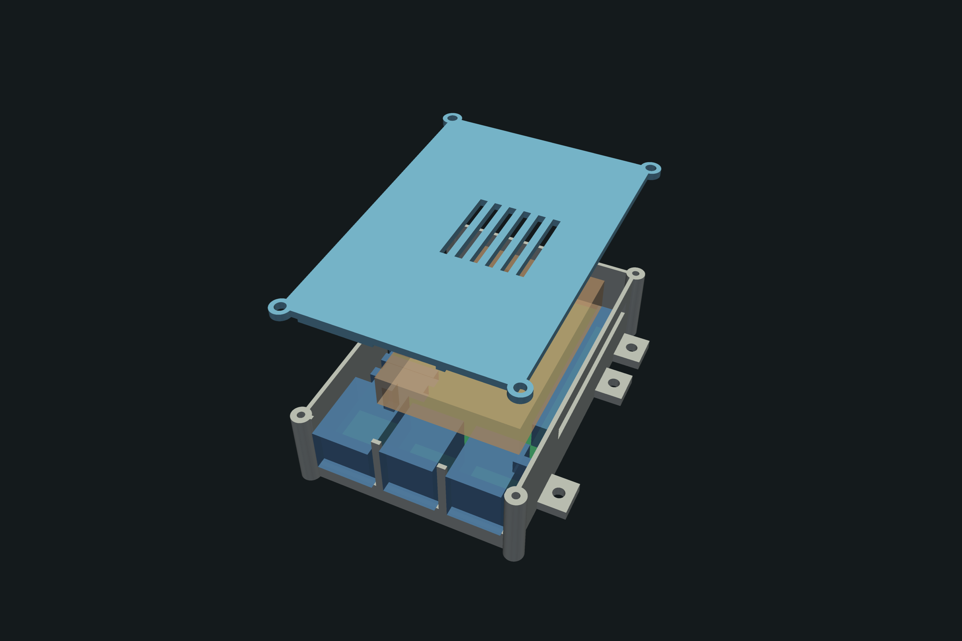
IF PRINTED: keep this slide and DELETE the next one
RESULT · IF PRINTED
Print-ready result: 0 PreForm warnings
0
23.0
61.9
PreForm warnings (print job)
min print time
ml resin incl. supports
THE CUP STORY (REAL PREFORM 3.64.2)
With PreForm's own auto-orient the final design had 1 resin-trapping cup in the base
Manufacturing's orientation tool compared 6 orientations in PreForm; flat won for both parts
Result: 0 warnings, both parts on one platform, 23.0 min, 61.9 ml
IF PRINTED: FILL IN
Say only what you tested.
[Photo of the printed case with the Pi inside here] [Checklist from results/print/ASSEMBLY.md: board drops in __ · screws grip __/4 · lid closes __ · ports fit __/7 · fan clears __]
6
Notes:
IF PRINTED version. The final design: local check failures 20 to 0. In real PreForm, with PreForm's own auto-orient, there was still one resin-trapping cup in the base, so the run itself ends as 'not all passing'. Then Manufacturing's orientation tool compared six orientations in PreForm and picked flat for both parts: zero warnings, one platform, 23.0 minutes, 61.9 ml. Then show the print and say only what you checked on the checklist.

Slide 7
IF NOT PRINTED: keep this slide and DELETE the previous one
RESULT · IF NOT PRINTED
Print-ready result: 0 PreForm warnings
0
23.0
61.9
PreForm warnings (print job)
min print time
ml resin incl. supports
THE CUP STORY (REAL PREFORM 3.64.2)
With PreForm's own auto-orient the final design had 1 resin-trapping cup in the base
Manufacturing's orientation tool compared 6 orientations in PreForm; flat won for both parts
Result: 0 warnings, both parts on one platform, 23.0 min, 61.9 ml
NOT PRINTED YET: FIT CHECKED IN GEOMETRY
Onshape: base + lid + official Pi 5 STEP in one frame; Boolean intersect = empty means no overlap
Lid 4.4 mm over the fan keep-out, 0.8 mm over the USB stack; top risk: wide USB-A plug, upper pair, 0.07 mm (use the lower pair)
7
Notes:
IF NOT PRINTED version. The final design: local check failures 20 to 0. In real PreForm, with PreForm's own auto-orient, there was still one resin-trapping cup in the base, so the run itself ends as 'not all passing'. Then Manufacturing's orientation tool compared six orientations in PreForm and picked flat for both parts: zero warnings, one platform, 23.0 minutes, 61.9 ml. We have not printed it yet. The fit is checked in geometry with the official Pi 5 model in Onshape; the one real risk is a wide USB-A plug in the upper pair.

Slide 8
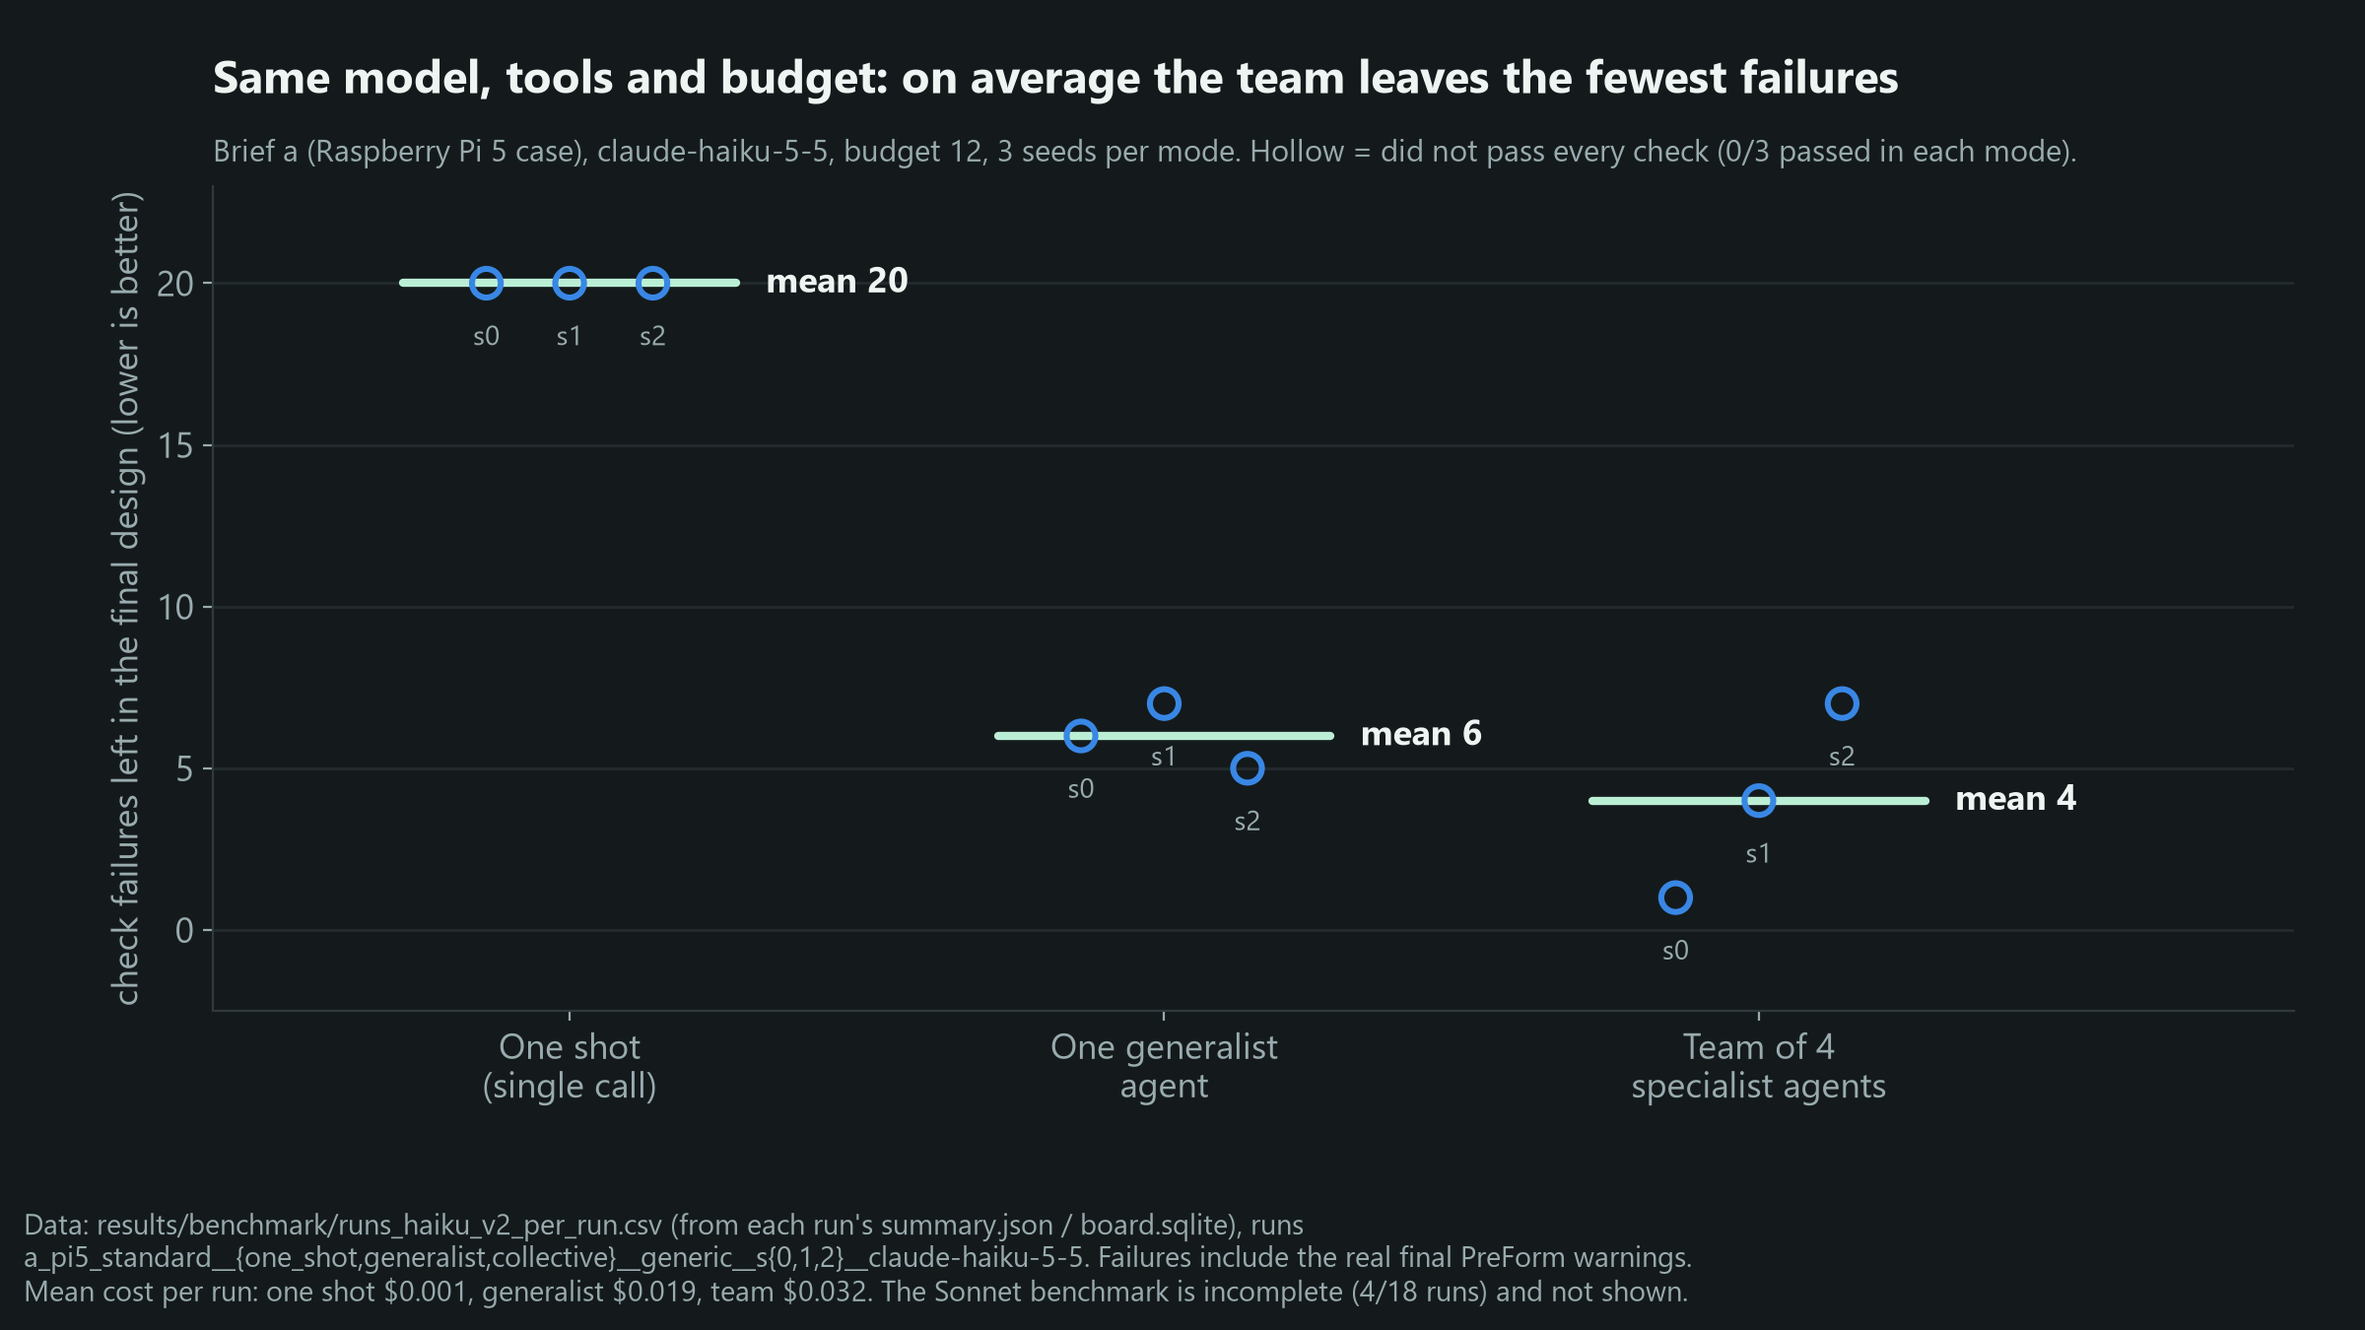
BENCHMARK · HAIKU · 3 SEEDS PER MODE
Benchmark: the team leaves the fewest failures, and no run passes
MEAN FAILURES LEFT
Team of 4: 4
One generalist: 6
One shot: 20
Passed every check: 0/3, 0/3, 0/3
Cost per run: team $0.032, generalist $0.019, one shot $0.001
Same model, tools, naive start, budget 12
Sonnet set incomplete (4/18 runs): no Sonnet claims
Only the Haiku set for brief a is complete. Failures include the real final PreForm warnings.
8
Notes:
A fair comparison: same model, Claude Haiku, same tools, same naive start, same budget, three seeds each. The one-shot model leaves 20 failures, one generalist agent 6, the team 4 on average. Honestly: none of the nine runs passed every check, the seeds vary a lot, and the team costs more per run, $0.032 vs $0.019. We have only 4 of 18 Sonnet runs, so we make no claims about Sonnet.

Slide 9
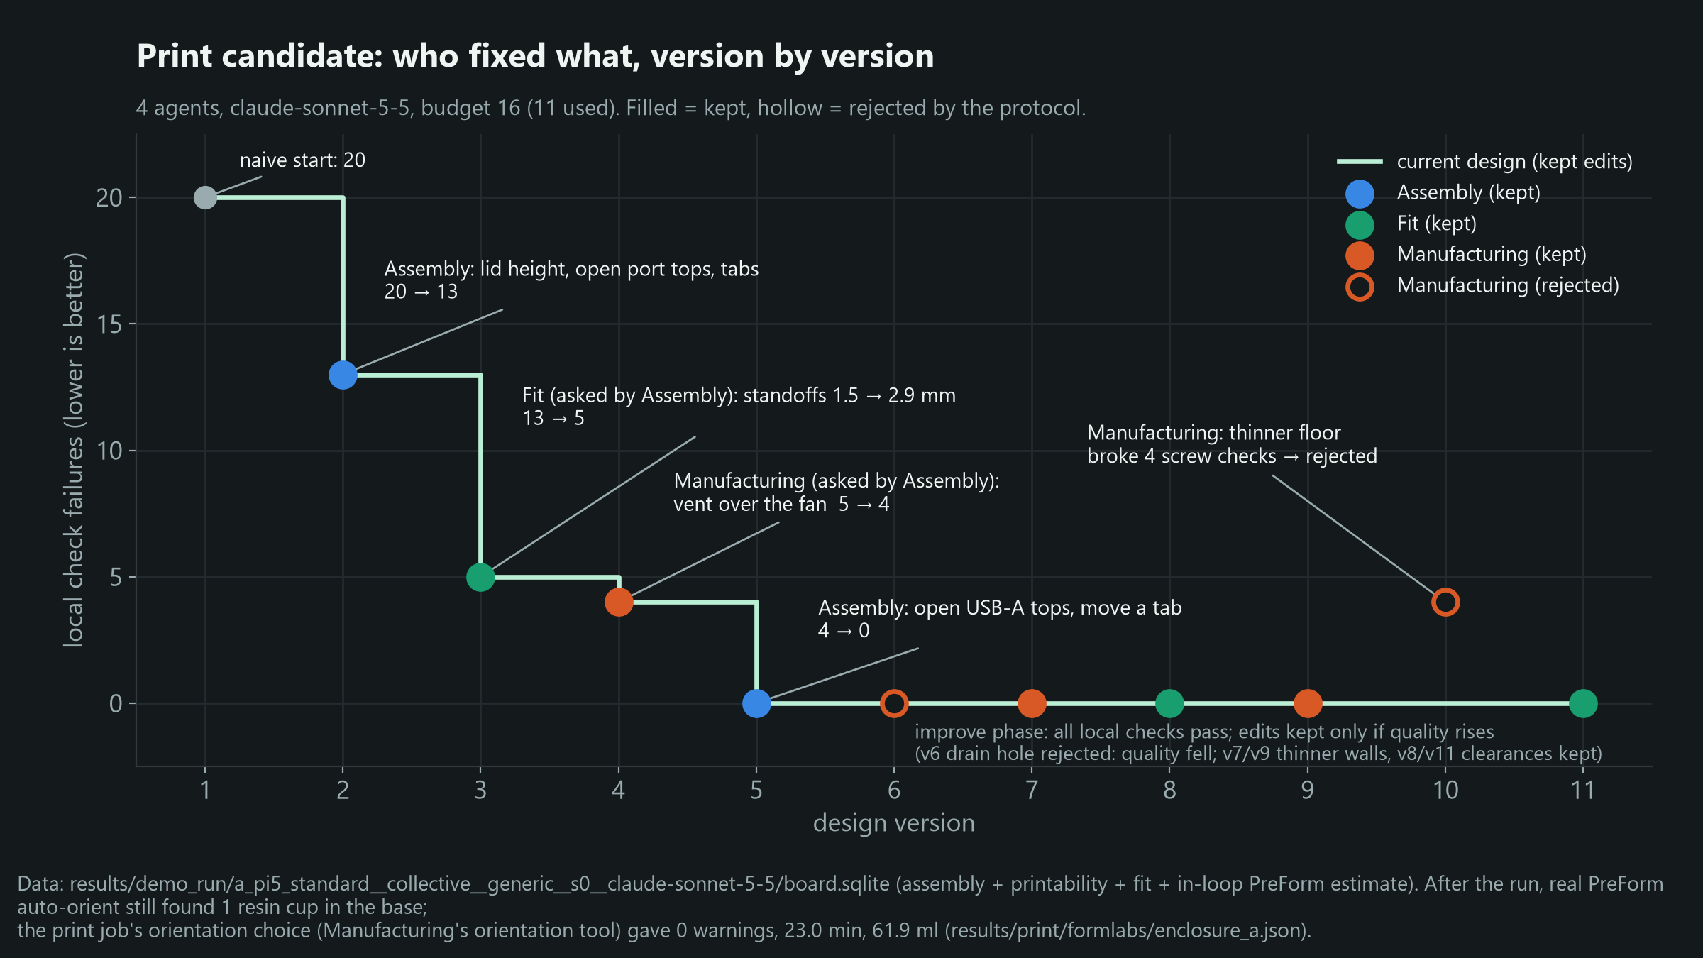
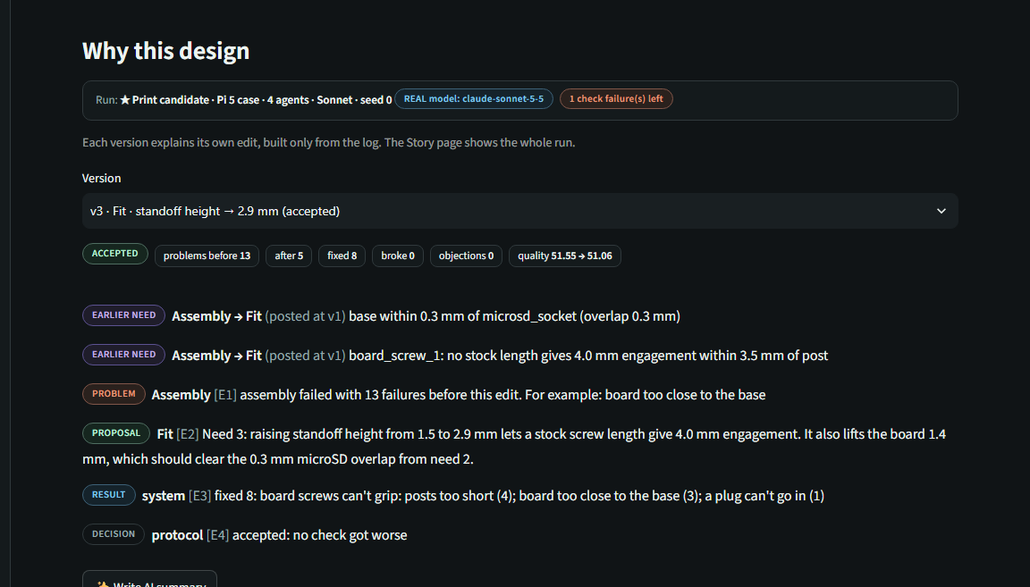
WHY THIS DESIGN
Trust: every claim traces back to the log
"Why this design" is built from the board log: failed check → need → proposal → breakdown → decision
The AI summary may not write numbers: placeholders are filled from the log, any digit it writes is removed and flagged
Charts are plain code over the logs; MOCK, UNVERIFIED and EXPERIMENTAL labels stay on everything
9
Notes:
Can you trust it? The Why-this-design view is built only from the log. The AI summary is not allowed to write numbers; code fills them in, and if the model writes a digit, it's removed and flagged. Every chart is code over the logs, and anything simulated or unmeasured stays labelled MOCK or UNVERIFIED.

Slide 10
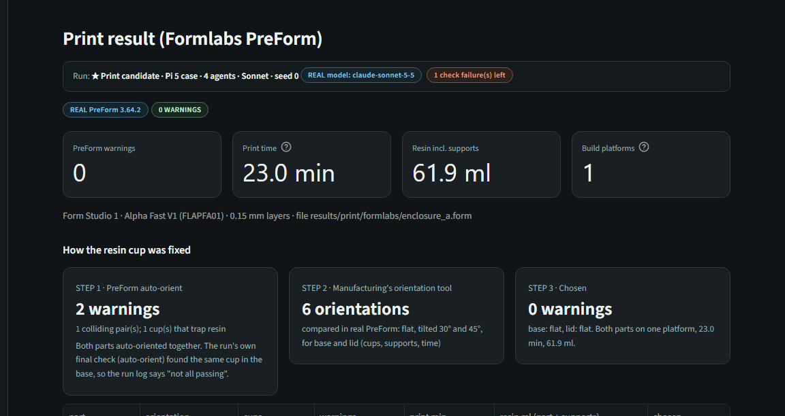
FORMLABS
Why it matters for Formlabs
PreForm in the loop: the Manufacturing agent calls the PreForm Local API (PreFormServer) and acts on real warnings (cups, supports)
Orientation tool picks the print orientation: 0 warnings, 23.0 min, 61.9 ml on one Form Studio 1 platform
Output is a .form file that prints as is (Alpha Fast V1, 0.15 mm)
Fit agent: clearances measured on a printed test plate for one printer + resin, not generic rules
Same design also as SLA STL, FDM STL (not PreForm-checked) and STEP
Every PreForm number on this slide is from results/print/formlabs/enclosure_a.json (real PreForm).
10
Notes:
Why Formlabs should care: PreForm is not the last step, it's a tool an agent uses during design. The Manufacturing agent reads real PreForm warnings and changes the design or the orientation. The output is a .form file you can print as is. And the Fit agent is built to use clearances measured on your own printer and resin, from a printed tolerance plate.

Slide 11
TEAMMATES: replace this
TEAMMATES: REPLACE THIS SLIDE
[Brackets + CalculiX simulation]
[Part designer: describe a bracket in words → parametric CAD → 3D finite elements (Gmsh + CalculiX)]
[Requirements: design load, max bend, least resin; result numbers from your logs]
[Virtual test rig vs measured bend: what was validated, what is simulated]
[Picture: stress / bend view from the Design Lab]
[Keep labels honest: simulated_pass vs physical_pass]
11
Notes:
TEAMMATES: replace this slide with the bracket part family and the CalculiX simulation. Use numbers from your logs only.

Slide 12
TEAMMATES: replace this
TEAMMATES: REPLACE THIS SLIDE
[Multi-provider agents]
[Mechanics / Fabrication / Measurement specialists on different providers (OpenAI, Claude, Gemini, NVIDIA Nemotron)]
[What a live round showed: only if it was actually run and logged]
[Onshape / Fusion / FreeCAD link and PreForm checks on your side]
[NVIDIA prize: only if the live Part Designer test really used Nemotron]
12
Notes:
TEAMMATES: replace this slide with the multi-provider agents. Only claim a live three-provider round or Nemotron use if it was logged.

Slide 13
HONEST STATUS
Limitations and next steps
NOT YET VALIDATED
NEXT
Several sizes are UNVERIFIED (plug sizes, cooler footprint and height): ruler checks in RISK_CHECK.md
Measured clearances need the tolerance test print (test plate not printed yet: guide values used)
FDM version passes our checks but was not checked by PreForm
Sonnet benchmark incomplete (4/18); no run passed every check, including real PreForm
Print the tolerance plate, fill in the fit test, rerun with measured clearances
Let the orientation tool run inside the loop so runs end with 0 PreForm warnings
Finish the benchmark (both briefs, Sonnet), compare cost per fixed failure
More part families behind the same interface (brackets from the team, free-form EXPERIMENTAL)
13
Notes:
What we have not proven yet: several part sizes come from drawings or typical plugs, not measurements. The measured clearances need the tolerance plate to be printed. The FDM version was not checked in PreForm. And the benchmark is incomplete for Sonnet. Next we print the plate, rerun with measured clearances, and finish the benchmark.

Slide 14
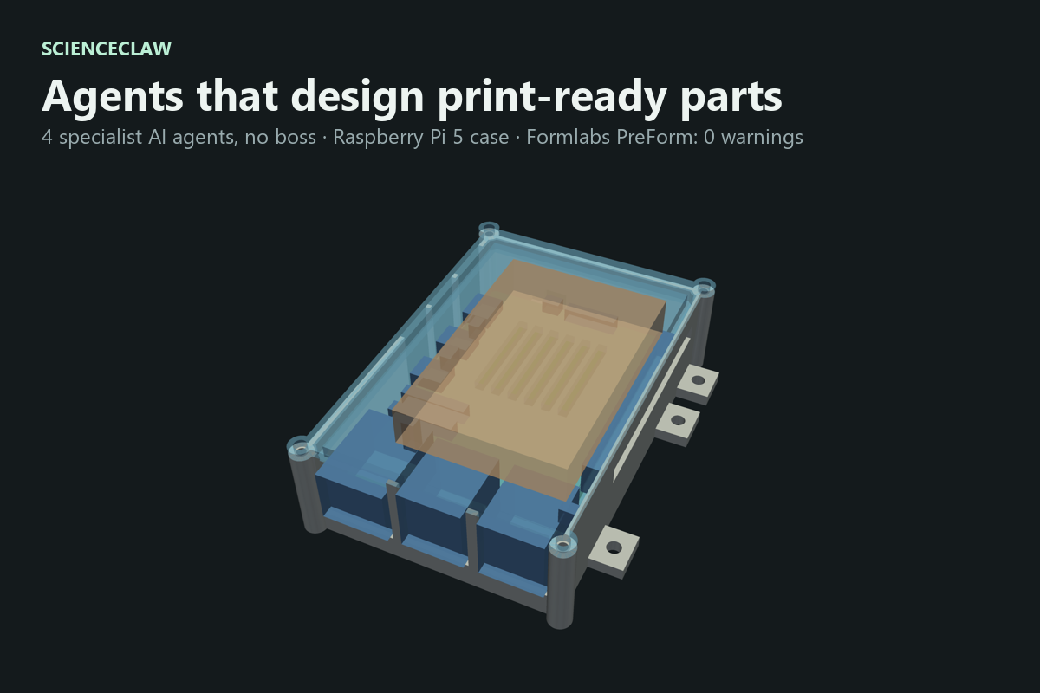
TRY IT
Links
CODE (BRANCH Mo_ver: ENCLOSURE AGENTS)
https://github.com/MishraAsh2007/ScienceClaw_Project/tree/Mo_ver
DEMO VIDEO (2:50)
https://github.com/MishraAsh2007/ScienceClaw_Project/blob/Mo_ver/results/submission/demo.mp4
RUN IT WITHOUT API KEYS
pip install -r requirements.txt
streamlit run app.py (Mock mode on by default)
[Teammates: add the Jash_ver / main links here]
14
Notes:
Everything is on GitHub, branch Mo_ver, including this deck, the demo video and the print files. You can run the app without any API key: Mock mode is on by default. Thank you.

