Slide 1
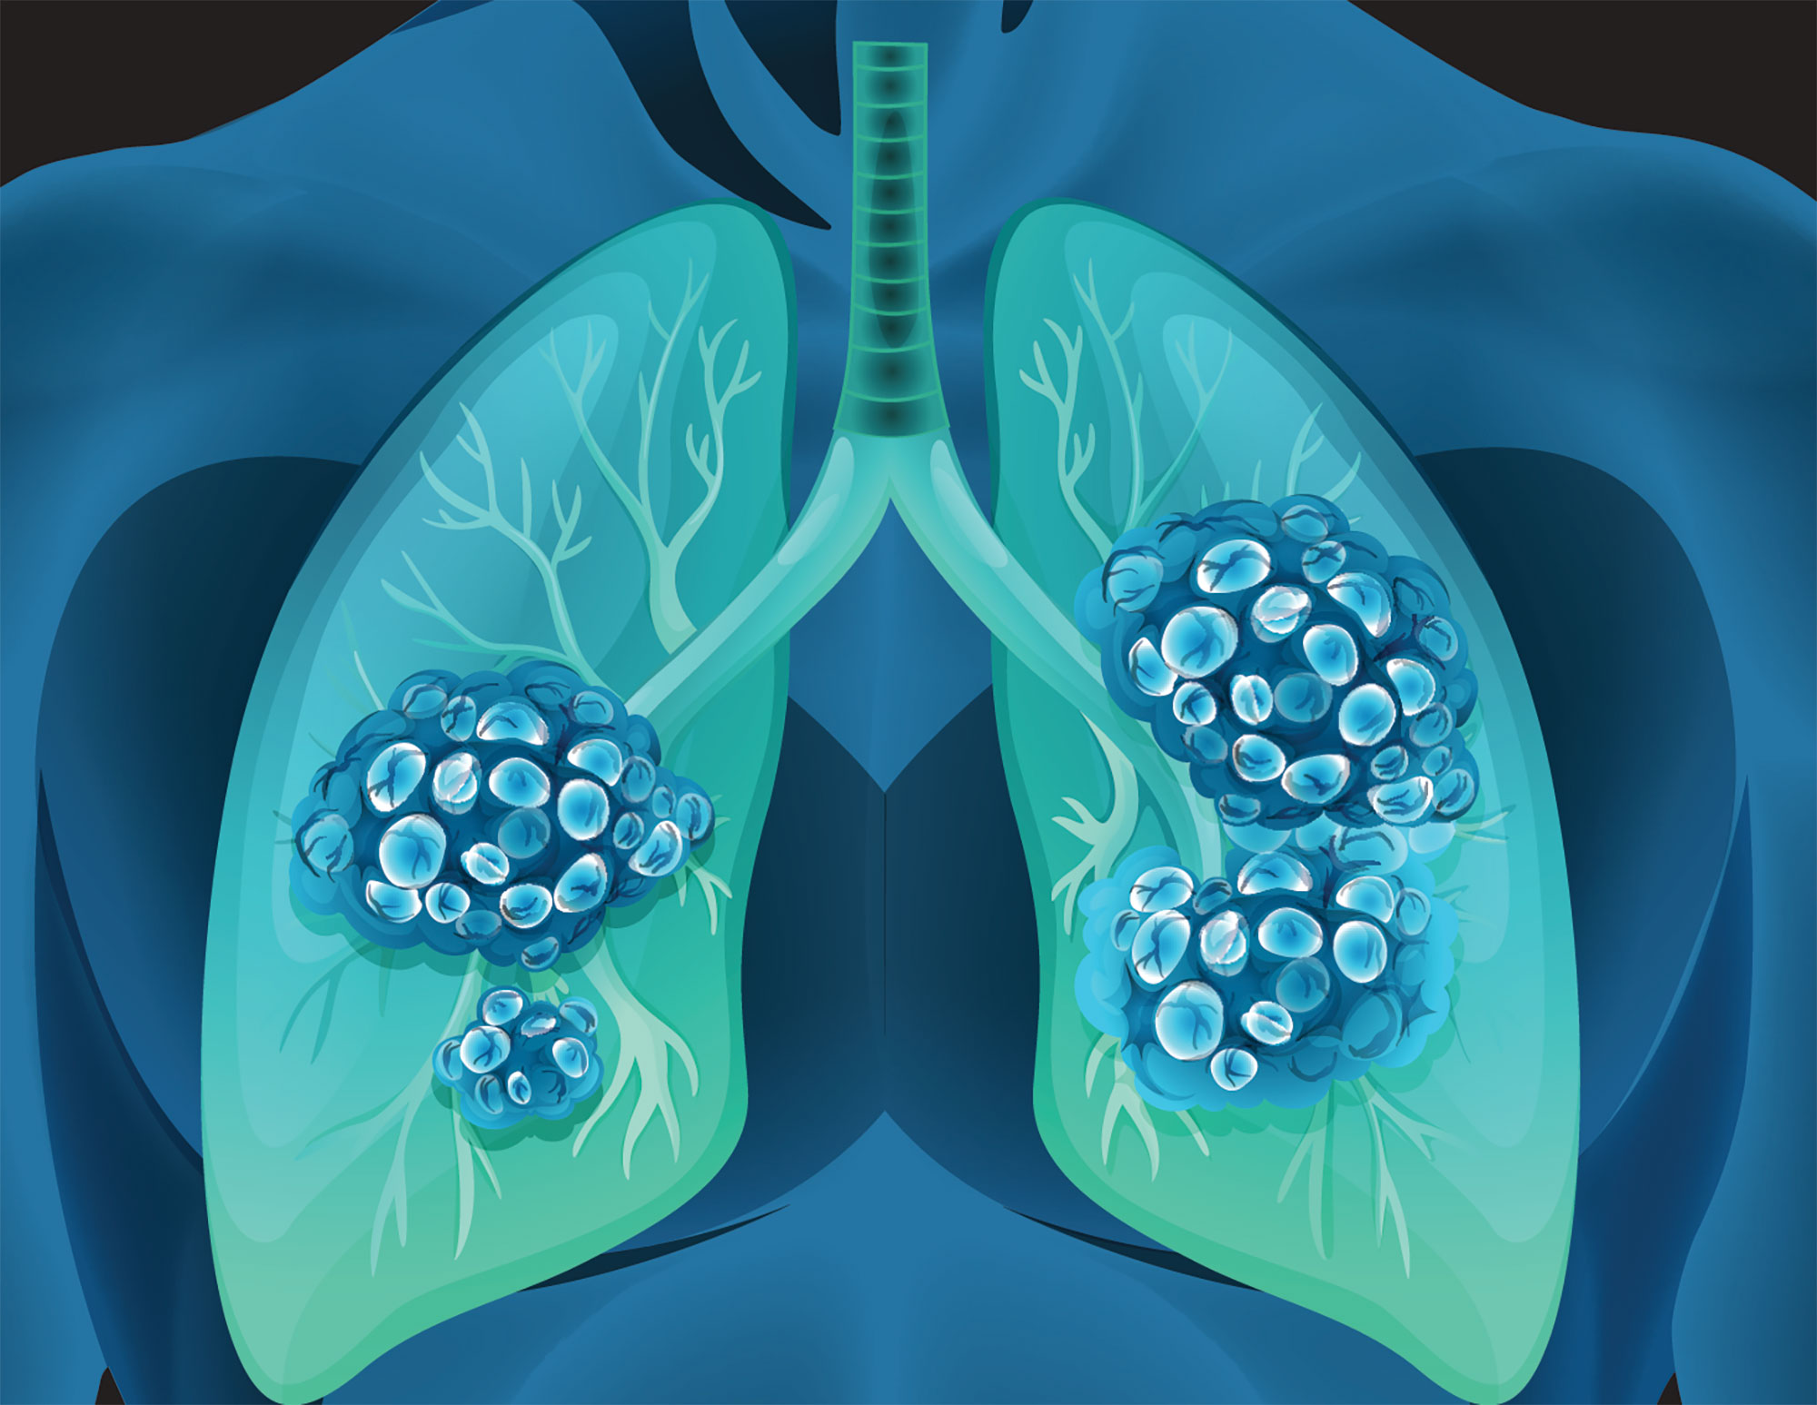
Prediction of Lung Cancer Using Machine Learning Algorithms
Student Name - Ayush Mishra
Registration number - 22MCA1028
Guide Name – Dr. Monica KM

Slide 2
Problem Statement
Lung cancer can cause complications, such as: Shortness of breath. People with lung cancer can experience shortness of breath if cancer grows to block the major airways. Lung cancer can also cause fluid to accumulate around the lungs, making it harder for the affected lung to expand fully when you inhale. The effectiveness of cancer prediction system helps the people to know their cancer risk with low cost and it also helps the people to take the appropriate decision based on their cancer risk status. The data is collected from the website online lung cancer prediction system.

Slide 3
Abstract
Lung cancer causes a cell imbalance that affects the lungs.
Lung cancer prediction is critical in the early stages, especially in densely populated and low-income nations.
Machine learning is increasingly being employed in cancer detection and diagnosis.
Lung cancer causes a cell imbalance that affects the lungs. We are testing which algorithm will give us good result among Classification And Regression Tree(CART), Support Vector Machine(SVM) .
Lung cancer is a chronic disease with the potential to cause a worldwide health care crisis.
This survey focuses on recent developments in machine learning which have made significant impacts in the detection and diagnosis of Lung cancer This also aim to propose an effective technique for earlier detection of the Lung cancer disease .
dard

Slide 4
Introduction
Lung cancer is major reason for loss of life in cancer related diseases.
Cause is unnatural progress of unwanted cells in the lungs.
People with smoking habits and past chest disease complications are at maximum risk to be diagnosed with lung cancer.
A cancer diagnosis is a key prerequisite for such socioeconomic advantages.
In progress of machine learning algorithms, huge role of lots of data and cost- effective computation .
Lung Cancer is exposure to harmful gases , air pollution and bad living conditions.

Slide 5
Motivation
Motivation
To know why young people might want to have genetic testing for lung cancer even while they are aware that the tested gene variants are just slightly more likely to cause the disease.
People are facing the problem of Lungs cancer and are not able to get proper guide and cure to rectify this diseases.
People who are suffering from lung cancer fells discomfort during pollution.
The main objective of choosing this domain is very essential by seeing all the current scenario and situation of the world in which mortality rate is rapidly every day.

Slide 6
IMPLEMENTATION

Slide 7
Literature Review Findings
Numerous research have looked into the application of machine learning to the diagnosis of lung cancer. Some of the key findings from the literature review are as follows:
According to a large number of research, good prediction depends on choosing the right characteristics from the dataset. Researchers commonly choose characteristics including gender, age, smoking, yellow finger and alcohol consuming.
The performance of the models has been assessed using performance criteria including accuracy, F1 score, and precision.
Data pre-processing , missing data has been filled with the mean of the total data of the particular column value for better prediction.
The effectiveness of machine learning models has been compared in several studies to clinical recommendations like those of the Chronic obstructive pulmonary disease (COPD). According to the findings, machine learning models can perform better in terms of accuracy and specificity than clinical standards.

Slide 8
Research Gap
Data quality: The accuracy of machine learning algorithms relies heavily on the quality and representativeness of the data used for training. If the training data is incomplete, biased, or otherwise flawed, it can lead to inaccurate predictions. In the case of lung cancer prediction, if the training data is not comprehensive or lacks diversity in terms of patients' demographics, disease stages, and other relevant factors, it may result in biased or inaccurate predictions.
Lack of interpretability: Many machine learning algorithms, such as deep learning models, are considered "black box" models, meaning that their decision-making process is not easily interpretable by humans. This can make it challenging to understand how and why a certain prediction is made, which may be a concern for clinicians and patients who want to understand the basis of a lung cancer prediction.

Slide 9
Data Dictionary
Total no. of attributes: 16
No .of instances: 309.
Numerical Dataset Values
COPD(Chronic obstructive pulmonary disease) dataset which is fetched originally from the National Institute of Cancer and Lung Diseases.

Slide 10
About the Implementation
The objective of this project is to classify whether someone has Lung Cancer or not.
Dataset consists of several Medical Variables(Independent) and one Lung Cancer Variable(Dependent).
The independent variables in this data set are :-’Gender', ‘Age', ‘Smoking', ‘Yellow_Fingers', ‘Anxiety‘ ,‘Peer_Pressure', ‘Chronic disease', 'Fatigue’,’ Allergy ’,’ Wheezing’,’ Alcohol Consuming’,’ Coughing’,’ Shortness Of Breath’,’ Swallowing Difficulty’,’ Chest Pain’,’ Lung_cancer’.
The Lung_Cancer variable value is either Yes or No indicating whether a person has Lung Cancer(Yes) or not(NO).

Slide 11
Attribute Information
GENDER : M [Male] , F [Female].
AGE : Age of patients.
SMOKING : 2 [Yes] , 1 [No].
YELLOW_FINGERS : 2 [Yes] , 1 [No].
ANXIETY : 2 [Yes] , 1 [No].
PEER_PRESSURE : 2 [Yes] , 1 [No].
CHRONIC DISEASE : 2 [Yes] , 1 [No].
FATIGUE : 2 [Yes] , 1 [No].
ALLERGY : 2 [Yes] , 1 [No].
WHEEZING : 2 [Yes] , 1 [No].
ALCOHOL CONSUMING : 2 [Yes] , 1 [No].
COUGHING : 2 [Yes] , 1 [No].
SHORTNESS OF BREATH : 2 [Yes] , 1 [No].
SWALLOWING DIFFICULTY : 2 [Yes] , 1 [No].
CHEST PAIN : 2 [Yes] , 1 [No].
LUNG_CANCER : YES [Positive] , NO [Negative].

Slide 12
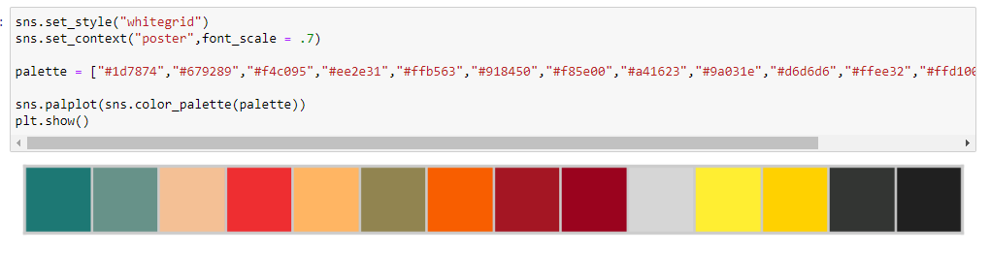
Data Visualization by Custom Palette
Attribute Information

Slide 13
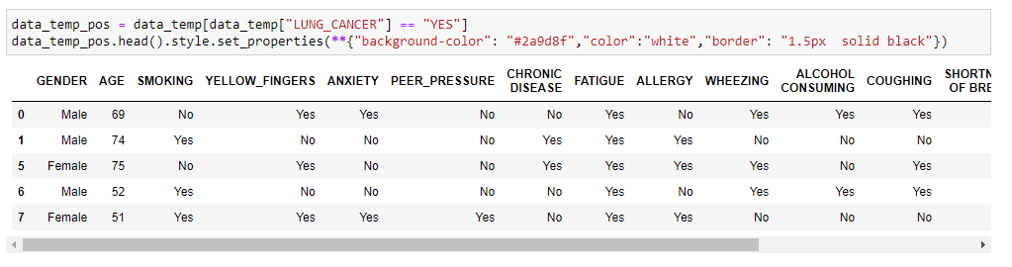
Positive Lung Cancer Cases

Slide 14
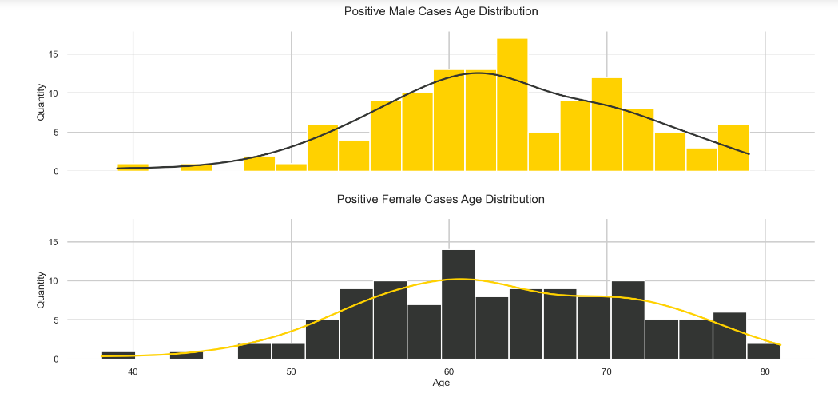
Positive Male and Female Cases Age Distribution

Slide 15
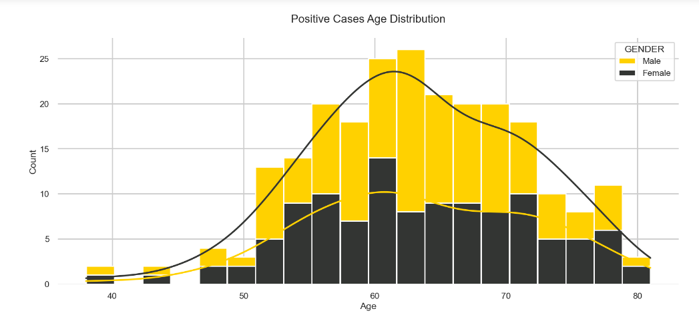
Positive Cases Age Distribution

Slide 16
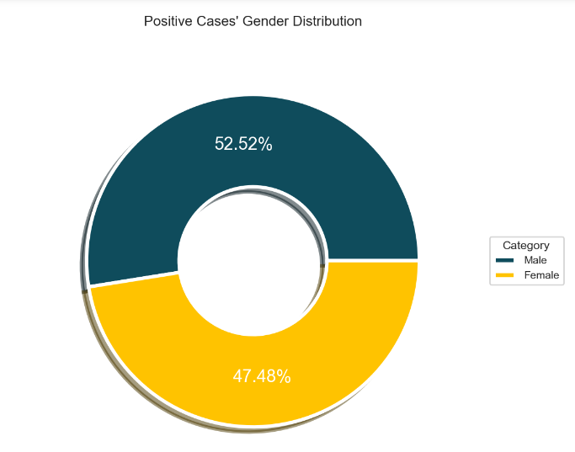
Positive Cases Gender Distribution

Slide 17
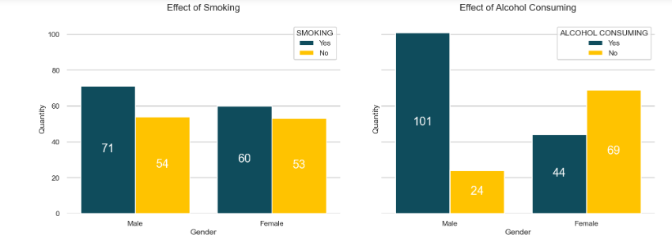
Gender-wise Positive cases reasons

Slide 18
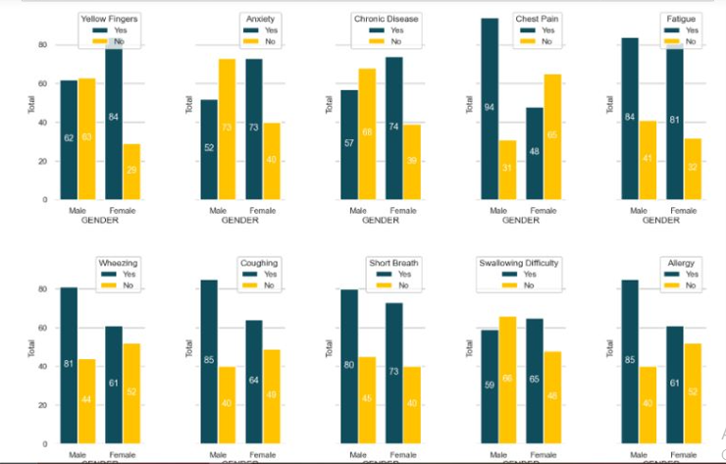
Gender-wise Positive Cases Symptoms

Slide 19
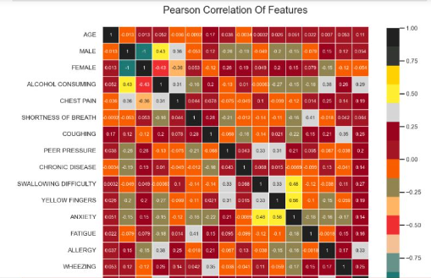
Correlation of Heat Map

Slide 20
Algorithms
6. Final Exercise - Lunar phases
Logistic Regression
Gaussian Naive Bayes
Support Vector Machine
Random Forest
K Nearest Neighbors

Slide 21
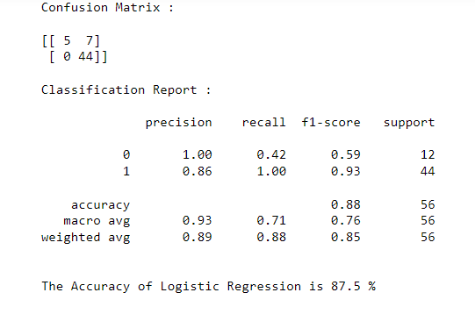
Logistic Regression
6. Final Exercise - Lunar phases
The logistic model is a statistical model that models the probability of an event taking place by having the
log-odds for the event be a linear combination of one or more independent variables. In regression analysis,
logistic regression is estimating the parameters of a logistic model.

Slide 22
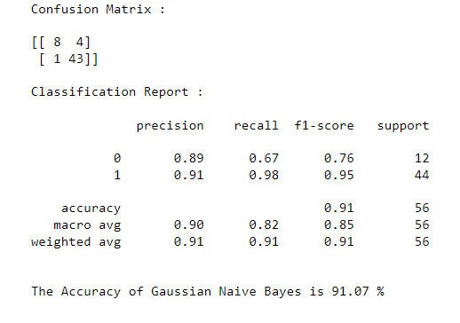
Gaussian Naïve Bayes
6. Final Exercise - Lunar phases
Gaussian Naive Bayes (GNB) is a classification technique used in Machine Learning (ML) based on the
probabilistic approach and Gaussian distribution. Gaussian Naive Bayes assumes that each parameter (also
called features or predictors) has an independent capacity of predicting the output variable. The combination
of the prediction for all parameters is the final prediction, that returns a probability of the dependent variable
to be classified in each group. The final classification is assigned to the group with the higher probability.

Slide 23
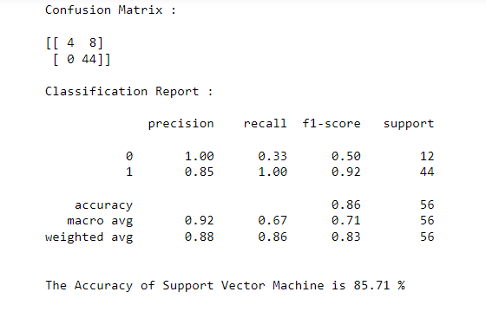
Support Vector Machine
6. Final Exercise - Lunar phases
Support vector machines (SVMs) are supervised machine learning algorithms, and they are used for
classification and regression analysis. The SVM performs both linear classification and nonlinear
classification. The nonlinear classification is performed using the Kernel function. The SVM method is
considered the best method for diagnosing coronary diseases.

Slide 24
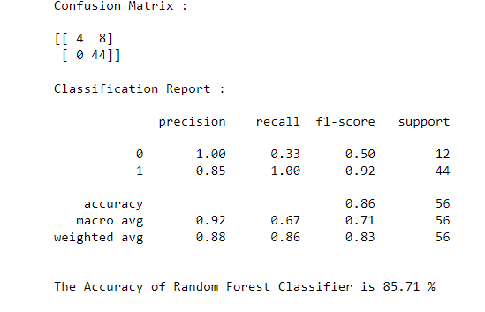
Random Forest
6. Final Exercise - Lunar phases
A Random Forest Algorithm is a supervised machine learning algorithm that is extremely popular and is used
for Classification and Regression problems in Machine Learning. We know that a forest comprises numerous
trees, and the more trees more it will be robust. Similarly, the greater the number of trees in a Random Forest
Algorithm, the higher its accuracy and problem-solving ability. Random Forest is a classifier that contains
several decision trees on various subsets of the given dataset and takes the average to improve the predictive
accuracy of that dataset.

Slide 25
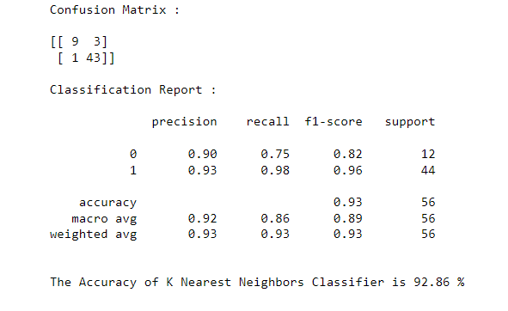
K-Nearest Neighbors
6. Final Exercise - Lunar phases
KNN is one of the simplest forms of machine learning algorithms mostly used for classification. It classifies
the data point on how its neighbor is classified. Image by Aditya. KNN classifies the new data points based
on the similarity measure of the earlier stored data points.

Slide 26
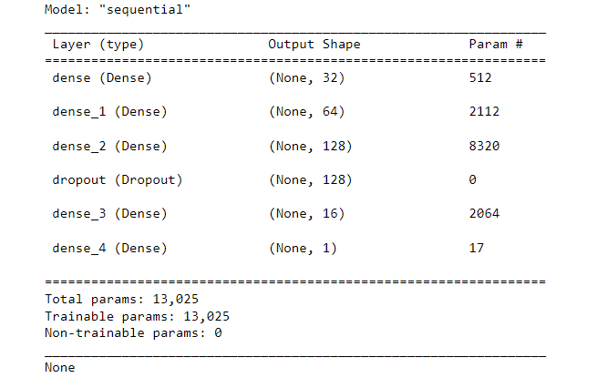
Neural Network Architecture
6. Final Exercise - Lunar phases

Slide 27
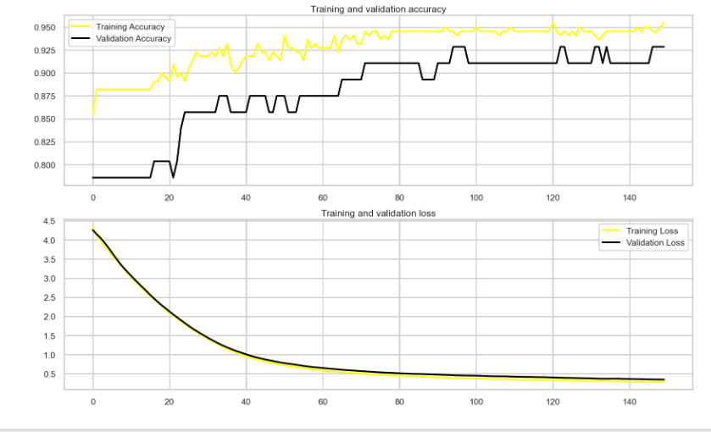
Training and Validation Accuracy
6. Final Exercise - Lunar phases

Slide 28
References
6. Final Exercise - Lunar phases
[1] Raoof, Syed Saba, M. A. Jabbar, and Syed Aley Fathima. "Lung Cancer prediction using machine learning: A comprehensive approach." In 2020 2nd International conference on innovative mechanisms for industry applications (ICIMIA), pp. 108-115. IEEE, 2020.
[2] Bharati, Subrato, Mohammad Atikur Rahman, and Prajoy Podder. "Breast cancer prediction applying different classification algorithm with comparative analysis using WEKA." In 2018 4th International Conference on Electrical Engineering and Information & Communication Technology (iCEEiCT), pp. 581-584. IEEE, 2018.
[3] Wang, Xi, Hao Chen, Caixia Gan, Huangjing Lin, Qi Dou, Efstratios Tsougenis, Qitao Huang, Muyan Cai, and Pheng-Ann Heng. "Weakly supervised deep learning for whole slide lung cancer image analysis." IEEE transactions on cybernetics 50, no. 9 (2019): 3950-3962.
[4] Thallam, Chinmayi, Aarsha Peruboyina, Sagi Sai Tejasvi Raju, and Nalini Sampath. "Early stage lung cancer prediction using various machine learning techniques." In 2020 4th International Conference on Electronics, Communication and Aerospace Technology (ICECA), pp. 1285-1292. IEEE, 2020.
[5] Faisal, Muhammad Imran, Saba Bashir, Zain Sikandar Khan, and Farhan Hassan Khan. "An evaluation of machine learning classifiers and ensembles for early stage prediction of lung cancer." In 2018 3rd international conference on emerging trends in engineering, sciences and technology (ICEEST), pp. 1-4. IEEE, 2018.

Slide 29
References
6. Final Exercise - Lunar phases
[6] Saji, Ganga V., Thasneem Vazim, and Sumod Sundar. "Deep Learning Methods for Lung Cancer Detection, Classification and Prediction-A Review." In 2021 Fourth International Conference on Microelectronics, Signals & Systems (ICMSS), pp. 1-5. IEEE, 2021.
[7] Rawat, Deepak. "Validating and Strengthen the Prediction Performance Using Machine Learning Models and Operational Research for Lung Cancer." In 2022 IEEE International Conference on Data Science and Information System (ICDSIS), pp. 1-5. IEEE, 2022.
[8] Khalsan, Mahmood, Lee R. Machado, Eman Salih Al-Shamery, Suraj Ajit, Karen Anthony, Mu Mu, and Michael Opoku Agyeman. "A survey of machine learning approaches applied to gene expression analysis for cancer prediction." IEEE Access 10 (2022): 27522-27534.
[9] Dang, Anh. "Cancer Prediction using Machine Learning Algorithms.“
[10] Lung Cancer Survival Prediction Using Supervised Machine-learning Classification Techniques, International Journal of Medical Informatics, JL. Patel and R. Sharpe 108, 1-8.
[11] Radhika, P. R., Rakhi AS Nair, and G. Veena. "A comparative study of lung cancer detection using machine learning algorithms." In 2019 IEEE International Conference on Electrical, Computer and Communication Technologies (ICECCT), pp. 1-4. IEEE, 2019.

Slide 30
References
6. Final Exercise - Lunar phases
[12] Nagarajan, Dr A., and J. Vasanth Wason. "Machine learning approach to predict lung cancer using CT scan images." International Journal of Advanced Trends in Computer Science and Engineering 8, no. 6 (2019): 2974-2976.
[13] Kavethanjali, V., S. Preethi, and V. Vasanthapriya. "Lung–Pleura Carcinoma Detection Using Machine Learning." In 2021 3rd International Conference on Signal Processing and Communication (ICPSC), pp. 294-298. IEEE, 2021.
[14] Ingle, Kshitija, Uttam Chaskar, and Shashikant Rathod. "Lung Cancer Types Prediction Using Machine Learning Approach." In 2021 IEEE International Conference on Electronics, Computing and Communication Technologies (CONECCT), pp. 01-06. IEEE, 2021.
[15] Kadir, Timor, and Fergus Gleeson. "Lung cancer prediction using machine learning and advanced imaging techniques." Translational lung cancer research 7, no. 3 (2018): 304

Slide 31

Thank You
6. Final Exercise - Lunar phases

