Slide 1

CAPSTONE PROJECT PROJECT TITLE
Presented By
Student Name: Nehal Mishra
College Name: acropolis institute of technology and research
Department: CSE(AI & ML)
Email ID: nehalmishra2005@gmail.com
AICTE Student ID: STU67187e6da20171729658477

Slide 2
OUTLINE
Problem Statement (Should not include solution)
Proposed System/Solution
System Development Approach (Technology Used)
Algorithm & Deployment
Result (Output Image)
Conclusion
Future Scope
References

Slide 3
Problem Statement
In many modern cities, rental bike services have been introduced as a smart and eco-friendly way to improve transportation. People can rent bikes for short trips, saving money and reducing traffic congestion. These services are very useful, especially in urban areas where public transport might be crowded or delayed.
However, one of the biggest challenges in managing a bike rental system is making sure that bikes are available when and where people need them. If there are too few bikes at a location during busy hours, users will have to wait, which leads to frustration and reduces trust in the service. On the other hand, having too many bikes sitting unused is also inefficient.
To avoid both of these problems, the system needs to predict how many bikes will be needed at each hour of the day, in advance. This way, the bike supply can be adjusted before demand peaks — such as during morning office rush or evening travel times.

Slide 4
Proposed Solution
This project aims to solve the real-world problem of managing the availability of rental bikes in urban areas. With bike-sharing services becoming more common, it’s important to make sure that bikes are available when and where people need them. One of the key challenges is predicting how many bikes will be needed each hour of the day.
To address this, the system uses historical data and machine learning to identify patterns in bike rentals and forecast future demand. This helps reduce waiting times, prevents shortages, and makes the overall system more efficient and reliable.
1. Data Collection
The project uses the hour.csv file from the UCI Bike Sharing Dataset.
The dataset includes hourly rental records with features like time, date, season, weather, temperature, and total rentals.
Future improvements could include real-time data like weather APIs, holiday schedules, or event calendars.
2. Data Preprocessing
The data was cleaned to remove inconsistencies and handle missing values.
Features were selected and prepared for time-series analysis.
The main focus was on the cnt column, which represents total hourly bike rentals.
3. Machine Learning Model
The ARIMA (AutoRegressive Integrated Moving Average) model was used for forecasting.
It is well-suited for univariate time-series prediction based on historical trends.
Model parameters were tuned and the final model was saved as arima bike model.pkl.
4. Deployment
A user-friendly web application was built using Flask to allow real-time predictions.
The application is hosted on Render, a cloud-based platform.
Users can access the live app here: https://bike-demand-arima.onrender.com
5. Evaluation
The model was evaluated using MAE (Mean Absolute Error) and RMSE (Root Mean Squared Error).
Based on performance, the model was fine-tuned to improve prediction accuracy.
Future improvements may include testing more advanced models like LSTM or SARIMA.
Result:
The system successfully predicts hourly bike demand using historical rental data. The model is lightweight and accurate, and the deployment makes it easily accessible for real-time use. This solution can support city planning and improve the efficiency of bike-sharing services.

Slide 5
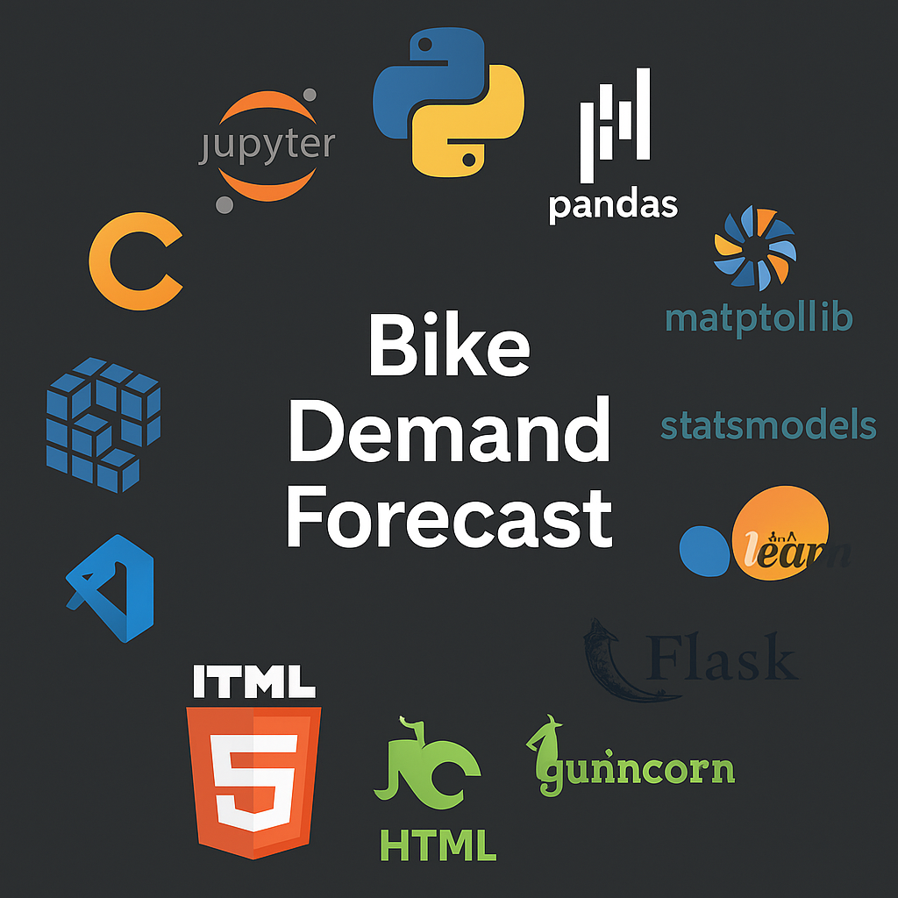
System Approach
1. System Requirements
Operating System: Windows 10/11 or Ubuntu
Python Version: 3.8 or higher
Editor: Visual Studio Code, Jupyter Notebook, or Google Colab
Browser: Chrome or Edge
Hosting Platform: Render (for web deployment)
2. Required Libraries
pandas – Data manipulation
numpy – Numerical operations
matplotlib, seaborn – Visualization
statsmodels – ARIMA model and time-series forecasting
scikit-learn – Evaluation (MAE, RMSE)
joblib – Saving/loading the model
flask – Web application framework
gunicorn – Server for deployment on Render
3. Installation All required libraries can be installed using:
pip install -r requirements.txt
Or individually:
pip install flask pandas numpy statsmodels matplotlib seaborn scikit-learn joblib gunicorn

Slide 6
Algorithm & Deployment
1. Algorithm Selection The ARIMA (AutoRegressive Integrated Moving Average) model was selected for this project as it is well-suited for univariate time-series forecasting problems. Since the goal is to predict hourly bike rental counts based on historical usage, ARIMA is an appropriate choice due to its ability to capture trends and seasonality in time-dependent data.
2. Data Input The model uses historical bike rental data from the hour.csv file, specifically focusing on the cnt column, which records the total number of rentals each hour. For simplicity and effectiveness, only this target variable was used, making the model univariate. However, the dataset also includes additional features such as time, weather, and season, which can be integrated in future improvements using multivariate models.
3. Training Process The ARIMA model was trained using the historical rental counts. The data was first made stationary through differencing, and then the model parameters (p, d, q) were chosen based on AIC scores and residual analysis. The model was trained using the statsmodels library in Python, and the best-fitting configuration was saved using joblib for later deployment.
4. Prediction Process After training, the model is used to forecast bike rental demand for the next hour. When the user clicks the "Predict" button on the web interface, the application loads the saved ARIMA model and generates a prediction based on the most recent data. In future versions, real-time data such as weather or special events can be incorporated to refine the predictions.

Slide 7
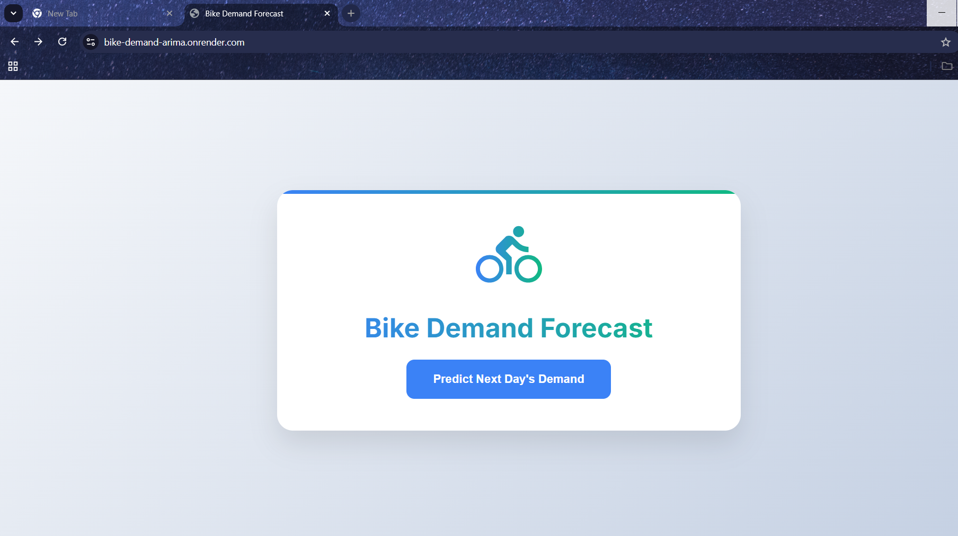
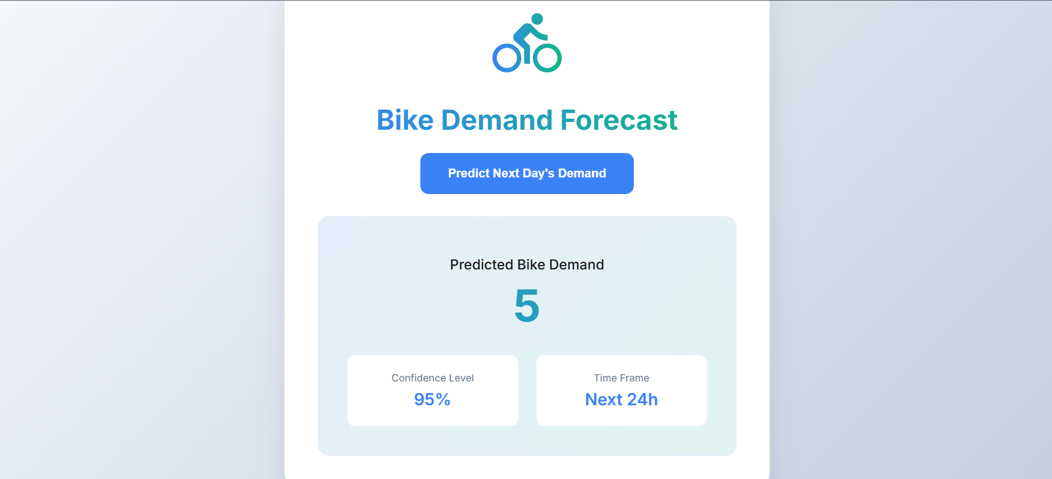
Result
BIKE DEMAND FORECAST UI
On clicking ‘Predict Next Day’s Demand’ button you get the Prediction

Slide 8
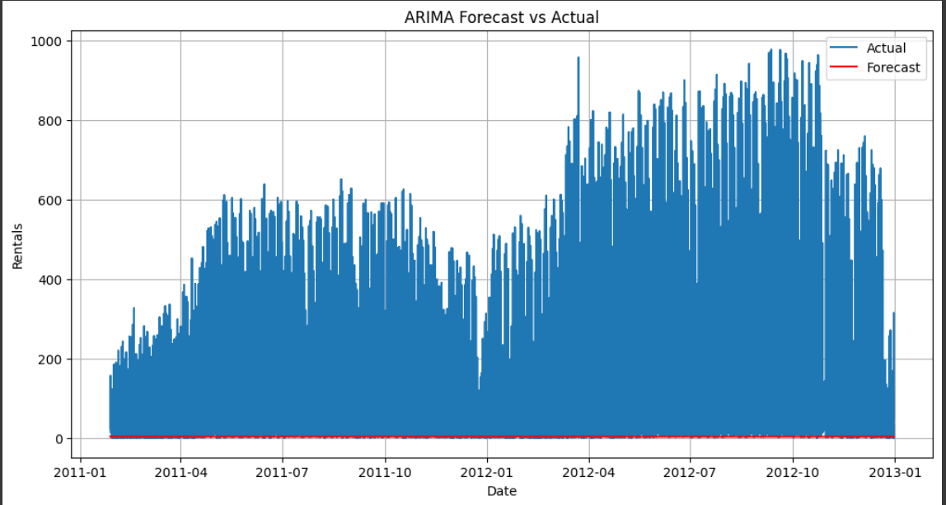

Slide 9
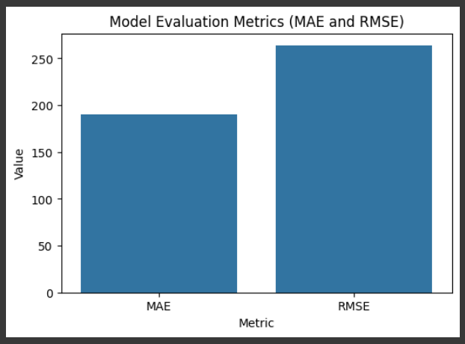

Slide 10
Conclusion
The ARIMA-based prediction model successfully forecasts hourly bike demand using historical rental data. The results show that the model captures key trends with reasonable accuracy, supporting better planning for bike availability in urban areas.
Challenges Faced:
Making the data stationary for ARIMA.
Tuning model parameters for best performance.
Limited to univariate input (only bike count used).
Future Improvements:
Include weather and event data (multivariate models).
Add real-time data for live predictions.
Improve user interface with interactive features.
Why It Matters: Accurate bike demand prediction ensures a steady supply, reduces waiting time, and helps cities run bike-sharing systems more efficiently.

Slide 11
Future scope
Integrate real-time data such as weather, holidays, and public events to improve accuracy.
Upgrade to advanced models like SARIMA, Prophet, or LSTM for handling complex trends.
Expand support to multiple cities or regions with location-specific models.
Develop an interactive dashboard for live monitoring and visualizations.
Explore edge computing for faster, on-site predictions and reduced latency.
Incorporate user feedback to continuously refine prediction accuracy.

Slide 12
References
References
UCI Machine Learning Repository – Bike Sharing Dataset (hour.csv) (Fanaee-T, Hadi; Gama, João)
Hyndman, R.J., & Athanasopoulos, G. (2018). Forecasting: Principles and Practice. https://otexts.com/fpp3/
Box, G. E. P., Jenkins, G. M., & Reinsel, G. C. (2015). Time Series Analysis: Forecasting and Control. Wiley.
Statsmodels Library Documentation – https://www.statsmodels.org/stable/index.html
Scikit-learn Documentation –
https://scikit-learn.org/
Article: “Understanding ARIMA Model in Python” – Analytics Vidhya https://www.analyticsvidhya.com/blog/2018/08/auto-arima-time-series-forecasting-python/
GitHub Repository
GitHub Link: https://github.com/MishraNehal/BikeDemand_ARIMA_Project

Slide 13
Thank you

