Slide 1
DATA DETECTIVE CHALLENGE
Road Accident & Traffic Safety Analytics
Innovative Self-Learning Activity
Shri Ramdeobaba College of Engineering and Management, Nagpur
B.Tech. Cyber Security | Semester VII | Session 2026–27
CCP7005 – Data Visualization Techniques
GROUP 1
1 – Arya Bhangadia | 18 – Harshvardhan Tendulka
36 – Mishthi Jain | 54 – Shreya Mishra
Objective: compare state-level fatal-collision patterns and study their relationship with driver behaviour and insurance variables.

Slide 2
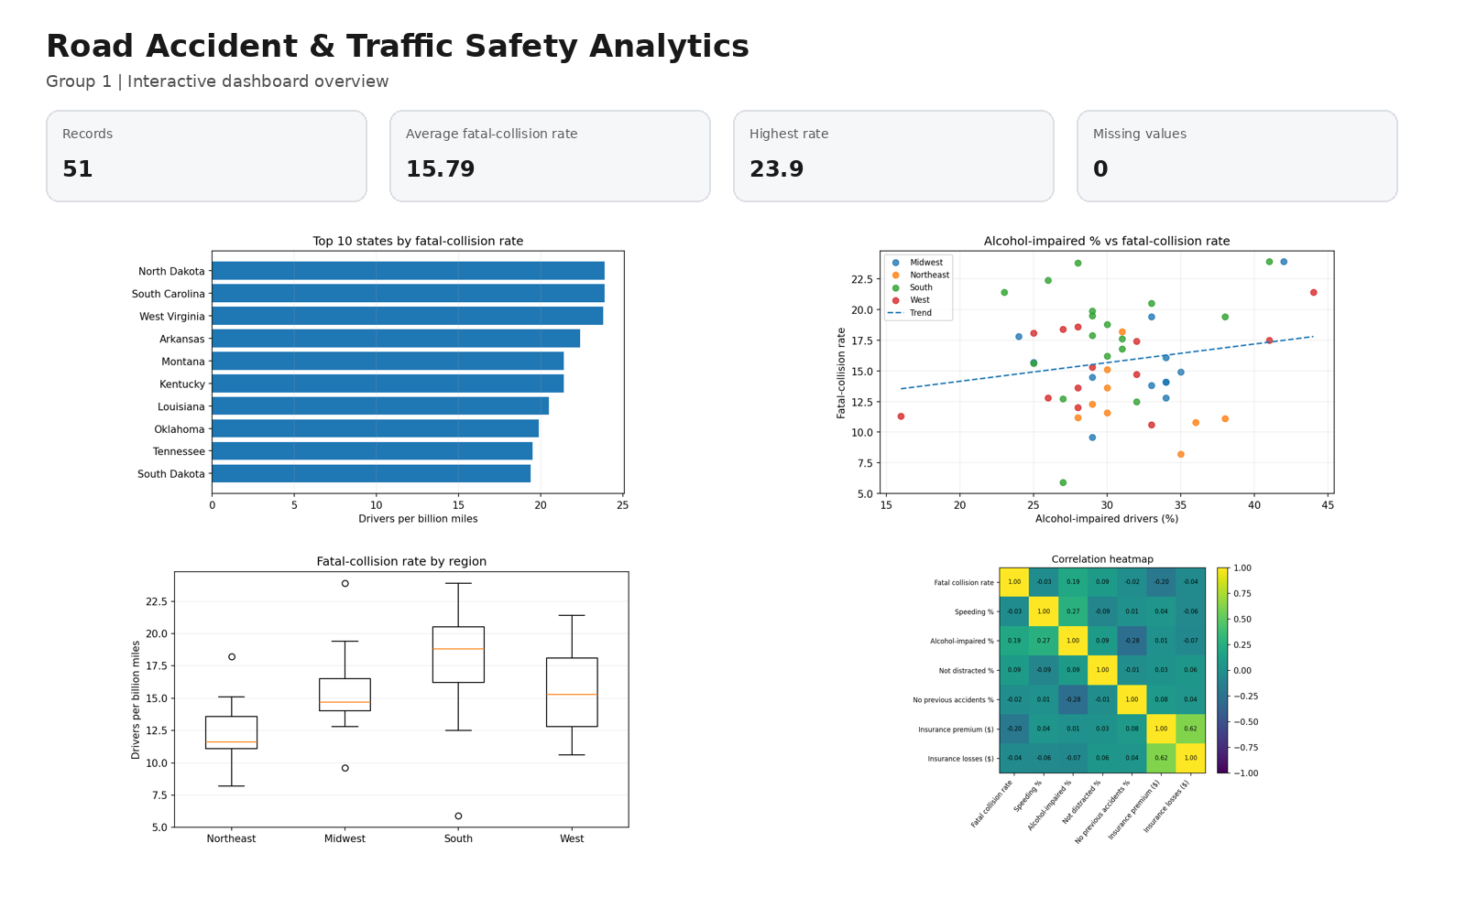
Dataset & Interactive Dashboard
FiveThirtyEight bad-drivers dataset | 51 state/DC records | 8 original attributes | no missing or duplicate rows
Records
Average rate
Highest rate
Missing values
Source:
51
15.79
23.9
0
FiveThirtyEight
Dashboard features
• Region, rate-range and state filters
• Four KPI cards
• Choropleth map
• Top-state bar chart
• Alcohol scatter plot
• Regional box plot
• Correlation heatmap
• Wrong visualization + AI critique
Built using Streamlit + Plotly

Slide 3
Questions Analysed & Main Findings
The focus is on insights and correct visualization choice, not on Python code.
Five analytical questions
Five major findings
Q1. How does the fatal-collision rate vary geographically? → Choropleth map
1. North Dakota and South Carolina have the highest rate: 23.9.
Q2. Which states have the highest fatal-collision rates? → Sorted bar chart
2. District of Columbia has the lowest rate: 5.9.
Q3. Is alcohol impairment related to the fatal-collision rate? → Scatter plot
3. Alcohol-impaired % has a weak positive relationship with the total rate (r ≈ 0.19).
4. Speeding % has almost no linear relationship with the total rate (r ≈ -0.03).
Q4. How do fatal-collision rates differ across regions? → Box plot
5. Insurance cost does not directly follow the fatal-collision ranking.
Q5. Which numerical variables move together? → Correlation heatmap
Bar chart (correct) vs pie chart of rates (misleading because rates are not parts of one whole).
3 recommendations
Prioritize high-rate states • use multiple risk factors • add road/weather/time data in future work
Wrong visualization challenge

