Slide 1
Cross-Attention Fusion of 3D MRI and Visual Evoked Potentials
Detecting and classifying vision defects: design and verification on synthetic data
Mishthi Jain
64 spatial tokens · 3D MRI
School of Computer Science and Engineering, VIT Chennai · BCSE497J project
Reg. No. [register number] Guide: [guide name, designation]
16 temporal tokens · 1D VEP
Notes:
Good morning. This is the NeuroImaging project: CAFN, a cross-attention fusion network that combines a 3D structural MRI volume with a 1D visual evoked potential to classify three conditions, healthy, glaucoma and optic neuritis or cortical visual impairment. The picture on the right is the whole idea in one frame: the MRI becomes 64 spatial tokens, the VEP becomes 16 temporal tokens, and the network lets the spatial tokens ask the temporal tokens what is relevant to them. One important framing point up front: there is no public paired MRI plus VEP dataset with diagnosis labels, so the project is developed and verified on synthetic data and I make no diagnostic accuracy claim.

Slide 2

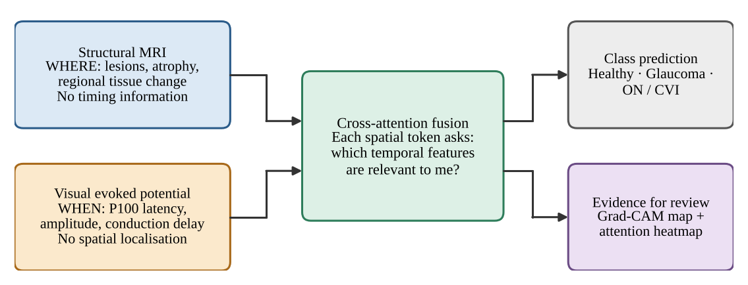

MRI shows where, VEP shows when
64.3 M
people estimated to live with glaucoma worldwide in 2013 (ages 40–80, prevalence 3.54%)
Our question
Can each spatial region of the brain scan ask which temporal features of the evoked-potential waveform are relevant to it?
Notes:
Disorders of the visual pathway, such as glaucoma, optic neuritis and cortical visual impairment, can be seen in two ways. Structural MRI tells us where: atrophy, lesions, regional change, but it carries no timing information. The visual evoked potential tells us when: P100 latency and amplitude reflect conduction along the pathway, but it has no spatial localisation. Glaucoma alone was estimated at about 64.3 million people in 2013, so a tool that uses both signals is worth exploring. The question this project asks is whether a network can let each spatial token query the temporal tokens, which is exactly what cross-attention does.

Slide 3




Four obstacles, four answers
Unimodal isolation
Cross-modal heterogeneity
Answer
Answer
One network, two streams: a 3D CNN for MRI and a 1D CNN for VEP, trained with a fused head.
Cross-attention: spatial tokens are queries, temporal tokens are keys and values.
Limited interpretability
No paired public dataset
Answer
Answer
3D Grad-CAM and an attention heatmap, used as inspection aids rather than explanations.
A class-conditioned synthetic generator with the same file interface as real data.
Notes:
There are four obstacles. First, most pipelines analyse either imaging or electrophysiology, not both. Second, a volume and a waveform differ in dimensionality, sampling and noise, so naive concatenation gives every feature the same standing. Third, black-box classifiers are hard to trust clinically. Fourth, there is no public dataset with paired MRI, VEP and diagnosis. CAFN answers the first three with an architecture, and the fourth with a synthetic data generator that exposes the same NIfTI and CSV interface as real data, so the complete path from files to an optimiser step can be tested before a cohort exists.

Slide 4



Three classes, three signatures
Healthy Control
Glaucoma
Optic Neuritis / CVI
100 ms
108 ms
140 ms
P100 latency
P100 latency
P100 latency
No volume change in the MRI block; strong P100 (amplitude 6.0).
Atrophy proxy: an octant block of the volume scaled ×0.4; P100 amplitude 2.5.
Lesion proxy: a block scaled ×1.8; delayed P100, amplitude 4.0.
Values are the synthetic generator's settings, chosen to follow the clinical pattern of delayed P100 in optic neuritis; they are not measurements from patients.
Notes:
The three target classes are healthy control, glaucoma, and optic neuritis or cortical visual impairment. In the synthetic generator each class has a signature in both modalities. The VEP is a sum of N75, P100 and N145 Gaussians, with P100 at 100, 108 and 140 milliseconds respectively. In the MRI, glaucoma gets an atrophy proxy, an octant block scaled down to 0.4, and optic neuritis gets a lesion proxy scaled up to 1.8. To be clear, these are generator settings that follow the clinical pattern, in particular delayed P100 in optic neuritis; they are not patient measurements.

Slide 5
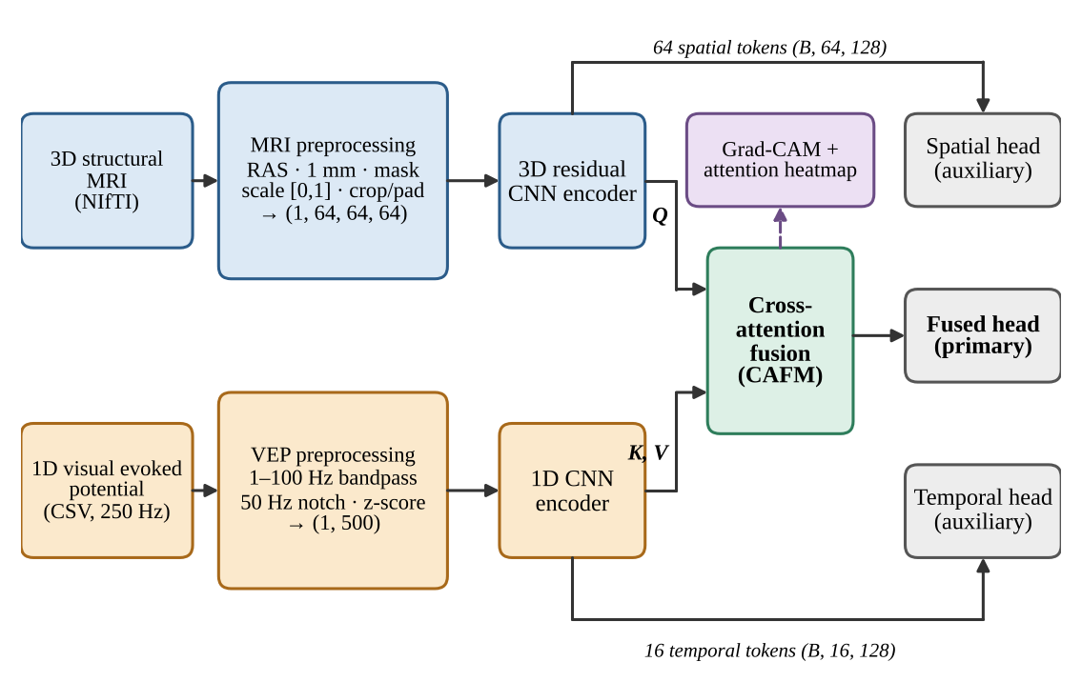


Two streams, one fusion module
Queries
64 spatial tokens from the 3D residual CNN
Keys and values
16 temporal tokens from the 1D CNN
Three heads
Fused (primary) plus two auxiliary unimodal heads
Notes:
Here is the end-to-end data flow. The MRI goes through preprocessing and a 3D residual CNN, giving 64 spatial tokens of dimension 128. The VEP goes through conditioning and a 1D CNN, giving 16 temporal tokens. The cross-attention fusion module takes the spatial tokens as queries and the temporal tokens as keys and values. There are three heads: the fused head is the primary output, and two auxiliary heads, one per modality, give each encoder its own gradient. The purple Grad-CAM and attention outputs are inspection aids, not part of the prediction.

Slide 6
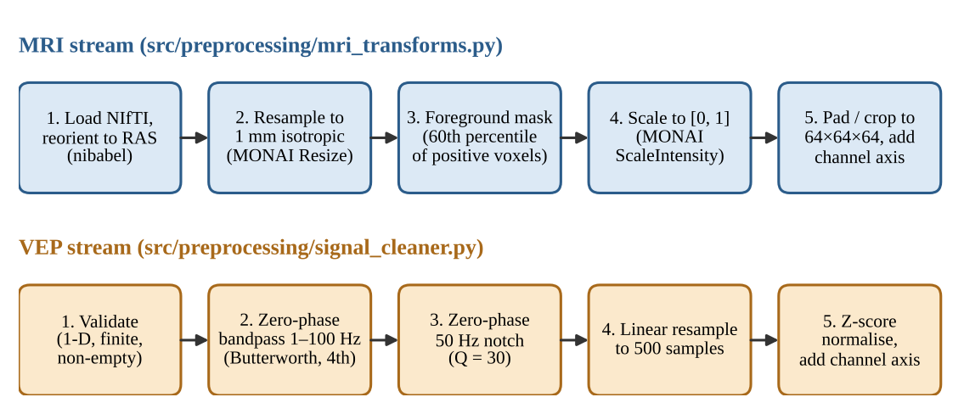
Each signal is brought to a fixed shape
Output tensors MRI (1, 64, 64, 64) · VEP (1, 500) · the 60th-percentile foreground mask is a placeholder, not skull-stripping
Notes:
Both modalities are brought to fixed shapes before the network. The MRI is loaded with NiBabel, reoriented to RAS, resampled to 1 millimetre isotropic, foreground-masked, scaled to zero-one and padded or cropped to 64 cubed. The VEP is validated, band-passed one to a hundred hertz, notch filtered at fifty hertz, resampled to 500 samples and z-scored. One caveat that I will come back to: the foreground mask uses the 60th percentile of positive voxels. It is a placeholder for proper skull-stripping.

Slide 7
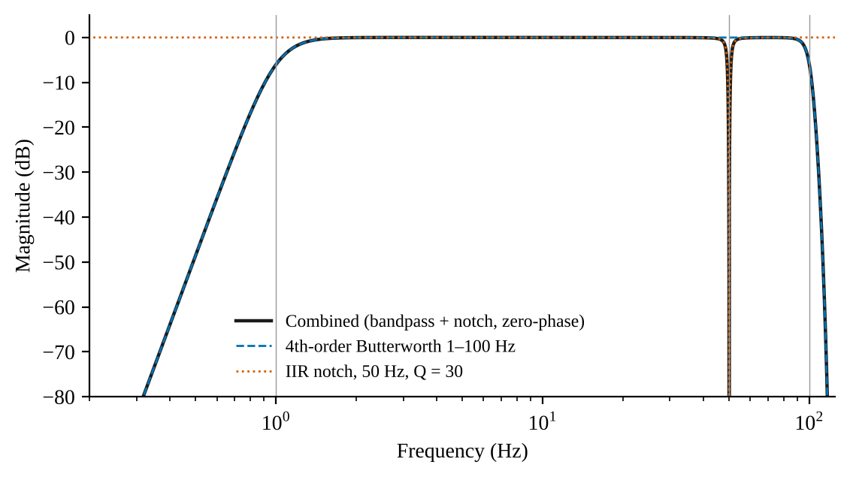
Zero-phase filtering keeps P100 in place
−97 dB
response at 50 Hz in the ideal forward–backward chain
22 dB
measured mains reduction over 150 records (0.152 → 0.0125)
49.18–50.83 Hz
Effective forward–backward response: 1–100 Hz Butterworth band-pass plus a 50 Hz notch (Q = 30).
−6 dB notch band (width 1.65 Hz)
The 22 dB figure is limited by the noise floor (0.0212 at 47 Hz), so it is a lower bound on the notch's attenuation.
Notes:
P100 latency is the clinically meaningful quantity, so the conditioning chain is designed not to move it. Filtering forward and backward, with sosfiltfilt and filtfilt, cancels phase and squares the magnitude. In this effective response the 50 hertz component is down by about 97 decibels, the minus 6 decibel notch band runs from 49.18 to 50.83 hertz, and the response at 1 hertz is minus 5.8 decibels. On 150 synthetic records the fitted 50 hertz amplitude fell from 0.152 to 0.0125, about 22 decibels. That measured number is limited by the noise floor, which is 0.0212 at 47 hertz, where nothing was injected, so it is a lower bound on the notch's attenuation rather than the ideal figure.

Slide 8
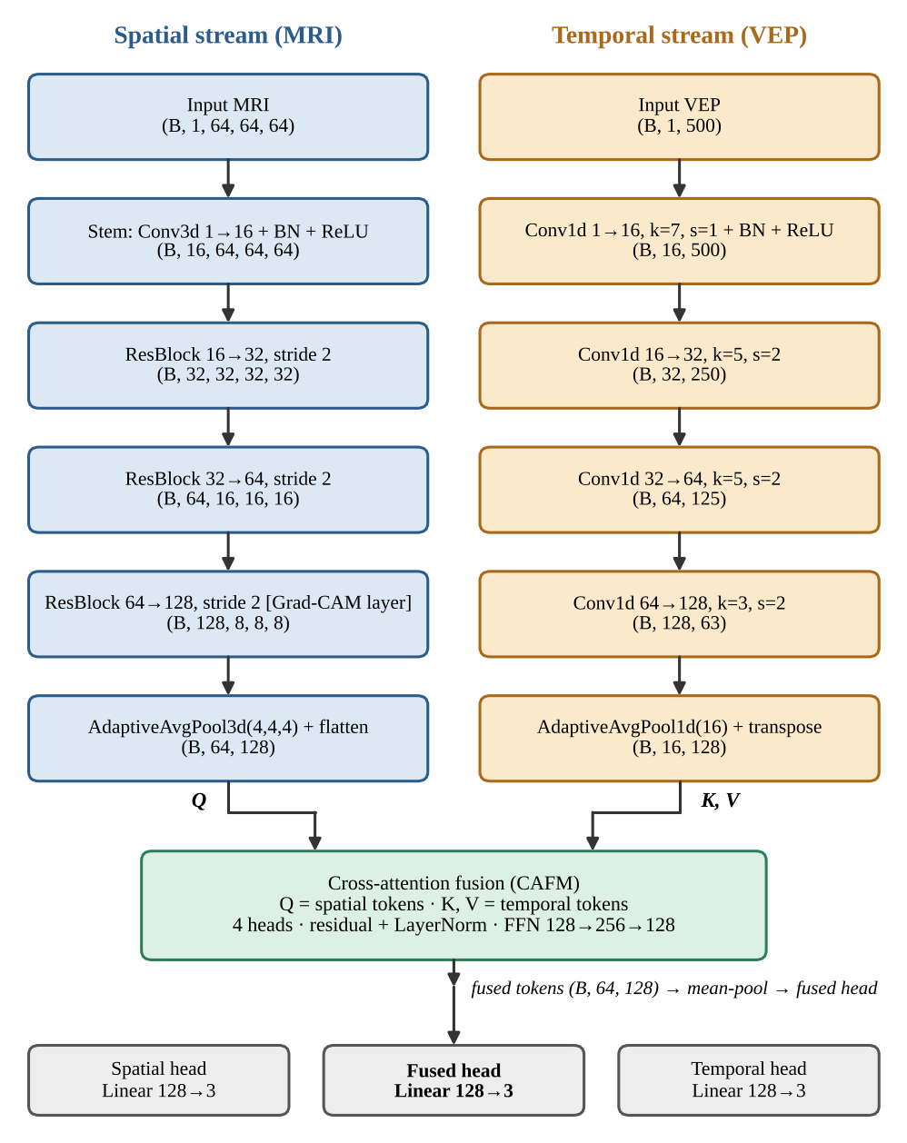
A 1.06 M-parameter two-stream network
3D residual CNN (MRI)
883,472 params · 83.7%
Stem plus three residual blocks, 16 → 128 channels; pooled to 64 tokens.
1D CNN (VEP)
37,968 params · 3.6%
Four Conv1d layers, 1 → 128 channels; pooled to 16 tokens.
Cross-attention fusion
132,480 params · 12.6%
4 heads, residual + LayerNorm, FFN 128 → 256 → 128.
Three linear heads
1,161 params
Fused, spatial and temporal heads, each 128 → 3.
Notes:
The whole network has 1,055,081 trainable parameters. The 3D residual CNN is the bulk, 883,472 parameters or 83.7 percent: a stem convolution and three residual blocks going from 16 to 128 channels, then adaptive pooling to 4 by 4 by 4, which gives the 64 spatial tokens. The 1D CNN has only about 38 thousand parameters and produces 16 temporal tokens. The cross-attention fusion module, with 4 heads, a residual connection, LayerNorm and a feed-forward block, adds 132 thousand. The three linear heads together are about 1,100 parameters.

Slide 9
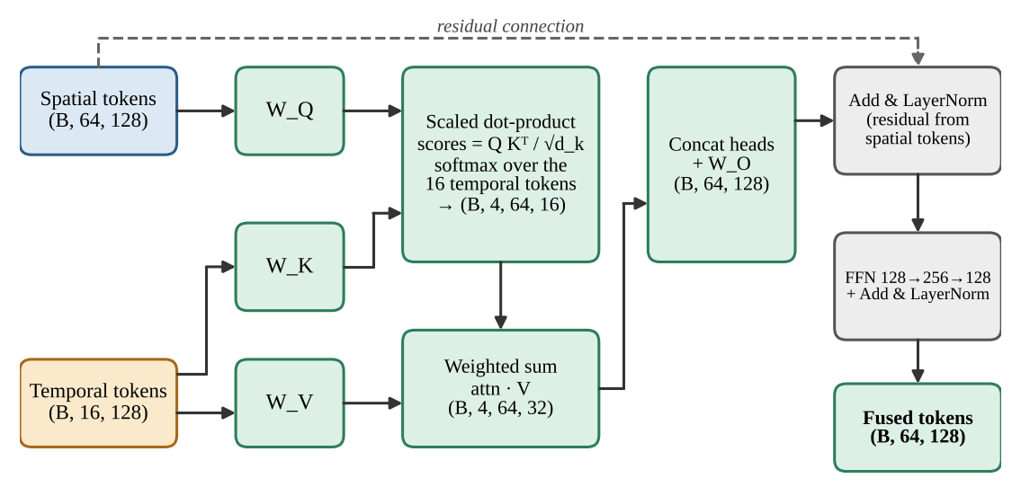

Spatial tokens query temporal tokens
Per head h
Q = X_{s} W_{Q}
K = X_{t} W_{K}, V = X_{t} W_{V}
A = softmax(Q Kᵀ / √d_{h})
4 heads · d_h = 32 · attention tensor (B, 4, 64, 16)
64 queries
16 keys and values
Fused tokens (B, 64, 128)
one per spatial token of the MRI
temporal tokens, nominally 125 ms each
plus the attention map for inspection
Notes:
This is the heart of CAFN. The spatial tokens X sub s are projected to queries, the temporal tokens X sub t are projected to keys and values. With 4 heads of dimension 32, the attention tensor is batch by 4 by 64 by 16: for every spatial token, a distribution over the 16 temporal tokens. The weighted sum of values is concatenated, projected, added back to the spatial tokens with a residual connection and LayerNorm, then passed through a small feed-forward block. The output keeps the spatial layout, 64 tokens of dimension 128, now enriched with temporal context. The attention tensor is also returned so that it can be plotted as a heatmap.

Slide 10
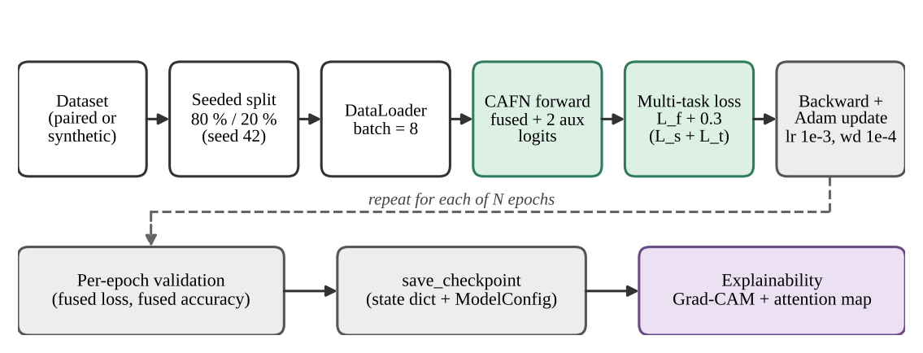
One fused loss, two auxiliary heads
Multi-task objective
L = L_{f} + 0.3 (L_{s} + L_{t})
Cross-entropy on the fused, spatial and temporal heads. The auxiliary terms stop the fused head from ignoring one modality.
Adam
1e-4
8
20
80 / 20
optimiser, lr 1e-3
weight decay
batch size
epochs
split, seed 42
Notes:
Training uses three cross-entropy losses: one on the fused head, and one on each unimodal head. The total is the fused loss plus 0.3 times the sum of the two auxiliary losses. The auxiliary terms give each encoder its own gradient and discourage the fused head from relying on one modality only. The configuration is Adam with learning rate 1e-3 and weight decay 1e-4, batch size 8, 20 epochs, a seeded 80/20 train and validation split. I want to be upfront that PyTorch was not available in the environment where this report and deck were prepared, so no training run was executed and no training curves are shown.

Slide 11
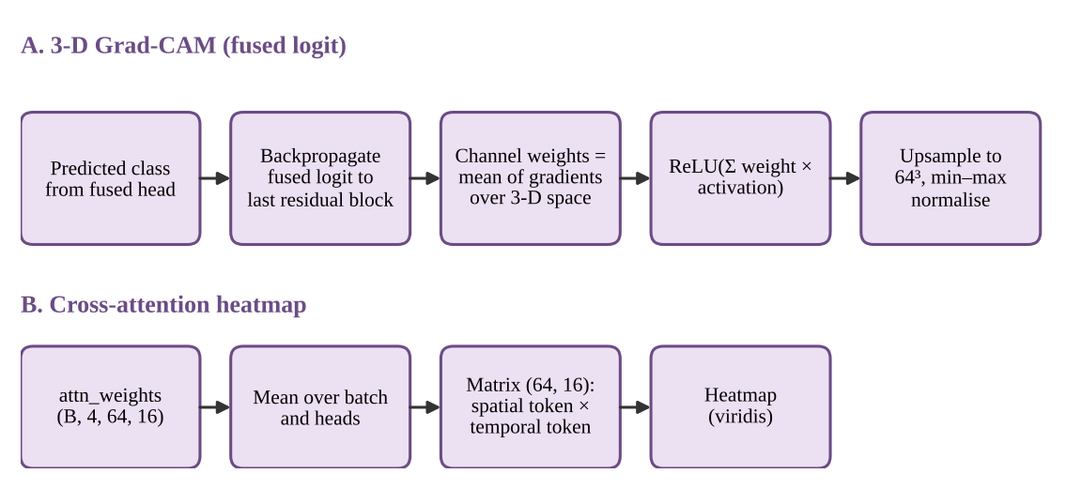

Explanations are inspection aids
What they show
Where the 3D encoder responds (Grad-CAM) and which temporal tokens each spatial token weights.
What they do not
A causal or clinical explanation: attention and saliency are not automatically faithful.
Planned: sanity checks of Grad-CAM and attention against clinician-marked regions, and tokens anchored to the VEP landmarks N75, P100 and N135.
Notes:
Two explainability outputs are built in. 3D Grad-CAM hooks the last residual block, back-propagates the fused logit, takes the mean gradient per channel as weights, applies a ReLU, and upsamples to 64 cubed. The attention heatmap averages the attention tensor over batch and heads to a 64 by 16 matrix of spatial token against temporal token. I deliberately call these inspection aids. The literature on attention and saliency is clear that these maps are not automatically faithful explanations, so they should be sanity-checked before anyone reads clinical meaning into them. That sanity checking is planned work.

Slide 12
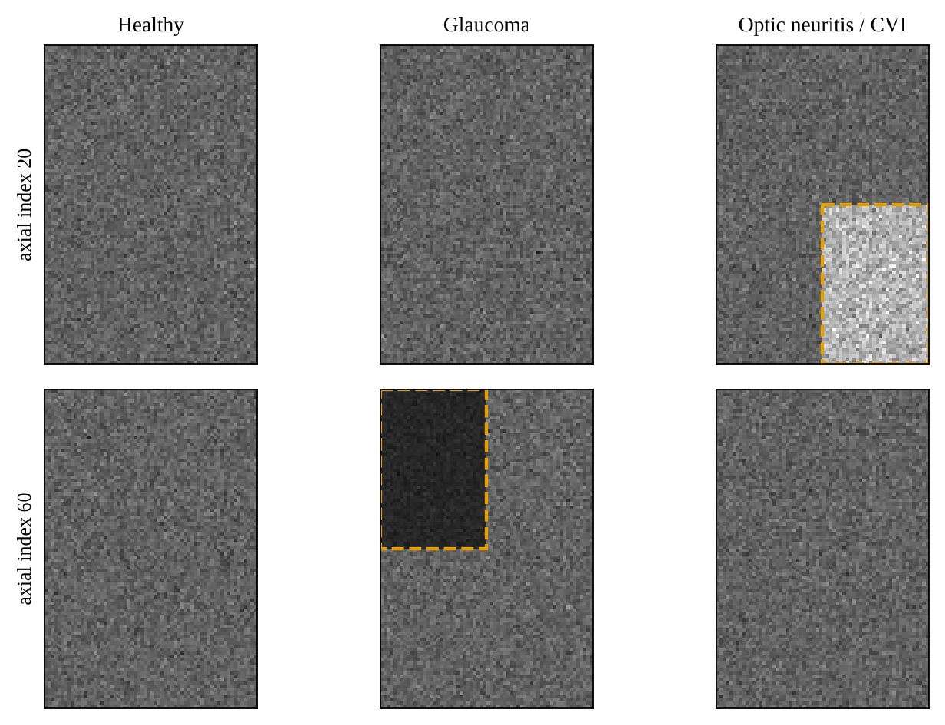
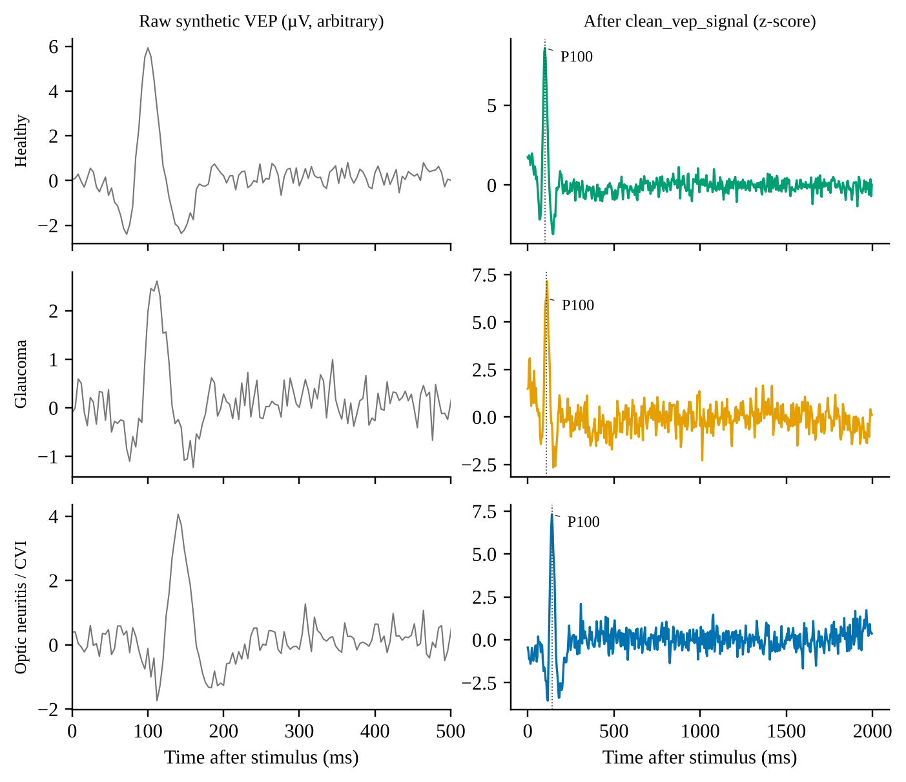
Synthetic data stands in for a cohort
MRI: N(100, 15²), 80×96×64. Glaucoma block ×0.4, Optic Neuritis/CVI block ×1.8 (dashed boxes).
VEP: N75–P100–N145 Gaussians plus 0.3 Hz drift, 50 Hz mains and noise (SD 0.3); raw left, conditioned right.
Notes:
Because labelled paired data are unavailable, a seeded generator writes class-conditioned MRI volumes and VEP records through the same NIfTI and CSV interface as real data. On the left, the MRI volume is Gaussian noise around 100, with an atrophy block for glaucoma and a lesion block for optic neuritis. On the right, the VEP is three Gaussians plus baseline drift, 50 hertz mains and noise: exactly the artefacts the conditioning chain is meant to remove. This lets us verify the machinery end to end, but it cannot tell us anything about diagnostic performance.

Slide 13
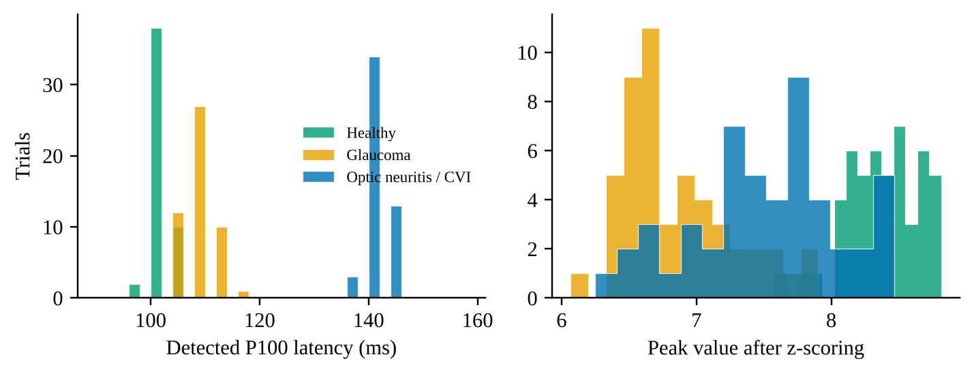
P100 recovered within one sample
149 / 150
Class | True | Raw | Zero-phase | Single-pass
Healthy Control | 100 | 101.8 ± 2.3 | 100.6 ± 1.9 | 101.1 ± 1.8
Glaucoma | 108 | 107.4 ± 2.7 | 108.0 ± 2.9 | 108.2 ± 2.3
Optic Neuritis / CVI | 140 | 141.3 ± 2.5 | 140.8 ± 2.1 | 141.0 ± 2.7
trials within 4 ms (one sample) of the ground truth
8 ms
Detected P100 latency in ms, mean ± SD, 50 trials per class at 250 Hz.
largest error: one Glaucoma trial
≤ 0.8 ms
class-mean offset from the true latency (zero-phase)
Notes:
On 150 synthetic VEP records, 50 per class, the zero-phase pipeline recovered P100 within one sample period, 4 milliseconds at 250 hertz, in 149 of 150 trials. The largest error was 8 milliseconds in a single glaucoma trial, and the class means differ from the truth by 0.64, 0.00 and 0.80 milliseconds. The table shows raw, zero-phase and single-pass detections side by side, and the histograms show that the three classes stay separated in latency, which is the property the conditioning chain has to preserve.

Slide 14
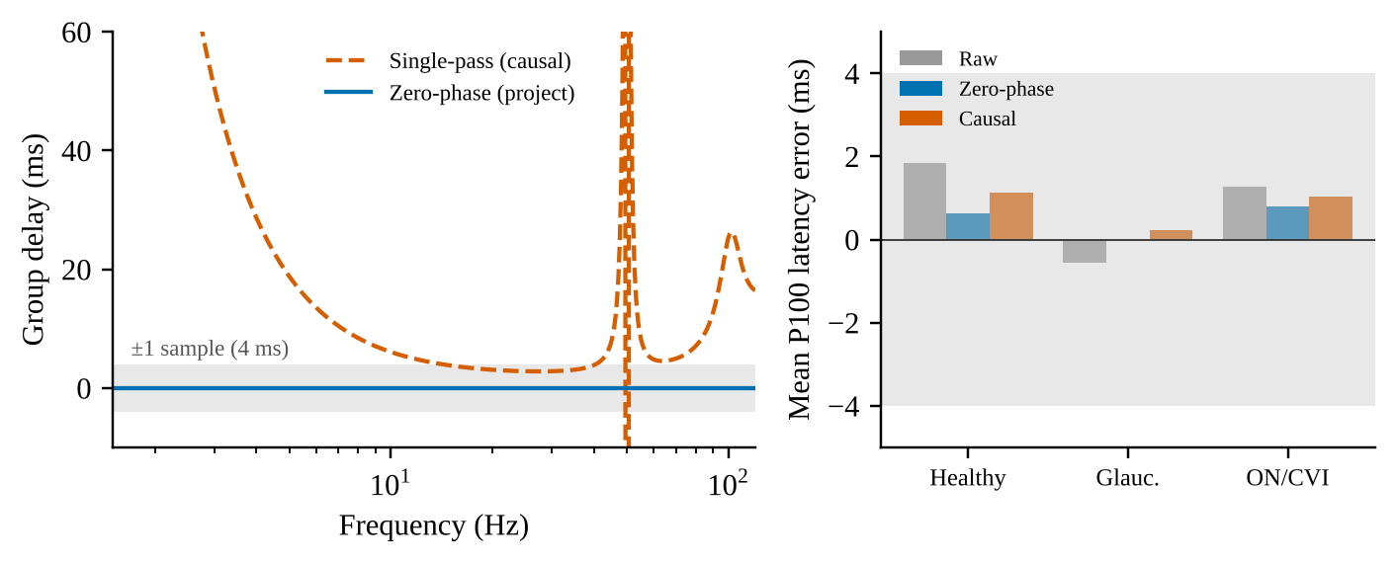
Zero-phase gain is not demonstrable
6.1 / 3.1 / 2.8 ms
single-pass group delay at 10 / 20 / 30 Hz
< 0.5 ms
difference between zero-phase and single-pass class means, below one 4 ms sample
Left: group delay of the single-pass filters vs the zero-phase pipeline. Right: mean P100 latency error by class.
So why zero-phase? Latency is the clinical quantity, and the case rests on that principle, not on an empirical gain at 250 Hz.
Notes:
This is a deliberately honest slide. A single-pass causal filter has group delay, 6.1, 3.1 and 2.8 milliseconds at 10, 20 and 30 hertz, so in principle it shifts the P100 peak. But on this smooth, low-frequency synthetic P100, the detected class means differ by less than half a millisecond, which is below one sample. So the benefit of zero-phase filtering cannot be demonstrated on these data. The case for it rests on the principle that latency is the clinical quantity; a real gain would need a higher sampling rate or a recorded cohort.

Slide 15
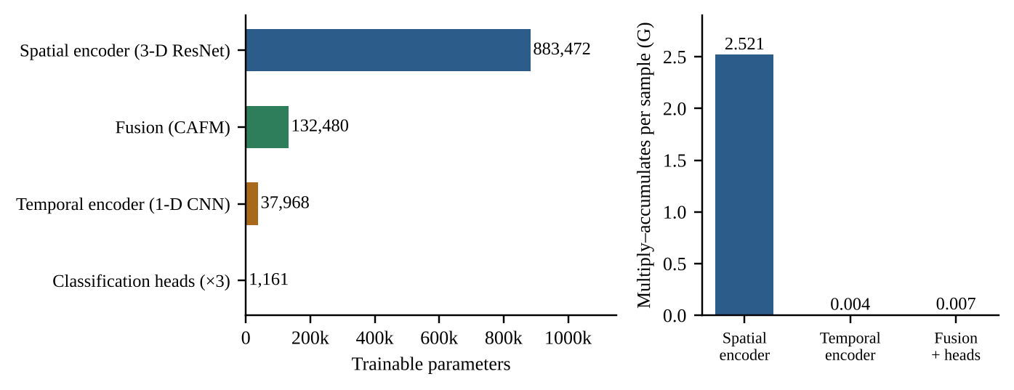
Compute sits in the early 3D layers
1.06 M
trainable parameters
2.53 G
multiply–accumulates per sample
82%
Left: trainable parameters by component. Right: multiply–accumulates per sample.
of MACs in residual blocks 1–2
Residual block 1 alone is 54% of the MACs. The fusion module holds 12.6% of the parameters but well under 1% of the compute, so speed-ups should target the early 3D stages.
Notes:
On cost: 1,055,081 parameters and about 2.53 billion multiply-accumulates per sample, counted analytically from the layer definitions. The 3D spatial encoder dominates the parameters, but what matters for speed is the compute: the first residual block alone accounts for 54 percent of the MACs and the first two for 82 percent. The fusion module holds about 12.6 percent of the parameters but well under 1 percent of the compute. So if training time ever becomes an issue, the early 3D stages are where to look, not the fusion.

Slide 16
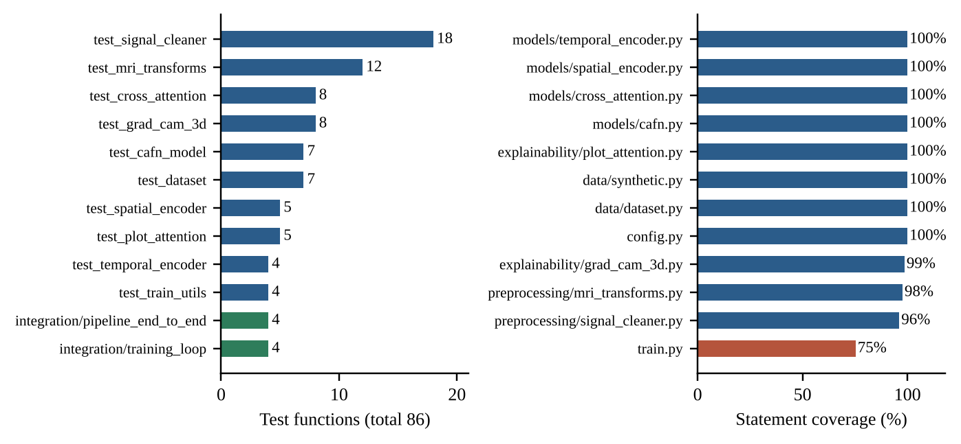
86 tests, 95.1% statement coverage
86
tests: 78 unit and 8 integration, in 12 files
95.1%
statement coverage (521 of 548)
8 of 12
modules fully covered; lowest is train.py (75.3%)
Left: test functions per file. Right: statement coverage per module.
Counts and coverage come from the repository's recorded data; the tests were not re-run here because PyTorch was unavailable.
Notes:
On verification: the repository contains 86 test functions in 12 files, 78 unit and 8 integration, with 95.1 percent statement coverage, 521 of 548 statements, and 8 of 12 modules fully covered. The lowest is the training script at 75.3 percent, mostly its command-line entry point. The tests assert shapes, value ranges, normalisation of attention rows, determinism, input validation and an end-to-end gradient flow. Please note these counts come from the repository's recorded data. The tests were not re-executed in this environment because PyTorch was not available.

Slide 17
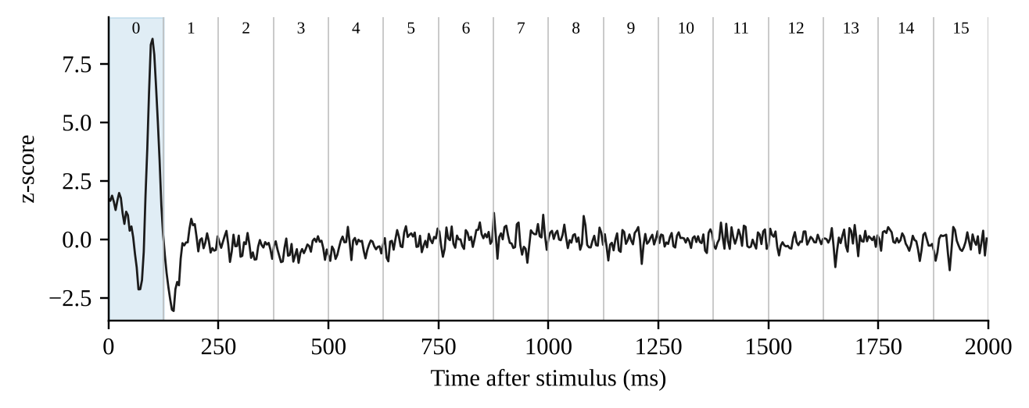



What the synthetic study taught us
0%
of the Glaucoma atrophy block survives the 60th-percentile mask; 99.7% of the lesion block does
P100 at 100 ms and 108 ms both fall in token 0; 140 ms falls in token 1 (tokens span ≈125 ms).
The mask is not neutral
Tokens are not time bins
Optimise early 3D stages
It zeroes exactly 60% of voxels, so validated skull-stripping is needed before conclusions about MRI.
Do not read attention at millisecond resolution; the 16 tokens are learned, uncalibrated features.
Compute concentrates in the first residual blocks, not in the fusion module.
Notes:
Three design observations came out of the synthetic experiments. First, the placeholder foreground mask is not neutral: by construction it zeroes 60 percent of voxels, and in the glaucoma volume it removes the entire atrophy block, 0 percent retained, while 99.7 percent of the optic neuritis lesion block survives. So conclusions about what the spatial encoder can learn depend on the preprocessing, and validated skull-stripping is needed. Second, with 16 temporal tokens over 2 seconds, each token is nominally 125 milliseconds, so the 100 and 108 millisecond P100 peaks land in the same token. The tokens are learned features, not calibrated time bins. Third, compute concentrates in the early 3D layers.

Slide 18

Evidence: shown and not shown
Verified
Not shown
Conditioning keeps P100 within 4 ms in 149 of 150 synthetic trials
Mains interference reduced by 22 dB
Model size and cost computed: 1.06 M parameters, 2.53 G MACs
Statement coverage 95.1% recorded for an 86-test suite
Generators and mask behave as specified
No training run: no learning curves, accuracy, sensitivity or AUC
Tests not re-executed here; counts come from repository records
Nothing about real patients or generalisation
No baselines or ablations, so the value of cross-attention is untested
The foreground mask is a placeholder, not skull-stripping
Notes:
To summarise the evidence honestly. What is verified: the conditioning chain preserves P100 latency on synthetic VEPs, mains interference is attenuated, the complexity figures are computed, and the code base has a recorded 95.1 percent statement coverage. What is not shown: any learning result. No training was run, so there are no learning curves, no accuracy, sensitivity or AUC. Nothing here says anything about real patients. There are no unimodal or concatenation baselines and no ablations, so the added value of cross-attention is untested. The contribution of this project is a tested, configuration-driven foundation for evaluation on a labelled cohort.

Slide 19



Next: a labelled cohort and baselines
1
2
3
4
5
Train properly
Add baselines
Validate masking
Check explanations
Ground the tokens
Patient-level splits; report sensitivity, specificity, AUC and calibration.
Unimodal and concatenation models; ablate the auxiliary loss and token counts.
Replace the percentile mask with validated skull-stripping.
Compare Grad-CAM and attention with clinician-marked regions.
Align temporal tokens with VEP landmarks N75, P100 and N135.
Notes:
The next steps are about evidence, not architecture. One: with a labelled, paired cohort, train with patient-level splits and report sensitivity, specificity, AUC and calibration. Two: add unimodal and concatenation baselines and ablate the auxiliary loss and token counts, so we can say whether cross-attention actually helps. Three: replace the percentile mask with validated skull-stripping. Four: sanity-check Grad-CAM and the attention maps against clinician-marked regions. Five: move toward anatomically grounded tokens aligned with the VEP landmarks N75, P100 and N135.

Slide 20
A tested foundation, not a diagnostic claim
149/150
22 dB
1.06 M
95.1%
P100 trials within one sample
mains interference removed
parameters, 2.53 G MACs
statement coverage, 86 tests
CAFN is a cross-attention fusion network for 3D MRI and VEP with a zero-phase conditioning chain, built so that the complete path from files to an optimiser step can be tested before a labelled cohort exists. No diagnostic accuracy is claimed.
Thank you · Questions?
Code: github.com/Mishthijainn/NeuroImaging
Notes:
To conclude: CAFN brings a 3D MRI and a 1D VEP into a common token space, fuses them with cross-attention, and keeps P100 latency intact through zero-phase conditioning. On synthetic data, P100 was recovered within one sample in 149 of 150 trials, mains interference fell by 22 decibels, the model has about 1.06 million parameters and 2.53 billion MACs per sample, and an 86-test suite covers 95.1 percent of statements. No diagnostic accuracy is claimed. What this project provides is a tested foundation, and the next step is a labelled paired cohort with baselines. Thank you, I am happy to take questions. The code is on GitHub.

Slide 21

Selected references
[1] Tham Y-C. et al., “Global prevalence of glaucoma and projections of glaucoma burden through 2040,” Ophthalmology, 2014.
[2] Halliday A.M., McDonald W.I., Mushin J., “Delayed visual evoked response in optic neuritis,” Lancet, 1972.
[3] Odom J.V. et al., “ISCEV standard for clinical visual evoked potentials (2016 update),” Doc. Ophthalmol., 2016.
[4] He K. et al., “Deep residual learning for image recognition,” CVPR, 2016.
[5] Çiçek Ö. et al., “3D U-Net: learning dense volumetric segmentation from sparse annotation,” MICCAI, 2016.
[6] Cardoso M.J. et al., “MONAI: an open-source framework for deep learning in healthcare,” arXiv:2211.02701, 2022.
[7] Vaswani A. et al., “Attention is all you need,” NeurIPS, 2017.
[8] Tsai Y-H.H. et al., “Multimodal transformer for unaligned multimodal language sequences,” ACL, 2019.
[9] Selvaraju R.R. et al., “Grad-CAM: visual explanations from deep networks via gradient-based localization,” ICCV, 2017.
[10] Jain S., Wallace B.C., “Attention is not explanation,” NAACL-HLT, 2019; Wiegreffe S., Pinter Y., “Attention is not not explanation,” EMNLP-IJCNLP, 2019.
[11] Adebayo J. et al., “Sanity checks for saliency maps,” NeurIPS, 2018.
Notes:
Backup slide. The full list of 34 references is in the paper and in the project report. Entries were written from known publication details and should be spot-checked before submission.

